Slide 1
BRAIN TUMOR DETECTION USING MRI IMAGES
PREESENTED BY :
1.Ananya Saha(B200789CS)
2.Aditya kinkar(B200848CS)
3.Prathmesh Shrirang Waydande(B200857CS)
GUIDE : PRANESH DAS
NATIONAL INSTITUTE OF TECHNOLOGY CALICUT

Slide 2
 | Agenda
1 | INTRODUCTION
2 | HISTORY EVOLUTION,CURRENT STATE, fUTURE ASPECTS
3. | PROBLEM STATEMENT
4. | LITERATURE SURVEY
5. | OBJECTIVES
6 | DESIGN
7. | WORK DONE TILL NOW
8. | WORK PLAN
9. | CONCLUSION
10. | REFERENCES

Slide 3
Introduction:
The word “Tumor” is a synonym for the word “neoplasm” which is formed by an abnormal growth of cells. A tumour is significantly different from cancer. Brain tumors are a significant health concern worldwide, with a profound impact on patients' lives and well-being. Brain tumor detection using MRI images, empowered by Machine Learning (ML), Computer Vision (CV), and Convolutional Neural Networks (CNN), represents a transformative stride in healthcare. This cutting-edge fusion of technology allows for the automated, precise, and early identification of brain tumors. It alleviates the burden of manual interpretation, improving accuracy and clinical efficiency. This introduction underscores the potential to revolutionize the diagnosis and treatment of brain tumors, promising quicker interventions and better patient outcomes, while highlighting the pivotal roles of ML, CV, and CNN in achieving these advancements

Slide 4
History:
The history of detecting brain tumors using MRI images begins in the 1970s with the development of MRI technology. Early MRI scans had limited resolution and were mainly used for anatomical studies. As technology advanced, MRI became a valuable tool for brain imaging. Early detection largely relied on manual interpretation by radiologists, which was time-consuming and subject to human error.
Evolution:
The field witnessed a significant shift with the advent of computer technology and machine learning. The 1990s brought the first attempts to use computer algorithms for image analysis. In the 21st century, there was a surge in research on automated brain tumor detection systems. Deep learning, especially Convolutional Neural Networks (CNNs), emerged as a powerful tool for feature extraction and classification. Shared datasets and competitions like BRATS spurred innovation.
Current State:
Today, automated systems using deep learning models play a pivotal role in brain tumor detection from MRI images. These systems offer high accuracy, efficiency, and consistency. They have reduced the workload on radiologists and are making early detection a reality. Ethical considerations and clinical integration are gaining importance.
Future Aspects:
The future holds exciting prospects for brain tumor detection. Real-time MRI analysis during surgeries or interventions, personalized medicine based on individual patient data, and multi-modal imaging data integration are emerging trends. Collaboration between medical and computer science professionals will continue to drive innovation, ensuring improved patient care and outcomes. However, addressing challenges like false positives and ensuring ethical data use will be central to future developments.

Slide 5
3.PROBLEM STATEMENT
The early and accurate detection of brain tumors is a critical medical challenge. Manual interpretation of MRI images for brain tumor diagnosis is time-consuming and prone to human error. Automating this process using computer vision and machine learning techniques can enhance diagnostic accuracy and expedite timely interventions.
.

Slide 6
Literature Survey
literature survey on brain tumor detection using MRI images reveal several key findings:
1.Image Preprocessing:
steps for image processing: how to apply all these techniques in detction MRI images.
1.noise reduction
2.contrast enhancement
3. Image registration
how to apply all these techniques in detection MRI images.
2. study of different types of algorithms like CNN,ANN and others, and how to apply them in the project model , which one could be best approach. In which case accuracy can come best, i.e., most accurate one.
3.Shift Towards Automation: There's a noticeable trend toward automating the detection process using machine learning and deep learning techniques, reducing reliance on manual interpretation.
4.Advancements in Deep Learning: Deep learning models, particularly CNNs, have gained prominence for their exceptional performance in image classification and feature extraction.
5.Challenges of False Positives: Many studies acknowledge the challenge of false positives in automated systems and the need for improved specificity.
6.Need for Large Datasets: A recurring theme is the importance of large, diverse datasets for training models to ensure robust performance.
7.Interdisciplinary Collaboration: Collaborative efforts between medical professionals and computer scientists are increasingly common, fostering innovation.

Slide 7
5.OBJECTIVE:
The primary objective of this research is to develop and evaluate a robust and efficient system for brain tumor detection using MRI images. Specifically, our goals include:
Enhancing Early Detection: Develop methods to identify brain tumors at an early stage, facilitating prompt medical intervention and improving patient prognosis.
2. Leveraging Technology: Utilize computer vision, machine learning, and deep learning techniques to automate the detection process,reducing the reliance on manual interpretation.
3. Improving Accuracy: Achieve high accuracy in classifying brain tumor images, minimizing false positives and false negatives
4. Streamlining Workflow: Create an efficient and user-friendly tool that can be integrated into clinical practice, optimizing the workflow
of healthcare professionals.
5. Enhancing Patient Care: Ultimately, contribute to improved patient care and outcomes by providing a reliable, noninvasive, and cost-effective method for brain tumor detection.

Slide 8
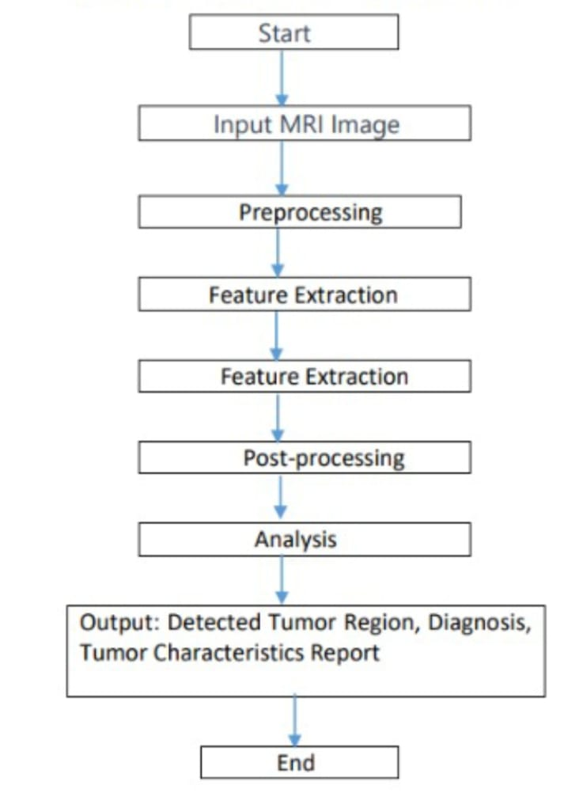
Design:

Slide 9
DESIGN cont...
1.Input MRI Image: This is the initial step where the Magnetic Resonance Imaging (MRI) scan of the brain is provided as input data for further processing.
2.Preprocessing: This stage involves various operations to prepare the MRI image for analysis.
Convert Image to Grayscale: Converting the image to grayscale to simplify processing.
Denoising: Removing noise or artifacts from the image.
Skull Stripping: Eliminating non-brain tissue or skull from the image.Image Enhancement: Improving image quality for better feature extraction
3.Feature Extraction: Extracting relevant information or features from the preprocessed image.
Extract Features: Capturing specific aspects such as shape, texture, intensity, etc., of the brain structures.
Feature Selection: Choosing the most relevant features for classification..
4.Classification: Using machine learning or statistical algorithms to categorize the features extracted into classes (tumor or non-tumor).
Choose Classification Algorithm: Selecting an appropriate algorithm (e.g., Support Vector Machines, Neural Networks) for classification.
Train Model with Extracted Features: Training the chosen model with the extracted features.
Test Model Performance: Evaluating the model's performance using testing data.

Slide 10
DESIGN cont...
5.Post-processing: Further refining the classified results.
Thresholding: Applying thresholds to distinguish tumor regions from non-tumor regions.
Morphological Operations: Refining the detected regions using operations like erosion, dilation, etc.
Tumor Segmentation: Isolating the precise regions corresponding to the detected tumor.
6.Analysis: Evaluating the segmented tumor regions and assessing their characteristics.
Evaluate Segmented Tumor: Analyzing the accuracy of the segmented tumor regions.
Assess Tumor Characteristics: Determining attributes such as size, location, and shape of the identified tumor.
7.Output: Providing the final results of the detection process.
Detected Tumor Region: Displaying the identified areas where tumors are located.
Diagnosis: Presenting a conclusion about the presence or absence of a tumor.
Tumor Characteristics Report: Offering detailed information about the tumor's properties, aiding in further medical assessment.
End: Concluding the process flow.

Slide 11
Workdone:
1.Project Initiation:
Conducted a thorough literature review to understand existing techniques and methodologies in brain tumor detection.Defined project scope, objectives, and success criteria.
2.Data Collection and Preprocessing:
Acquired a diverse dataset of MRI images containing both tumor and non-tumor samples. Implemented
preprocessing steps, including normalization, noise reduction, and contrast enhancement, to prepare the data for analysis.
3.Feature Extraction:
Identified relevant features such as texture, shape,and intensity from preprocessed MRI images.Utilized advanced techniques such as wavelet transform and histogram analysis for effective feature extraction.
4.Segmentation:
Implemented segmentation algorithms to separate the images into different regions. Detected potential tumor regions based on intensity variations and spatial characteristics.
5.Model Development:
Explored machine learning models, including Support Vector Machines (SVM) and Random Forest, for
classification. Investigated deep learning approaches, particularly Convolutional Neural Networks (CNN),
for end-to-end learning.
6.Training and Validation:
Split the dataset into training and validation sets. Trained and fine-tuned the chosen model(s) using labeled data to ensure robust performance.

Slide 12
Workplan:
Phase 1: Project Initiation:
a.Define Project Objectives:
Clearly articulate the goals and deliverables of the brain tumor detection project.
b.Gather Requirements:
Collaborate with medical professionals to understand their needs and expectations.
c.Ethical Considerations:
Establish ethical guidelines for handling medical data and ensure compliance with privacy regulations.
Phase 2: Data Collection and Preprocessing:
Data Acquisition: Collect a diverse dataset of MRI images with labeled tumor regions
Data Preprocessing: Standardize image resolution, normalize intensity, and apply noise reduction techniques.
Data Splitting: Divide the dataset into training, validation, and testing sets.

Slide 13
WORKPLAN cont...
Phase 3: Algorithm Development
a.Literature Review:
Conduct an in-depth review of existing algorithms and methodologies for brain tumor detection.
b.Select Features:
Choose relevant features for extraction, considering both traditional and deep learning approaches.
c.Develop Preprocessing Pipeline:
Implement the preprocessing steps identified in the algorithm design.
d.Feature Extraction Module:
Build a module to extract features from preprocessed images.
e.Segmentation Module:
Implement a segmentation algorithm to identify potential tumor regions.
f.Classification Module:
Develop a classification model to distinguish tumor and non-tumor regions.
Phase 4: Model Evaluation and Refinement
Evaluation Metrics:
Define metrics (e.g., sensitivity, specificity) for evaluating the performance of the model.
Model Training:
Train the model using the training dataset and validate on the validation set.
Performance Analysis:
Evaluate the model's performance and refine it based on feedback from the medical team.

Slide 14
CONCLUSION:
A two-step approach for detecting brain tumor tissue was introduced in this process. The thresholding approach is combined with using a shape descriptor in this method. The thresholding algorithm groups picture pixels in the first phase, after which the image is binaries using a threshold value. Although tumor structures are formed in binary elements, they are frequently surrounded by healthy structures. The second step eliminates non-tumor tissues, only detecting those corresponding to the tumor. The CNN algorithm can be used to classify MRI images. It will improve the accuracy of brain tumor diagnosis.

Slide 15
REFERENCES:
1. Adham Aleid , Khalid Alhussaini , Reem Alanazi, Meaad Altwaimi, Omar Altwijri and Ali S. Saad , Artificial Intelligence Approach for Early Detection of Brain Tumors Using MRI Images. Applied Sciences 2023.
2. Chetana Srinivas,1 Nandini Prasad K. S.,1 Mohammed Zakariah,2 Yousef Ajmi Alothaibi , 3 Kamran Shaukat , 4 B. Partibane,5 and Halifa Awal, Deep Transfer Learning Approaches in Performance Analysis of Brain Tumor Classification Using MRI Images. Hindawi Journal of Healthcare Engineering 2022.
3. AHMED S. MUSALLAM , AHMED S. SHERIF , AND MOHAMED K. HUSSEIN , A New Convolutional Neural Network Architecture for Automatic Detection of Brain Tumors in Magnetic Resonance Imaging Images . IEEE Access , January 4, 2022.
4. Ramdas Vankdothu , Mohd Abdul Hameed . Brain tumor MRI images identification and classification based on the recurrent convolutional neural network. Elsevier 2022.
5. Muhammad Arif ,F. Ajesh, Shermin Shamsudheen , 3 Oana Geman , Diana Izdrui , and Dragos Vicoveanu. Brain Tumor Detection and Classification by MRI Using Biologically Inspired Orthogonal Wavelet Transform and Deep Learning Techniques. Hindawi Journal of Healthcare Engineering. 24 May 2023.
6. D. Rammurthy , P.K. Mahesh . Whale Harris hawks optimization based deep learning classifier for brain tumor detection using MRI images. Journal of King Saud University – Computer and Information Sciences. 15 August 2020.
7. Osman Ozkaraca , Okan ˙Ihsan Ba grıaçık , Hüseyin Gürüler , Faheem Khan , Jamil Hussain , Jawad Khan and Umm e Laila . Multiple Brain Tumor Classification with Dense CNN Architecture Using Brain MRI Images. MDPI 28 January 2023.
8. Soheila Saeedi ,Sorayya Rezayi, Hamidreza Keshavarz and Sharareh R. Niakan Kalhori . MRIbased brain tumor detection using convolutional deep learning methods and chosen machine learning techniques. BMC Medical Informatics and Decision Making. 2023.
9. Moinul Islam· Md. Tanzim Reza· Mohammed Kaosar . Mohammad Zavid Parvez. Effectiveness of Federated Learning and CNN Ensemble Architectures for Identifying Brain Tumors Using MRI Images. SPRINGER .28 August 2022.
10. V. Vinay kumar , P. Grace Kanmani Prince. Deep belief network Assisted quadratic logit boost classifier for brain tumor detection using MR images. ELSEVIER. March 2023.
11. K. V. Archana* and G. Komarasamy. A novel deep learning-based brain tumor detection using the Bagging ensemble with K-nearest neighbour. DE GRUYTER. September 09, 2022.

