Slide 1
RetailIQ
Smart Retail Intelligence Platform
Machine Learning & Generative AI based Retail Management System
Team Members
Anamika Yadav (CS3C) - Team Leader
Ananya Saxena (CS3D)
Ananya Dixit (CS3B)
Akshita Singh (CS3G)
Akanksha Tripathi (CS3J)
Akshra (CS3B)

Slide 2

The Problem
Small and medium retailers in India rely on manual record-keeping or basic billing software, leaving them with no real insight into business performance — just transaction records. Existing AI-powered platforms are priced for large businesses and assume English-language dashboards, leaving small Indian retailers with guesswork instead of data-driven decisions.
No Demand Insight
Overstocking or understocking due to inability to predict demand
No Fraud Detection
No way to detect errors or unusual sales activity
Unaffordable Tools
Cin7, Zoho, IBM priced for large businesses only

Slide 3



Proposed Solution
RetailIQ — a web-based platform combining Machine Learning and Generative AI, purpose-built for small and medium retailers.
"Role-based access for Admin, Manager, and Employee — ensuring the right people see the right data."
— Access Control
"ML-driven demand forecasting, anomaly detection, and a conversational AI Business Assistant — all in one platform."
— Intelligence Layer

Slide 4

Core Features
RetailIQ delivers a comprehensive suite of intelligent tools designed to transform how small and medium retailers manage and grow their business.
Authentication & Role-Based Access
Secure login with Admin, Manager, and Employee roles.
Real-Time Dashboard & Inventory
Live sales, profit, stock overview with low-stock alerts.
ML Forecasting & Anomaly Detection
Demand prediction and unusual sales pattern flagging.
AI Business Assistant & Reports
Natural-language Q&A and auto-generated business summaries.

Slide 5

What Makes RetailIQ Different
WhatsApp-Based Reporting
Business summary delivered where owners already are
Employee-Level Anomaly Attribution
Flags irregular sales tied to specific staff shifts
Regional-Language Voice Assistant
Hindi and regional Indian language support
Built for small retailers: Not a stripped-down enterprise tool
Free-tier API approach: Affordable for micro-businesses
No English barrier: Operates in local Indian languages
Fraud & shrinkage detection: Employee-level attribution

Slide 6
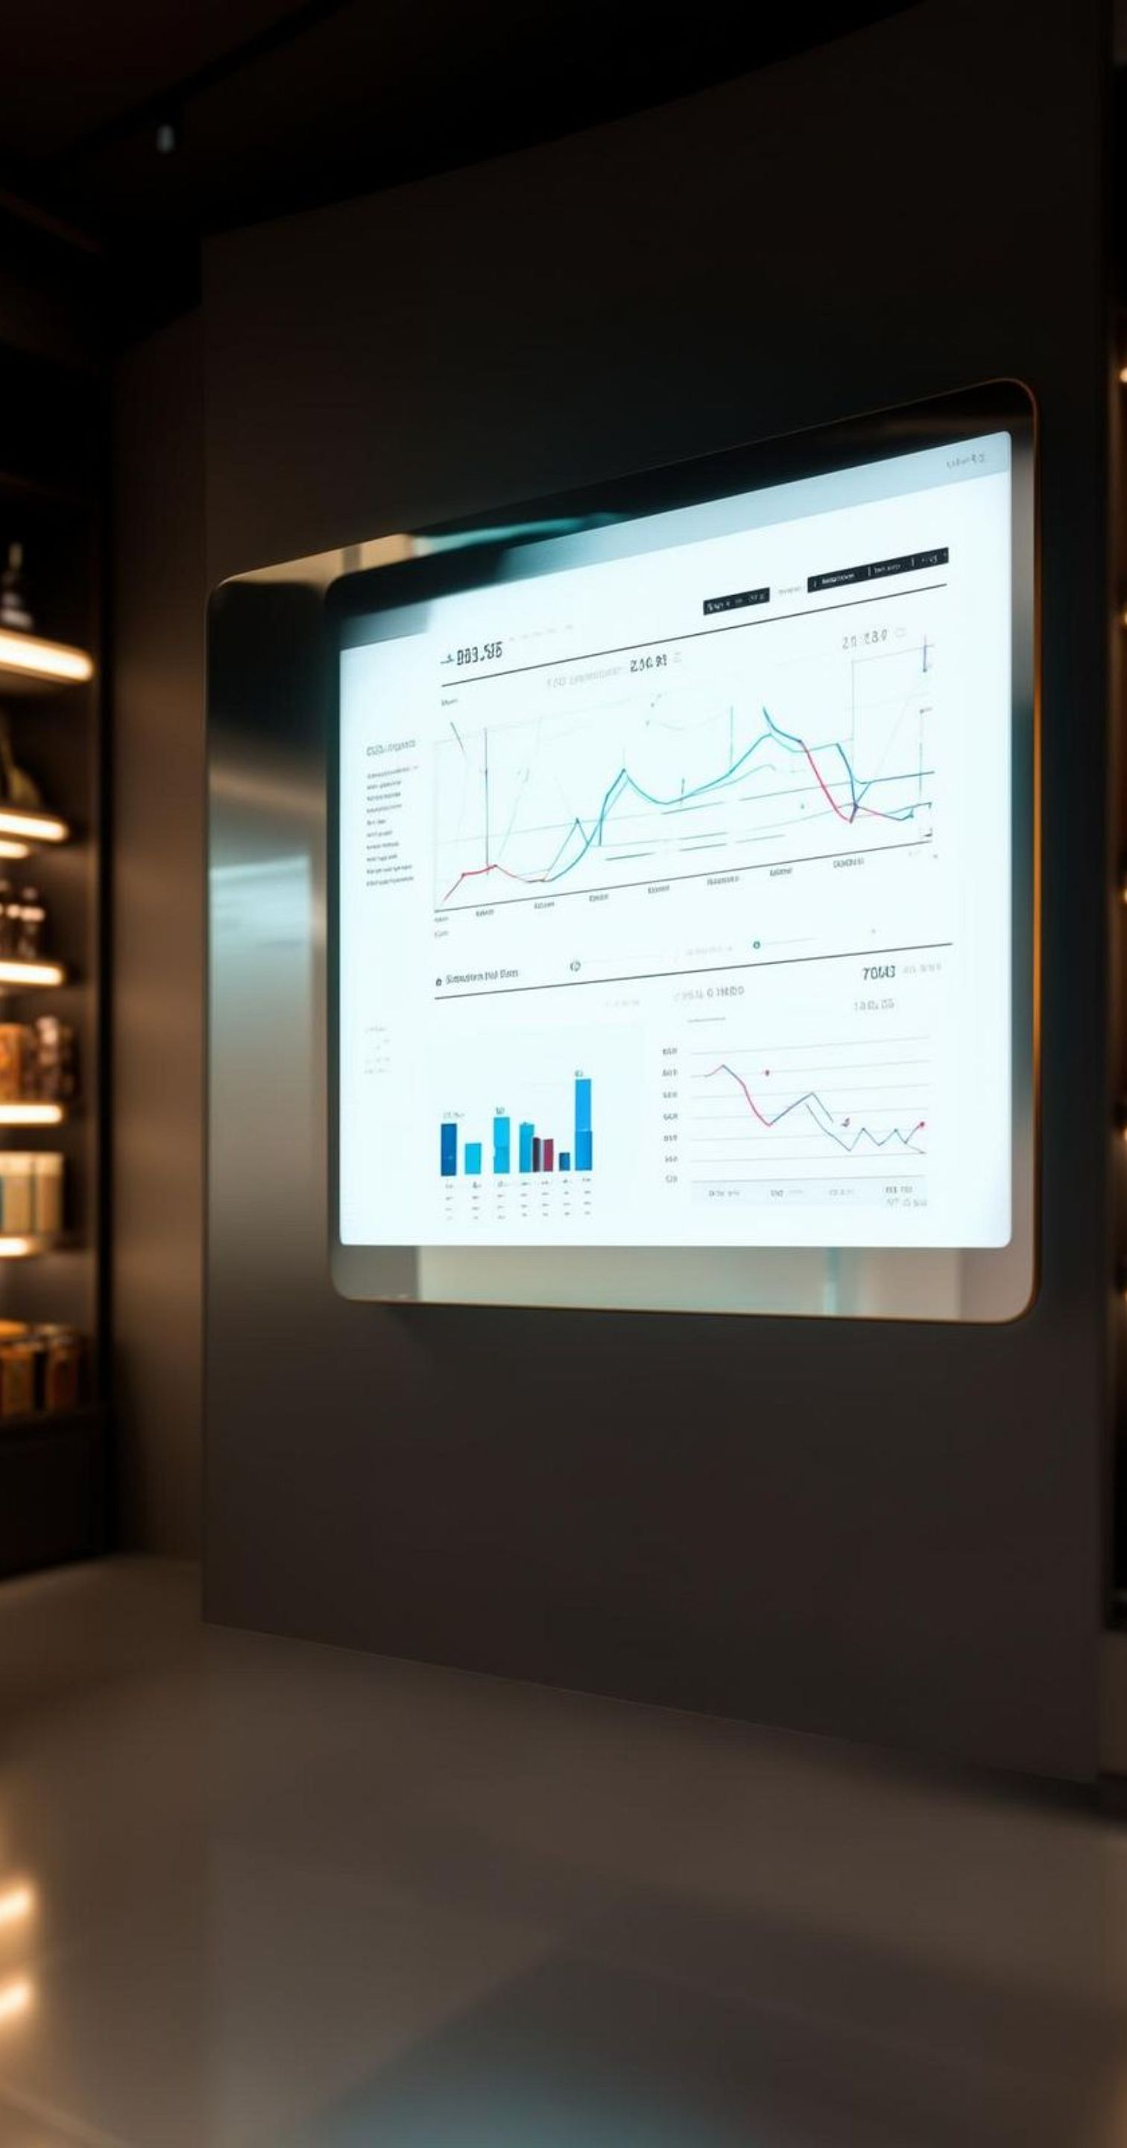
How RetailIQ Compares
Capability
Cin7 / Zoho
Enterprise (IBM)
RetailIQ
AI Demand Forecasting
Paid add-on
Yes (complex)
Included
Affordable for small shops
No ($349+/mo)
No
Yes (free-tier APIs)
Regional language support
No
No
Yes
WhatsApp-native reporting
No
No
Yes
Employee anomaly attribution
No
Partial
Yes
Simple, non-technical setup
Partial
No
Yes
RetailIQ is the only platform that combines affordability, regional language support, WhatsApp-native delivery, and employee-level fraud detection in a single product built for Indian small retailers.

Slide 7

System Architecture
1
2
React Frontend
Node.js + Express Backend
User interface layer for Admin, Manager, and Employee roles with real-time dashboard.
Single layer communicating with both frontend and PostgreSQL database. All routing handled here.
3
4
FastAPI ML/GenAI Microservices
PostgreSQL Database
All ML and Generative AI work happens through internal FastAPI microservice calls from the backend.
Persistent data store for inventory, sales, users, and analytics hosted via Neon.

Slide 8

Technology Stack
RetailIQ is built on a modern, full-stack architecture combining proven web technologies with cutting-edge AI and ML tooling.
1
Frontend
React.js, HTML, CSS, JavaScript
2
Backend & Database
Node.js, Express.js, Prisma ORM, PostgreSQL (Neon), JWT + bcrypt Auth
3
Machine Learning
Python, Scikit-learn, Pandas, NumPy, FastAPI service layer
4
AI, Voice & Messaging
Gemini API / OpenAI API, OpenAI Whisper, Google Cloud TTS, Twilio WhatsApp API

Slide 9

Future Scope
RetailIQ's roadmap extends the platform's intelligence and reach with features designed for real-world Indian retail conditions.
OCR Invoice Scanning
GenAI-powered automatic restock entry
Festival-Aware Forecasting
Diwali, Holi, and regional festival demand spikes
Offline-First PWA Mode
Low-connectivity support for rural retailers
Voice-based billing: Hands-free transaction entry
Dead-stock alerts: Slow-moving inventory clearance
Auto-categorization: New products via photo recognition
Multi-branch support: Scale to multiple store locations

Slide 10





Conclusion
Full-Stack Development
1
React + Node.js + PostgreSQL
End-to-end modern web architecture
Machine Learning
2
Scikit-learn + FastAPI microservices
Demand forecasting & anomaly detection
Generative AI
3
Gemini / OpenAI + Whisper + TTS
Voice assistant & auto-generated reports
Purpose-Built for India
4
Affordable, multilingual, WhatsApp-native
Serving underserved small & medium retailers

