Slide 1
MOONSHOT BLUEPRINT
BLACK SWAN
FORGE
Discover disasters nobody thought to test.
Find the smallest repair before people pay the cost.
ADVERSARIAL INFRASTRUCTURE SCIENCE
Synthetic research prototype · Plausible under the assumptions of this model.

Slide 2
BLACK SWAN FORGE
THE MISUNDERSTOOD PROBLEM
We cannot monitor a failure nobody has imagined.
Cities are locally resilient—and globally brittle.
LOCAL VIEW
SYSTEM REALITY
Power healthy
Hospital generator ready
Fuel inventory available
Authentication fails
Payments stop
Fuel delivery stops
Hospital capacity collapses
≠
The deeper problem is epistemic: which cross-domain counterexamples have we failed to imagine?
02

Slide 3
BLACK SWAN FORGE
ZERO TO ONE
A new category—not another dashboard.
Existing tools begin with known conditions. BLACK SWAN FORGE searches for unknown mechanisms.
MONITORING
DIGITAL TWINS
CHAOS ENGINEERING
What is failing now?
What will this scenario do?
Does this chosen fault survive?
Observe known deviations.
Replay expected behavior.
Test a human hypothesis.
BLACK SWAN FORGE
What failure nobody rehearsed can collapse the system?
DISCOVER → MINIMIZE → FALSIFY → REPAIR → VERIFY
03

Slide 4
BLACK SWAN FORGE
EXECUTABLE METHOD
A disaster becomes an executable counterexample.
Every claim must survive replay.
01
02
03
04
05
DISCOVER
→
MINIMIZE
→
FALSIFY
→
REPAIR
→
VERIFY
Evolutionary search
Delta debugging
Delete causal links
Cost–risk frontier
Counterfactual replay
Output: a reproducible initial condition, event-backed causal trace, measurable collapse, and verified intervention.
No paid API. No generated explanation. Deterministic when seeded.
04

Slide 5
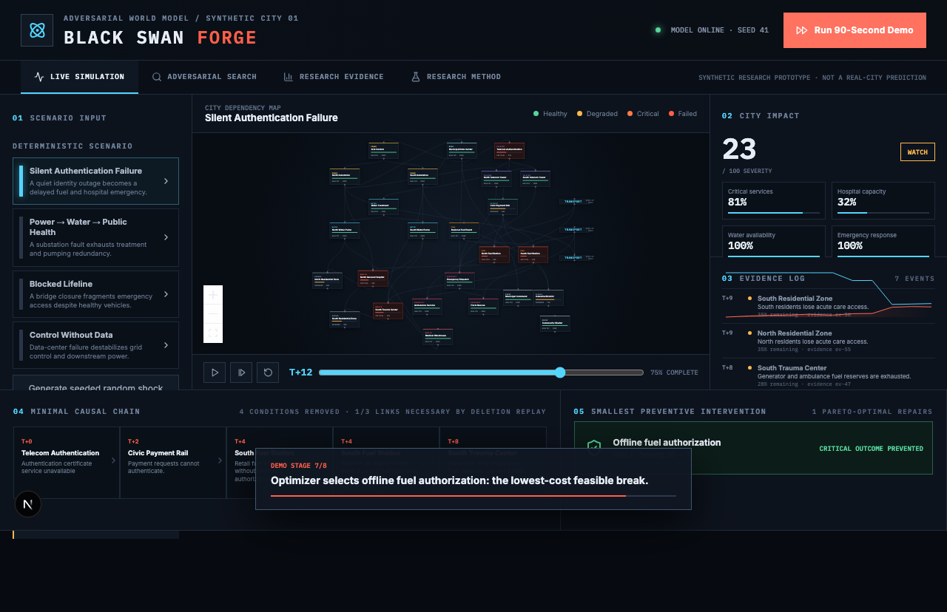
BLACK SWAN FORGE
WORKING PROTOTYPE
The future is already executable.
28 components · 46 delayed dependencies · 11 infrastructure domains
Healthy city → delayed hospital collapse → minimal causal chain → offline fuel authorization → hospital survives
05

Slide 6
BLACK SWAN FORGE
THE QUIET FAILURE
The dangerous part is the delay.
A small identity outage crosses four organizational boundaries before the hospital sees it.
T+0
T+3
T+5
T+9
TELECOM AUTH
PAYMENTS
FUEL
HOSPITAL
→
→
→
Certificate service fails
Requests cannot authenticate
Transactions stop
Emergency capacity < threshold
SMALLEST PREVENTIVE INTERVENTION
Offline emergency fuel authorization
HOSPITAL SURVIVES
06

Slide 7
BLACK SWAN FORGE
MEASURED EVIDENCE
Search beats simpler baselines.
Equal budgets. Fixed seeds. No fabricated benchmark claims.
1.90×
mean evolutionary / random
collapse-discovery ratio
95% CI [1.65, 2.15]
19 / 20 seeds won
Scientific honesty: random sampling found more unique signatures. The method improves collapse yield, not every objective.
07

Slide 8
BLACK SWAN FORGE
PHYSICS BRIDGE
From synthetic dependencies to physical redistribution.
A public IEEE 14-bus bridge solves DC power flow and N−1 overload cascades.
B′θ = P
LINE 1–2 OUT
→
3 OVERLOAD TRIPS
Fᵢⱼ = (θᵢ − θⱼ) / xᵢⱼ
↓
MATPOWER demand · generation · reactance
259 MW
LOAD ISLANDED · 2 ITERATIONS
Boundary: MATPOWER does not provide branch MVA limits for case14; overload limits are derived experimental assumptions, explicitly labeled.
08

Slide 9
BLACK SWAN FORGE
PATH TO REALITY
Bold does not mean vague.
A staged route from open benchmarks to governed infrastructure research.
01
OPEN BENCHMARKS
Power · water · transport · communications
02
SECURE INGESTION
Operator topology stays inside its boundary
03
HYBRID SOLVERS
AC power · hydraulics · traffic · inventories
04
EXPERT-BLINDED REVIEW
Plausibility · novelty · actionability · risk
05
SHADOW EXERCISES
Historical and tabletop replay; no control
06
FEDERATED NETWORK
Share dependency contracts, not sensitive topology
09

Slide 10
THE FUTURE THIS CREATES
Civilization should learn
its hidden dependencies
in simulation—
not in disaster.
A crash-testing layer for civilization.
Not an autonomous controller. A machine for generating hypotheses humans can falsify before real people become the experiment.

