Slide 1
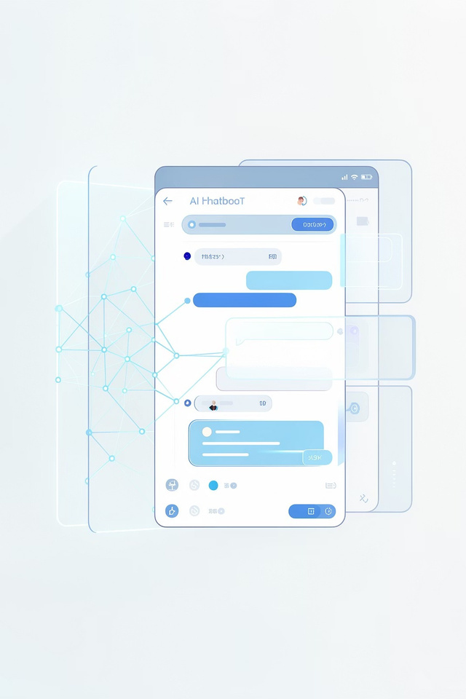
SupportPlus AI
SmartKnowledge
Enhancer
Customer Support using Generative AI—Built with RAG, Memory (Mem0),
and Web Search

Slide 2

Problem Statement
Slow & Repetitive
No Memory
Customer support responses are often slow, repetitive, and inconsistent across interactions.
Limiteduse of past user
interactions — every query starts from scratch.
Static FAQs
Traditional FAQ systems lack adaptability and cannot handle real-time needs.
There is a clear need for an intelligent, real-time support system that is personalized, accurate, and contextual.

Slide 3
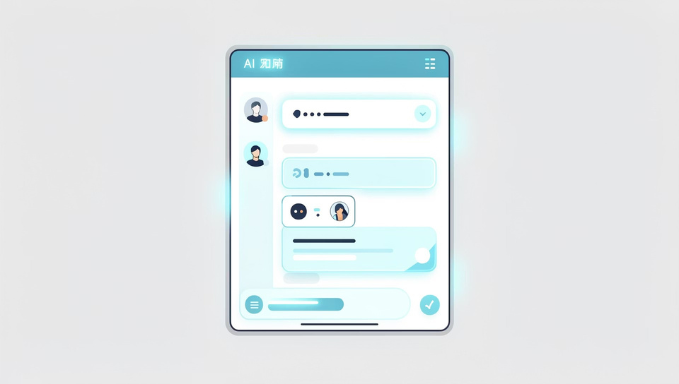


Proposed Solution — SupportPlus AI
SupportPlus AI is an AI-powered customer support assistant that combines three intelligent data sources to deliver personalized, accurate, and contextual answers.
Internal FAQs
User Memory
Real-Time Web Data
Structured knowledge base for consistent answers
Past interactions for personalization
Live information when FAQs fall short

Slide 4
System Architecture
User Chat
FastAPI
AI Services
Personalized Reply
The frontend chat interface (HTML, CSS, JS) communicates with a FastAPI backend, which orchestrates four core AI services — Gemini LLM, RAG via Chroma DB, Mem0 memory, and Firecrawl web search — to generate intelligent, personalized responses.

Slide 5
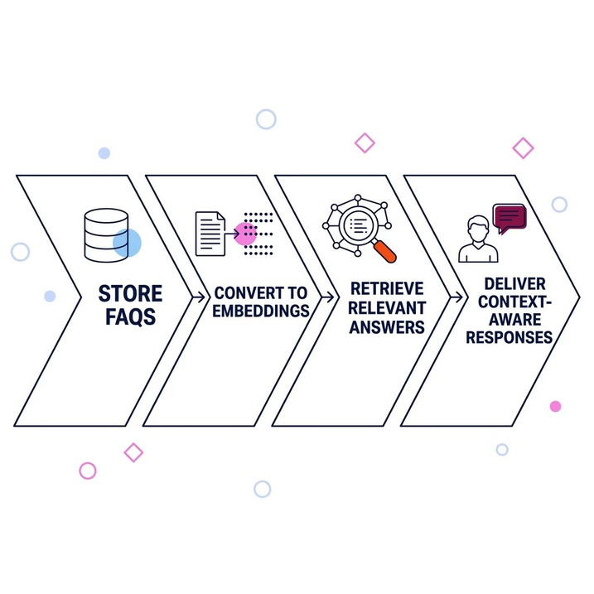
RAG for Knowledge Retrieval
How RAG Works
Retrieval-Augmented Generation (RAG) stores FAQs in a vector database (Chroma DB), converts text into embeddings, and retrieves the most relevant answers based on the user's query.
FAQs stored as vectors in Chroma DB
Text converted into semantic embeddings
Relevant answers retrieved by query similarity
Ensures accurate, context-aware responses

Slide 6
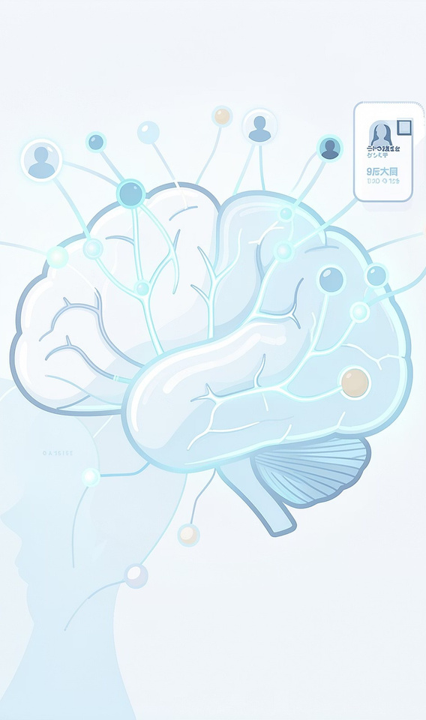
Personalized Memory System (Mem0)
Stores User History
Retrieves Preferences
Remembers pastissues and solutions per user
Recalls user-specific settings
and habits
Faster Resolution
Personalization speedup troubleshooting
Example: "User prefers restarting router for WiFi issues" — Mem0 recalls this and applies it automatically.

Slide 7
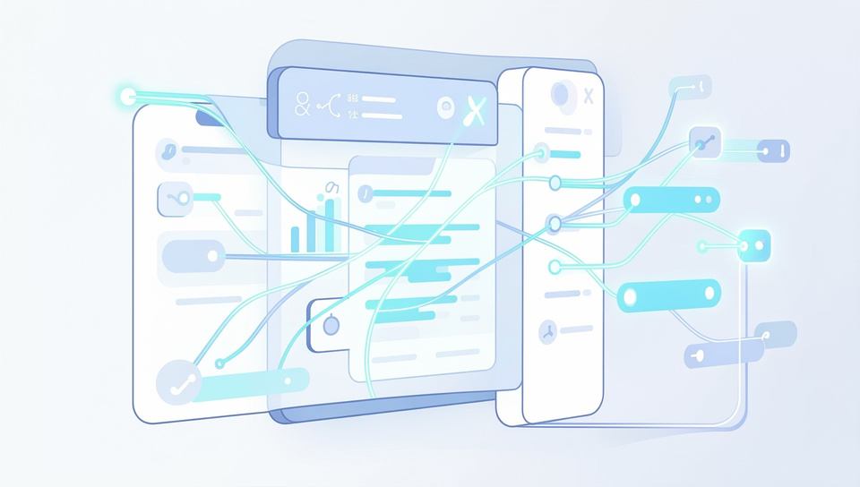
Real-Time Web Support (Firecrawl)
When internal FAQs are insufficient, Firecrawl fetches the latest troubleshooting steps from the web, combining multiple sources into a single, coherent response.
Always Up-to-Date
Multi-Source Synthesis
Enhanced Accuracy
Fetches the latest information beyond static FAQs
Combines multiple web sources into one clear response
Improves answer quality when FAQs are insufficient

Slide 8
Response Generation using LLM
Memory
FAQs
Web Results
Gemini Response
The Gemini model combines memory, FAQs, and web results following a priority logic: Memory > FAQs > Web, ensuring the most personalized and relevant answer is always delivered first.
Memory
FAQs
Web
Highest priority — user-specific context first
Structured knowledge base as fallback
Real-time data when other sources are insufficient

Slide 9
Key Features
Personalized Responses
Real-Time Knowledge
Learns from Feedback
Tailored answers based on individual user history and preferences
Live web data keeps responses current and accurate
Continuously improves through
user interaction patterns
Scalable Architecture
Improved Satisfaction
Built to grow with increasing user demands and data
Faster, smarter responses drive
higher customer satisfaction

Slide 10
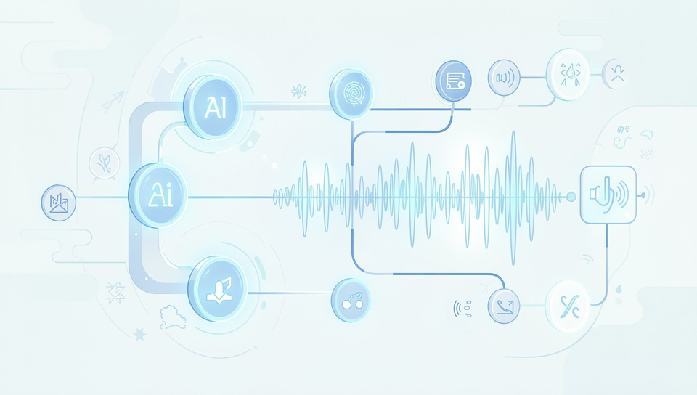
Conclusion & Future Work
What We Built
SupportPlus AIis an intelligent customer
support assistant combining multiple AI techniques — RAG, memory, and real- time web search — to deliver
personalized, accurate, and contextual
responses.
Multi-Language Support
Voice-Based Interaction
Analytics Dashboard
Expand accessibility across languages
Hands-free support via voice input
Advanced insights into support patterns

Slide 11
Thank You

