Slide 1
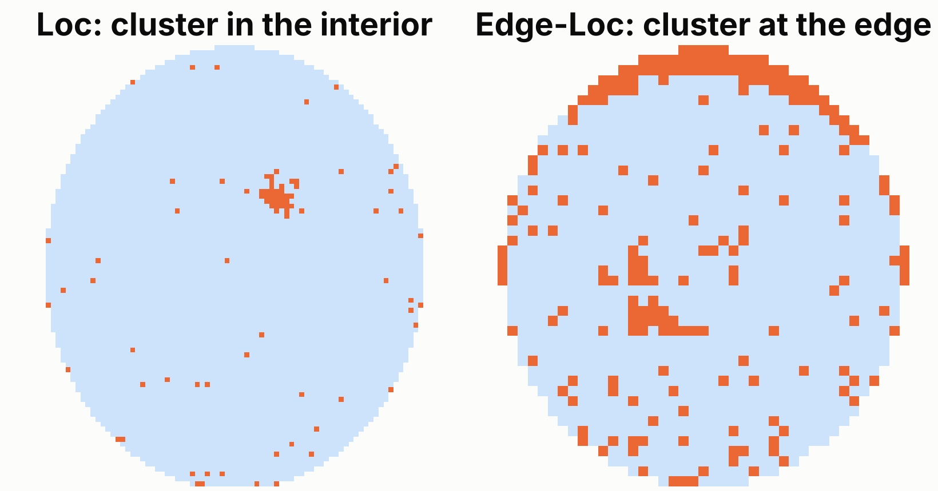
Which team gets this wafer?
A wafer shows a local cluster of failing dies. The model predicts which of two look-alike patterns it is.
Edge-Loc: hold the tool
A tool’s edge process is drifting. It repeats on every wafer.
Loc: normal review
A one-off particle or local event on that wafer.
Data
WM-811K, real fab wafer maps. 8,782 labelled wafers, 59% Edge-Loc. We built 10 physical features per map.
Evaluation loss
(5 × missed Edge-Loc + 1 × false alarm) / wafers. A missed tool problem costs 5 unnecessary holds. Our assumption.
Why this question
“Defect or no defect” is almost perfectly predictable here (AUC 0.995). We chose a harder, more useful question.
DBA5106 Project 2, Version 2 (with data). Orange = failing die, light blue = passing die. Source: WM-811K (Kaggle, qingyi/wm811k-wafer-map).
Notes:
The decision: a wafer shows a local cluster of failing dies. Edge-Loc means a tool's edge process is drifting, so we hold the tool. Loc is a one-off particle. The two mistakes don't cost the same: a missed Edge-Loc lets the tool keep damaging lots, a false alarm costs one unnecessary tool hold. We assume 5 to 1; that ratio is our assumption and we test other ratios later. Data: WM-811K, 8,782 wafers labelled Edge-Loc or Loc by engineers. We turned each wafer map into 10 physical features, such as fail rate by zone and where the largest cluster sits. We did not use the easier question, defect versus no defect, because it is almost perfectly predictable (AUC 0.995).

Slide 2
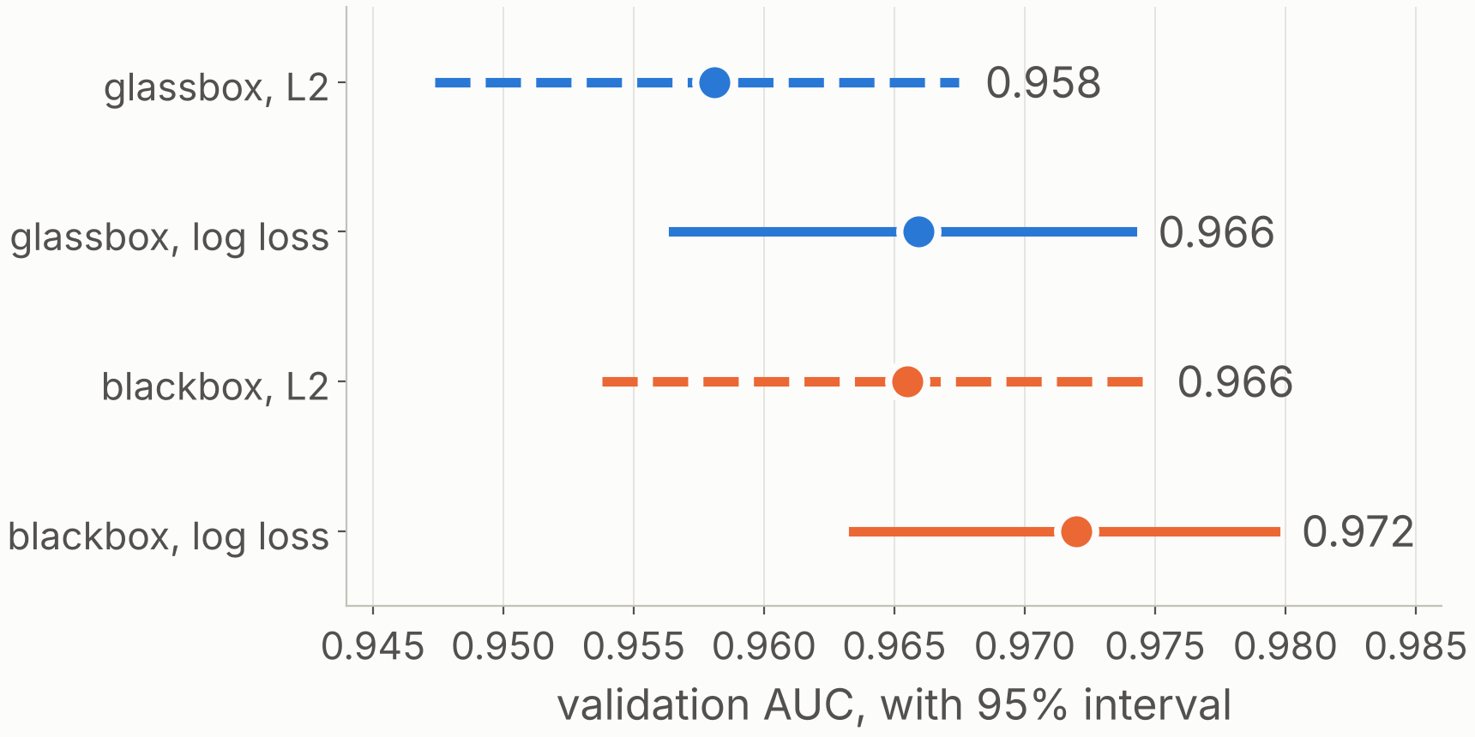
Four models, one fair comparison
Validation AUC | L2 loss | Log loss
Glassbox: L1 linear model | 0.958 | 0.966
Blackbox: boosted trees | 0.966 | 0.972
Log loss beats L2 for both
+0.008 for the glassbox, +0.007 for the blackbox. Both intervals exclude zero. L2 scores fall outside 0–1 for 20–29% of wafers.
How we kept it fair: split by lot, 60 / 20 / 20. Each model tuned separately by cross-validation inside the training split. 24 configurations in total.
Why validation, not training
The blackbox scores 1.000 on its own training data and 0.972 on validation.
Solid = log loss, dashed = L2. Intervals resample whole lots, 2,000 times. Validation: 1,756 wafers.
Notes:
Glassbox: an L1-penalised linear model. With L2 loss that is LASSO regression on the 0/1 label; with log loss it is L1 logistic regression. Blackbox: gradient-boosted trees, with squared error and with log loss. Within each row only the training loss changes. Each of the four was tuned separately by 5-fold cross-validation inside the training split, with folds by lot: 6 penalty values for the glassbox, tree depth times number of trees for the blackbox, 24 configurations in total. The validation split was used only to compare the four tuned models. Log loss wins for both model types. We split by lot because wafers from one lot look alike, and a random split would flatter validation.

Slide 3
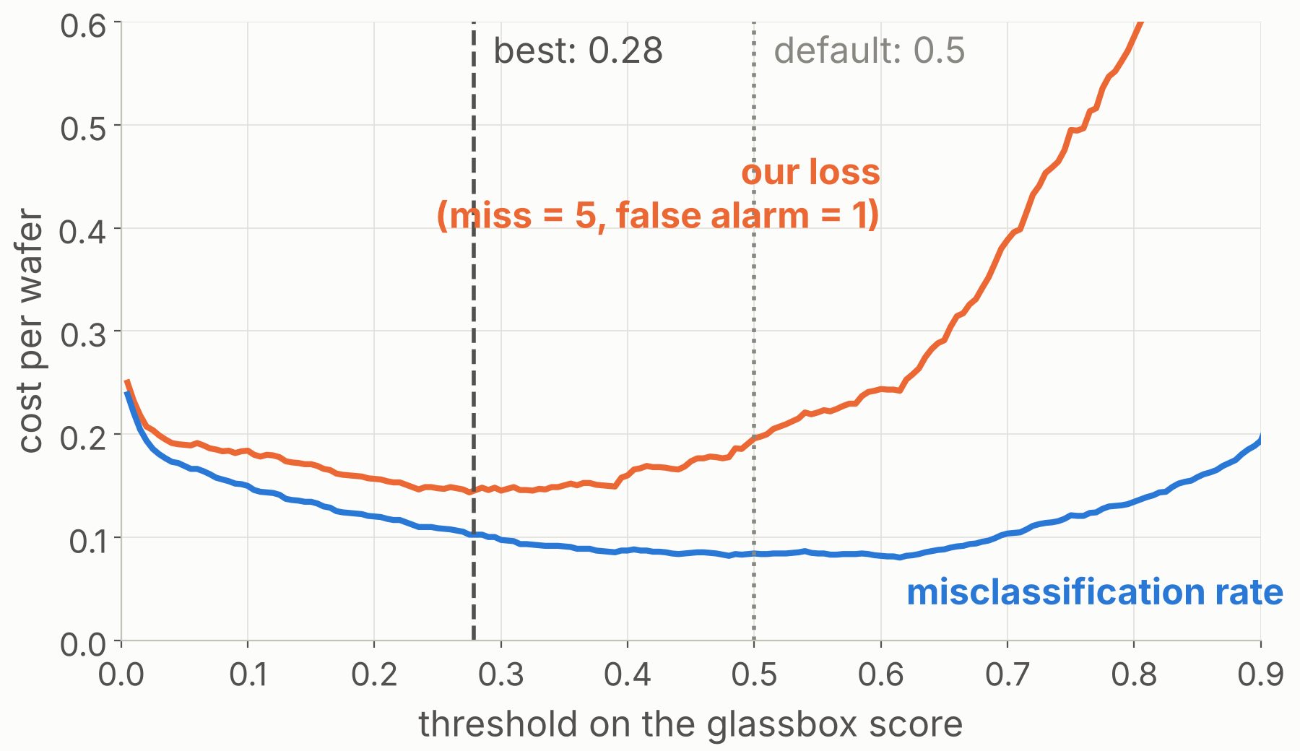
We chose the glassbox, at threshold 0.28
Higher AUC, but not lower cost
The blackbox’s AUC is 0.006 higher (95% CI +0.0001 to +0.012). Its evaluation loss is not lower: 0.149 against the glassbox’s 0.143.
Rule set before looking
A blackbox must cut the cost by 10% to earn its opacity. It didn’t.
−27%
−1.8 pts
At 0.28 we miss 18 Edge-Loc wafers instead of 49, for 161 false alarms instead of 99.
cost vs a 0.5 threshold (0.196 → 0.143)
accuracy (91.6% → 89.8%)
Validation split. Minimising plain misclassification would move the threshold the other way, to 0.61.
Notes:
The blackbox has the highest validation AUC, by 0.006, and the interval only just excludes zero. But at our cost ratio its evaluation loss is not lower: 0.149 against 0.143. AUC averages over all thresholds; our costs only care about the low-threshold end. We had set a rule in advance: choose the blackbox only if it lowers the cost by at least 10 percent. So we chose the glassbox, L1 logistic regression. Then the threshold: the cost-minimising threshold is 0.28, not 0.5. That gives up 1.8 points of accuracy and cuts the cost by 27 percent. This is the evidence that the evaluation loss, not accuracy, should drive the decision.

Slide 4
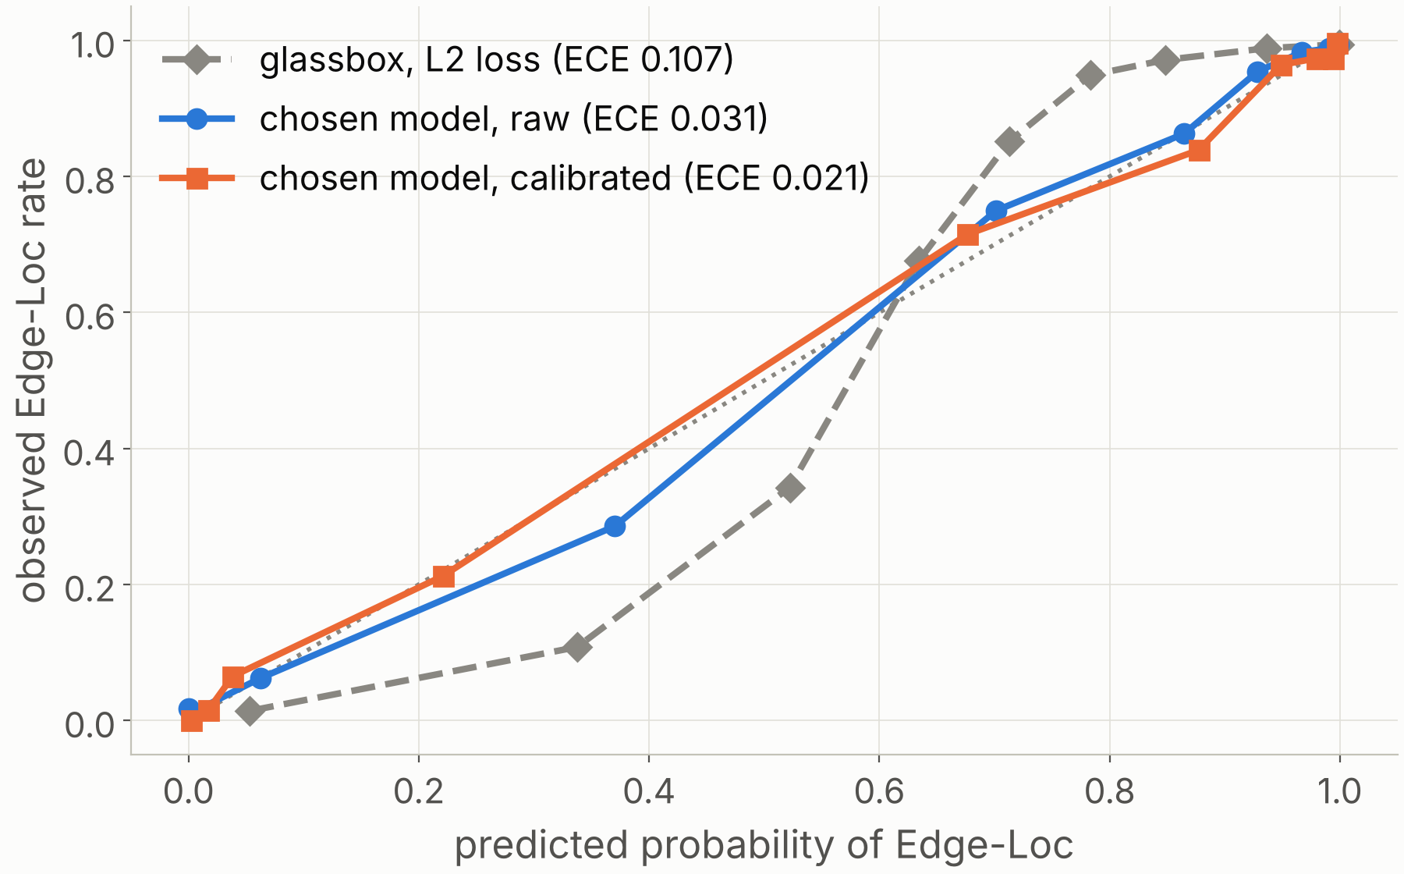
Calibration: mildly off, then fixed
0.031 → 0.021
calibration error (ECE) of the chosen model; AUC unchanged
What was wrong
It under-predicts between 0.2 and 0.5, where our threshold sits.
The fix
Isotonic regression, fitted on out-of-fold training scores so validation stays clean. Platt scaling barely helps a logistic model (0.029).
Why it matters
Theory gives the threshold for calibrated probabilities: 1/(1+5) = 0.167. Ours is 0.22, at almost the same cost.
Validation split, equal-count bins. The glassbox stays the cheaper model for cost ratios from 3 to 8.
Notes:
We checked calibration with a reliability diagram, the expected calibration error and the Brier score, for all four models. The L2 glassbox is the worst, with an error of 0.107. Our chosen model is mildly off at 0.031: it under-predicts between 0.2 and 0.5, exactly where the threshold sits. The fix: isotonic regression fitted on out-of-fold training scores, so the validation split is not reused. That takes the error to 0.021 and leaves AUC unchanged. Platt scaling barely helps a logistic model, but it works well for the blackbox, 0.034 to 0.013. Why it matters: with calibrated probabilities, decision theory gives the threshold directly as 1 over 1 plus the cost ratio, 0.167. Our searched threshold is 0.22, and using 0.167 costs almost the same. We also varied the cost ratio from 1 to 10: the glassbox stays the cheaper model from 3 to 8.

Slide 5
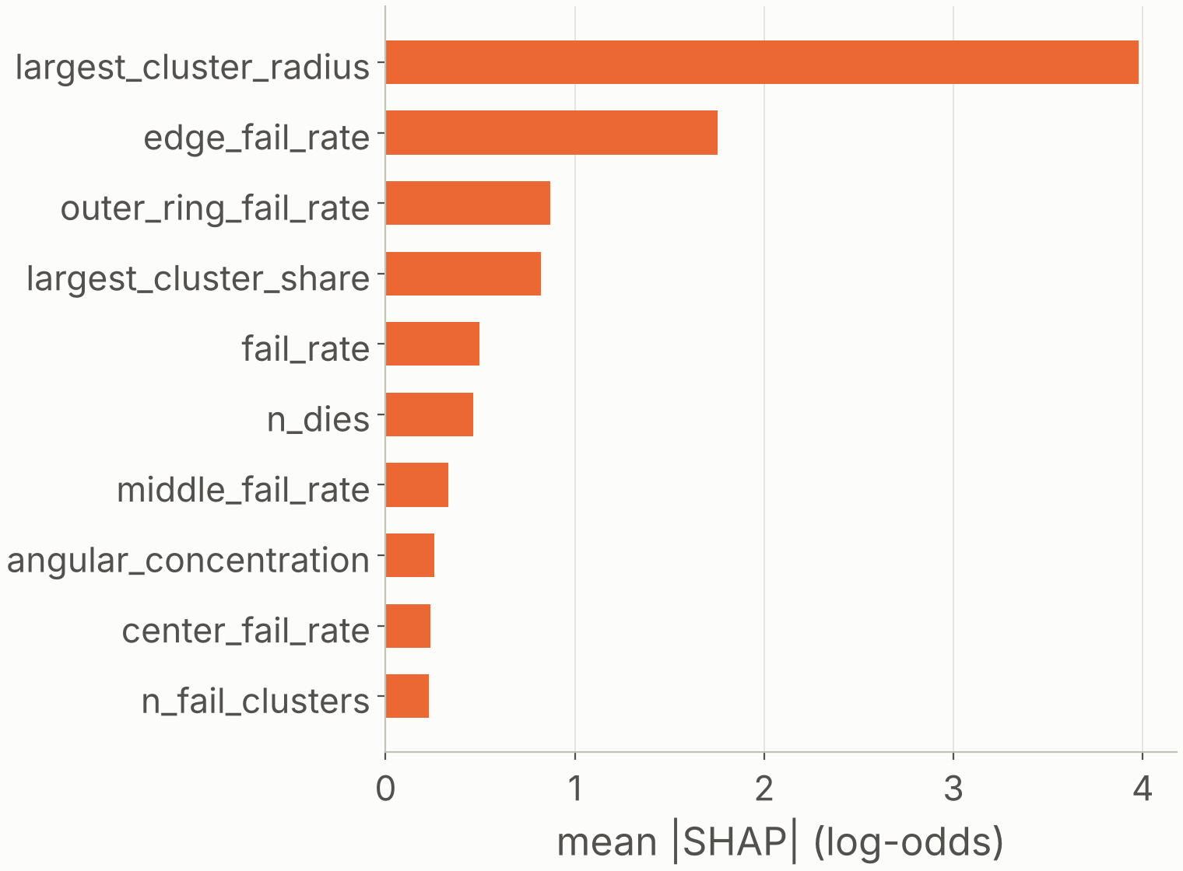
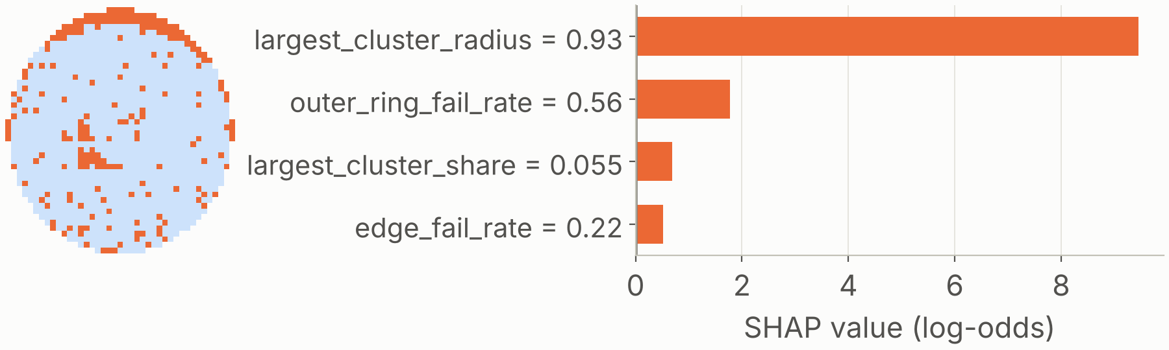
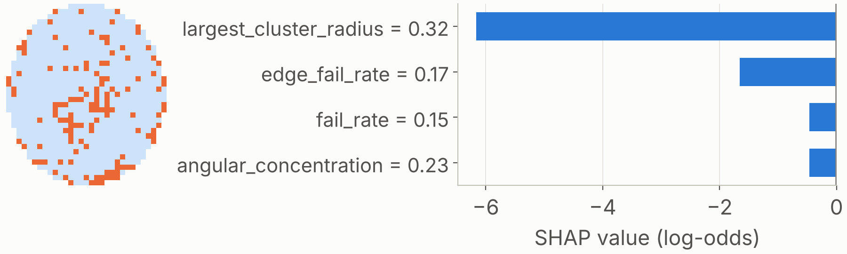
Tree SHAP on the blackbox: it looks at the edge
Global: what the model relies on
Local: two wafers, next to their maps
Most confident Edge-Loc. P(Edge-Loc) = 1.000. The cluster is at the edge (radius 0.93).
Costliest mistake. Labelled Edge-Loc, P = 0.000. Its cluster is near the centre (radius 0.32). Possibly a labelling error.
Where the largest cluster sits dominates, then the edge fail rates.
Caution: the fail-rate features are correlated, so SHAP credit among them is unstable. Orange pushes towards Edge-Loc, blue towards Loc.
Notes:
The brief requires tree SHAP on a tree-based blackbox even though we chose the glassbox. We applied it to the log-loss gradient-boosted trees, on the validation split. Global: the mean absolute SHAP value per feature. The radius of the largest cluster is far ahead at 4.0, then the edge fail rate at 1.8 and the outer ring fail rate at 0.9. The model asks the question an engineer would: is the cluster at the edge? Local: two wafers picked by rule, not by hand. The most confident Edge-Loc: the cluster is at the edge and that one feature carries most of the prediction. The costliest mistake: a wafer labelled Edge-Loc that the model scores as Loc. Its largest cluster is near the centre, and the glassbox agrees with the blackbox, so this may be a labelling error. Cautions: the fail-rate features are correlated, so the ranking among them is not reliable. And the glassbox is not automatically readable either: its coefficients have large opposite signs for the same reason. SHAP values add up exactly to the model's output.

Slide 6
Test result, used once, and an honest audit
0.958
0.181
97.3%
−56%
AUC (95% CI 0.946 to 0.969)
evaluation loss per wafer (CI 0.143 to 0.223)
of Edge-Loc wafers caught; accuracy 88.3%
cost vs holding the tool for every wafer (0.409)
Audit of our own choice
Limits
What we did differently
On test, the blackbox we didn’t choose scores 0.158 against our 0.181. The difference (−0.023, 95% CI −0.051 to +0.007) isn’t distinguishable from zero. We did not switch after seeing test.
The 5:1 cost ratio is our assumption.
Test is worse than validation (0.181 vs 0.143): the optimiser’s curse.
Labels are engineers’ judgements; some look wrong.
Our own physical features, not a CNN.
Splits by lot; 24 configurations; test used once.
An interval on every comparison.
Final model: L1 logistic regression (log loss) + isotonic calibration, threshold 0.22. Test split: 1,758 wafers.
Notes:
The test split was used once, with the model, calibrator and threshold frozen. AUC 0.958. Evaluation loss 0.181 per wafer, which is 56 percent below holding the tool for every wafer and 17 percent below using a 0.5 threshold. We catch 97.3 percent of Edge-Loc wafers. Test is worse than validation, 0.181 against 0.143. That is the optimiser's curse from the lectures: the model and threshold were both picked on validation, so the test number is the honest one. Audit: after freezing everything, we scored the blackbox we did not choose on test. It does somewhat better, 0.158 against 0.181, with 8 fewer missed wafers and the same false alarms. The difference is not distinguishable from zero, and we did not switch, because choosing after seeing test would make the test meaningless. So our choice is defensible on interpretability and on the validation evidence, but the data does not prove the glassbox is cheaper. Limits: the 5 to 1 cost ratio is assumed; the labels are human judgements. Next steps: real cost figures from a fab, and a sparser glassbox such as EBM or a shallow tree.

