Slide 1
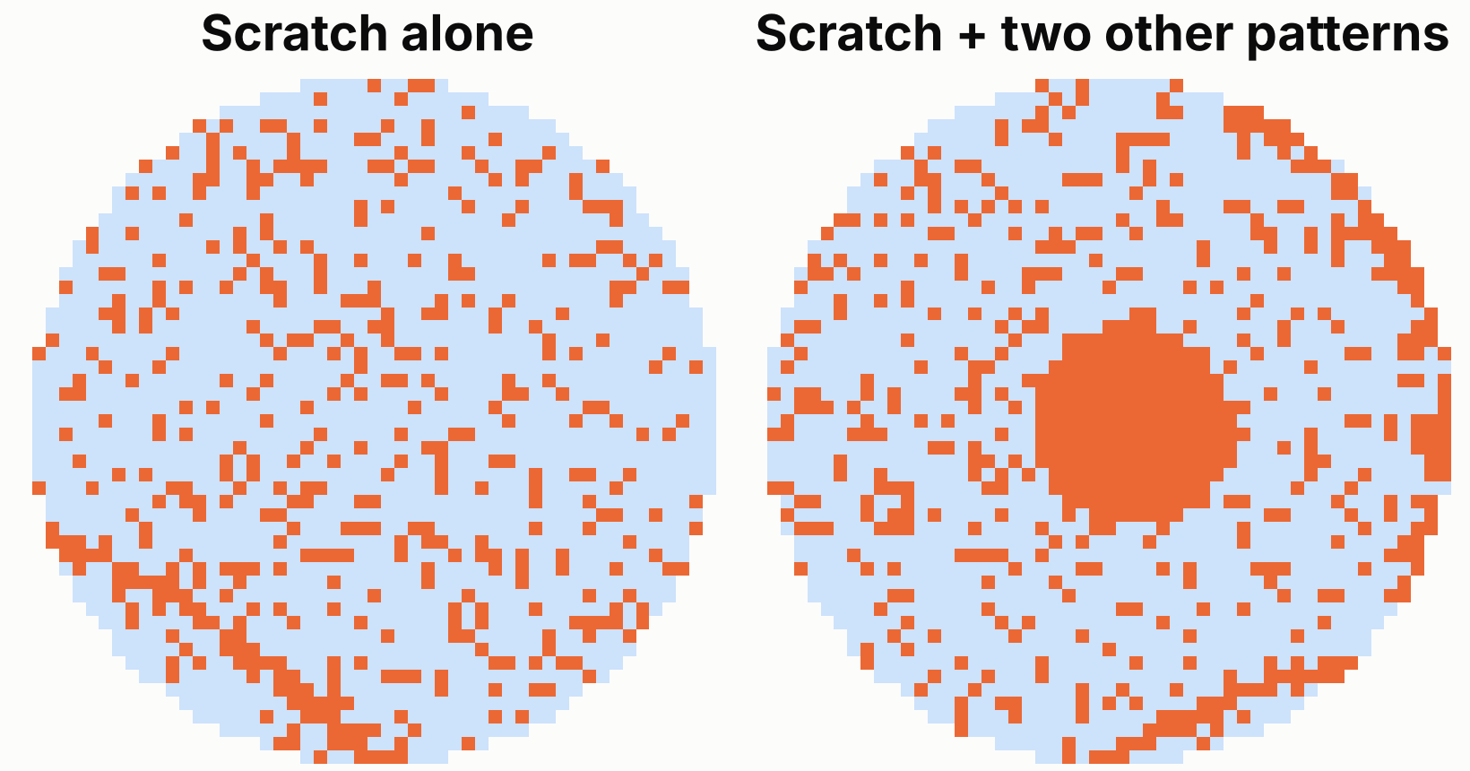
Is there a scratch on this wafer?
A scratch is a thin line of failing dies from mechanical contact. Here it must be found among other defects.
Scratch: hold the handling path
A robot, carrier or polishing step is damaging wafers. It repeats until fixed.
No scratch: normal review
The wafer may carry other patterns, but not this one.
Data
MixedWM38: 36,991 wafer maps, each labelled with every pattern it has. 49% have a scratch (balanced by the authors, partly with generated maps).
Cleaning we had to do
Dropped 1,024 duplicate maps (97.7% scratch). Deleted the die-count feature: it gave the label away.
Everything else is the same
Same features, models, search grids and split sizes. Same loss: (5 × missed + 1 × false alarm) / wafers.
DBA5106 Project 2, second run, same pipeline. Orange = failing die, light blue = passing die. Source: MixedWM38 (Kaggle, co1d7era/mixedtype-wafer-defect-datasets).
Notes:
This is the second run. We repeat the whole pipeline of the first project on a different semiconductor dataset, to see whether the same method reaches the same decision. The question: does this wafer have a scratch? A scratch is a thin line of failing dies from mechanical contact. In this dataset one wafer can carry several patterns at once, so the scratch has to be found among other defects; even by eye it is hard to see in these two examples. Data: MixedWM38, 36,991 wafer maps after cleaning. Two cleaning steps were needed before the task was honest: we dropped 1,024 exact duplicate maps, 97.7 percent of which were scratch wafers, and we deleted the die-count feature, because in this dataset it gives the label away. The 49 percent scratch rate is artificial: the authors balanced the classes, partly with generated maps. Everything else is identical to the first run: the features, the four models, the search grids, the 60/20/20 split, and the 5 to 1 evaluation loss.

Slide 2
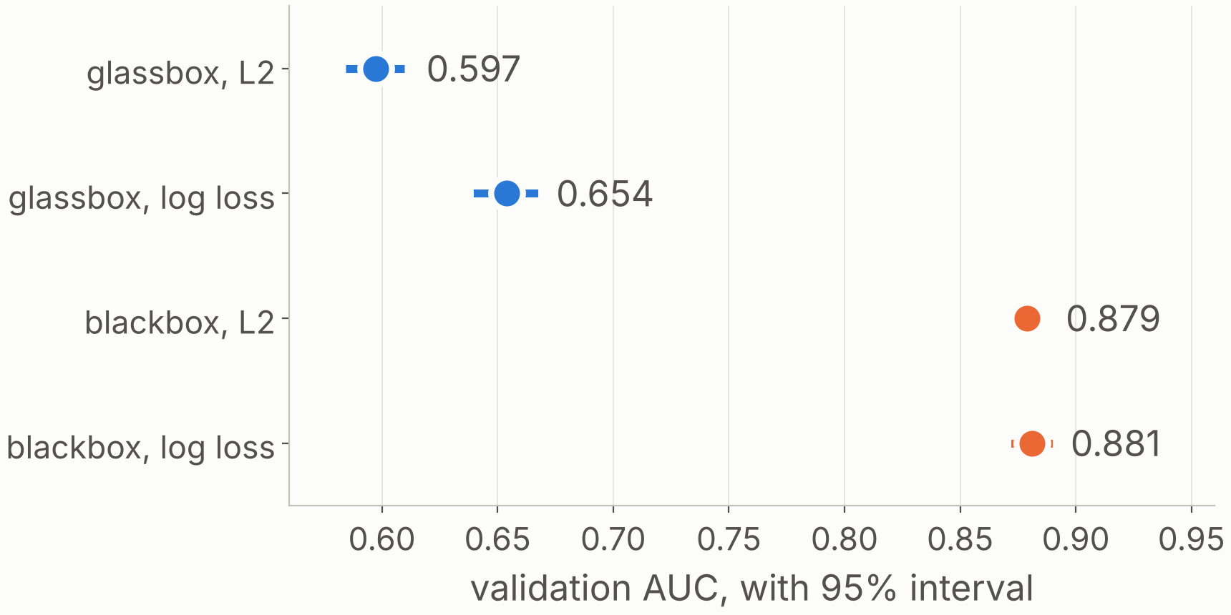
The same four models, a very different picture
Validation AUC | L2 loss | Log loss
Glassbox: L1 linear model | 0.597 | 0.654
Blackbox: boosted trees | 0.879 | 0.881
The glassbox can’t see a thin line
Zone fail rates don’t describe a scratch, and a linear model can’t combine them. The trees can: +0.227 AUC (95% CI +0.215 to +0.241).
Same setup as the first run: 60 / 20 / 20 split, each model tuned separately by cross-validation inside the training split, 24 configurations. The split is random here, because this dataset has no lot information.
Log loss beats L2, or ties
+0.057 for the glassbox. For the blackbox +0.002, with an interval that includes zero: a tie, so we keep log loss for its probabilities.
Solid = log loss, dashed = L2. Intervals resample wafers, 2,000 times. Validation: 7,398 wafers. Training AUC of the blackbox: 0.930.
Notes:
The same four models as in the first run: an L1-penalised linear model and gradient-boosted trees, each with L2 loss and with log loss, tuned separately by cross-validation inside the training split, 24 configurations. The picture is very different. In the first run all four models were between 0.958 and 0.972. Here the glassbox reaches only 0.654 and the blackbox 0.881, a gap of 0.227. The reason: none of our features describes a thin line, and a linear model cannot combine zone fail rates into one. The trees can pick up combinations. On the loss: log loss beats L2 clearly for the glassbox, by 0.057. For the blackbox the difference is 0.002 and the interval includes zero, so it is a tie, and by our rule a tie goes to log loss because its output is a probability. The L2 blackbox puts 10 percent of its scores outside 0 to 1. One difference in setup: the split is stratified random, not by lot, because this dataset has no lot information.

Slide 3
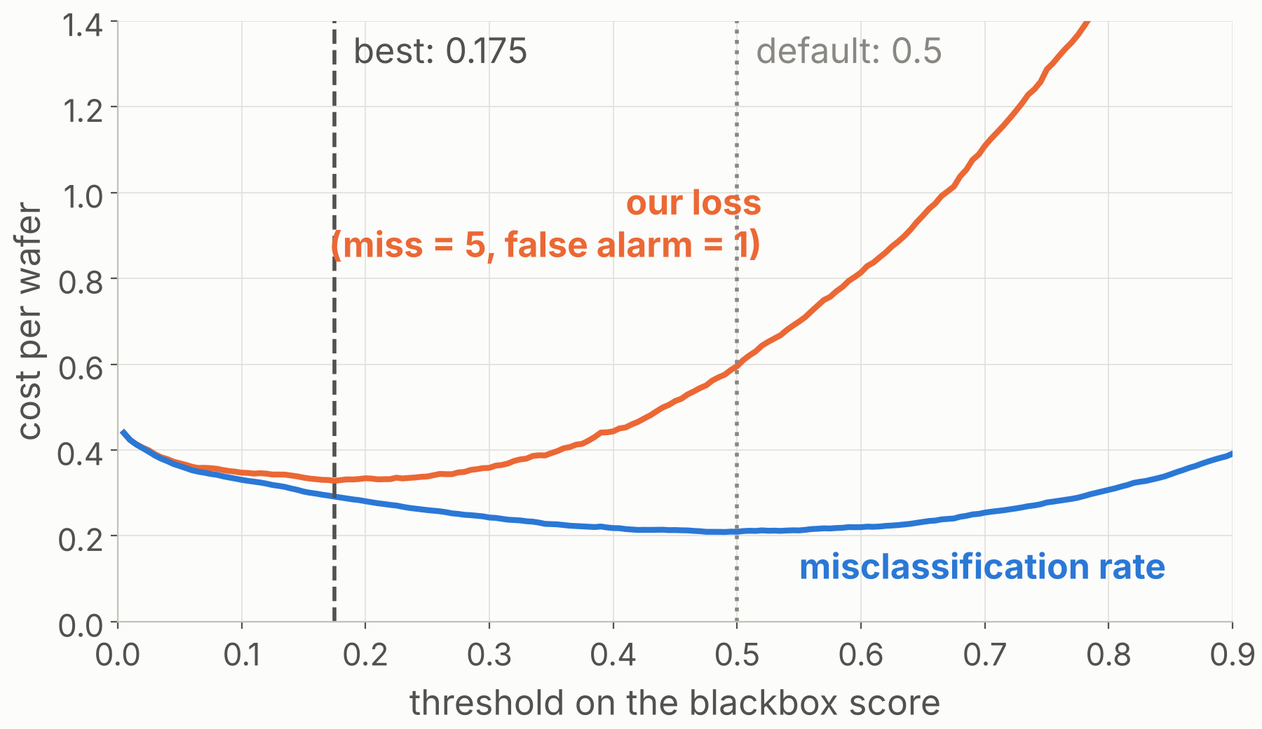
This time the blackbox wins, at threshold 0.175
Same rule, opposite answer
The blackbox must cut the cost by 10% to earn its opacity. Here it cuts it by 36%: 0.328 per wafer against 0.512.
The glassbox adds nothing
Its best cost, 0.512, is the cost of holding the tool for every wafer (0.513).
−45%
−8.2 pts
At 0.175 we miss 68 scratched wafers instead of 714, for 2,088 false alarms instead of 835.
cost vs a 0.5 threshold (0.595 → 0.328)
accuracy (79.1% → 70.9%)
Validation split. Minimising plain misclassification would leave the threshold at 0.49. The choice holds for every cost ratio from 1 to 10.
Notes:
We applied the same decision rule as in the first run, fixed in advance: choose the blackbox only if its validation AUC is distinguishably higher and it lowers the evaluation loss by at least 10 percent. In the first run the blackbox failed that test and we chose the glassbox. Here it passes easily: the AUC gap is 0.227 and the cost is 36 percent lower, 0.328 against 0.512. In fact the glassbox's best cost equals the cost of simply holding the tool for every wafer, so it adds nothing. Then the threshold. The cost-minimising threshold is 0.175, not 0.5. That cuts the cost by 45 percent, by catching 646 more scratched wafers for 1,253 more false alarms. Accuracy falls by 8 points while the cost falls by almost half, which again shows why the evaluation loss, not accuracy, should drive the decision. Unlike the first run, the choice of model holds for every cost ratio from 1 to 10.

Slide 4
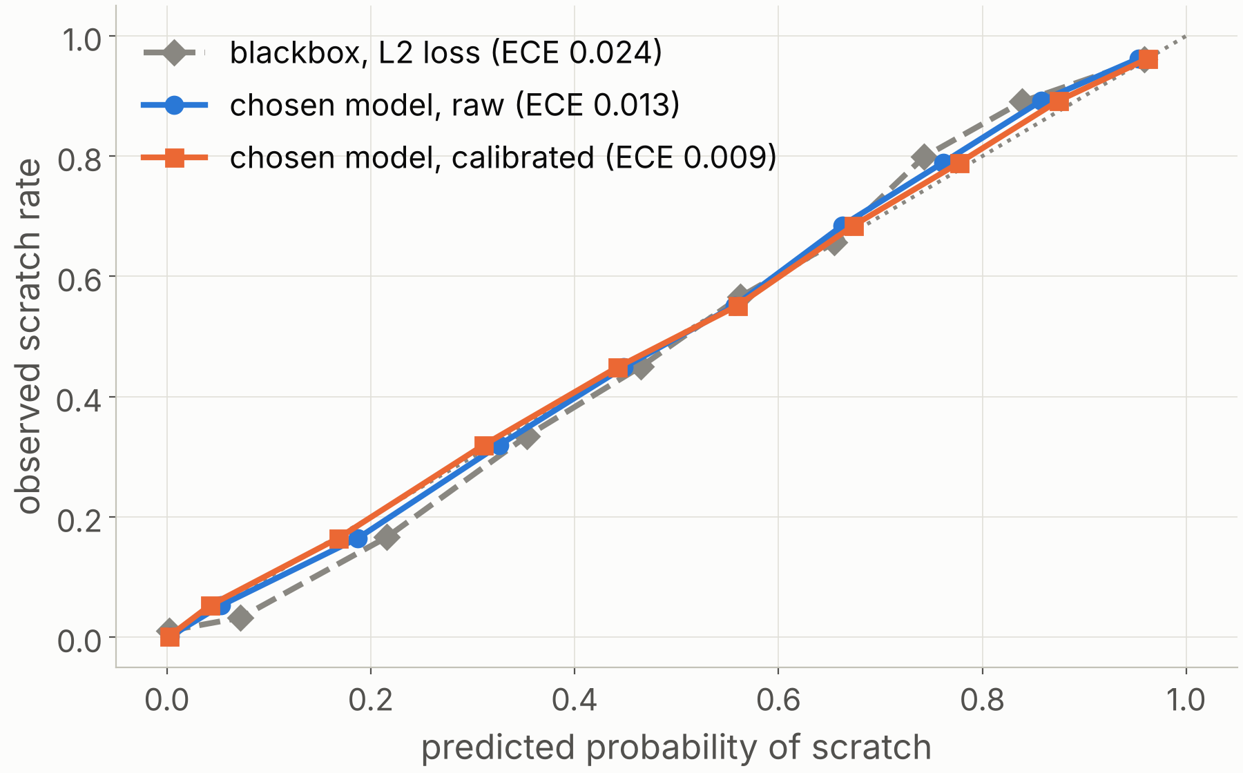
Calibration: already good, and the threshold shows it
0.013 → 0.009
calibration error (ECE) of the chosen model; AUC unchanged
What we found
Boosted trees trained with log loss on 22,195 wafers were close to calibrated from the start.
The fix
Platt scaling, fitted on out-of-fold training scores. A small gain. In the first run isotonic regression was the better fix.
Why it matters
Theory gives the threshold: 1/(1+5) = 0.167. Ours is 0.155. In the first run, with worse calibration, it was 0.22.
Validation split, equal-count bins. For cost ratios 1 to 4 the searched threshold is within 0.02 of the formula.
Notes:
Same calibration check as in the first run: reliability diagram, expected calibration error and Brier score for all four models. Here the chosen model was already close to calibrated: an error of 0.013 before any fix. Platt scaling, fitted on out-of-fold training scores, takes it to 0.009 without changing AUC. In the first run the chosen model was a logistic regression with an error of 0.031, and isotonic regression was the better fix. The link to the threshold is clearer here. With calibrated probabilities, decision theory gives the threshold as 1 over 1 plus the cost ratio, 0.167. Our searched threshold on calibrated probabilities is 0.155. In the first run it was 0.22. So the better calibrated the model, the closer the searched threshold is to the formula. For cost ratios from 1 to 4, the searched threshold matches the formula to within 0.02.

Slide 5
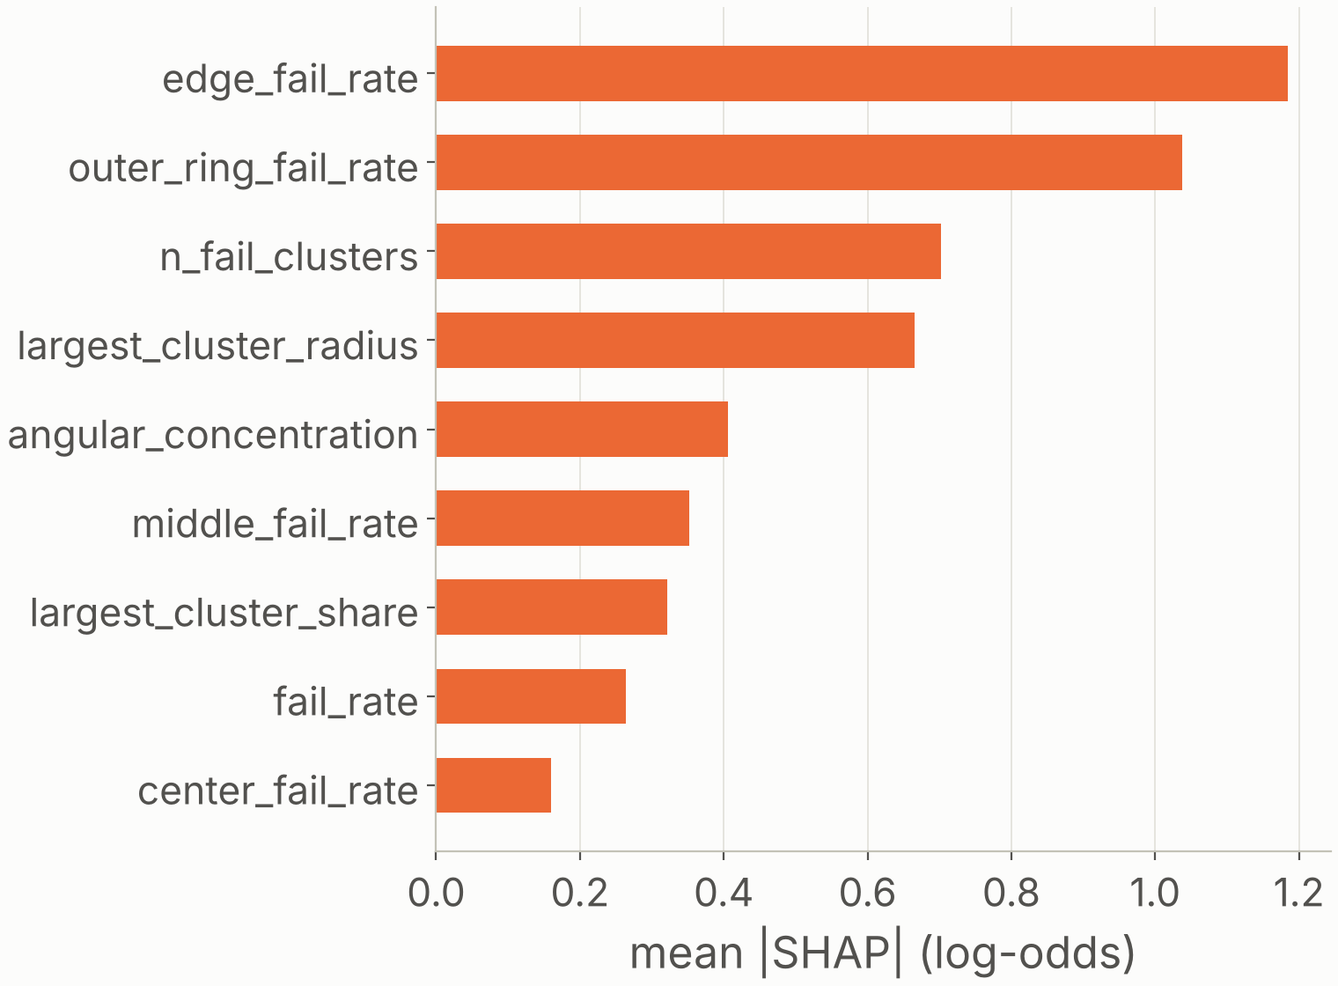
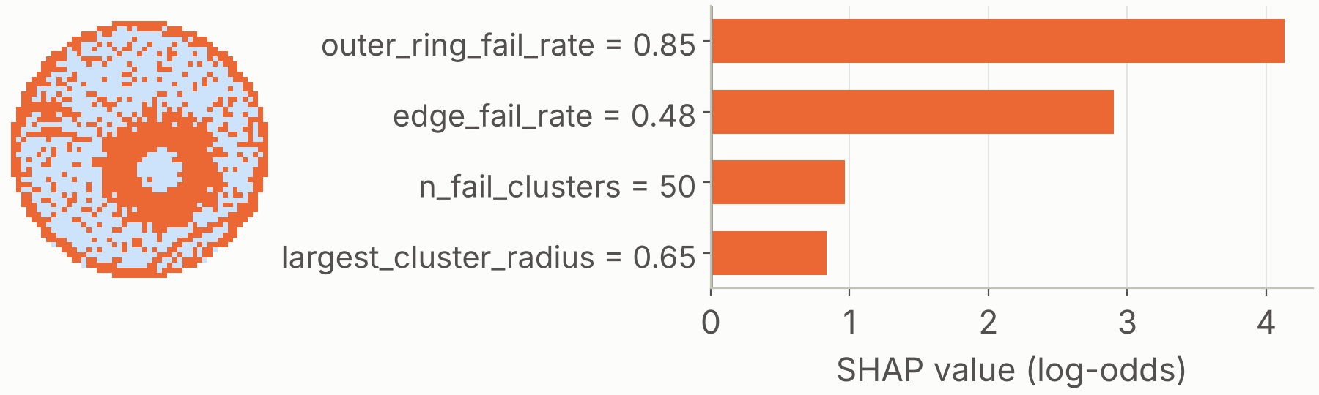
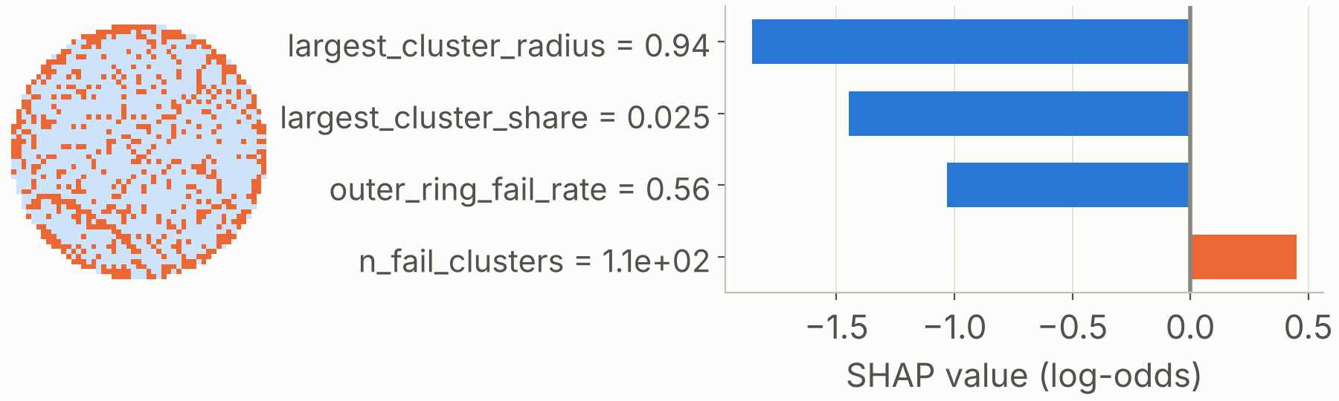
Tree SHAP: the model does not look at the scratch
Global: what the model relies on
Local: two wafers, next to their maps
Most confident scratch. P = 1.000. Label: Donut + Edge-Ring + Loc + Scratch. No line is visible; the edge fail rates decide.
Costliest mistake. Label: Edge-Loc + Scratch, P = 0.013. A cluster at the very edge pushes it to “no scratch”.
Edge fail rates lead. No feature describes a line.
Likely cause: the model has learned which mixes of patterns come with the Scratch label in this dataset. Orange pushes towards scratch, blue away.
Notes:
This is the most important slide of the second run. Tree SHAP on the chosen blackbox, on the validation split. Globally, the model relies on the edge fail rate and the outer ring fail rate, then the number of failing clusters. None of these describes a thin line. Locally, the wafer the model is most sure has a scratch is labelled Donut plus Edge-Ring plus Loc plus Scratch. Look at its map: there is no visible line. The prediction comes from its edge fail rates. And the costliest mistake is a wafer labelled Edge-Loc plus Scratch that the model scores at 0.013, because its largest cluster sits at the very edge. So the model is not detecting scratches. It has probably learned which mixes of patterns tend to carry the Scratch label in this dataset, which may reflect how the mixed maps were built. That would not transfer to a real fab. This is the value of SHAP here: an AUC of 0.88 looked like success, and the explanation shows the model learned the wrong thing. In the first run, by contrast, SHAP matched the physics: the model asked whether the cluster was at the edge.

Slide 6
Two runs, one pipeline, opposite decisions
 | Run 1: Edge-Loc | Run 2: Scratch
Data | Real fab maps, 8,782 | Real + GAN maps, 36,991
AUC, glassbox / blackbox | 0.966 / 0.972 | 0.654 / 0.881
Loss, glassbox / blackbox | 0.143 / 0.149 | 0.512 / 0.328
Model chosen | Glassbox | Blackbox
Threshold; saving vs 0.5 | 0.28; −27% | 0.175; −45%
Calibration error | 0.031 → 0.021 | 0.013 → 0.009
Test AUC | 0.958 | 0.882
Test loss (hold every wafer) | 0.181 (0.409) | 0.330 (0.513)
SHAP matches the physics? | Yes | No
0.882
−36%
run 2 test AUC (CI 0.874 to 0.889)
run 2 test cost vs holding every wafer
What the comparison shows
The same rule picks the glassbox when a linear model captures the signal, and the blackbox when it can’t. Log loss never loses to L2.
Which to trust
Run 1. Run 2 has the bigger gap, but its model reads how the dataset was built, and its 49% scratch rate is artificial.
AUC and loss rows are validation, log-loss models, at each model’s best threshold. Test splits used once. Loss levels are not comparable across runs.
Notes:
Test result for the second run, used once: AUC 0.882, evaluation loss 0.330 per wafer, 36 percent below holding the tool for every wafer. Validation and test agree, 0.328 against 0.330, because the validation split is four times larger than in the first run, so there is little optimiser's curse. The audit agrees with the choice: the glassbox we did not choose scores 0.513 on test. Now the comparison. Same pipeline, same grids, same cost ratio, same decision rule. The rule picks the glassbox in run 1 and the blackbox in run 2, for a reason we can explain: a linear model captures edge versus interior, but not a thin line among other defects. Log loss beats or ties L2 in every case. Tuning the threshold pays off in both, more where the model is weaker. Better calibration puts the searched threshold closer to the theoretical one. Which result do we trust? Run 1: real data, and a model whose explanation matches the physics. Run 2 has the more dramatic gap, but SHAP shows its model reads how the dataset was assembled, and its 49 percent scratch rate is artificial, so its loss levels cannot be compared with run 1 or with a real fab. Limits for both: the 5 to 1 cost ratio is our assumption.

