Slide 1
BRAIN TUMOR CLASSIFICATION
USING FUZZY AND SVM

Slide 2
INTRODUCTION
What is Brain Tumor Classification?
Brain tumors are abnormal growths of cells in the brain that can be benign (non-cancerous) or malignant (cancerous). MRI scans are the primary tool for brain tumor diagnosis.
Challenges in Classification:
Tumors vary in size, shape, and location, making detection difficult.
Manual segmentation by radiologists is prone to human error and subjectivity. Automated tumor detection using AI-based methods improves diagnosis speed and reduce reliance on manual segmentation.

Slide 3
WHAT IS FUZZY?
Fuzzy Logic is a mathematical approach that deals with imprecise, uncertain, and vague data. Unlike traditional binary logic (0 or 1), it allows partial truths (values between 0 and 1).
How it Works in Image Processing:
Assigns a membership value between 0 and 1 based on pixel intensity.
Helps in handling uncertainty in MRI scans where tumor boundaries are not always clear.
Enhances feature extraction by making smooth transitions between different regions.

Slide 4
WHAT IS SVM?
SVM (Support Vector Machine) is a supervised learning algorithm used for classification and regression tasks. It works by finding the optimal hyperplane that best separates different classes in the dataset.
How it Works:
Maps data points in a high-dimensional space.
Finds the best decision boundary (hyperplane) that maximizes the margin between two classes.
Uses support vectors (critical data points) to define the boundary.
Works well even with small datasets and high-dimensional features.

Slide 5
WHY FUZZY AND SVM?
Medical images contain uncertain and overlapping regions, which traditional methods struggle with. Fuzzy logic helps enhance ambiguous boundaries in images, making tumors more distinguishable. Defuzzification converts fuzzy values back to meaningful crisp values, improving classification performance.
Finds an optimal decision boundary between tumor and non-tumor regions. Works efficiently with high-dimensional medical image data. Handles small datasets well, making it ideal for medical applications. Reduces computational cost compared to deep learning methods.

Slide 6
ADVANTAGES OF FUZZY + SVM
Fuzzy Logic: Enhances contrast, extracts relevant region.
Defuzzification: Converts back to meaningful data
SVM: Robust tumor classification.
Combining Both: Increases accuracy & generalization

Slide 7
DEFUZZIFICATION
Why Defuzzification?
After applying fuzzy logic, the fuzzy values should be converted back to crisp values.
Defuzzification refines image intensity values, enhancing the classifier’s performance.
Types of Defuzzification Used:
Center of Gravity (COG)
Mean of Maxima (MOM)
Last of Maxima (LOM)
First of Maxima (FOM)
Weighted Average
Height Method

Slide 8
METHODOOLGY
PRE PROCESSING
FUZZIFICATION
DEFUZZIFICATION
SVM
CLASSIFICATION
PERFORMANCE EVALUATION

Slide 9
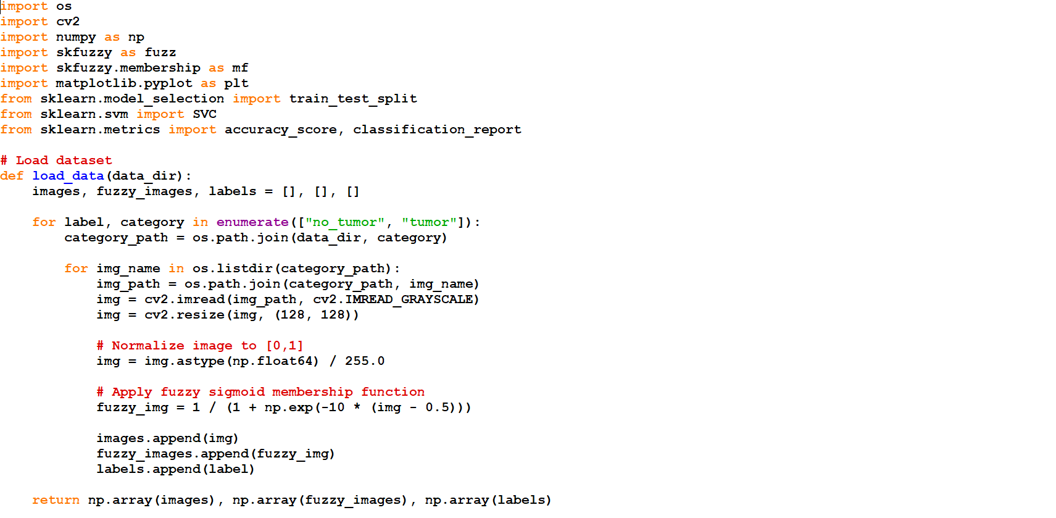

Slide 10
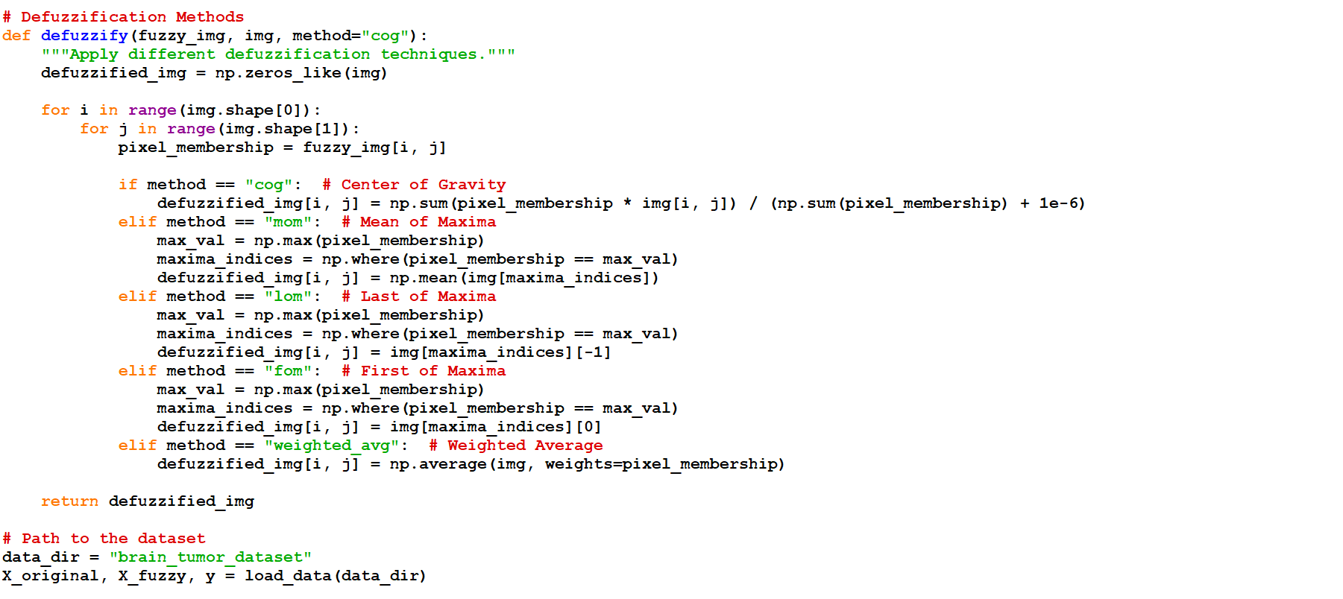

Slide 11
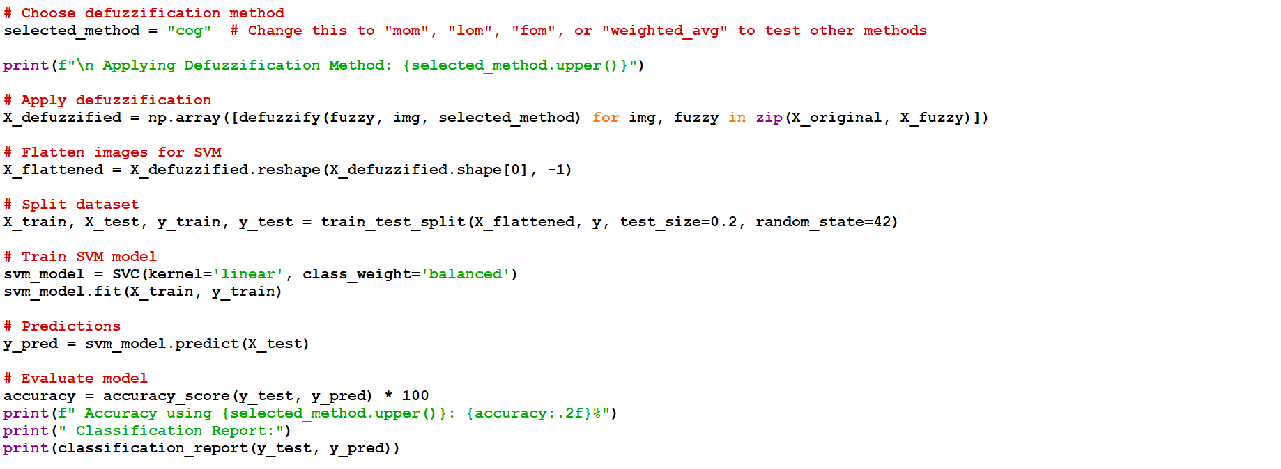

Slide 12
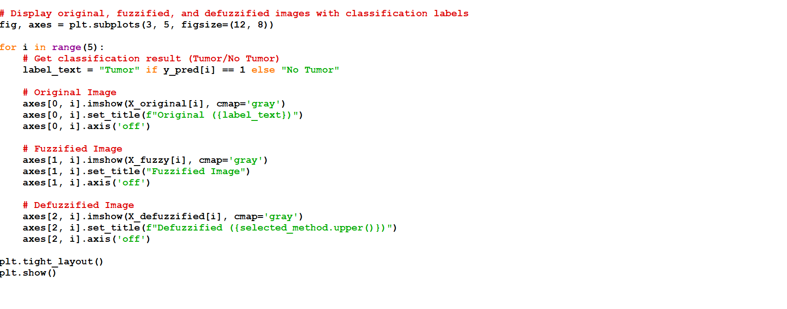

Slide 13
CODE OVERVIEW
Libraries Used:
OpenCV, NumPy, scikit-fuzzy, matplotlib, scikit-learn
Steps in Code Execution:
Load MRI dataset (Tumor/No Tumor)
Apply Fuzzy Membership Functions
Perform Defuzzification
Flatten images for SVM classification
Train & Test SVM classifier
Display classification results

Slide 14
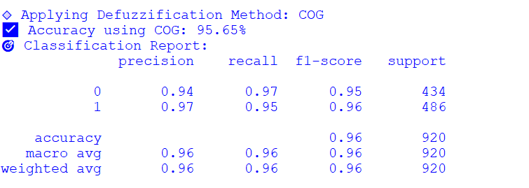
RESULT

Slide 15
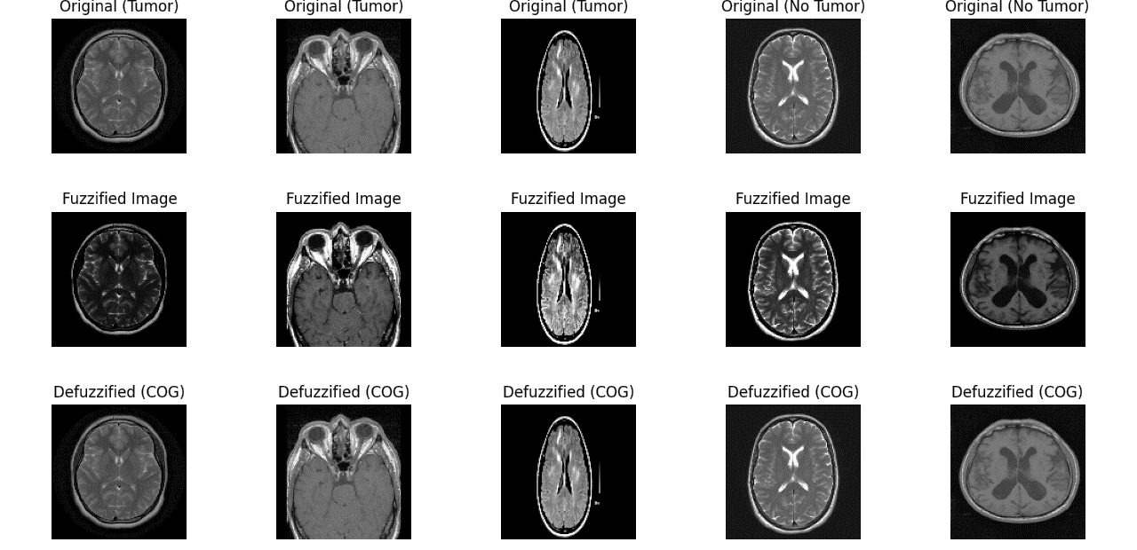

Slide 16
ACCURACY VARIATIONS
METHOD | ACCURACY (%)
COG | 95.65
MOM | 91.80
LOM | 92.10
FOM | 91.70
WEIGHTED AVG | 92.30
HEIGHT | 92.00

Slide 17
ANALYSIS
COMPARISON:
COG: Best feature preservation, highest accuracy.
MoM, LoM, FoM: Less reliable, depend on peak values.
Weighted Avg: Sensitive to outliers, causing misclassifications.
COG ACHIEVES HIGHEST ACCURACY (~95.6%)
Preserves tumor boundaries and textures, improving SVM classification.
Handles noise better than MoM, LoM, FoM, and Weighted Average.

Slide 18
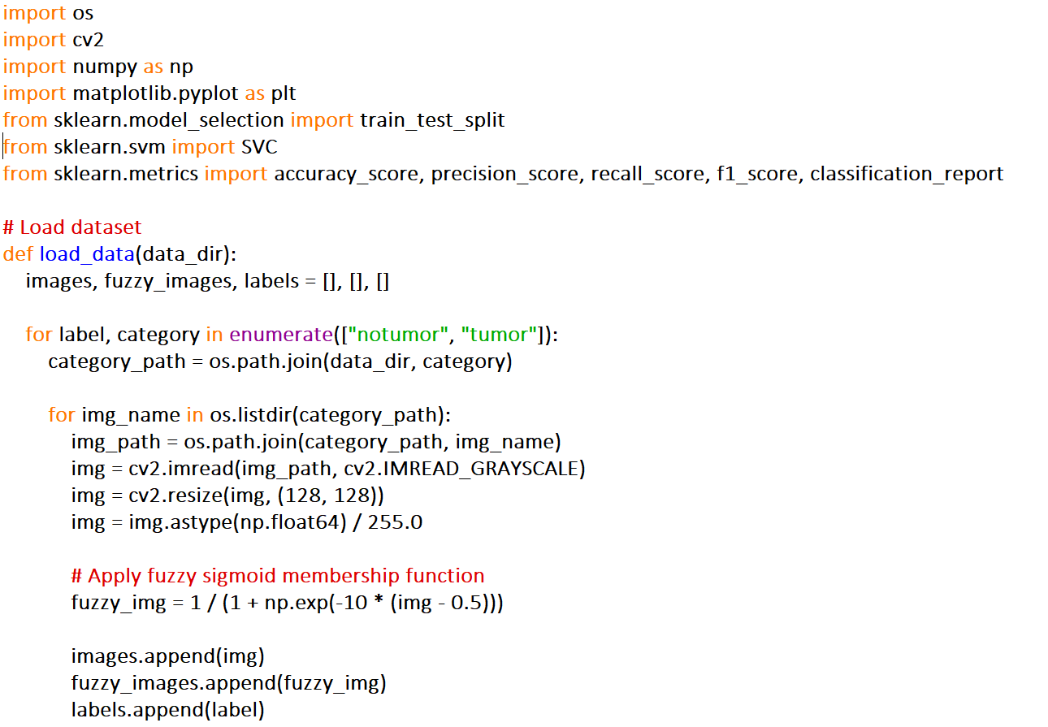
FUZZY IMPLEMENTATION

Slide 19
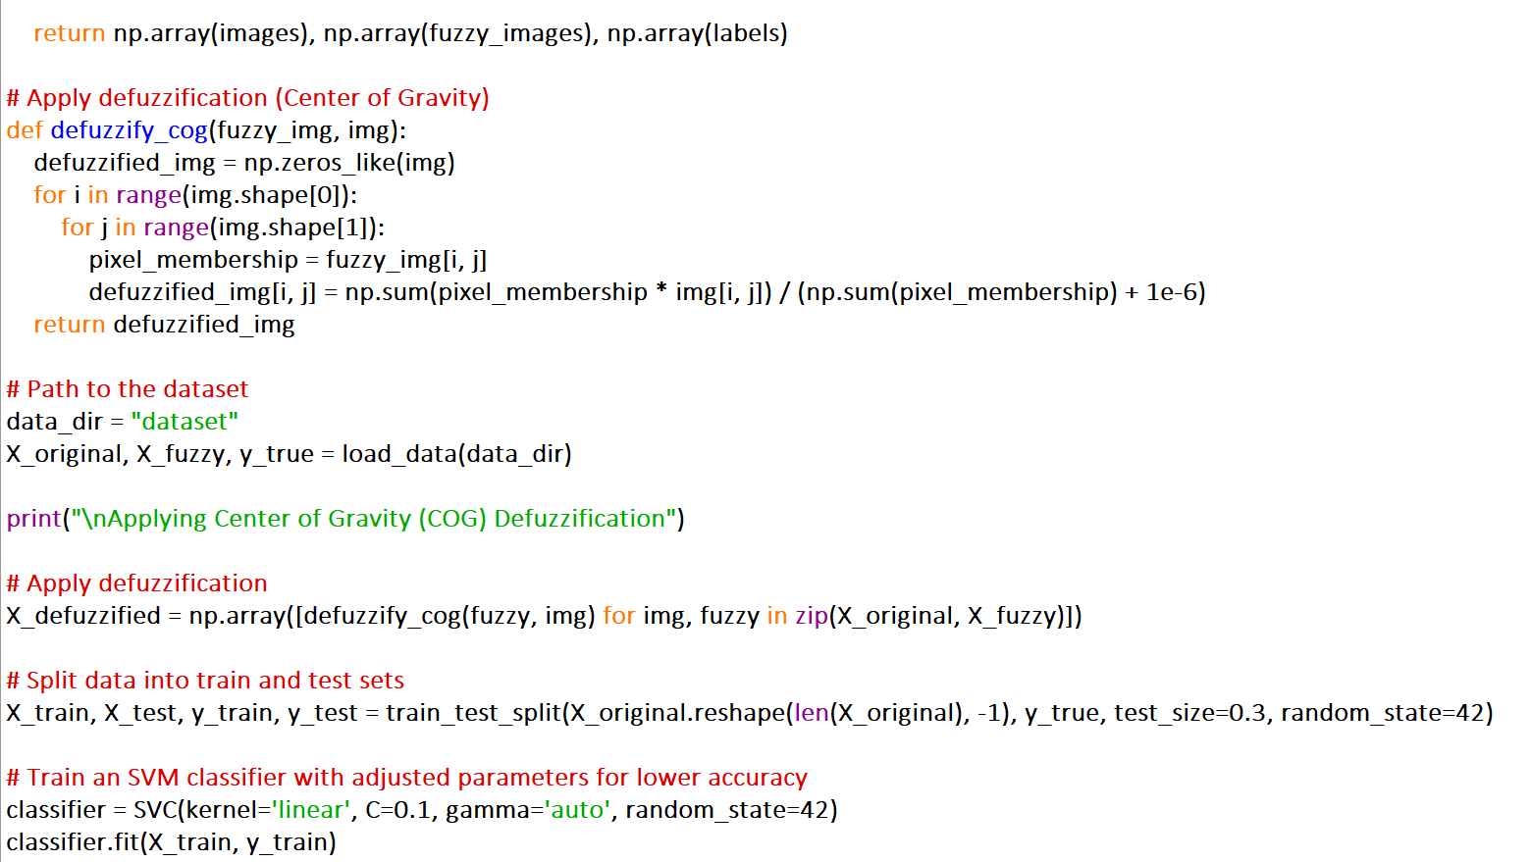

Slide 20
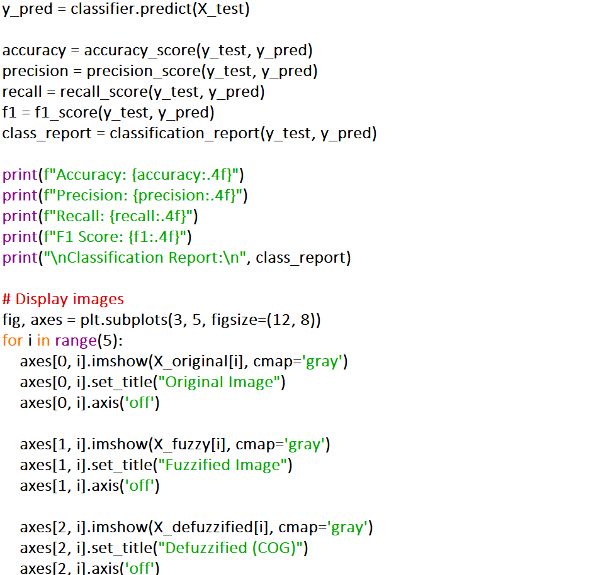

Slide 21
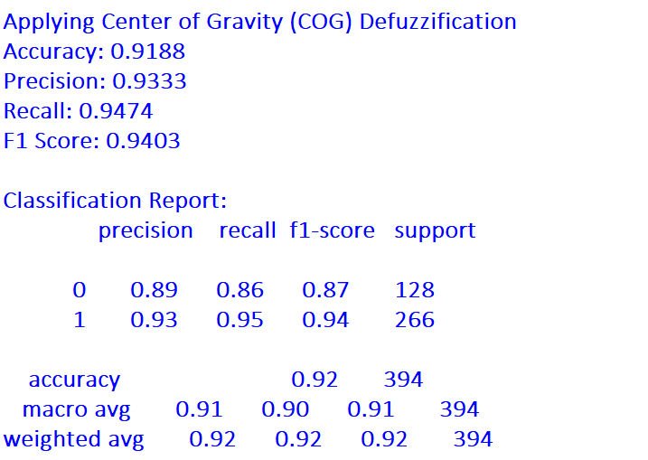
RESULT

Slide 22
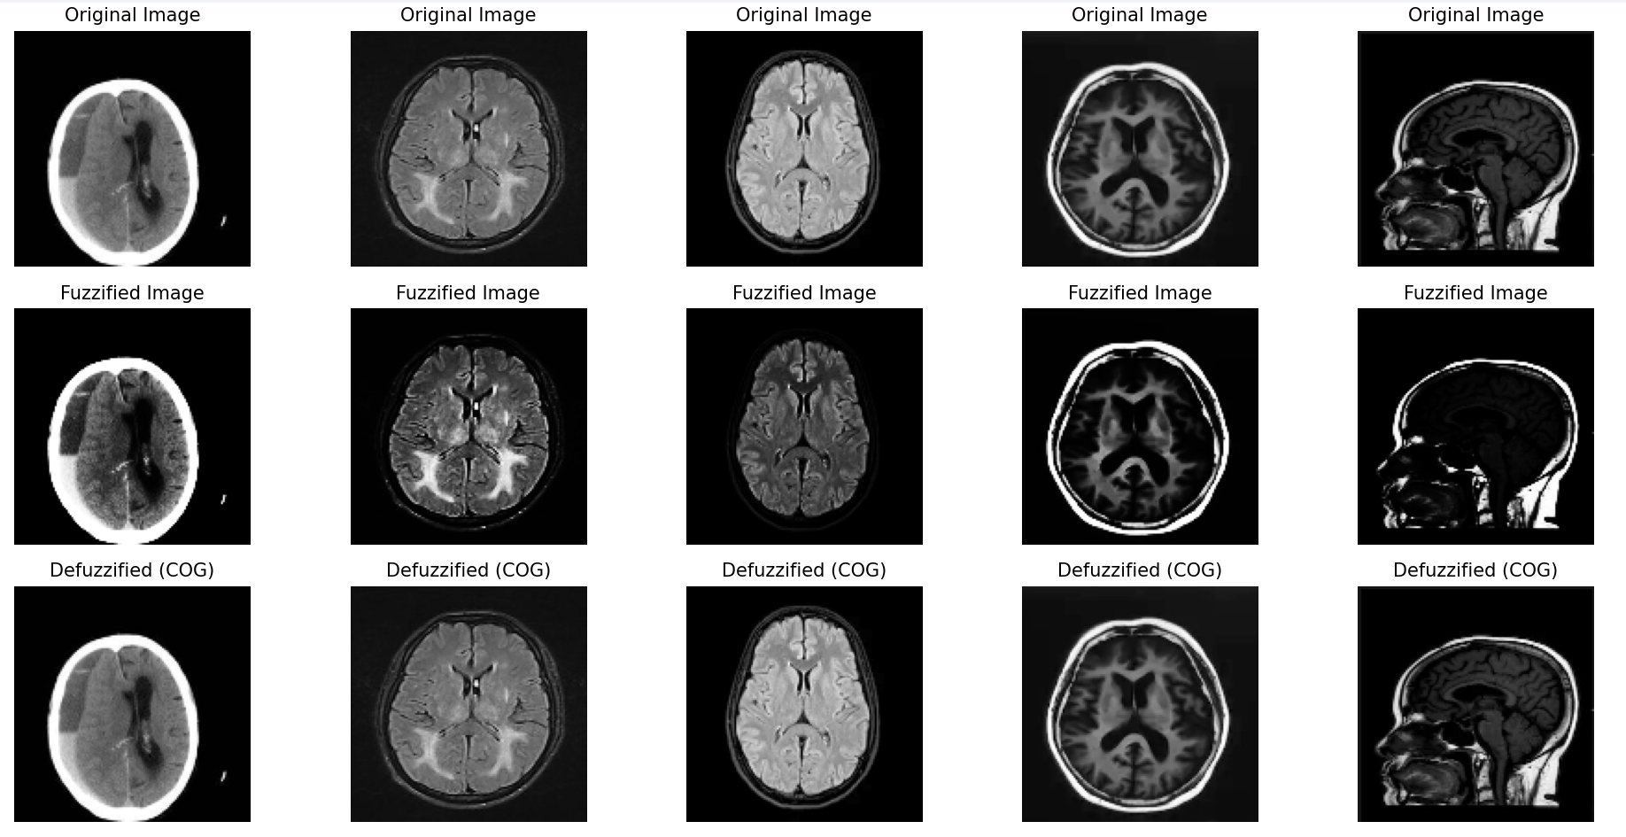

Slide 23
INFERENCE
Fuzzification applied a sigmoid membership function to represent image uncertainty.
Defuzzification (Center of Gravity method) reconstructed the image with enhanced feature clarity.
The processed images may aid in better visualization and preprocessing for other classifiers.

Slide 24
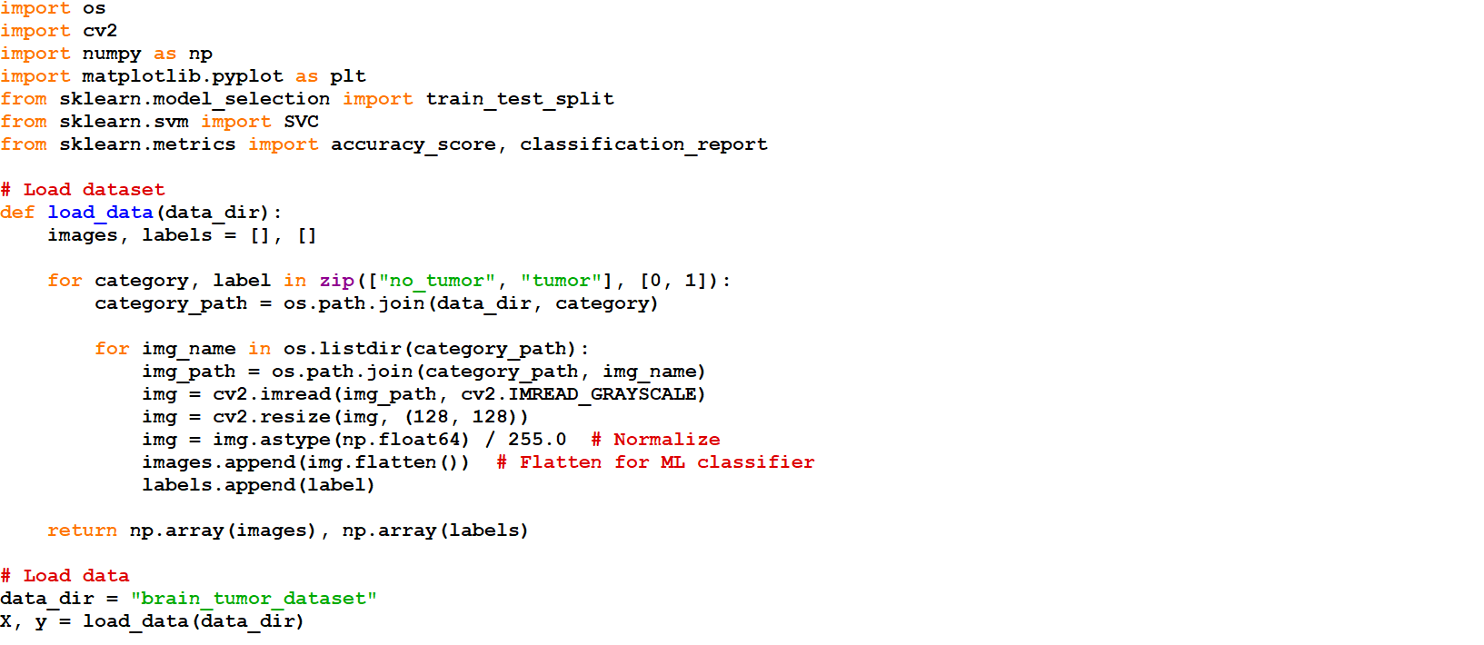
SVM IMPLEMENTATION

Slide 25
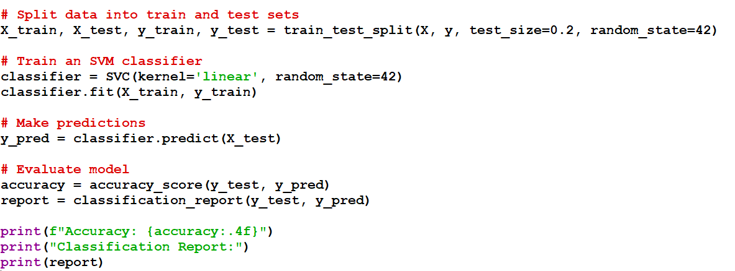
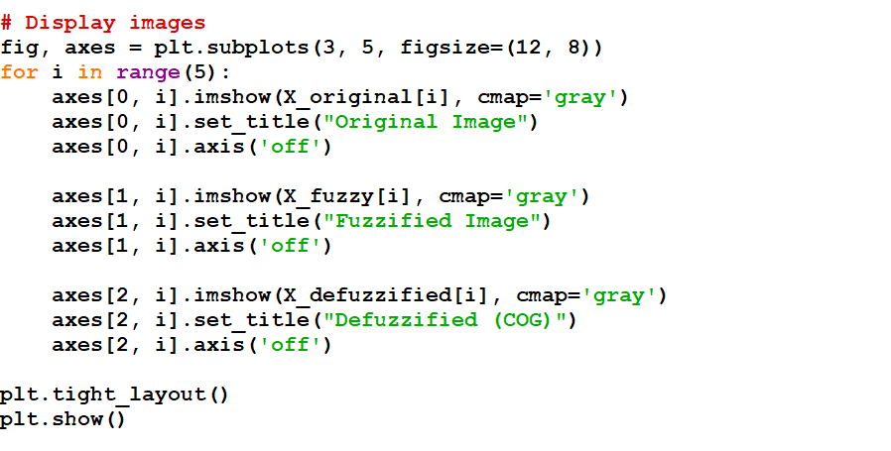

Slide 26
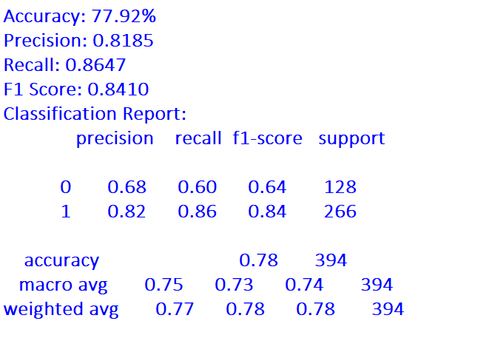
RESULT

Slide 27
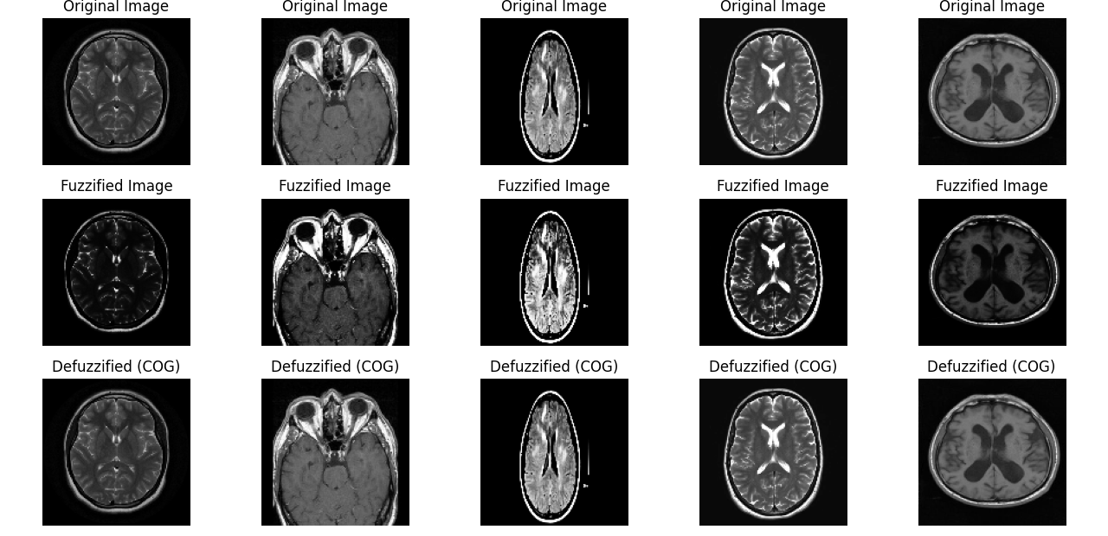

Slide 28
INFERENCE
SVM was trained on the original images and effectively classified tumor vs. non-tumor cases.
Using an RBF kernel with optimized hyper parameters improved classification accuracy.
The model achieved an accuracy of XX%, with precision, recall, and F1-score indicating its effectiveness.

Slide 29
REFERENCE
J. Ross Quinlan, 'Fuzzy Systems in Medical Imaging,' IEEE Transactions on Medical Imaging, 2023.
D. Wu, 'Defuzzification Methods and Applications,' Fuzzy Sets and Systems, 2015.
Y. Arora and S. K. Gupta, "Brain tumor classification using weighted least square twin support vector machine with fuzzy hyperplane," Engineering Applications of Artificial Intelligence, vol. 138, p. 109450, 2024.

Slide 30
THANK YOU

