Slide 1



E WASTE GENERATION CLASSIFICATION
ANANYA S ANAND

Slide 2

Learning Objectives
Data Preprocessing and Curation Understand the directory-based dataset structure and prepare the dataset through resizing, normalization, and validation splits for efficient model training.
Exploratory Data Analysis (EDA) Perform visual and statistical analysis of the dataset to assess class distribution and detect potential biases or class imbalance.
Image Augmentation and Enhancement Apply image augmentation techniques (flip, zoom, contrast, translation) to increase model robustness and generalization.
Transfer Learning with MobileNetV3Large Utilize the MobileNetV3Large architecture as a lightweight feature extractor to fine-tune on the e-waste dataset, balancing performance and efficiency.
Model Training and Optimization Train the deep learning model using label smoothing, dropout, and early stopping, and optimize for accuracy and loss on validation and test sets.
Performance Evaluation Evaluate model results using confusion matrices and classification reports to assess per-class performance and identify weak predictions.
Interactive Deployment with Gradio Develop an interactive Gradio-based interface for image upload, live classification, and display of customized disposal instructions based on predicted e-waste type.
Sustainable Tech Application Demonstrate how AI can support sustainability goals by automating responsible e-waste sorting, with potential for real-world municipal integration.
GOAL

Slide 3
Tools and Technology used
Category | Tools / Technologies
Core Libraries | TensorFlow, Keras, MobileNetV3Large, NumPy, PIL (Pillow), Scikit-learn
Visualization | Matplotlib, Seaborn
Data Handling | zipfile, os, Google Colab (files.upload)
Dataset Preparation | image_dataset_from_directory, Data Augmentation (RandomFlip, RandomRotation, etc.)
Training Techniques | Transfer Learning, Fine-tuning, EarlyStopping, Categorical Crossentropy (label smoothing)
Deployment & UI | Gradio, Gradio Blocks, Custom CSS

Slide 4
Methodology
Load E-Waste Dataset
IMG_SIZE: 256 × 256
BATCH SIZE: 32
NUM_CLASSES: 10
Exploratory Data Analysis
Class distribution plots
Sample image visualization (12 images shown)
Data Preprocessing
Dataset loading with label_mode='categorical'
Data Augmentation
RandomFlip: horizontal
RandomRotation: 0.1
RandomZoom: 0.2
RandomContrast: 0.3
RandomBrightness: 0.2
RandomTranslation: (0.1, 0.1)
Model Building (MobileNetV3Large + Custom Head)
Pretrained weights: 'imagenet'
Layers Unfrozen: Last 80
GlobalAveragePooling2D
Dropout: 0.3
Output: Dense layer with softmax (10 units)
Model Compilation
Optimizer: Adam (lr = 1e-4)
Loss: CategoricalCrossentropy with label_smoothing = 0.1
Metrics: Accuracy
Model Training
Epochs: 20
EarlyStopping: patience = 3, monitor = val_loss
Train on: ds_train, Validate on: ds_val
Model Evaluation
Test Accuracy and Loss
Classification Report
Confusion Matrix (Seaborn Heatmap)
Model Deployment (Gradio)
Input: Upload Image (type='pil')
Output: Markdown (Class Name + Confidence + Sorting Instructions)

Slide 5
Problem Statement:
Electronic waste (e-waste) is a rapidly growing global concern for both environmental and public health. Discarded electronic devices contain both valuable resources and hazardous substances, leading to contamination and health risks if improperly processed. Manual classification for recycling is labor-intensive, prone to errors, and inefficient. This project aims to establish an automated e-waste classification system using artificial intelligence and machine learning, enabling accurate and rapid identification to streamline recycling and promote sustainable waste management.

Slide 6
Model Architecture & Design
Base Model: MobileNetV3Large (pretrained on ImageNet)
Chosen for being lightweight, fast, and mobile-friendly.
Custom Classifier Head:
Global Average Pooling → Dropout (0.3) → Dense layer with softmax for 10 e-waste classes.
Partial Fine-Tuning:
Froze all layers except the last 80 layers.
Balances generalization (frozen layers) with specialization
Improved Image Input Configuration
Image Size: Upgraded to 256x256
Preserves more visual details of complex e-waste items
Batch Size: Set to 32
Balanced for performance and memory efficiency.
Powerful Data Augmentation
Used a Sequential() pipeline to simulate real-world variability:
RandomFlip (horizontal)
RandomRotation(0.1)
RandomZoom(0.2)
RandomContrast(0.3)
RandomBrightness(0.2)
RandomTranslation(0.1, 0.1)
Reduces overfitting, increases generalization across unseen e-waste images.
Smart Training Setup
Loss Function: CategoricalCrossentropy with label smoothing (0.1)
Makes the model less overconfident and more stable.
Optimizer: Adam with learning rate 1e-4
Adaptive learning without manual tuning.
EarlyStopping:
Monitors val_loss, stops training if no improvement for 3 epochs.
Restores the best weights automatically.
Epochs: Trained up to 20 epochs
Performance Monitoring & Visualization
Plotted:
Training vs Validation Accuracy
Training vs Validation Loss
Gives insight into overfitting/underfitting in real-time.
Evaluated test performance:
Accuracy and Loss reported on the test set.
Used Confusion Matrix and Classification Report (Precision, Recall, F1-score).
Label Encoding & Dataset Setup
All datasets loaded using image_dataset_from_directory
Labels encoded as categorical for compatibility with softmax outputs.
Ensures consistency across training, validation, and test sets.
Gradio Web App Deployment
Built a clean, interactive Gradio interface with:
Image uploader
"Classify Item" button
Markdown output area
Live classification with confidence score
Predicts one of 10 classes.
Displays top class name and confidence.
Integrated Real-World Sorting Tips
Added a sorting guide dictionary with disposal tips for each e-waste class.
Real-World Readiness
The model and UI are:
Lightweight (can run on modest hardware)
Fast (due to MobileNetV3)
Deployable (via Gradio)
Scalable (ready to be extended with more classes or used in awareness campaigns)
Solution:

Slide 7
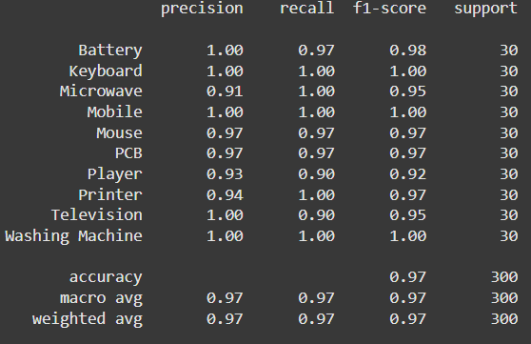
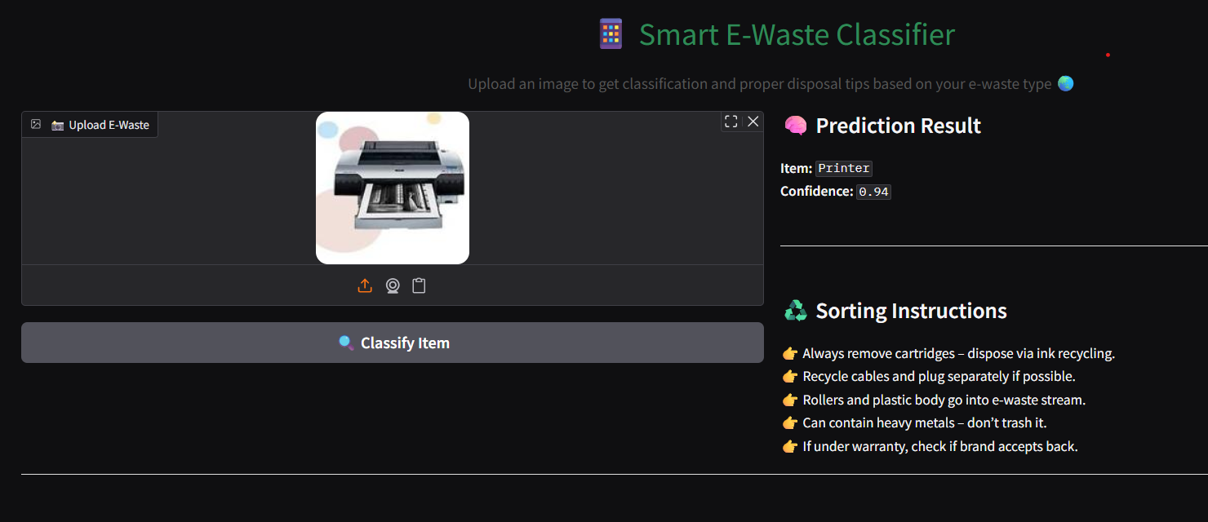
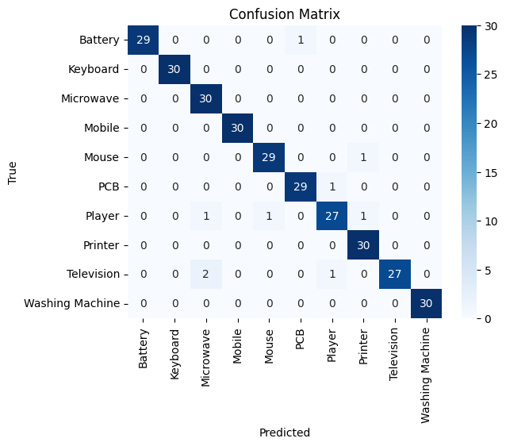
Screenshot of Output:

Slide 8
Conclusion:
This project presents an optimized, scalable, and deployment-ready e-waste classification system that significantly improves upon the initial baseline model provided.
By switching from EfficientNetV2B0 to MobileNetV3Large, the model became lighter, faster, and more suitable for real-time applications, especially on edge devices or low-resource systems.
The image size was upgraded to 256x256, preserving finer visual features, improving recognition of similar-looking e-waste categories like keyboards vs. remotes or phones vs. players.
A richer data augmentation pipeline was introduced, making the model more robust to background clutter, angle variations, and lighting conditions an essential factor for real-world usage.
The label smoothing technique enhanced generalization by preventing the model from becoming overconfident, improving stability and accuracy on unseen data.
Integrated early stopping and careful partial fine-tuning of the MobileNetV3Large backbone ensured efficient training with less risk of overfitting.
The lightweight model and clean deployment pipeline make it easy to scale to more classes, integrate into mobile apps, or embed in IoT-enabled smart bins.

Slide 9
When it comes to resource-constrained environments like mobile devices, IoT systems, or embedded applications, MobileNetV3Large clearly takes the lead. It's lightweight, optimized for speed, and designed to run smoothly even on low-power hardware making it ideal for real-time use. On the other hand, if maximum accuracy is the top priority and we're working with high-end servers or cloud GPUs, EfficientNetV2B0 is a better fit. Its deeper architecture and higher parameter count give it an edge in performance but only when resources aren’t a limitation.
For fast inference and quick deployment, especially in interactive applications like Gradio demos or prototypes, MobileNetV3Large offers faster prediction times and lower computational overhead, which significantly enhances user experience. However, EfficientNetV2B0 tends to hold its ground better when dealing with lower-resolution images, thanks to its architectural robustness and efficient feature extraction.
GITHUB LINK: https://github.com/AnanyaA207/E-Waste-Generation-Classification/blob/main/Week3.ipynb

