Slide 1
EMPLOYEE SALARY PREDICTION
CAPSTONE PROJECT
Presented By:
Ananya S Anand – PSG College of Technology

Slide 2
OUTLINE
Problem Statement
System Development Approach
Algorithm & Deployment
Result
Conclusion
Future Scope
References

Slide 3
Problem Statement
Software developer salaries vary significantly across countries, educational backgrounds, and levels of experience. This inconsistency creates challenges for job seekers, recruiters, and organizations trying to make informed decisions. Without reliable insights, predicting fair compensation becomes difficult. There is a need to analyze patterns in global salary trends to better understand the key factors influencing developer pay.

Slide 4
System Approach
System Requirements
Operating System: Windows/Linux/MacOS
Processor: Intel i5 or above
RAM: Minimum 4 GB
Python Version: 3.8 or above
Browser: Chrome, Firefox, or Edge
Libraries Required
streamlit – for building the web app interface
numpy – for numerical operations
pandas – for data handling and analysis
matplotlib & seaborn – for data visualization
scikit-learn – for preprocessing, training, and model evaluation
pickle – for model serialization and loading

Slide 5
Algorithm & Deployment
1. Data Collection:
Key Columns Used:
CountryEdLevel (Education Level)
YearsCodePro (Years of Professional Experience)
Employment
ConvertedComp → renamed to Salary
2. Data Preprocessing:
Removed rows with:
NaN values in critical fields
Missing or zero salary values
Employment type ≠ "Employed full-time“
Outlier Removal:
Salary kept between $10,000 and $250,000
Removed rows with country = “Other” (based on frequency cutoff)
3. Feature Engineering
Country and EdLevel:
Cleaned and grouped categories
Label Encoded using LabelEncoder
YearsCodePro:
Converted textual responses like "More than 50 years" → 50“
Less than 1 year" → 0.5

Slide 6
4. Model Training & Evaluation
Models Used:
Linear Regression
Decision Tree Regressor
Forest Regressor
Hyperparameters (Random Forest / Decision Tree):
Tuned using GridSearchCV
Evaluation Metric:
Root Mean Squared Error (RMSE) used for all models.
Final model selected based on lowest RMSE after tuning.
5. Model Serialization
Pickled the best model and encoders
6. Inference on New Data
Input sample transformed using label encoders

Slide 7
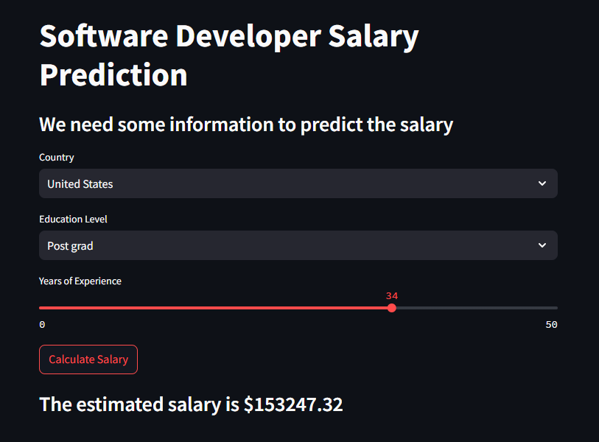
Result
https://github.com/AnanyaA207/Employee-Salary-Prediction

Slide 8
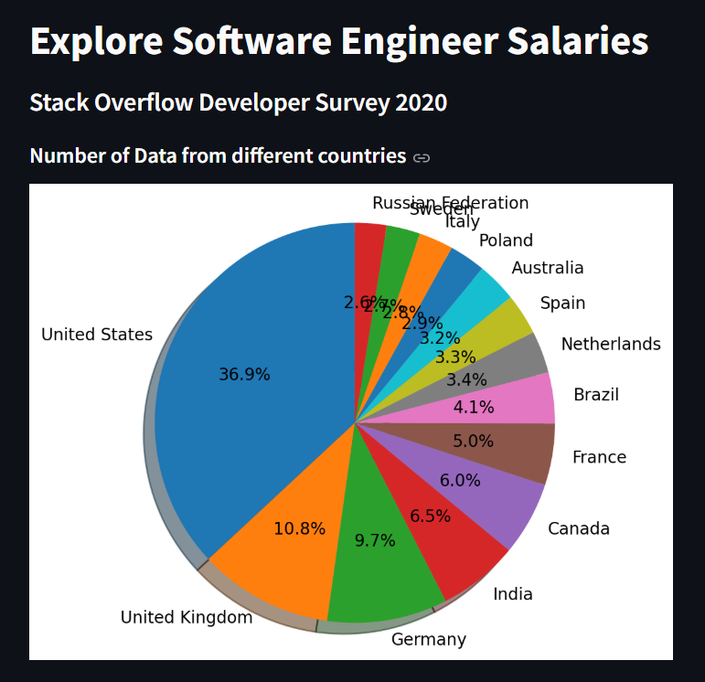

Slide 9
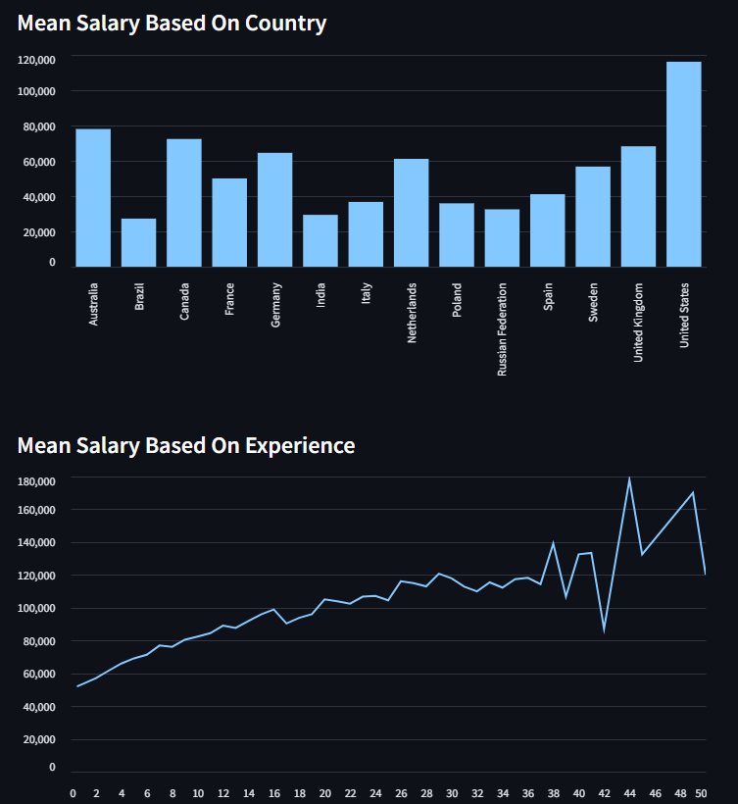

Slide 11
Conclusion
The project successfully built a machine learning model that predicts software developer salaries based on factors like education, country, and experience. The DecisionTreeRegressor model, deployed via Streamlit, provides quick and interpretable predictions. Label encoding ensured categorical features were machine-readable, and saved models improved reusability.
The proposed system performed well on the dataset, showing promising accuracy and responsiveness. However, challenges included model generalization due to limited diversity in training data, and compatibility issues when loading pickled models from different scikit-learn versions.
To improve the solution, we could:
Use a more robust regression model (e.g., RandomForest or XGBoost)
Apply Bayesian optimization for hyperparameter tuning
Include additional features like company size or job role
Update the dataset regularly to reflect evolving salary trends

Slide 12
Future scope
Incorporate More Features: Future versions can include variables like job title, industry domain, company size, and remote vs on-site work status for more precise predictions.
Advanced Algorithms: Models like XGBoost, CatBoost, or ensemble methods can be introduced to improve prediction accuracy and reduce overfitting.
Global Generalization: Expanding the dataset to include broader geographies and diverse job markets would make the system more universally applicable.
Hyperparameter Optimization: Integration of Bayesian optimization or grid search techniques can fine-tune the model for peak performance.
Interactive Dashboard: Creating a more dynamic user interface with filters, graphs, and export options would enhance usability for HR teams and job seekers.

Slide 13
References
“Salary Prediction Using Machine Learning” – Malaiarasan et al. (2025) A recent study using Stack Overflow Developer Survey data, employing regression models and a Streamlit-based web interface to predict software developer compensation based on demographics and experience. “Statistical Machine Learning Regression Models for Salary Prediction” – MDPI (2021) Large-scale analysis of economics‑wide pay levels using machine learning regressions, incorporating features like occupation type, organization size, and job classification.

Slide 14
THANK YOU

