Slide 1

Oblivious Single Access Machines: A New Model for Oblivious Computing
Ananya Appan, David Heath, Ling Ren

Slide 2


Secure Memory Outsourcing
client
server
…

Slide 3



Secure Memory Outsourcing
client
server
Revealing access patterns
May leak sensitive information
…

Slide 4

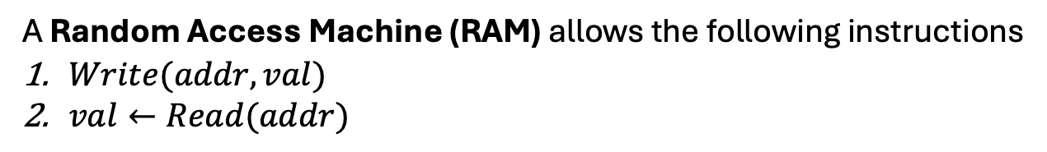
Oblivious RAM
A Random Access Machine (RAM) allows the following instructions
$Write(addr,val)$
$val←Read(addr)$
An Oblivious Random Access Machine (ORAM) only leaks the number of instructions
…
client
ORAM (compiler)
server

Slide 5


Oblivious RAM
A Random Access Machine (RAM) allows the following instructions
$Write(addr,val)$
$val←Read(addr)$
An Oblivious Random Access Machine (ORAM) only leaks the number of instructions
5
…
Simulator
server

Slide 6
Oblivious RAM
A Random Access Machine (RAM) allows the following instructions
$Write(addr,val)$
$val←Read(addr)$
An Oblivious Random Access Machine (ORAM) only leaks the number of instructions
Cost Metrics
Blowup
Rounds
…
client
ORAM (compiler)
server

Slide 7


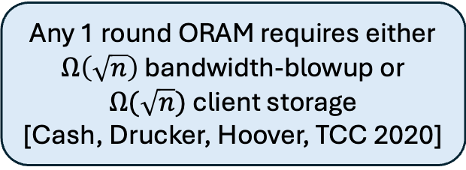
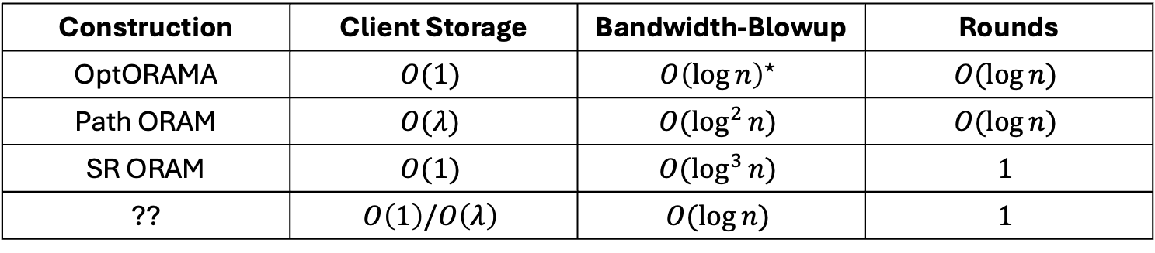
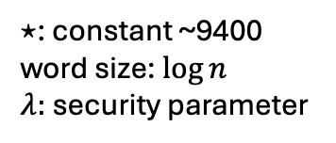
Existing ORAM Constructions
Construction | Client Storage | Bandwidth-Blowup | Rounds
OptORAMA | $$O(1)$$ | $$O{\left(\log{n}\right)}^{⋆}$$ | $$O(\log{n})$$
Path ORAM | $$O(λ)$$ | $$O(\log^{2}{n})$$ | $$O(\log{n})$$
SR ORAM | $$O(1)$$ | $$O(\log^{3}{n})$$ | $$1$$
?? | $$O\left(1\right)/O\left(λ\right)$$ | $$O(\log{n})$$ | $$1$$
$⋆$: constant ~9400
word size: $\log{n}$
$λ:$security parameter
Any 1 round ORAM requires either $Ω\left(\sqrt{n}\right)$ bandwidth-blowup or $Ω(\sqrt{n})$ client storage
[Cash, Drucker, Hoover, TCC 2020]
Consider a new model of computation!

Slide 8
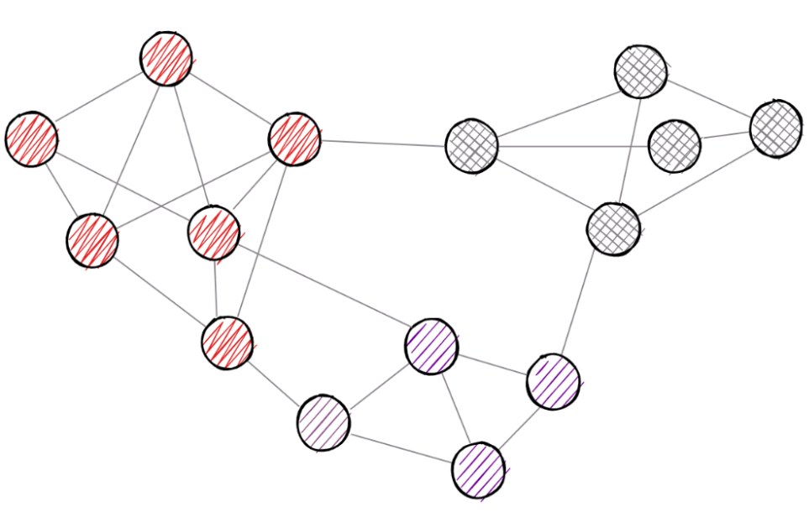
Roadmap
More Efficient Oblivious Algorithms
Smart (Oblivious) Pointers
12
Oblivious Single Access Machine

Slide 9
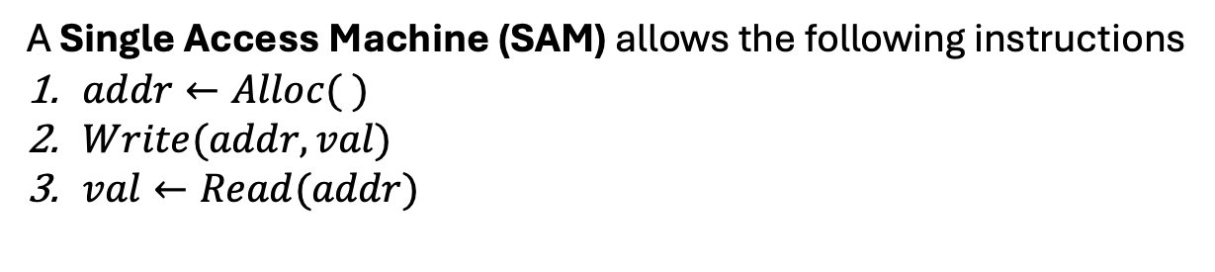
Oblivious Single Access Machine (OSAM)
A Single Access Machine (SAM) allows the following instructions
$addr←Alloc( )$
$Write(addr,val)$
$val←Read(addr)$
With two restrictions
Every address must first be allocated
Every address is read at most once and written at most once
An Oblivious Single Access Machine (OSAM) only leaks the number of non-Alloc operations
…
client
OSAM (compiler)
server

Slide 10
Oblivious Single Access Machine (OSAM)
A Single Access Machine (SAM) allows the following instructions
$addr←Alloc( )$
$Write(addr,val)$
$val←Read(addr)$
With two restrictions
Every address must first be allocated
Every address is read at most once and written at most once
An Oblivious Single Access Machine (OSAM) only leaks the number of non-Alloc operations
5
…
Simulator
server

Slide 11



Valid SAM Programs
$Write\left(addr,val\right)$
$val←Read(addr)$
$addr←Alloc\left(\right)$
$Write\left(addr, val\right)$
$val←Read(addr)$
Every address must be allocated first!

Slide 12

Valid SAM Programs
$addr←Alloc()$
$Write\left(addr, val\right), val←Read\left(addr\right)$
$Write\left(addr,val\right), Read\left(addr\right)$
$addr_{1}←Alloc()$
$Write\left(addr_{1}, val\right), val←Read\left(addr_{1}\right)$
$addr_{2}←Alloc()$
$Write\left(addr_{2},val\right), Read\left(addr_{2}\right)$
Every address can be written/read at most once!

Slide 13

Valid SAM Programs
$addr←Alloc()$
$?←Read\left(addr\right)$
Okay to read an unwritten address!

Slide 14

Valid SAM Programs
$addr←Alloc()$
$None←Read\left(addr\right)$
Okay to read an unwritten address!

Slide 15

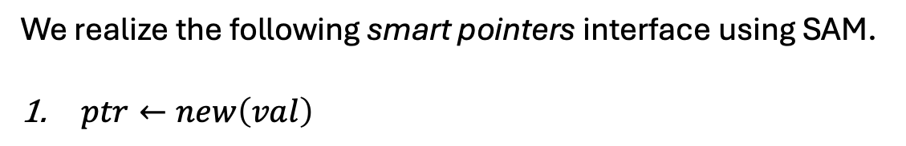

SAM is Useful for Pointer Programs
We realize the following smart pointers interface using SAM.
$ptr←new\left(val\right)$
$$p$$
$$val$$

Slide 16
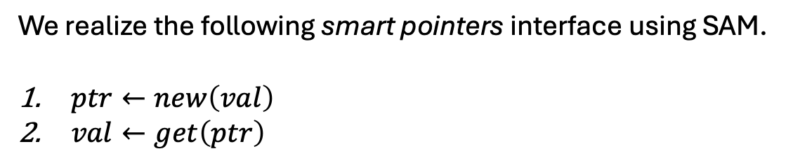
SAM is Useful for Pointer Programs
We realize the following smart pointers interface using SAM.
$ptr←new\left(val\right)$
$val←get\left(ptr\right)$
$$p$$
$$val$$

Slide 17

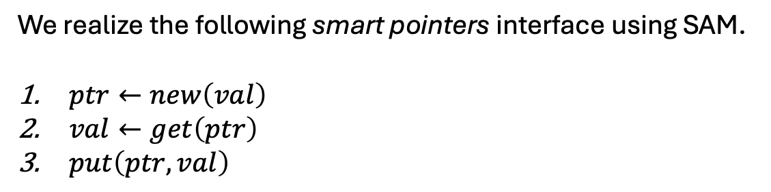
SAM is Useful for Pointer Programs
We realize the following smart pointers interface using SAM.
$ptr←new\left(val\right)$
$val←get\left(ptr\right)$
$put\left(ptr,val\right)$
$$p$$
$$val′$$

Slide 18
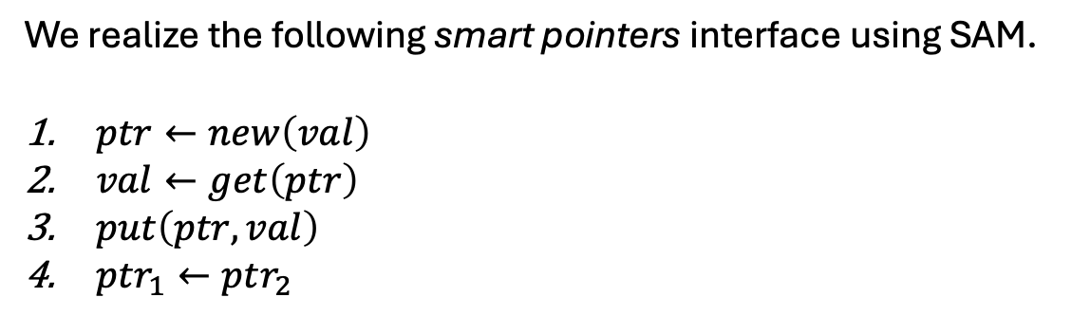

SAM is Useful for Pointer Programs
We realize the following smart pointers interface using SAM.
$ptr←new\left(val\right)$
$val←get\left(ptr\right)$
$put\left(ptr,val\right)$
$ptr_{1}←ptr_{2}$
$$p$$
$$val′$$
$$q$$

Slide 19
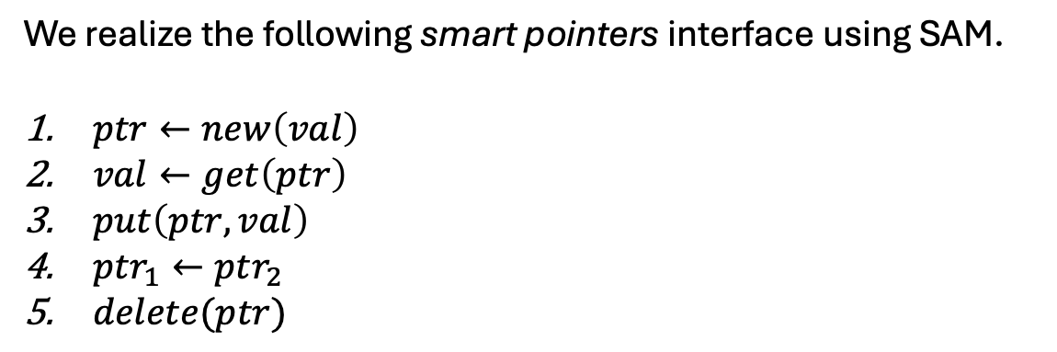
SAM is Useful for Pointer Programs
We realize the following smart pointers interface using SAM.
$ptr←new\left(val\right)$
$val←get\left(ptr\right)$
$put\left(ptr,val\right)$
$ptr_{1}←ptr_{2}$
$delete(ptr)$
$$val′$$
$$q$$

Slide 20
SAM is Useful for Pointer Programs
We realize the following smart pointers interface using SAM.
$ptr←new\left(val\right)$
$val←get\left(ptr\right)$
$put\left(ptr,val\right)$
$ptr_{1}←ptr_{2}$
$delete(ptr)$
$$val′$$
$$q$$
Doubly Linked Lists, Splay Trees, Tries, Graphs,…..
Notes:
Repeatedly dereference pointers

Slide 21
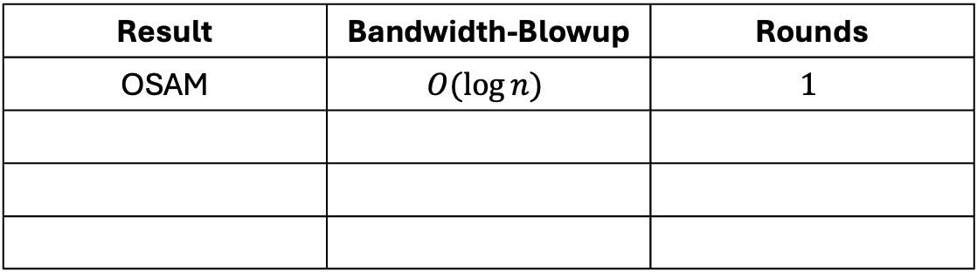
Our Results
Result | Bandwidth-Blowup | Rounds
OSAM | $$O(\log{n})$$ | $$1$$

Slide 22



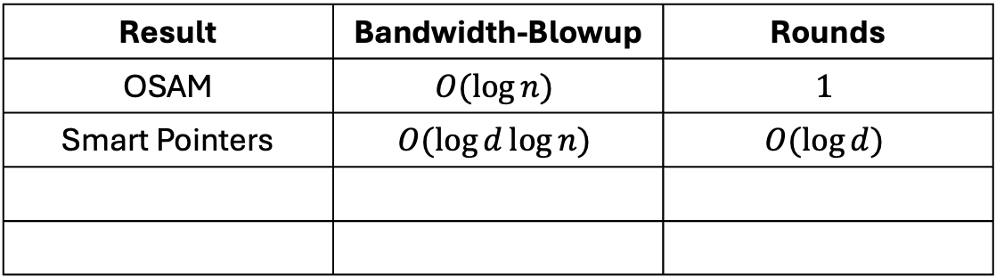


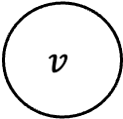
Our Results
Result | Bandwidth-Blowup | Rounds
OSAM | $$O(\log{n})$$ | $$1$$
Smart Pointers | $$O(\log{d}\log{n})$$ | $$O(\log{d})$$
$$p2$$
$$p3$$
$$p1$$
…
$$pd$$
$$v$$
$d$: No. of shared pointers

Slide 23
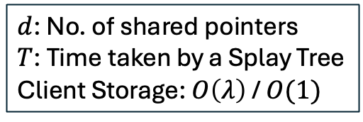
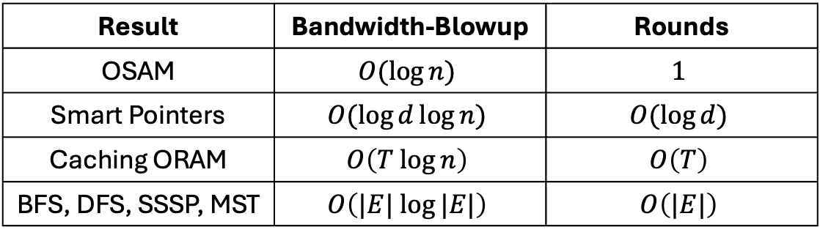
Our Results
Result | Bandwidth-Blowup | Rounds
OSAM | $$O(\log{n})$$ | $$1$$
Smart Pointers | $$O(\log{d}\log{n})$$ | $$O(\log{d})$$
Caching ORAM | $$O\left(T log{n}\right)$$ | $$O\left(T\right)$$
BFS, DFS, SSSP, MST | $$O\left(|E| log{|E|}\right)$$ | $$O\left(|E|\right)$$
$$p2$$
$$p3$$
$$p1$$
…
$$pd$$
$$v$$
$d$: No. of shared pointers
$T$: Time taken by a Splay Tree
Client Storage: $O\left(λ\right)$ / $O(1)$

Slide 24
Roadmap
More Efficient Oblivious Algorithms
Smart (Oblivious) Pointers
12
Oblivious Single Access Machine

Slide 25


Path ORAM
$$Read(1)$$
$$ReadPath(3)$$
client
ORAM
server
original | 1 | 2 | 3 | 4
mapped | 3 | 2 | 3 | 1

Slide 26


Path ORAM
$$Read(1)$$
$$ReadPath(3)$$
$$val$$
$$path$$
client
ORAM
server
original | 1 | 2 | 3 | 4
mapped | 3 | 2 | 3 | 1

Slide 27


Path ORAM
$$Write(4,val)$$
client
ORAM
server
original | 1 | 2 | 3 | 4
mapped | 4 | 2 | 3 | 1

Slide 28

Path ORAM
$$Read(1)$$
$$ReadPath(4)$$
$$val$$
$$path$$
client
ORAM
server
original | 1 | 2 | 3 | 4
mapped | 4 | 2 | 3 | 1

Slide 29






Path ORAM
$$ReadPath(1)$$
$$path_{1}$$
$$Read(1)$$
$$ReadPath(1)$$
$$val$$
$$path_{2}$$
client
ORAM
$$ReadPath(4)$$
server
$$path_{3}$$

Slide 30






Path OSAM
$$Alloc()$$
$$addr$$
$$Write(leaf,val)$$
$$Write(addr,val)$$
client
OSAM
server
$$addr←ctr‖leaf$$

Slide 31


Path OSAM
$$Read(addr)$$
$$ReadPath(leaf)$$
client
OSAM
server
$$addr←ctr‖leaf$$

Slide 32


Path OSAM
$$Read(addr)$$
$$ReadPath(leaf)$$
$$val$$
$$path$$
client
OSAM
server
$$addr←ctr‖leaf$$

Slide 33
Path OSAM
$$Read(addr)$$
$$ReadPath(leaf)$$
$$val$$
$$path$$
client
OSAM
server
$$addr←ctr‖leaf$$
Every address is -
read at most once
freshly allocated

Slide 34
Roadmap
More Efficient Oblivious Algorithms
Smart (Oblivious) Pointers
12
Oblivious Single Access Machine

Slide 35

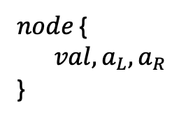
Pointers for (Unbalanced) Trees
$$a_{1}$$
$node$ {
$val, a_{L},a_{R}$
}
1
2
3
4
5

Slide 36
Pointers for (Unbalanced) Trees
$$a_{1}$$
1
2
3
4
5

Slide 37
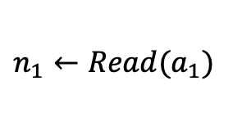
Pointers for (Unbalanced) Trees
$$a_{1}$$
1
$n_{1}←Read(a_{1})$
2
3
4
5

Slide 38


Pointers for (Unbalanced) Trees
$${a′}_{1}$$
1
$n_{1}←Read\left(a_{1}\right)$
$a_{1}^{′}←Alloc( )$
2
3
4
5

Slide 39
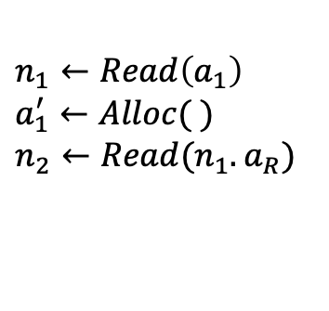
Pointers for (Unbalanced) Trees
$${a′}_{1}$$
1
2
$n_{1}←Read\left(a_{1}\right)$
$a_{1}^{′}←Alloc( )$
$n_{2}←Read(n_{1}.a_{R})$
3
4
5

Slide 40


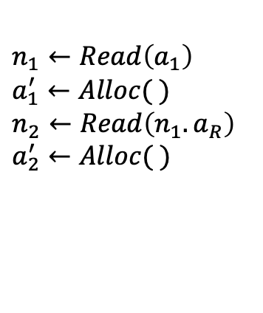
Pointers for (Unbalanced) Trees
$${a′}_{1}$$
$${a′}_{2}$$
1
2
$n_{1}←Read\left(a_{1}\right)$
$a_{1}^{′}←Alloc( )$
$n_{2}←Read\left(n_{1}.a_{R}\right)$
$a_{2}^{′}←Alloc( )$
3
4
5

Slide 41
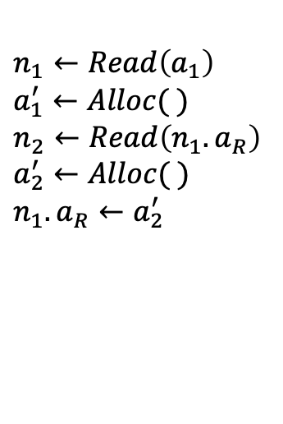
Pointers for (Unbalanced) Trees
$${a′}_{1}$$
$${a′}_{2}$$
1
2
$n_{1}←Read\left(a_{1}\right)$
$a_{1}^{′}←Alloc( )$
$n_{2}←Read\left(n_{1}.a_{R}\right)$
$a_{2}^{′}←Alloc( )$
$n_{1}.a_{R}←a_{2}^{′}$
3
4
5

Slide 42
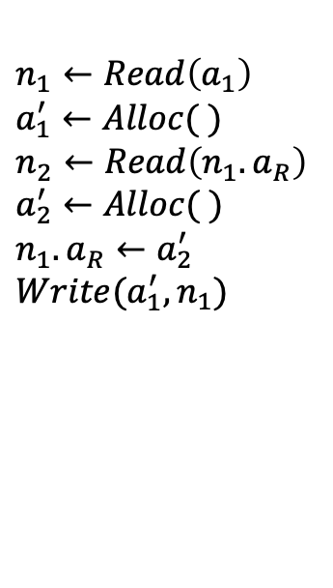
Pointers for (Unbalanced) Trees
$${a′}_{1}$$
$${a′}_{2}$$
2
1
$n_{1}←Read\left(a_{1}\right)$
$a_{1}^{′}←Alloc( )$
$n_{2}←Read\left(n_{1}.a_{R}\right)$
$a_{2}^{′}←Alloc( )$
$n_{1}.a_{R}←a_{2}^{′}$
$Write({a_{1}^{′},n}_{1})$
3
4
5

Slide 43
Pointers for (Unbalanced) Trees
$${a′}_{1}$$
$${a′}_{2}$$
2
3
1
4
5

Slide 44

Pointers for (Unbalanced) Trees
$${a′}_{1}$$
$${a′}_{2}$$
2
$${a′}_{3}$$
3
1
4
5

Slide 45
Pointers for (Unbalanced) Trees
$${a′}_{1}$$
$${a′}_{3}$$
3
1
2
4
5

Slide 46
Pointers for Graphs: Difficulty
1
2
3

Slide 47
Pointers for Graphs: Difficulty
1
2
3

Slide 48

Pointers for Graphs: Difficulty
1
2
3

Slide 49
Pointers for Graphs: Difficulty
1
2
3
Address held by 2 has
already been read

Slide 50
Pointers for Graphs: Difficulty
1
2
Cannot rebuild
entire graph!
3
Update pointers with the
new addresses of values

Slide 51

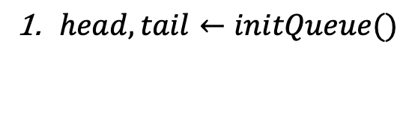

Building Block: Oblivious Message Queue
$head, tail←initQueue()$
$$head$$
$$tail$$

Slide 52



Building Block: Oblivious Message Queue
$head, tail←initQueue()$
$tail′←enqueue\left(tail,val\right)$
$$v_{1}$$
$$head$$
$$tail$$

Slide 53



Building Block: Oblivious Message Queue
$head, tail←initQueue()$
$tail′←enqueue\left(tail,val\right)$
$$v_{1}$$
$$v_{2}$$
$$head$$
$$tail$$

Slide 54


Building Block: Oblivious Message Queue
$head, tail←initQueue()$
$tail′←enqueue\left(tail,val\right)$
$$v_{1}$$
$$v_{2}$$
$$v_{3}$$
$$head$$
$$tail$$

Slide 55

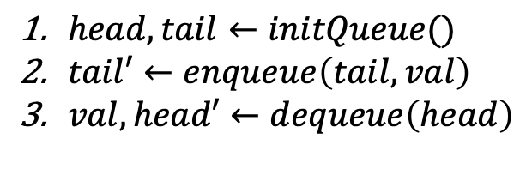
Building Block: Oblivious Message Queue
$head, tail←initQueue()$
$tail′←enqueue\left(tail,val\right)$
$val,head′←dequeue\left(head\right)$
$$v_{1}$$
$$v_{2}$$
$$v_{3}$$
$$head$$
$$tail$$

Slide 56

Building Block: Oblivious Message Queue
$head, tail←initQueue()$
$tail′←enqueue\left(tail,val\right)$
$val,head′←dequeue\left(head\right)$
$$v_{2}$$
$$v_{3}$$
$$head$$
$$tail$$

Slide 57


Building Block: Oblivious Message Queue
$head, tail←initQueue()$
$tail′←enqueue\left(tail,val\right)$
$val,head′←dequeue\left(head\right)$
$$v_{3}$$
$$head$$
$$tail$$

Slide 58

Building Block: Oblivious Message Queue
$head, tail←initQueue()$
$tail′←enqueue\left(tail,val\right)$
$val,head′←dequeue\left(head\right)$
$$head$$
$$tail$$

Slide 59

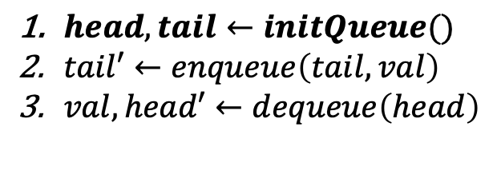
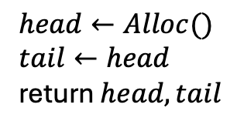
Building Block: Oblivious Message Queue
$head, tail←initQueue()$
$tail′←enqueue\left(tail,val\right)$
$val,head′←dequeue\left(head\right)$
SAM Program
$head←Alloc()$
$tail←head$
return $head, tail$
$$head$$
$$tail$$

Slide 60
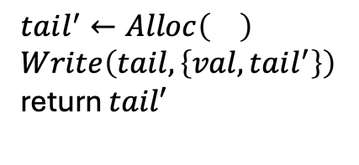
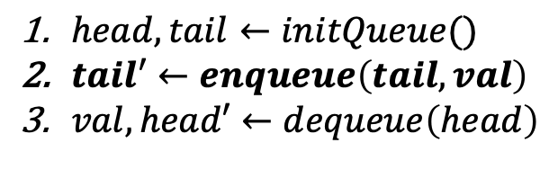
Building Block: Oblivious Message Queue
$head, tail←initQueue()$
$tail′←enqueue\left(tail,val\right)$
$val,head′←dequeue\left(head\right)$
SAM Program
$$v_{1}$$
$tail^{′}←Alloc\left(\right)$
$Write\left(tail,\left\{val,tail^{′}\right\}\right)$
return $tail′$
$$head$$
$$tail$$

Slide 61

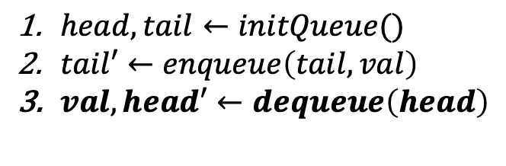
Building Block: Oblivious Message Queue
$head, tail←initQueue()$
$tail′←enqueue\left(tail,val\right)$
$val,head′←dequeue\left(head\right)$
SAM Program
$$v_{1}$$
$\text{return} Read\left(head\right)$
$$head$$
$$tail$$

Slide 62
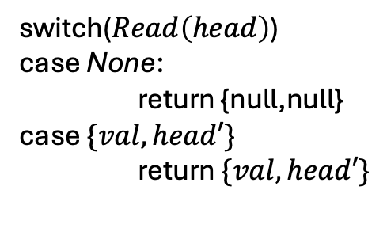

Building Block: Oblivious Message Queue
$head, tail←initQueue()$
$tail′←enqueue\left(tail,val\right)$
$val,head′←dequeue\left(head\right)$
SAM Program
switch($Read\left(head\right)$)
case None:
return {null,null}
case $\{val,head′\}$
return $\{val,head′\}$
$$head$$
$$tail$$

Slide 63


Dereferencing a Pointer
$$p$$
$$v$$

Slide 64
Dereferencing a Pointer
$$p$$
$$v$$

Slide 65

Dereferencing a Pointer
$$p$$
$$v$$

Slide 66

Dereferencing a Pointer
$$p$$
$$v$$

Slide 67
Dereferencing a Pointer
$$p$$
$$v$$

Slide 68
Dereferencing a Pointer
$$p$$
$$v$$

Slide 69
Dereferencing a Pointer
$$p$$
$$v$$

Slide 70
Dereferencing a Pointer
$$p$$
$$v$$

Slide 71
Dereferencing a Pointer
$$p$$
$$v$$

Slide 72
Dereferencing a Pointer
$$p$$
$$v$$

Slide 73



Sharing Two Pointers
$$p_{1}$$
$$p_{2}$$
$$v$$

Slide 74
Sharing Two Pointers
$$p_{1}$$
$$p_{2}$$
$$v$$

Slide 75
Sharing Two Pointers
$$p_{1}$$
$$p_{2}$$
$$v$$

Slide 76
Sharing Two Pointers
$$p_{1}$$
$$p_{2}$$
$$v$$

Slide 77

Sharing Two Pointers
$$p_{1}$$
$$p_{2}$$
$$v$$

Slide 78
Sharing Two Pointers
$$p_{1}$$
$$p_{2}$$
$$v$$

Slide 79
Sharing Two Pointers
$$p_{1}$$
$$p_{2}$$
$$v$$

Slide 80
Sharing Two Pointers
$$p_{1}$$
$$p_{2}$$
$$v$$

Slide 81

Sharing Two Pointers
$$p_{1}$$
$$p_{2}$$
$$v$$

Slide 82
Sharing Two Pointers
$$p_{1}$$
$$p_{2}$$
$$v$$

Slide 83
Sharing Two Pointers
$$p_{1}$$
$$p_{2}$$
$$v$$

Slide 84
Sharing Two Pointers
$$p_{1}$$
$$p_{2}$$
$$v$$

Slide 85
Sharing Two Pointers
$$p_{1}$$
$$p_{2}$$
$$v$$

Slide 86
Sharing Two Pointers
$$p_{1}$$
$$p_{2}$$
$$v$$

Slide 87
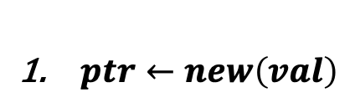


Realizing Smart Pointers
$ptr←new\left(val\right)$
$$p$$
$$a_{1}$$
$$val$$

Slide 88

Realizing Smart Pointers
$ptr←new\left(val\right)$
$val←get\left(ptr\right)$
$$p$$
$$a_{1}$$
$$val$$

Slide 89

Realizing Smart Pointers
$ptr←new\left(val\right)$
$val←get\left(ptr\right)$
$$p$$
$$a_{2}$$
$$val$$

Slide 90

Realizing Smart Pointers
$ptr←new\left(val\right)$
$val←get\left(ptr\right)$
$put\left(ptr,val\right)$
$$p$$
$$a_{2}$$
$$val$$

Slide 91

Realizing Smart Pointers
$ptr←new\left(val\right)$
$val←get\left(ptr\right)$
$put\left(ptr,val\right)$
$$p$$
$$a_{3}$$
$$val′$$

Slide 92

Realizing Smart Pointers
$ptr←new\left(val\right)$
$val←get\left(ptr\right)$
$put\left(ptr,val\right)$
$ptr_{1}←ptr_{2}$
$$p$$
$$a_{3}$$
$$val′$$

Slide 93



Realizing Smart Pointers
$ptr←new\left(val\right)$
$val←get\left(ptr\right)$
$put\left(ptr,val\right)$
$ptr_{1}←ptr_{2}$
$$p$$
$$a_{4}$$
$$val′$$
$$a_{4}$$
$$q$$

Slide 94

Realizing Smart Pointers
$ptr←new\left(val\right)$
$val←get\left(ptr\right)$
$put\left(ptr,val\right)$
$ptr_{1}←ptr_{2}$
$$p$$
$$a_{4}$$
$$val′$$
$$a_{4}$$
$$q$$

Slide 95




Realizing Smart Pointers
$ptr←new\left(val\right)$
$val←get\left(ptr\right)$
$put\left(ptr,val\right)$
$ptr_{1}←ptr_{2}$
$$p$$
$$a_{5}$$
$$val′$$
$$a_{5}$$
$$a_{4}$$
$$q$$

Slide 96





Realizing Smart Pointers
$ptr←new\left(val\right)$
$val←get\left(ptr\right)$
$put\left(ptr,val\right)$
$ptr_{1}←ptr_{2}$
$$p$$
$$a_{6}$$
$$val′$$
$$a_{6}$$
$$a_{5}$$
$$a_{4}$$
$$q$$

Slide 97

Realizing Smart Pointers
$ptr←new\left(val\right)$
$val←get\left(ptr\right)$
$put\left(ptr,val\right)$
$ptr_{1}←ptr_{2}$
$delete(ptr)$
$$val′$$
$$a_{6}$$
$$a_{5}$$
$$a_{4}$$
$$q$$

Slide 98

























Sharing Multiple Pointers
$$n_{3}$$
$$n_{3}$$
$$a_{3}^{2}$$
$$a_{3}^{2}$$
$$a_{3}^{3}$$
$$a_{3}^{3}$$
$$a_{3}^{1}$$
$$a_{3}^{2}$$
4
$$n_{2}$$
$$n_{2}$$
4
$$a_{2}^{3}$$
$$a_{2}^{3}$$
$$a_{2}^{2}$$
$$a_{2}^{2}$$
$$a_{2}^{2}$$
$$n_{1}$$
$$a_{2}^{1}$$
$$n_{1}$$
$$a_{2}^{1}$$
3
$$a_{1}^{3}$$
$$a_{1}^{3}$$
3
$$a_{1}^{2}$$
$$a_{1}^{2}$$
$$a_{1}^{2}$$
1
$$a_{1}^{1}$$
2
2
1

Slide 99
Roadmap
More Efficient Oblivious Algorithms
Smart (Oblivious) Pointers
12
Oblivious Single Access Machine

Slide 100

Graph Simulation

Slide 101
Graph Simulation
1
1₂
₁2
2
2₃
1₃
1₆
1₄
₂3
₁3
₁6
3
₁4
6
4
₄3
6₄
₆4
4₃
₅3
4₅
5₃
₄5
5

Slide 102
Graph Simulation
1
1₂
₁2
2
2₃
1₃
1₆
1₄
₂3
₁3
₁6
3
₁4
6
4
₄3
6₄
₆4
4₃
₅3
4₅
5₃
₄5
5

Slide 103
Graph Simulation
1
1₂
₁2
2
2₃
1₃
1₆
1₄
₂3
₁3
₁6
3
₁4
6
4
₄3
6₄
₆4
4₃
₅3
4₅
5₃
₄5
5

Slide 104
Graph Simulation
1
1₂
₁2
2
2₃
1₃
1₆
1₄
₂3
₁3
₁6
3
1₃
₁4
1₂
6
4
₄3
1₄
₆4
6₄
4₃
1₆
₅3
4₅
5₃
₄5
5

Slide 105
Graph Simulation
1
1₂
₁2
2
2₃
1₃
1₆
1₄
₂3
₁3
₁6
3
₁4
1₂
1₃
6
4
₄3
1₄
₆4
6₄
4₃
1₆
₅3
4₅
5₃
₄5
5

Slide 106
Graph Simulation
1
1₂
₁2
2
2₃
1₃
1₆
1₄
₂3
₁3
₁6
3
₁4
1₂
1₃
6
4
₄3
1₄
₆4
6₄
4₃
1₆
₅3
4₅
5₃
₄5
5

Slide 107
Graph Simulation
1
1₂
₁2
2
2₃
1₃
1₆
1₄
₂3
₁3
₁6
3
₁4
1₂
1₃
6
4
₄3
1₄
₆4
6₄
4₃
1₆
₅3
4₅
5₃
₄5
5

Slide 108
Graph Simulation
1
1₂
₁2
2
2₃
1₃
1₆
1₄
₂3
₁3
₁6
3
₁4
1₂
1₃
6
4
₄3
1₄
₆4
6₄
4₃
1₆
₅3
4₅
5₃
₄5
5

Slide 109
Summary
We realize the following smart pointers interface using SAM.
$ptr←new\left(val\right)$
$val←get\left(ptr\right)$
$put\left(ptr,val\right)$
$ptr_{1}←ptr_{2}$
$delete(ptr)$
$$p2$$
$$p3$$
$$p1$$
…
$$pd$$
Result | Bandwidth-Blowup | Rounds
OSAM | $$O(\log{n})$$ | $$1$$
Smart Pointers | $$O(\log{d}\log{n})$$ | $$O(\log{d})$$
Caching ORAM | $$O\left(T log{n}\right)$$ | $$O\left(T\right)$$
BFS, DFS, SSSP, MST | $$O\left(|E| log{|E|}\right)$$ | $$O\left(|E|\right)$$
$$v$$
$d$: No. of shared pointers
$T$: Time taken by a Splay Tree
Client Storage: $O\left(λ\right)$ / $O(1)$

