Slide 1
AGRITECH · ENGINEERING CONCEPT
SoilSense
IoT-Based Smart Soil Monitoring & Decision Support System
MEASURE · INTERPRET · INFORM

Slide 2
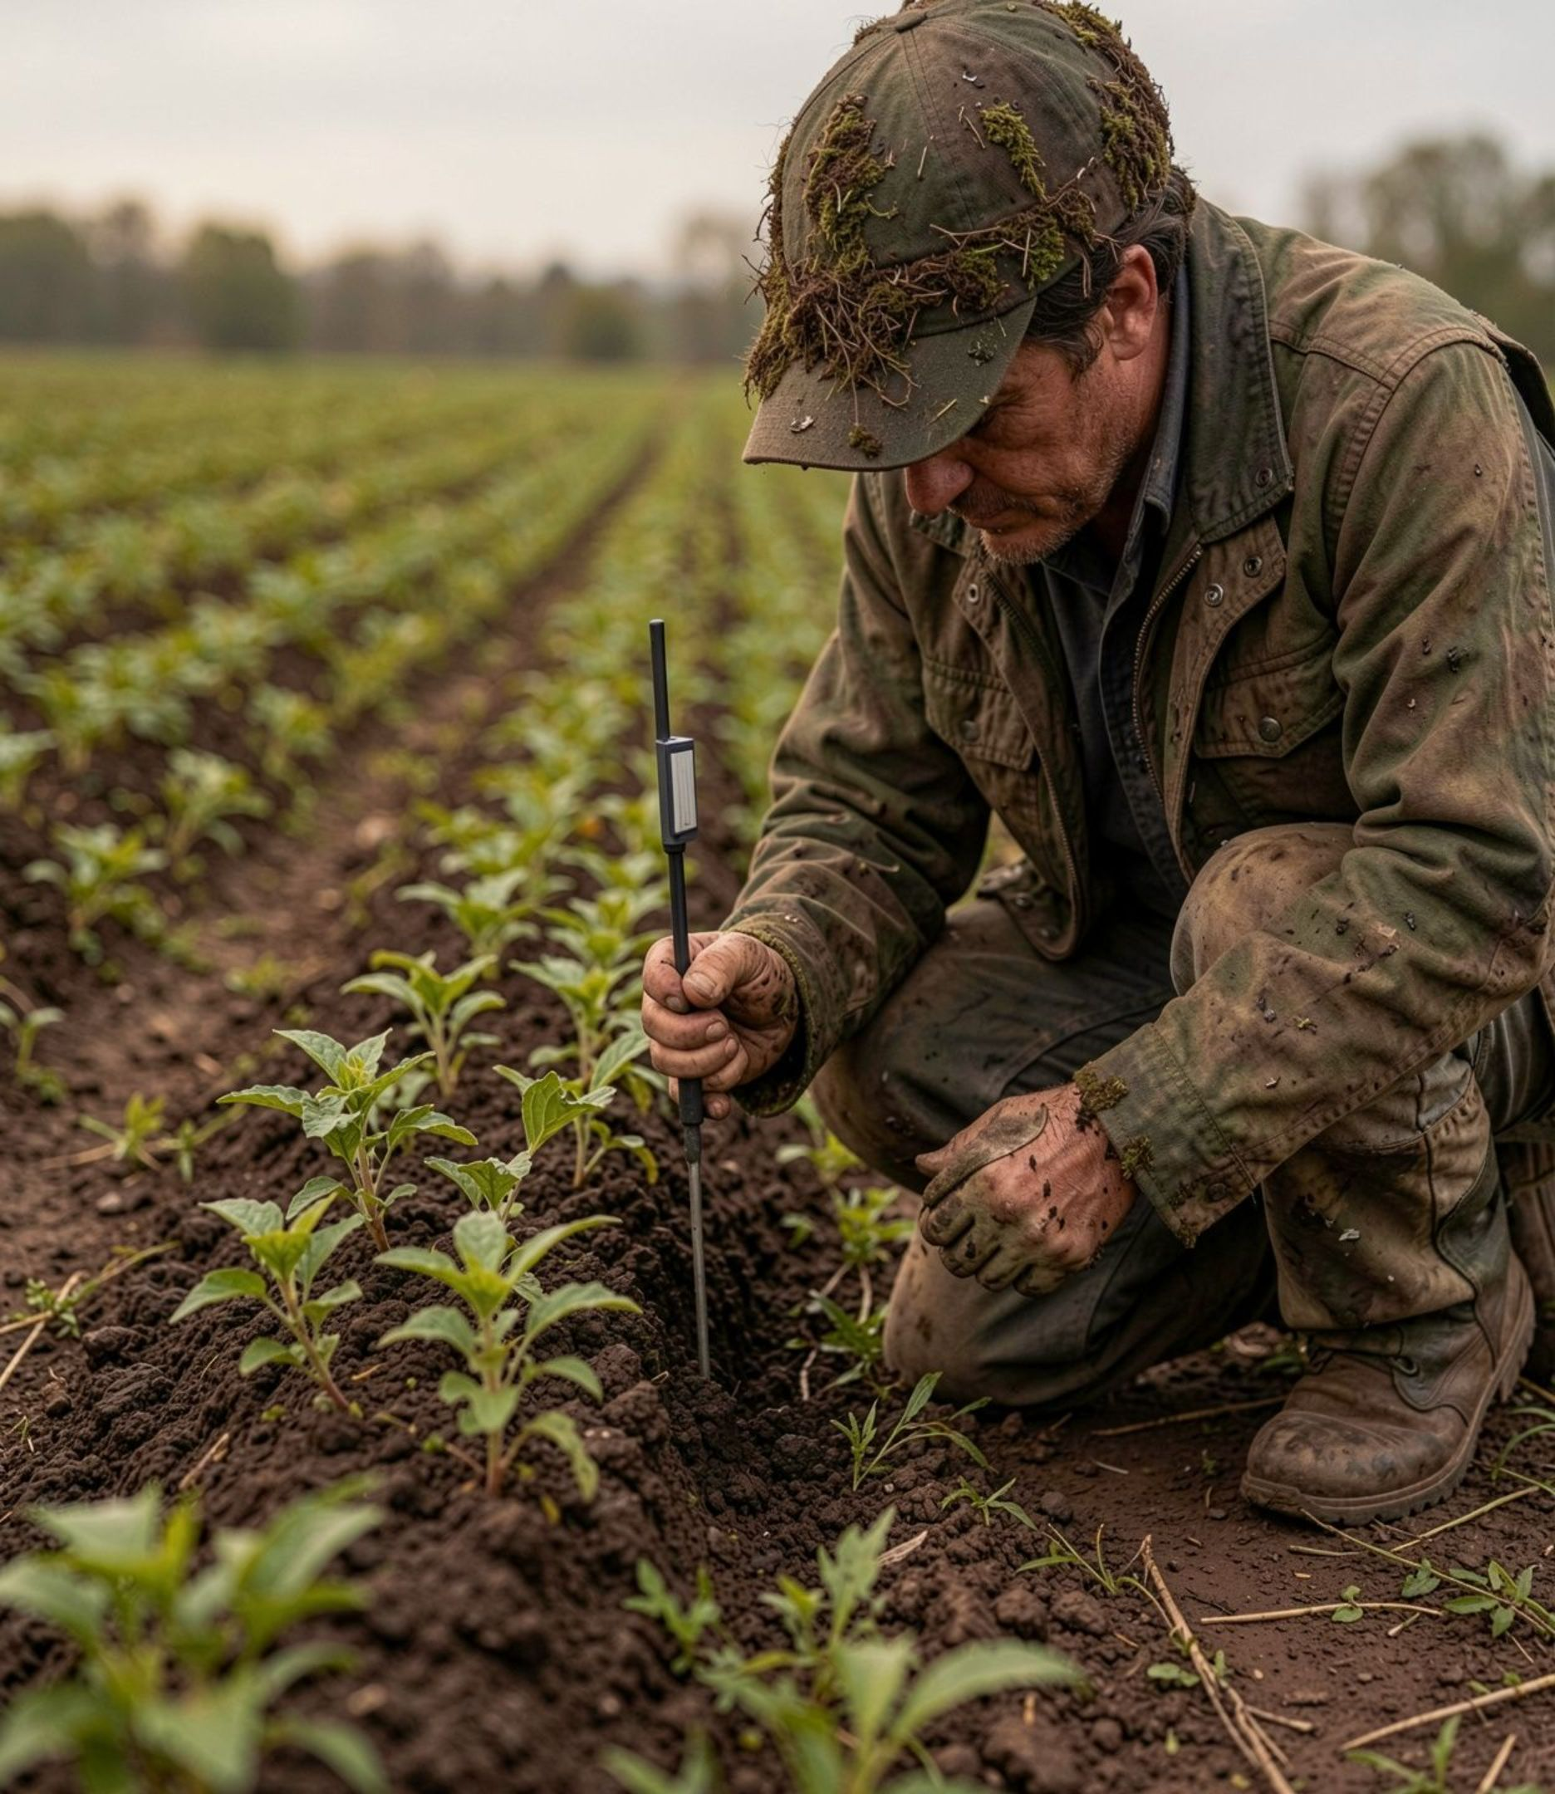
01 · THE DECISION GAP
Soil changes faster than decisions do.
The challenge is not a lack of readings. It is the distance between a reading and a useful next step.
FIELD
WATER
Conditions need continuous monitoring.
Irrigation depends on moisture and water availability.
CROP CARE
TRANSLATION
Crop-care decisions depend on nutrient and pH conditions.
Raw readings are difficult to turn into action.

Slide 3



02 · THE CORE IDEA
SoilSense turns readings into decisions.
02
03
01
INTERPRET
INFORM
MEASURE
Microcontroller captures readings and applies interpretation logic.
Surface soil status, alerts, and action-oriented guidance.
Collect NPK, pH, and moisture data.
A COMPACT LOOP FROM MEASUREMENT TO PRACTICAL GUIDANCE.
MEASURE → INTERPRET → INFORM

Slide 4





03 · SYSTEM ARCHITECTURE
Three sensors. One clear signal.
PHYSICAL WORLD →
SENSING →
PROCESSING →
SOIL / FIELD CONDITIONS
Moisture · nutrients · pH
NPK · pH · MOISTURE SENSORS
MICROCONTROLLER
Data processing
A PROPOSED SENSING-TO-USER ARCHITECTURE FOR TURNING SOIL CONDITIONS INTO UNDERSTANDABLE INFORMATION.
PHYSICAL WORLD → SENSING → PROCESSING → ANALYSIS → USER → DECISION
ANALYSIS →
USER →
DECISION
SOIL-CONDITION ANALYSIS
Soil status
DASHBOARD / ALERT
Farmer-facing information
DECISION SUPPORT

Slide 5
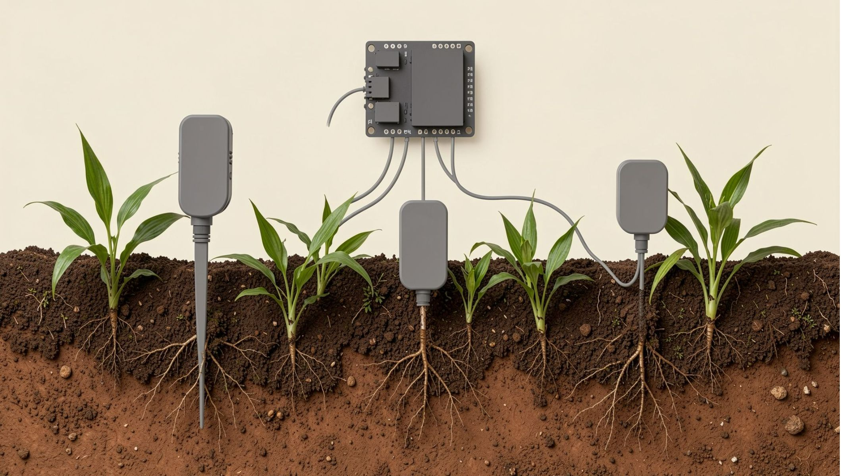
04 · INSIDE SOILSENSE
From the field to the microcontroller.
PROPOSED HARDWARE CONFIGURATION — A CLEAR STARTING POINT FOR IMPLEMENTATION.
PROPOSED HARDWARE CONFIGURATION
NPK · PH · MOISTURE SENSING IN A CONNECTED SOIL/CROP ENVIRONMENT.
NPK SENSOR
PH SENSOR
Soil nutrient sensing
Soil acidity sensing
SOIL MOISTURE SENSOR
MICROCONTROLLER
Water availability sensing
Receives sensor signals
THE ARCHITECTURE IS PRESENTED AS A PROPOSED CONFIGURATION, NOT A CLAIM OF COMPLETED FIELD HARDWARE.

Slide 6




05 · DATA FLOW
Every reading has a purpose.
01
02
03
04
05
06
PHYSICAL WORLD
CAPTURE
PROCESS
INTERPRET
INFORM
ACT
Moisture · nutrients · pH
Sensors
Raw readings
Microcontroller
Data processing
Soil condition analysis
Soil status
Action-oriented information
Farmer decision
THE SYSTEM MOVES FROM PHYSICAL CONDITIONS TO INFORMATION, THEN TO ACTION.
RAW DATA → PROCESSING → MEANING → ACTION

Slide 7
06 · INNOVATION & DIFFERENTIATION
The difference is not sensing. It is understanding.
TRADITIONAL SENSOR APPROACH
SOILSENSE
Sensor → raw reading
Sensor → reading
→ Interpretation → soil status
ILLUSTRATIVE COMPARISON OF THE INTERPRETATION GAP.
Uncontextualized number
ILLUSTRATIVE EXAMPLE
Farmer interprets the number.
SOIL STATUS
Moisture: Adequate
pH: Within range
Nutrients: Requires attention
CONFUSING RAW-NUMBER TREATMENT
ACTION-ORIENTED INFORMATION
SoilSense adds a meaning layer between measurement and decision.

Slide 8
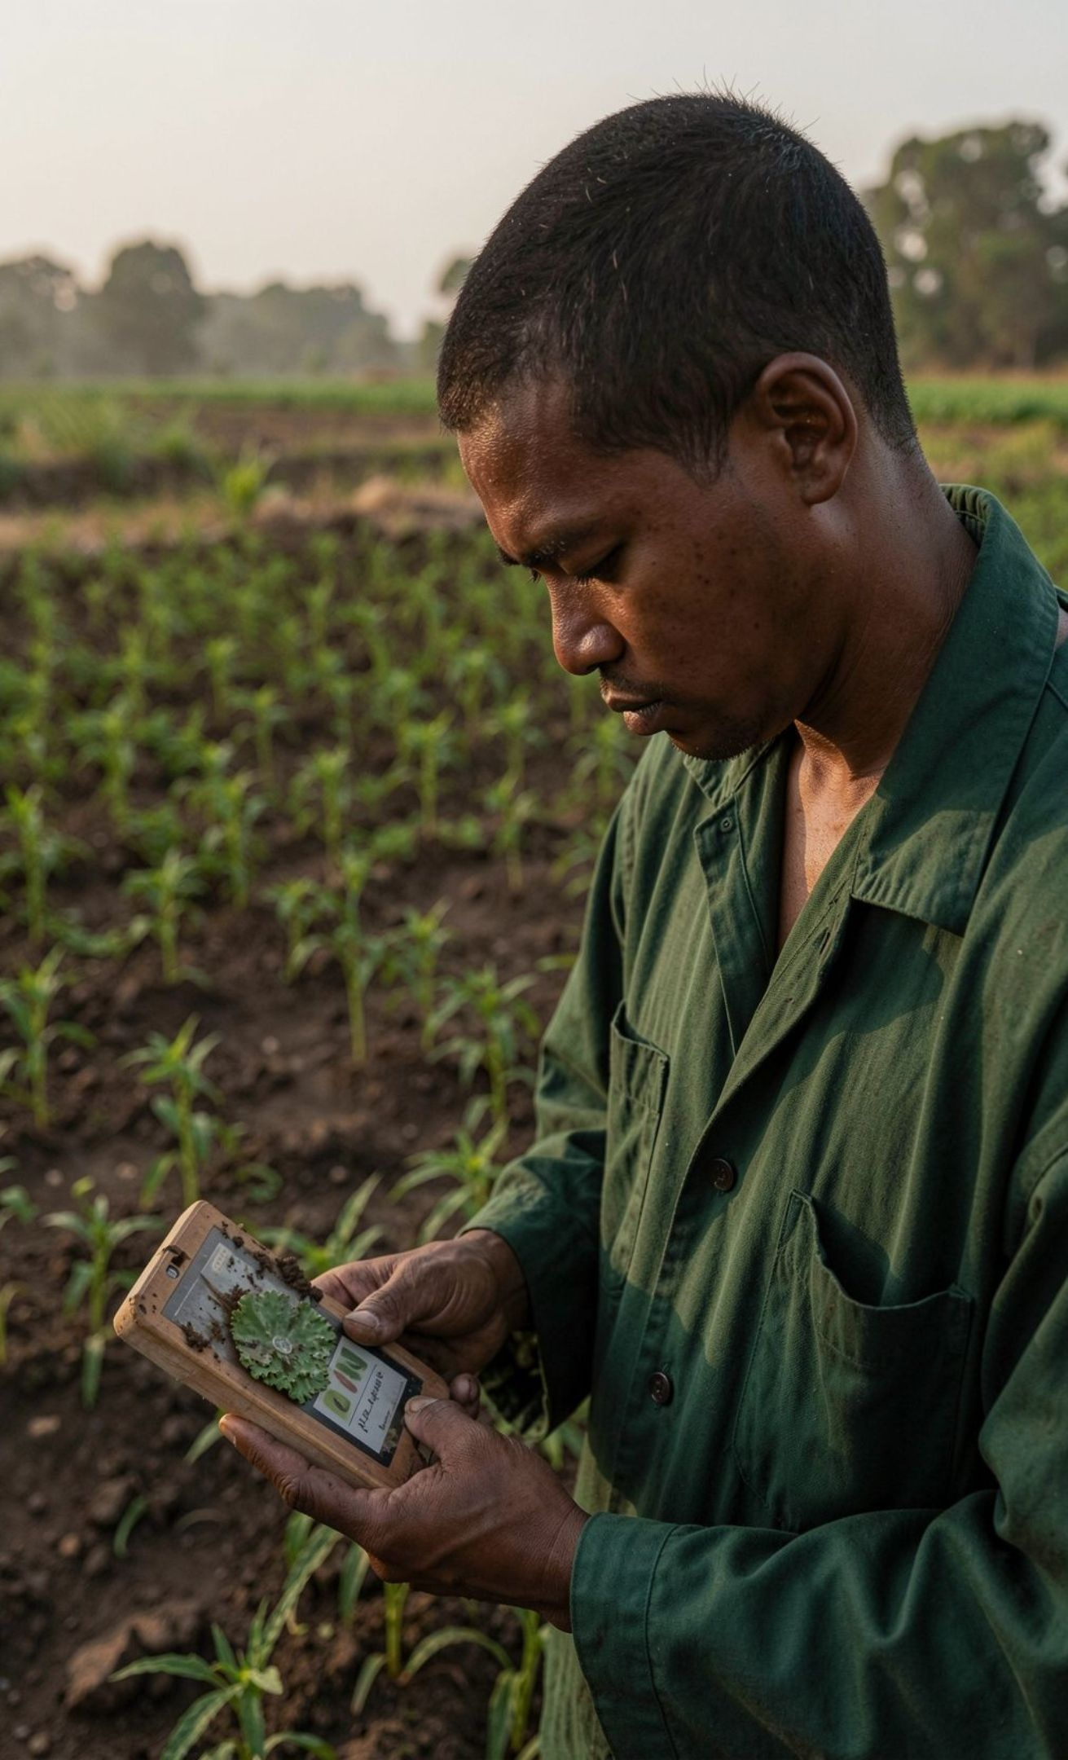




07 · EXPECTED IMPACT
Better information at the moment it matters.
The value proposition is decision support — not a promise of quantified outcomes.
Understand
Decide
Support better understanding of soil conditions.
Enable more informed irrigation decisions.
Care
Build
Support more informed crop-care decisions.
Lay a foundation for data-driven agriculture.

Slide 9






08 · FUTURE SCOPE
From prototype to platform.
CURRENT CONCEPT
01 · FUTURE
02 · FUTURE
Sensing + interpretation loop
Crop-specific ranges
Weather integration
Reference ranges and recommendations.
Bring weather context into decisions.
Soil readings become understandable information.
THE CURRENT CONCEPT ESTABLISHES THE SENSING AND INTERPRETATION LOOP. THESE EXTENSIONS ARE FUTURE SCOPE.
CURRENT CONCEPT → FUTURE SCOPE → FUTURE PLATFORM
03 · FUTURE
04 · FUTURE
FUTURE PLATFORM
Historical tracking
Dashboard evolution
Connected decision support
Build a timeline of soil data.
Improve notifications and farmer workflows.
Extensions remain future scope.
FUTURE ENABLERS
CLOUD CONNECTIVITY · MOBILE APPLICATION · AI/ML RECOMMENDATIONS · PREDICTIVE CROP-CARE INSIGHTS

Slide 10
09 · CLOSING STATEMENT
Measure. Interpret. Inform.
SoilSense bridges the gap between raw soil measurements and practical farming decisions.
REAL-TIME SOIL MONITORING · MEANINGFUL INTERPRETATION · ACTION-ORIENTED FARMER INFORMATION

