Slide 1

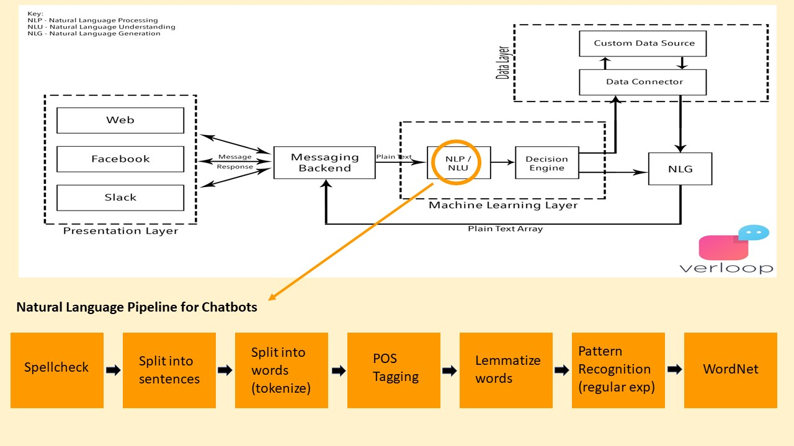
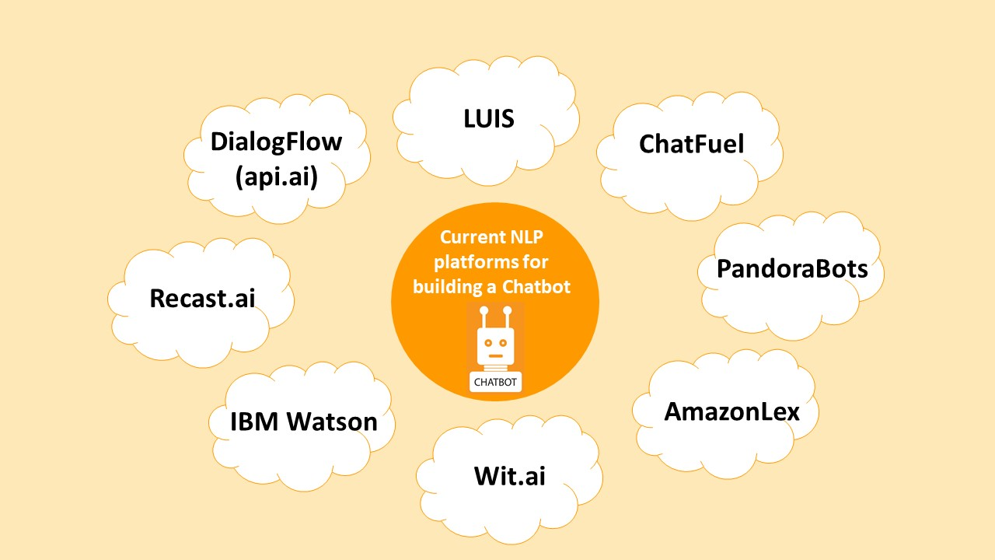
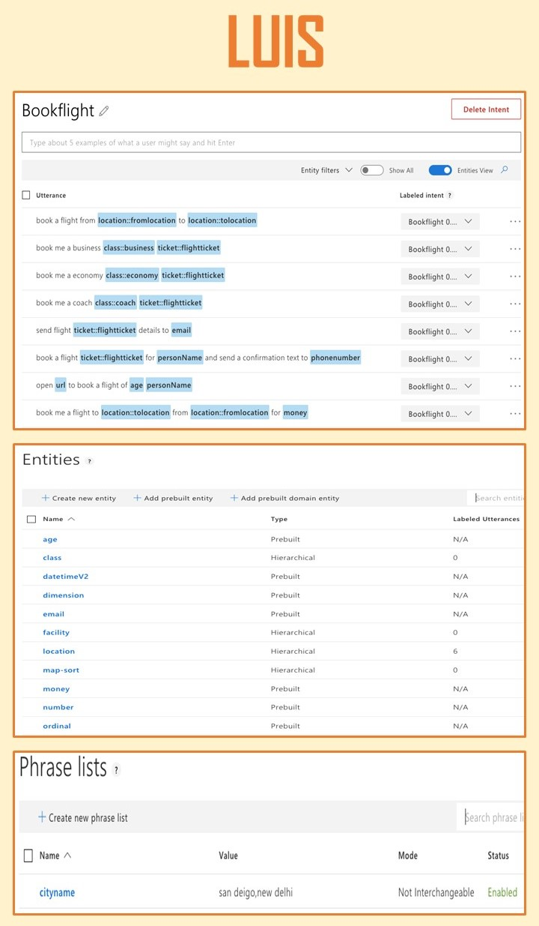
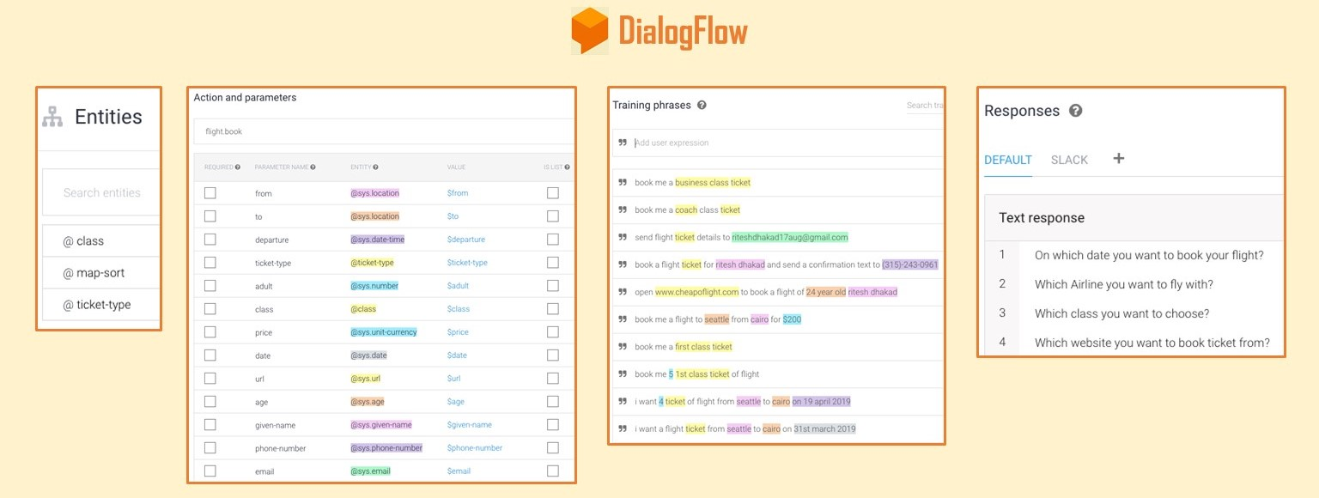
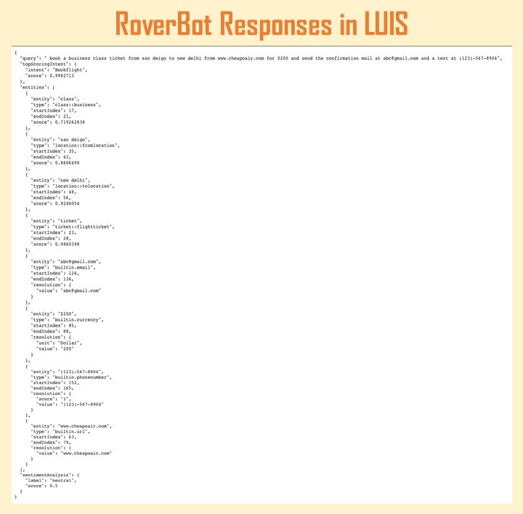
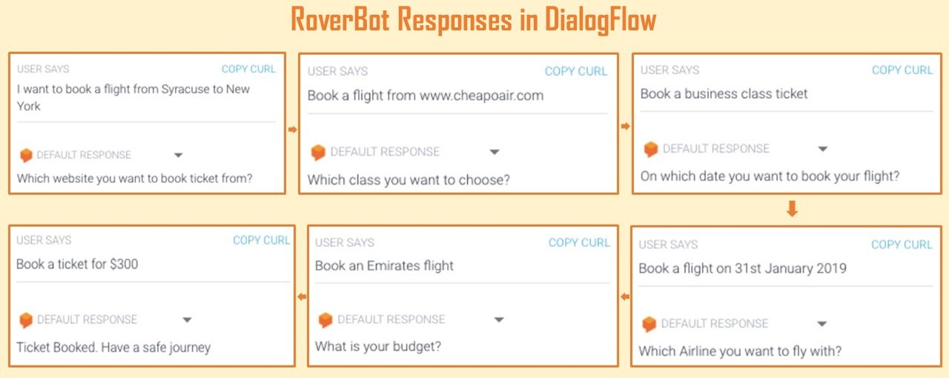
RoverBot
Ananya Bhupathipalli
Koushik Godbole
Omkar Mutreja
Ritesh Dhakad
Chatbots are AI programs that converse with humans through a chat interface
Chatbot uses:
Natural Language Processing (NLP) to converse with customers
Natural Language Understanding (NLU) to convert unstructured input to structured form so that a machine can understand
Natural Language Generation (NLG) to represent machine output in text format
LUIS | DialogFlow (api.ai)
Microsoft LUIS (Language Understanding Intelligent Service) uses - Intent: Represents action the user wants to perform Utterances: User input Entity: Identifies & extracts useful information from user utterances Features: Features help LUIS recognize both intents and entities by providing hints to LUIS that certain words and phrases are a part of a category or follow a pattern | Acquired by Google, DialogFlow uses - Agent: They are the NLU modules Intent: Represents action the user wants to perform Entities: Identifies & extracts useful information from user input Context: These are basically training phrases Responses: Responses are speech to text and text to speech capabilities
Microsoft LUIS understands the intent, and provides detailed metrics on how it matches the intents and entities, using which we can also measure true positives, true negatives, false positives and false negatives. However, building a conversational bot with LUIS required us to use UWP (Universal Windows Platform) apps | DialogFlow includes a rich set of domains for building chatbots and provides us with an interface to converse with chatbot and obtain responses. However, it does not provide metrics related to intent and entity matching

