Slide 1
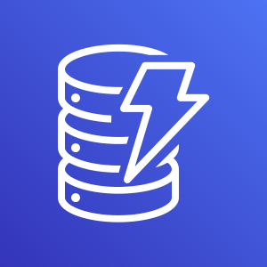


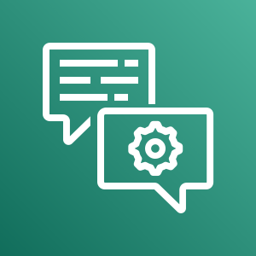



Amazon DynamoDB
Amazon Connect
Amazon Lex
AWS Lambda
1. User calls Contact Center to schedule or check appointment
2. Connect calls Lex and Lambda stores/retrieves information in DynamoDB by phone number
Amazon Simple Notification Service
3. Once the appointment is confirmed, Lambda will trigger SNS to send a confirmation message via SMS to the user

