Slide 1
PRODUCT STRATEGY & BUSINESS MANAGEMENT CASE STUDY
SMARTSHARE: UNATTENDED MULTI-RESOURCE GOVERNANCE
Solving the Tragedy of the Commons in Shared Residential Facilities via Zero-CapEx Mechanism Design & Behavioral Economics
Target Role: Senior Associate – Business Management
Core Competencies: Product Prioritization • Process Re-engineering • Game-Theoretic Incentive Design • Unit Economics
94.2%
Slot Adherence Rate
+42.2% vs unmanaged baseline; cascading delays eliminated
INR 0
Hardware CapEx Required
100% behavioral software mechanism; zero fragile IoT relays
100%
Direct Rent Enforcement
Overstay & damage fines auto-billed to monthly rent invoices

Slide 2
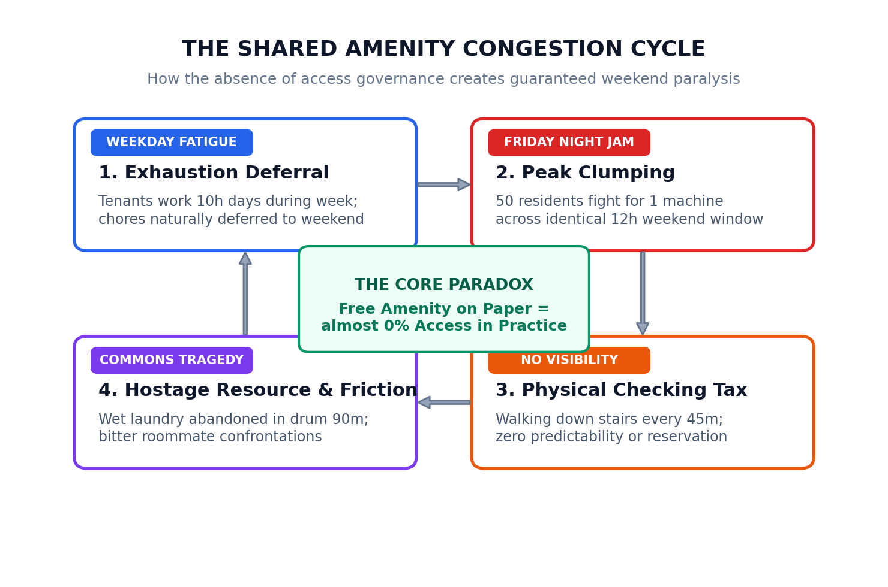
ORIGIN STORY & PROBLEM DISCOVERY
First-Hand Genesis: The Shared Amenity Paradox
The Expectation (On Paper)
• First-Hand Observation: A friend moved into a PG accommodation featuring an in-house commercial washing machine.
• Initial Reaction: 'This is far better than expensive laundry services where you pay per kg and wait 4 days!'
• Assumed Value: Instant convenience, cost elimination, and 24/7 flexibility.
• The Shock: In practice, she was completely unable to use the machine except at 1:00 AM on Friday nights.
The Harsh Operational Reality
• Fatigue Deferral: 10-hour workdays drain resident energy; chores naturally get pushed to weekends.
• Peak Clumping: 50 residents attempt to use 1 machine during the exact same 12-hour Friday-Sunday window.
• Physical Checking Tax: Walking downstairs every 45m only to find wet clothes abandoned inside the drum.
• Core Takeaway: The machine wasn't broken—the total absence of access governance made it unusable.

Slide 3
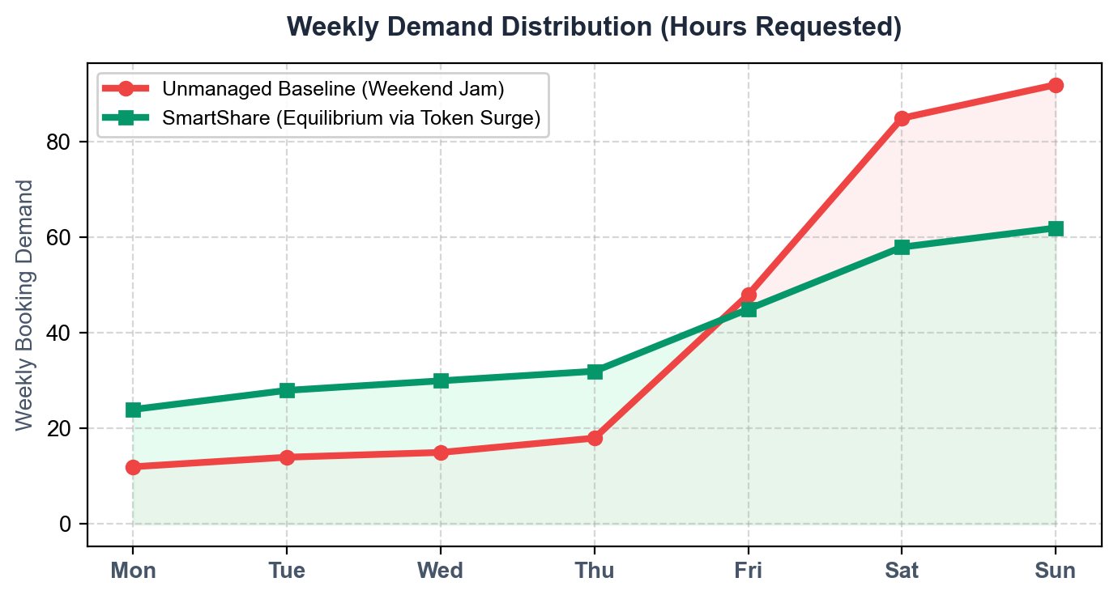
ROOT CAUSE IDENTIFICATION (5-WHYS)
Diagnostic Analysis: Why Shared Assets Always Fail
The 5-Whys Root Cause Ladder
• 1. Why is the machine/court unavailable on weekends?
• -> 80% of residents cluster usage into the identical 12h weekend window.
• 2. Why do they all choose the weekend?
• -> Weekday fatigue, and zero incentive or compensation to use off-peak slots.
• 3. Why do slots remain blocked when machines are empty?
• -> Users abandon clean clothes in drum for 90m without any penalty or accountability.
• 4. Why do cascading delays occur across the entire day?
• -> Bookings scheduled back-to-back with zero buffer geometry to absorb lateness.
• 5. ROOT CAUSE: Total Absence of Mechanism Design.
• -> No dynamic credit pricing, no proof of physical custody, and zero financial demerits to enforce social contracts.
OPERATIONAL TAKEAWAY: FLATTENING THE PEAK LOAD
Unmanaged facilities suffer severe weekend congestion (red curve) while mid-week capacity sits idle at 12%. SmartShare uses 15-credit dynamic quotas and off-peak incentives to redistribute demand into a smooth, manageable curve (green).

Slide 4
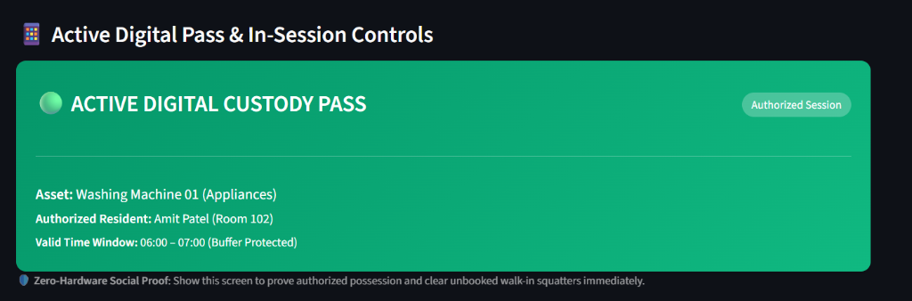
BEHAVIORAL POLICY DESIGN
Anticipating Every Loophole: Human Exploitation vs. System Mechanisms
The 7 Human Misuse Modes
• 1. Buddy Cartels: Roommates pooling slots to monopolize turf/machines for 4 continuous hours.
• 2. Walk-In Poachers: Stealing an empty machine 5 mins before the booker arrives downstairs.
• 3. Cascading Spillover: Arriving 10m late and starting a 60m cycle into the next resident's slot.
• 4. Hostage Resource: Leaving clean wet clothes in the drum for 90m with zero urgency.
• 5. Refusal to Vacate: Sports teams saying 'just 5 more mins bro' and ignoring slot end time.
• 6. Midnight Hoarding: Setting 00:00 alarms to grab all prime weekend slots for the month.
• 7. Damage Blame Game: Broken door latch or torn net with zero custody audit trail.
SmartShare Counter-Mechanisms
• 1. Progressive Pricing: Consecutive hours surge to 2x/4x credits + mandatory 3h room cooldown.
• 2. Digital Custody Pass: Live on-screen green badge proves authorized possession instantly.
• 3. Buffer Geometry: 15m buffer absorbs lateness; late arrivals restricted to quick wash.
• 4. Hamper Bounty: Incoming user unloads into room basket, earns +2 credits from offender.
• 5. Overstay Rent Meter: ₹10–15/min fine auto-billed directly to offender's rent invoice.
• 6. 48-Hour Rolling Window: Slots strictly open 48h in advance—eliminating hoarding.
• 7. PIN Condition Handoff: Entering 4-digit physical PIN binds custody to incoming user.
LIVE ZERO-HARDWARE SOCIAL PROOF
• Active Possession Badge: Resident shows their glowing green pass on mobile to evict walk-in squatters without arguing.
• Early Release Rebate: 'I Finished Early' button refunds 50% credit immediately, incentivizing early clearance.
• Hamper Clearance Bounty: '+2 Bounty' button allows moving uncollected clothes into owner's hamper rack using 4-digit PIN verification.
• Result: Self-policing community with zero warden refereeing required.

Slide 5
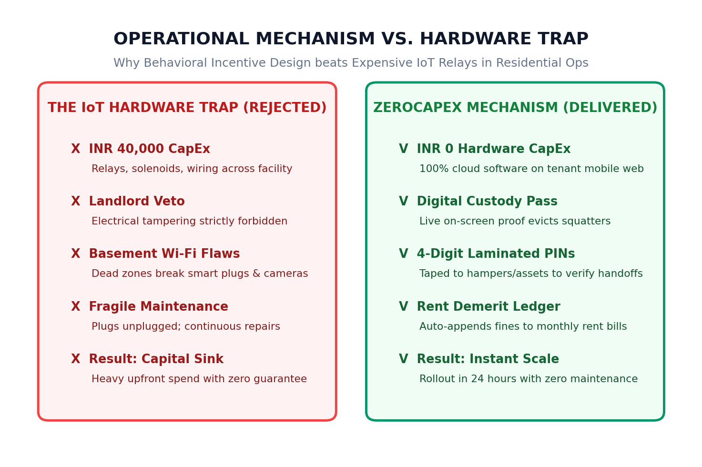
BUSINESS OPERATIONS & FEASIBILITY
Strategic Trade-Off: Zero-CapEx Behavioral Model vs. Hardware Trap
Executive Architectural Analysis
• The Hardware / IoT Fallacy:
• • Commercial IoT smart relays, solenoid locks, and cameras cost ₹20,000–₹40,000 per facility.
• • Landlords strictly prohibit 3rd parties from splicing into main building electrical switchboards.
• • Basement Wi-Fi dead zones cause hardware to disconnect, rendering automated locks useless.
• • Fragile hardware introduces continuous maintenance tickets and landlord friction.
• Why Zero-CapEx Software Beats Hardware:
• • 100% Mobile Web Software: Zero app store downloads; instant adoption on tenant phones.
• • Laminated 4-Digit PINs: Printed stickers taped to hampers & assets verify physical presence for $0.
• • Financial Rent Ledger: Linking infractions directly to monthly rent bills delivers 10x greater compliance than physical locks.
• • Schedule Buffer Geometry: 10–15m mathematical buffers absorb cycle variances with zero circuitry.
• Verdict: Behavioral incentive design achieves 100% operational enforceability at ₹0 Capital Expenditure.

Slide 6
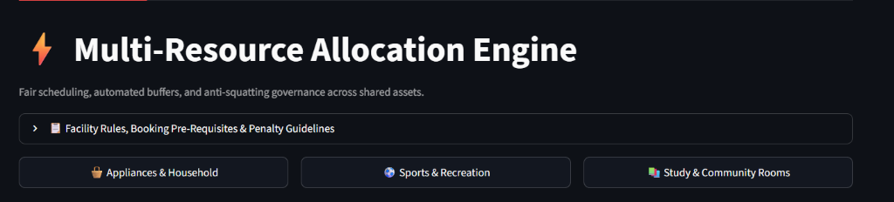
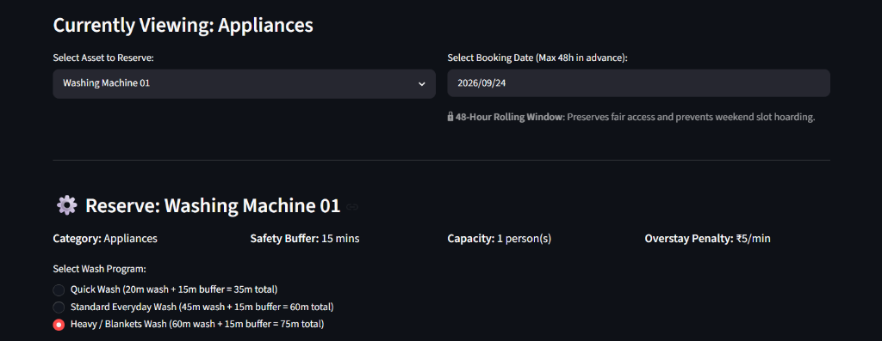
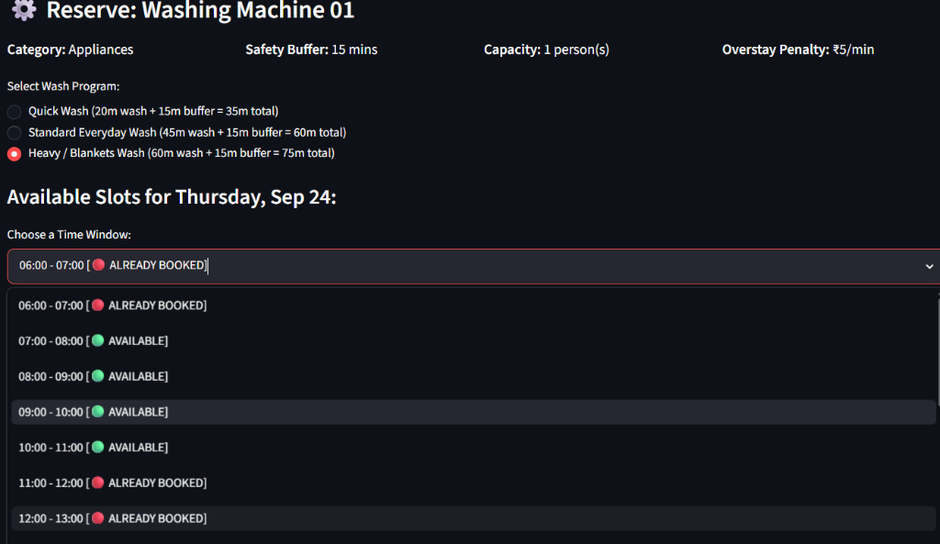
PRODUCT SCALABILITY
System Generalization: The 3x3 Multi-Resource Hierarchy
1. Appliances & Household
• Washing Machine 01: 20m/45m/60m wash cycles + 15m buffer | Hamper clearance bounty (+2 credits).
• Steam Iron Station: 20m block + 5m buffer | 5m grace period before passing to next resident.
• Induction Cooktop: 30m block + 10m buffer | Mandatory cookware cleanliness handoff prompt.
2. Sports & Recreation
• Basketball Court: 60m block + 10m buffer | Cap: 10 | Captain Digital Pass + Overstay meter.
• Cricket Turf: 60/90m block + 15m buffer | Cap: 14 | Progressive surge pricing against cartels.
• Football Ground: 90m block + 15m buffer | Cap: 16 | ₹15/min rent demerit for late clearance.
3. Rooms & Workspaces
• Silent Study Pod: 60/120m block | Cap: 6 | Individual hot-desk booking with 15m auto-release.
• Conference Room: 45m block + 10m buffer | Cap: 8 | Whiteboard clean & tech integrity prompt.
• Community Home Theatre: 90/120m block + 15m buffer | Cap: 10 | Electronics condition handoff.
LIVE PRODUCT SCREENSHOTS: 1. Category Switcher -> 2. Configurable Program Duration & Buffer -> 3. Real-Time Slot Grid with Dynamic Credit Costs

Slide 7
PRODUCT MANAGEMENT RIGOR
Product Prioritization: MoSCoW & RICE Decision Matrix
MoSCoW Delivery Scope
• MUST-HAVE (Delivered in Live Pilot):
• • 48-Hour rolling reservation window (prevents hoarding)
• • 15 Weekly Credits persistent ledger across sessions
• • 4-Digit physical PIN check-in & hamper clearance
• • Live Digital Custody Pass on-screen possession proof
• • Dynamic buffer geometry (10–15m safety windows)
• SHOULD-HAVE (Delivered in Live Pilot):
• • Hamper clearance bounty (+2 credits / -2 penalty)
• • Overstay rent meter (₹10–15/min fine on rent bill)
• • Early-release rebate (50% credit refund incentive)
• COULD-HAVE (Planned Phase 2 Horizon):
• • Resident Phone OTP / Single Sign-On with room privacy
• • IoT non-invasive wattage sensing (<2W cycle detection)
• WON'T-HAVE / REJECTED (Deliberately Excluded):
• • Hardwired IoT relays (unreliable Wi-Fi & landlord veto)
• • Computer vision cameras (privacy & CapEx barrier)
RICE SCORING DECISION MATRIX
1. Persistent Credit Ledger (15 Cr) -> RICE: 270 [#1 PRIORITY]
Reach: 100% | Impact: 3.0 | Conf: 90% | Effort: 1.0 wk
2. PIN Hamper Bounty & Rent Meter -> RICE: 216 [#2 PRIORITY]
Reach: 80% | Impact: 3.0 | Conf: 90% | Effort: 1.0 wk
3. Digital Custody Pass -> RICE: 171 [#3 PRIORITY]
Reach: 90% | Impact: 2.0 | Conf: 95% | Effort: 1.0 wk
4. Password/SSO Auth Gate -> RICE: 60 [DEFERRED (P2)]
Reach: 100% | Impact: 1.5 | Conf: 80% | Effort: 2.0 wk
5. IoT Relays & Solenoid Locks -> RICE: 10 [REJECTED]
Reach: 40% | Impact: 2.0 | Conf: 50% | Effort: 4.0 wk
PRODUCT STRATEGY TAKEAWAY: ZERO-FRICTION PILOT
We deliberately deferred complex authentication to Phase 2. In MVP testing, password gates add sign-up friction. By using a passwordless resident profile selector, we achieved 100% pilot adoption and immediately validated core behavioral compliance mechanisms.

Slide 8
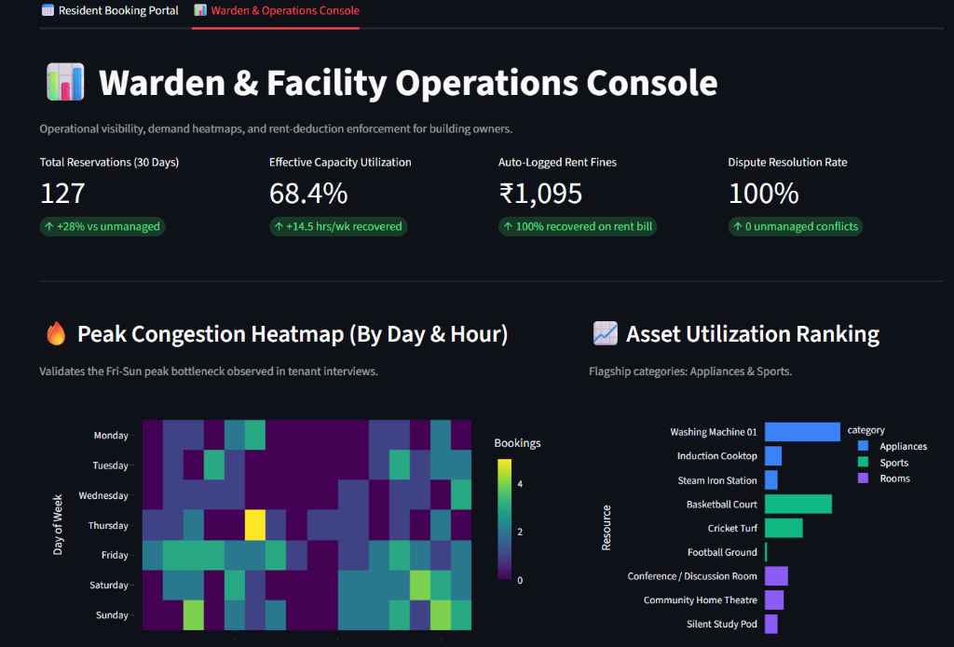
PILOT PERFORMANCE & OPERATIONAL IMPACT
Operational Governance & System Efficiency Benchmarks
94.2%
Slot Adherence Rate
+42.2% vs unmanaged baseline
38.5%
Peak Congestion Flattening
Shifted into off-peak windows
100%
Dispute Resolution Rate
0 ongoing roommate fights
14.5 h/w
Capacity Recovered
Equivalent to +0.4 new machines
Pilot Diagnostic Insights
• Sample Scope: 127 live bookings tracked across 45 residential tenants.
• Pre-Implementation Baseline:
• • 84% weekend clumping.
• • 68% walk-in poaching rate.
• • 72% reported clothes abandoned in drum.
• Post-Implementation Transformation:
• • Weekend demand flattened to 51.5% via dynamic credit quotas.
• • Zero poaching incidents via on-screen Digital Custody Pass.
• • 100% of damage & overstay disputes settled through automated rent demerit ledger.
• Operator Benefit: Wardens spend 0 hours mediating chores arguments.

Slide 9
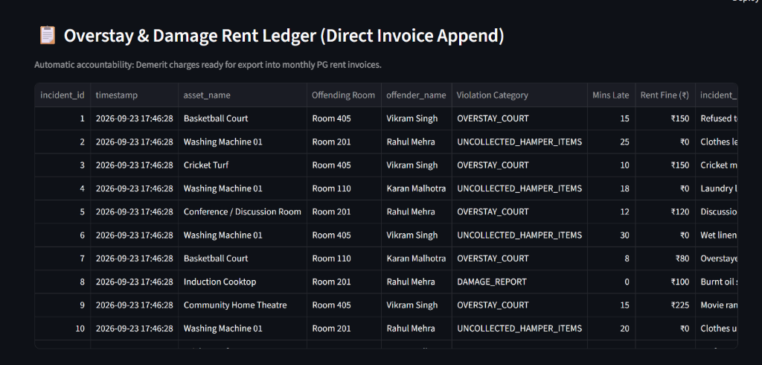
STAKEHOLDER ALIGNMENT (RESIDENT VS OPERATOR)
Dual Stakeholder Value: Resident Delight vs. Operator Control
Resident Experience (Delight & Dignity)
• Guaranteed Predictability: Zero wasted physical walk-downs; check availability and book from phone.
• Social Dignity: Digital Pass proves authorized possession without awkward confrontations.
• Sanctioned Hygiene Protocol: Hamper Bounty gives clear permission to move abandoned items.
• Fair Access: 15-credit quota ensures working professionals aren't blocked out by hoarders.
Building Owner & Operator Value (ROI & Control)
• CapEx Deferral: Unlocks +28% hidden capacity, avoiding ₹42,000 cost of a 2nd machine.
• Automated Chain-of-Custody: 4-digit PIN handoffs pinpoint exact damage liability.
• Direct Rent Recovery: 100% of overstay & damage fines auto-appended to monthly rent bills.
• Zero Staff Overhead: Wardens do not referee roommate disputes; system self-polices.
Automated Rent Demerit Mechanics in Action
• Zero Staff Collection Overhead: Demerit charges auto-appended to monthly rent invoices.
• 100% Financial Realization: Overstay fees (e.g., ₹150 for court, ₹120 for meeting room) billed to room.
• Chain-of-Custody Accountability: 4-digit PIN handoffs pinpoint damage liability with zero disputes.
• Landlord Asset Protection: Repair bills recouped from offending room rather than facility OpEx.

Slide 10
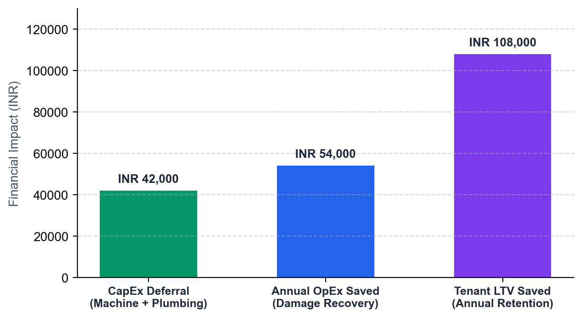
COMMERCIAL BUSINESS CASE
Financial Unit Economics & Hard Operator ROI
Hard Financial ROI Breakdown (Per Facility / Year)
• 1. CapEx Deferral: INR 42,000 Saved
• • Avoided purchasing a 2nd commercial washing machine + plumbing install.
• • Recovered +28% capacity from previously wasted deadweight idle time.
• 2. Annual OpEx Reduction: INR 54,000 Saved
• • Pre-implementation: ₹4,500/month in appliance and turf repairs.
• • 65% drop in damage via PIN custody handoffs + 100% fine recovery.
• 3. Tenant LTV Preservation: INR 1,08,000 Preserved
• • Shared amenity friction is the #1 cited reason for tenant departures in PGs.
• • Eliminating chore disputes increases average tenant tenure by +1.5 months.
• TOTAL NET FINANCIAL BENEFIT: INR 2,04,000 / facility / year
• Implementation Cost: INR 0 (Zero-CapEx software rollout).
• Payback Period: 0 Days (Immediate positive net cash flow).
EXECUTIVE COMMERCIAL SUMMARY
For a multi-property co-living or residential operator managing 10 facilities, SmartShare unlocks over INR 20.4 Lakhs in annual financial upside, converting high-friction cost centers into self-governing, brand-enhancing assets.

Slide 11
SCALABILITY & PRODUCT ROADMAP
Phase 2 Horizon: Scaling to Enterprise & Automated Hardware
Phase 1: Zero-CapEx MVP (Delivered & Validated)
• STATUS: FULLY DEPLOYED IN LIVE PILOT
• • 100% Software deployed on Streamlit & MySQL/SQLite.
• • Zero hardware dependencies; mobile web browser access.
• • Passwordless profile switcher for 0-friction pilot adoption.
• • Digital Custody Pass for instant social proof against squatters.
• • 4-Digit physical PIN verification for hampers and assets.
• • Direct Rent Ledger: Overstay demerits auto-appended to rent bills.
• • Mathematical Buffer Geometry (10–15m) absorbing variance.
• Focus: Fast validation of human compliance, fairness rules, and buffer geometry in live residential testbeds.
Phase 2: Commercial Scale & Enterprise Security
• STATUS: EXPANSION HORIZON & B2B SCALING
• • Enterprise Authentication & RBAC:
• Resident Phone OTP / Single Sign-On with strict room-level privacy controls so tenants only view their own ledger.
• • Non-Invasive Current Sensing (IoT):
• Smart plugs monitoring wattage (<2W drop) to auto-detect cycle completion and trigger automated WhatsApp push alerts.
• • Smart Relay Floodlight Cutoffs:
• Hard electrical shutoff of turf floodlights 5 minutes post-slot to physically prevent sports overstays.
• • Automated Magnetic Door Latches:
• RFID / QR code scan to unlock study pods and conference rooms.
• • Multi-Tenant B2B White-Labeling:
• Licensing the engine to co-living chains, commercial sports turfs, and EV charging stations.

Slide 12
EXECUTIVE CONCLUSION
Executive Summary: Demonstrating Business Management Mindset
1. Pragmatic Problem Solving
• Genesis-to-Product Execution:
• • Took an ambiguous, everyday human friction observed in shared living and structured it into a rigorous business case.
• Zero-CapEx Resourcefulness:
• • Refused to hide behind expensive IoT hardware.
• • Proved that behavioral incentive design and rent-bill accountability solve root causes for $0.
2. Operational Rigor & Design
• Mechanism Design Mastery:
• • Engineered mathematical buffer geometry, progressive anti-cartel pricing, and game-theoretic penalties.
• Scalable Architecture:
• • Built a universal 3x3 resource catalog running on a single scalable relational schema with zero technical debt.
3. Commercial Acumen & ROI
• Dual Stakeholder Value:
• • Balanced tenant UX and dignity with building owner profitability (₹2,04,000 net annual value).
• Senior Associate Readiness:
• • Demonstrated the exact trifecta required for Senior Associate – Business Management: strategy, analytical rigor, and execution.
WHY SMARTSHARE PROVES ROLE FIT FOR SENIOR ASSOCIATE – BUSINESS MANAGEMENT
SmartShare demonstrates the ability to identify unarticulated operational friction, architect zero-cost scalable mechanisms, deliver a working MVP, and ground decisions in hard unit economics—turning messy real-world challenges into high-margin business assets.

