Slide 1

Lambda++
the power of cluster computing,
at your fingertips
Ananya Kumar, Jake Zimmerman

Slide 2
Functional Programming in C++ is A Good Thing™
Same language that teams are already using
Fast, compiled language
Lambda functions in C++11 are concise
bool paren_match(Sequence<int> &seq) {
auto plus = [](int a, int b) { return a + b; };
auto min = [](int a, int b) { return a < b ? a : b; };
seq.scan(plus, 0);
return seq.get(seq.length() - 1) == 0 &&
seq.reduce(min, INT_MAX) >= 0;
}

Slide 3
The Sequence Abstraction
2 | 5 | 1 | -3 | 4 | 8
Feels like an array on steroids
Supports any data type
ints, floats, pairs, structs, and more (types!)
Thrives with higher order functions
map, scan, reduce, tabulate

Slide 4
Some Implementation Jargon
mandelbrot
compute elements of mandelbrot set
paren_match
determine whether parentheses are well-matched
SerialSequence
Implement abstract Sequence class serially
ParallelSequence
Parallel Sequence class implementation (naive)
UberSequence
Heavily optimized parallel Sequence implementation

Slide 5
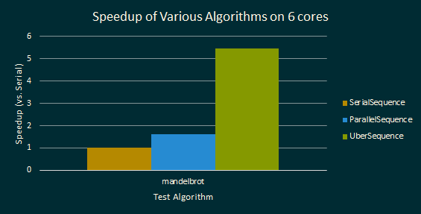
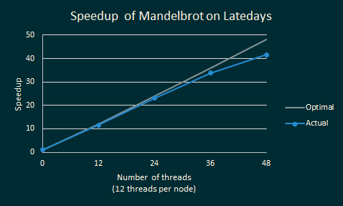
Near optimal speedup on mandelbrot
Tabulate to compute mandelbrot set elements
Data parallel, math heavy
Reaches near-peak speedup on GHC and Latedays

Slide 6
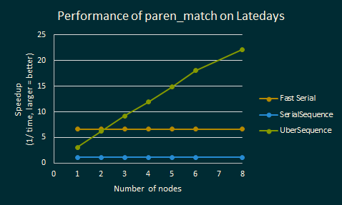
Speedup on paren_match
scan + reduce to determine well-matchedness
much harder to parallelize (not data parallel)
Fast Serial wins on one and two nodes
Linear speedup with number of nodes

Slide 7
Data is Spread across Nodes
2 | 5 | 1 | -3 | 4 | 8
2 | 5
1 | 3
4 | 8
Node 1
Node 2
Node 3

Slide 8
Randomized Load Distribution
Split
Interleave
1 | 2 | 1 | 2 | 1 | 2 | 1 | 2
Randomize
1 | 2 | 2 | 1 | 1 | 1 | 2 | 2
Notes:
2 nodes, 800,000 elements

Slide 9
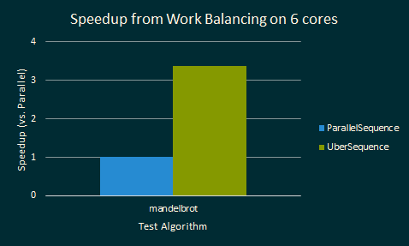
Load Distribution Improves Performance
ParallelSequence has no load distribution
Load distribution is responsible for a big part of the speedup in UberSequence

Slide 10
Profile cluster to determine fastest nodes
Average
Fast Node
Slow

Slide 11
MPI Between Nodes,
OpenMP within a Node
MPI
Node 1
Node 2
1-1 | 1-2 | 1-3 | 1-4
2-1 | 2-2 | 2-3 | 2-4
OMP Threads
OMP Threads
Maximize utilization of available resources
Notes:
2 nodes, 800,000 elements

Slide 12
Reduce: Parallelizes Well with MPI + OpenMP
Stage 1 - Node 1
1 | 2 | 3 | 4
9 | 10 | 11 | 12
1 | 2
3 | 4
9 | 10
11 | 12
Thread 1
Thread 2
Thread 1
Thread 2
3
7
19
23
10
42
Notes:
Single node

Slide 13
Reduce: Minimizes Communication
Stage 2 - Node 1
MPI
Node 1
Node 2
Node 1
Node 2
10
26
42
58
136
Notes:
Single node

Slide 14
Questions
Lambda++
the power of cluster computing,
at your fingertips
Ananya Kumar, Jake Zimmerman

Slide 15
Lambda++ is...
a C++ functional programming library
designed for running algorithms
across a cluster
that
approaches near optimal speedups
while enabling programmers to write
concise, functional code.

