Slide 1


MANIPAL
UNIVERSITY
School of Computer Science and Engineering
Department of Computer Science and Engineering
Hybrid AI Model for Accurate Renewable Energy Output Forecasting
Presented By: Ananya Sharma
2427030109
Section B
Supervised By: Ms Babita Tiwari

Slide 2
1.Introduction
2.Literature Survey
3.Research Gap
4.Problem Statement
5.Objectives
6.Methodology
7.Proposed Solution
8.References
OUTLINE

Slide 3

INTRODUCTION
-Renewable energy like solar and wind is key to a sustainable future, but their reliance on weather makes energy production unpredictable and hard to forecast.
-To address this challenge, we developed the Renewable Energy Forecast Tool — an AI-driven platform that uses machine learning to analyze historical energy data and weather factors like temperature, humidity, wind speed, and solar irradiance.
This data analysis provides accurate and timely forecasts of future renewable energy generation.

Slide 4
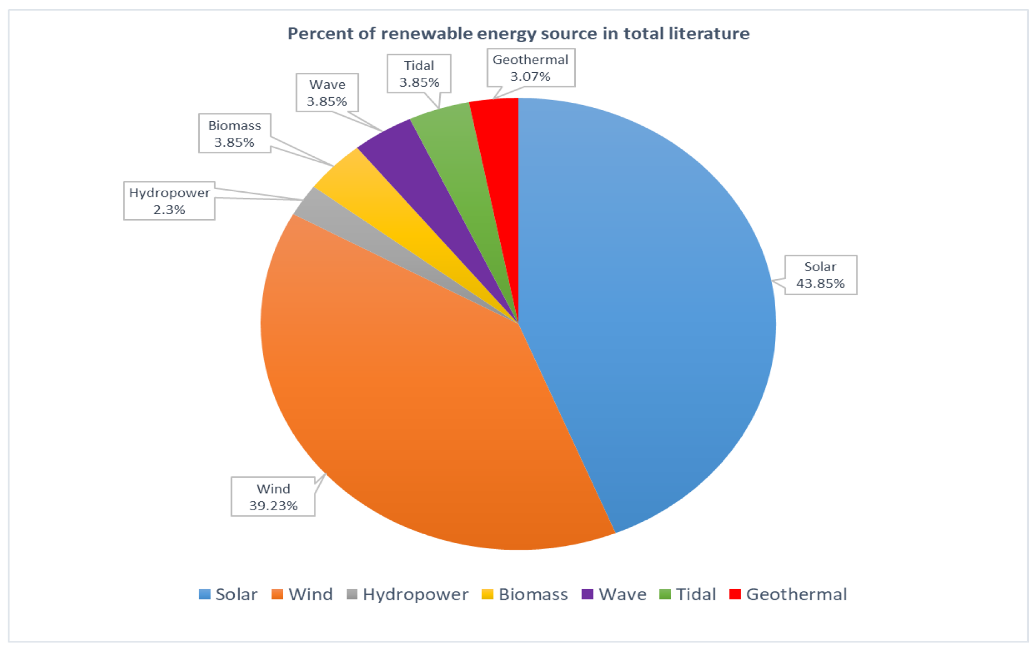
-Through providing reliable predictions, our tool enables optimal energy management, reduces dependence on fossil fuels, and ensures smooth integration of renewables into the grid, ultimately leading to a more resilient, efficient, and environmentally friendly energy system.
FIGURE 1 : PERCENT OF RENEWABLE ENERGY SOURCE IN TOTAL LITERATURE

Slide 5
LITERATURE SURVEY
ARTICLE TITLE | PUBLISHED YEAR | DESCRIPTION | DATA USED | RESULT & DISCUSSION
AI-Powered Energy Forecasting Models for Smart Grid-Integrated Solar and Wind Systems [1] | 2025 | It highlights at different machine learning methods to predict solar and wind energy, focusing on helping manage smart grids better. | Historical energy generation, weather parameters (temp, wind speed, humidity, solar radiation) | Hybrid AI models (like LSTM + SVM) showed higher accuracy in forecasting solar and wind energy than traditional models. This led to better grid stability and reduced energy losses.
AI-Powered Renewable Energy Forecasting: A Hybrid Deep Learning and Physics-Based Model for Solar and Wind Energy Prediction in Smart Grid Applications [2] | 2024 | This paper combines deep learning with physics-based models to improve the accuracy of solar and wind energy forecasts. It leverages both data-driven insights and physical principles to handle the variability of renewable sources effectively. | Weather data (solar radiation, temperature, wind speed), historical energy output | The hybrid deep learning and physics-based model outperformed others in forecasting solar and wind energy, improving accuracy and grid reliability.
Deep Learning-Based Spatio-Temporal Forecasting of Solar and Wind Energy Generation [3] | 2023 | Uses advanced models that look at both location and time patterns to better predict how much solar and wind energy will be produced. | Spatial weather data, historical energy output | The deep learning model effectively captured spatial and temporal patterns, significantly improving forecasting accuracy for solar and wind energy. This leads to better grid management and renewable integration.
A Survey of Artificial Intelligence Methods for Renewable Energy Forecasting: Methodologies and Insights [4] | 2024 | Reviews many AI techniques for forecasting renewable energy and discusses their pros and cons. | Various datasets from literature | The survey shows hybrid AI methods improve renewable energy forecasting accuracy by combining traditional models with optimization techniques, addressing challenges of intermittency.
Real-Time Solar and Wind Power Forecasting Using Edge AI and IoT Devices [5] | 2023 | Focuses on making quick, real-time energy predictions using AI on small devices placed near solar and wind sources. | Real-time sensor data from IoT devices, weather data | Edge AI with IoT enables fast, real-time solar and wind forecasting, improving grid response and reducing cloud dependence
02
03

Slide 6
LITERATURE SURVEY
ARTICLE TITLE | PUBLISHED YEAR | DESCRIPTION | DATA USED | RESULT & DISCUSSION
Hybrid deep learning CNN-LSTM model for forecasting direct normal irradiance [6] | 2025 | this study combines CNN and LSTM to capture both spatial patterns (cloud textures, light intensity) and time-series trends to predict direct normal irradiance accurately. | Satellite solar images, on-ground irradiance sensors, historical DNI readings. | the hybrid model delivered consistently higher DNI forecast accuracy, especially during rapidly changing weather, demonstrating strong potential for solar-rich regions.
Deep Learning Enhanced Solar Energy Forecasting with AI-Driven IoT [7] | 2021 | This paper presents a deep learning model integrated with IoT sensors to improve real-time solar energy forecasting by capturing rapid changes in environmental conditions. | IoT-based irradiance sensors, panel temperature, humidity, cloud index, and historical PV output collected at high frequency. | The deep learning + IoT setup achieved significantly lower prediction error than traditional ML models due to richer real-time data.
An optimized deep learning based hybrid model for prediction of daily average global solar irradiance using CNN SLSTM architecture [8] | 2025 | This paper introduces a hybrid CNN-SLSTM deep learning model that captures both spatial irradiance patterns and long-term temporal dependencies for accurate daily solar irradiance prediction. | Historical global solar irradiance records, sky/irradiance time-series, temperature, humidity, and auxiliary meteorological data. | The model effectively learns stable temporal trends and short-term variations simultaneously, improving forecasting accuracy for daily solar irradiance under diverse weather conditions.
Sky Image-Based Localized, Short-Term Solar Irradiance Forecasting for Multiple PV Sites via Cloud Motion Tracking [9] | 2021 | This paper proposes a sky-image–driven forecasting system that analyzes cloud movement patterns to deliver accurate short-term irradiance predictions across multiple nearby PV sites. | High-resolution sky images, cloud motion vectors, site-level solar irradiance readings, temperature, and short-term PV output. | By understanding real cloud movement instead of relying solely on sensor values, the model achieved better localized forecasting performance across multiple solar installations.
02
03

Slide 7
LITERATURE SURVEY: research papers brief
This study shows how deep learning and machine learning models like SVM, random forests, and LSTM improve solar and wind energy forecasting. Accurate predictions help integrate renewables into smart grids more smoothly, reducing backup power needs and boosting reliability. It also highlights the importance of training models with real historical weather and energy data.[1]
01
This paper combines deep learning (CNN, LSTM) with physics-based principles to improve solar and wind energy forecasting. Tested on real farm data, the hybrid model outperformed traditional methods, delivering more accurate and reliable predictions. This helps grid operators plan better, reduce uncertainty, and integrate renewable energy more smoothly into the grid.[2]
04

Slide 8
RESEARH GAP
While many researchers have done great work using machine learning and AI to forecast renewable energy, we noticed some important limitations after studying the latest papers:
1.Not built for real-time use: Most models rely on historical data and struggle to adapt to sudden changes, limiting their real-time effectiveness.
2.Limited data input variety: Many tools rely on just weather or past energy data, lacking integration of multiple real-time sources for improved accuracy.
3.Too complex, not very explainable:
Advanced models like deep learning often act as black boxes, offering little insight into their predictions for users.
4.Mostly academic, not ready for deployment: Many solutions are tested only in labs or simulations, with limited real-world or edge-device deployment.

Slide 9

Problem
Statement
“The unpredictable nature of solar and wind
energy poses a major challenge to consistent
and reliable energy planning.”

Slide 10

Objectives
Develop an intelligent forecasting system capable of accurately predicting solar and wind energy generation, leveraging artificial intelligence in a responsible and ethical manner.
Enhance forecasting accuracy by integrating historical generation data with real-time weather inputs, ensuring dynamic, timely, and actionable energy predictions.
Support strategic energy planning by minimizing uncertainty in renewable energy output, thereby facilitating a more reliable transition away from fossil fuels.
Design a user-centric and scalable solution that is intuitive, transparent, and trustworthy, with the flexibility to adapt and perform effectively in real-world operational environments.

Slide 11
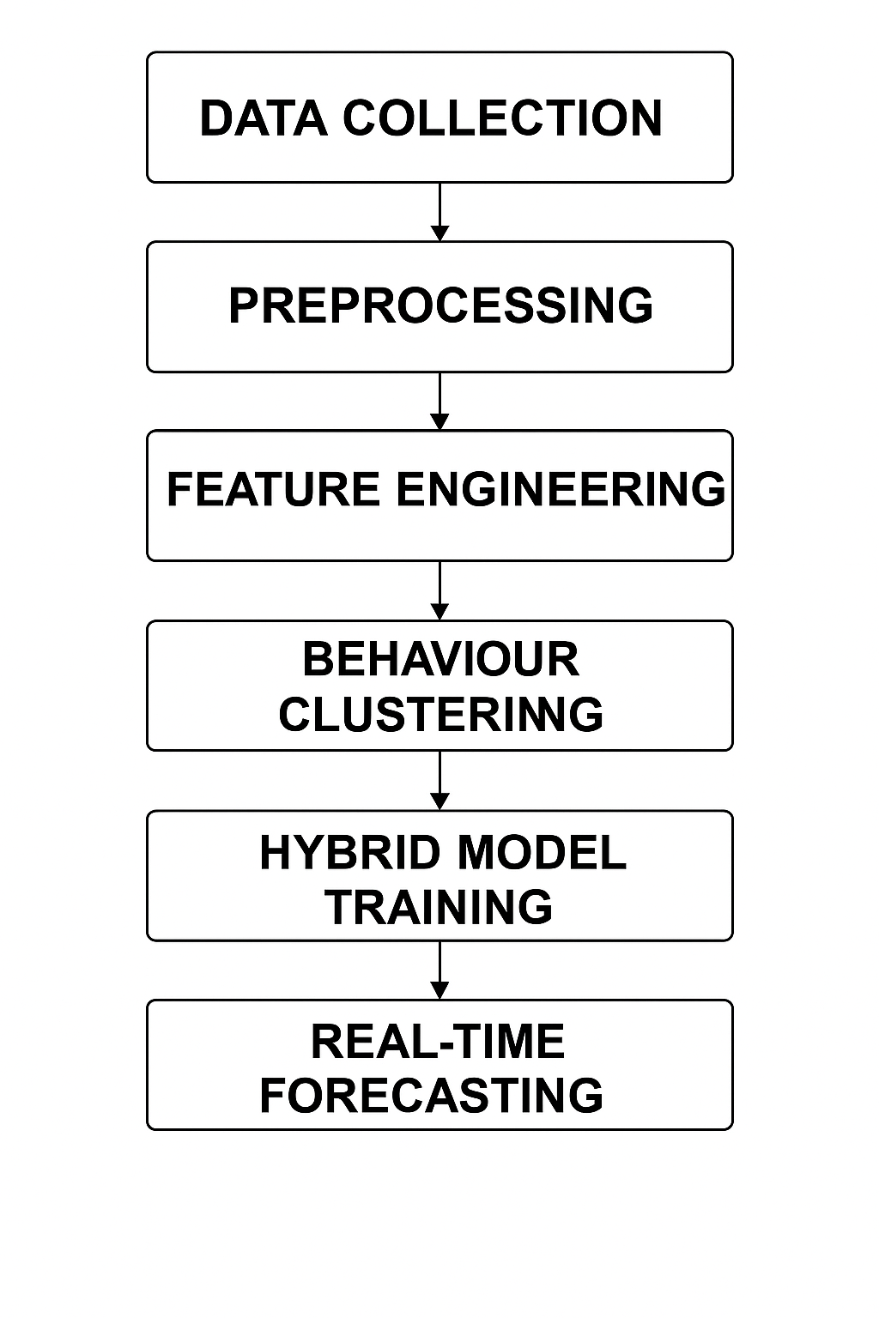
Methodology
1) Data Collection – Solar irradiance, PV output, ambient temperature, time-stamps
2) Preprocessing – Cleaning, smoothing, noise reduction, missing-value handling
3)Feature Engineering – Irradiance variability, rolling mean/std, lag values, time-vectors
4)Behaviour Clustering – K-Means grouping into Sunny, Intermittent-Cloud, Overcast
5)Hybrid Model Training – Cluster-specific ML models (Linear, Random Forest, XGBooster)
6)Real-Time Forecasting – Auto-cluster detection + adaptive prediction + error correction
01
04
FIGURE2 : Flowchart representation of Methodology

Slide 12
Methodology (detailed explanantion)
Data Collection
The first step of the system is collecting relevant solar and environmental data. Solar energy output is highly dependent on changing weather conditions. Therefore, collecting accurate historical and environmental data is essential to build a reliable forecasting system.
The system is designed to operate using standard datasets without requiring expensive hardware sensors or imaging systems.
Data Preprocessing
Raw solar data often contains noise, missing values, and sudden fluctuations caused by cloud movement or atmospheric disturbances.
This step ensures that the forecasting models receive stable and meaningful input data, improving overall prediction accuracy.
Feature Engineering
Instead of directly using raw irradiance values, the system generates additional derived features that help understand solar behavior patterns over time.
These engineered features allow the system to capture trends, fluctuations, and temporal dependencies in solar energy generation.
This step transforms raw data into behavior-aware indicators, making the forecasting process more intelligent.
Behaviour-Based Clustering
After feature extraction, K-Means clustering is applied to classify solar behavior into three main weather regimes:
Sunny
Intermittent-Cloud
Overcast
02
03

Slide 13
Different weather conditions show different statistical characteristics.
Instead of using one single forecasting model for all situations, the system first identifies the current solar behavior pattern.
This clustering step is a core innovation of the system because it allows the forecasting process to adapt according to weather conditions.
Cluster-Specific Hybrid Model Training
Once the data is grouped into behavior clusters, separate lightweight machine learning models are trained for each cluster.
By assigning a specialized model to each weather regime, the system ensures better prediction performance compared to using a single universal model.
This hybrid approach balances accuracy and computational efficiency.
Real-Time Forecasting and Adaptive Error Correction
In the final stage, the system operates in near real-time.
After prediction, an adaptive error-correction mechanism compares predicted values with actual observations and makes minor adjustments if needed.
Additionally, selective retraining is applied only to the underperforming cluster model instead of retraining the entire system.
This reduces computational cost and maintains long-term model efficiency.
In conclusion, the methodology converts solar forecasting from a static prediction problem into an adaptive, behavior-aware intelligent system that improves accuracy while maintaining computational efficiency.
02
03

Slide 14
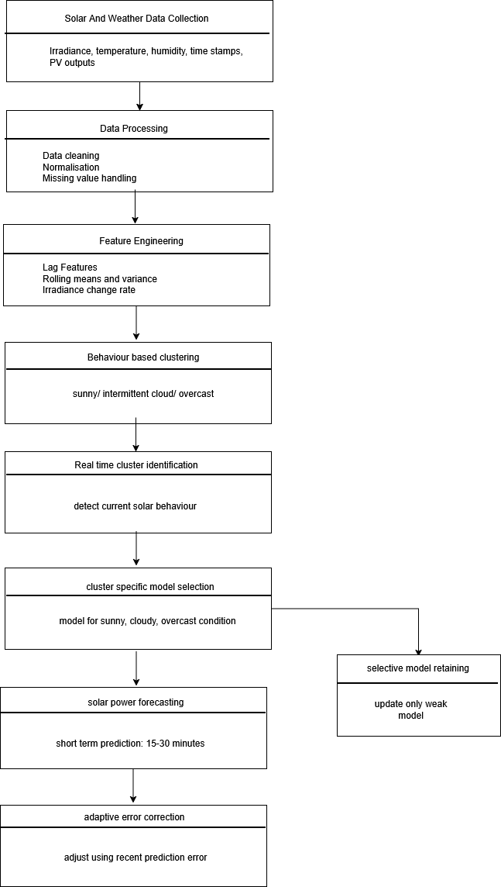
Detailed system architecture:
This diagram represents the complete working flow of the proposed adaptive forecasting system.
The process begins with data acquisition and preprocessing, followed by behaviour-based clustering. Based on the detected solar condition, a specialized model is selected for prediction.
The system then applies adaptive error correction and selectively retrains only the underperforming model to maintain efficiency.
02
Figure 3 : Detailed analysis of flowchart of Hybrid AI-Based Adaptive Weather-Cluster Solar Forecasting System.

Slide 15
Proposed Solution
Our proposed solution focuses on delivering a highly accurate, solar-centric forecasting system:
Develop a solar forecasting system that first identifies the current solar-behaviour pattern (sunny, intermittent-cloud, overcast) using clustering on irradiance variability.
Train small, specialized ML models for each cluster so the model that is best suited for the current solar condition is automatically selected.
Perform real-time cluster detection so that the system dynamically switches to the most appropriate forecasting model based on the latest weather behavior.
Implement a lightweight error-correction loop that adapts predictions based on short-term deviations between predicted and actual solar output.
Enable selective retraining only for the cluster that shows performance drift, minimizing computation and keeping the model fresh.
01
04

Slide 16
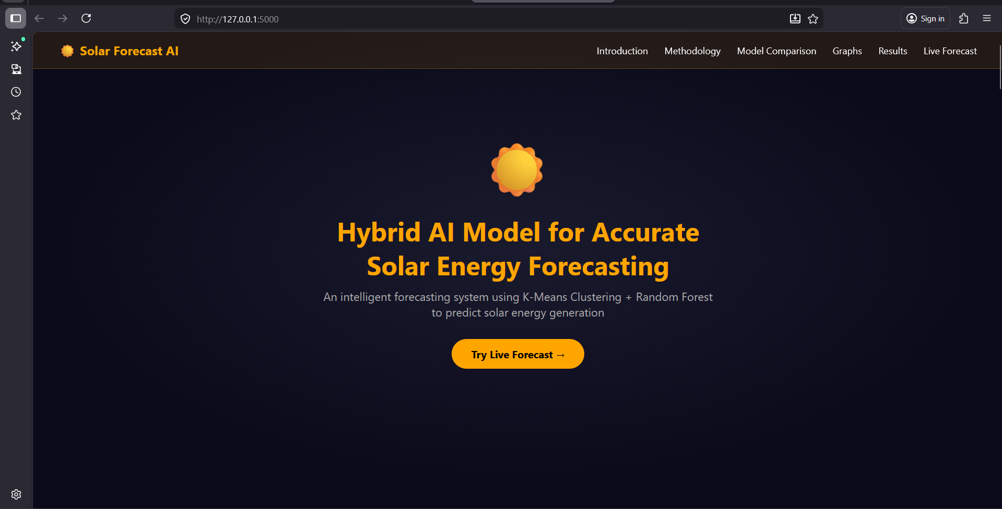
RESULTS AND IMPLEMENTATION
01
04
FIGURE 4 : SYSTEM INTERFACE OVERVIEW : THE FRONT PAGE OF WEBSITE

Slide 17
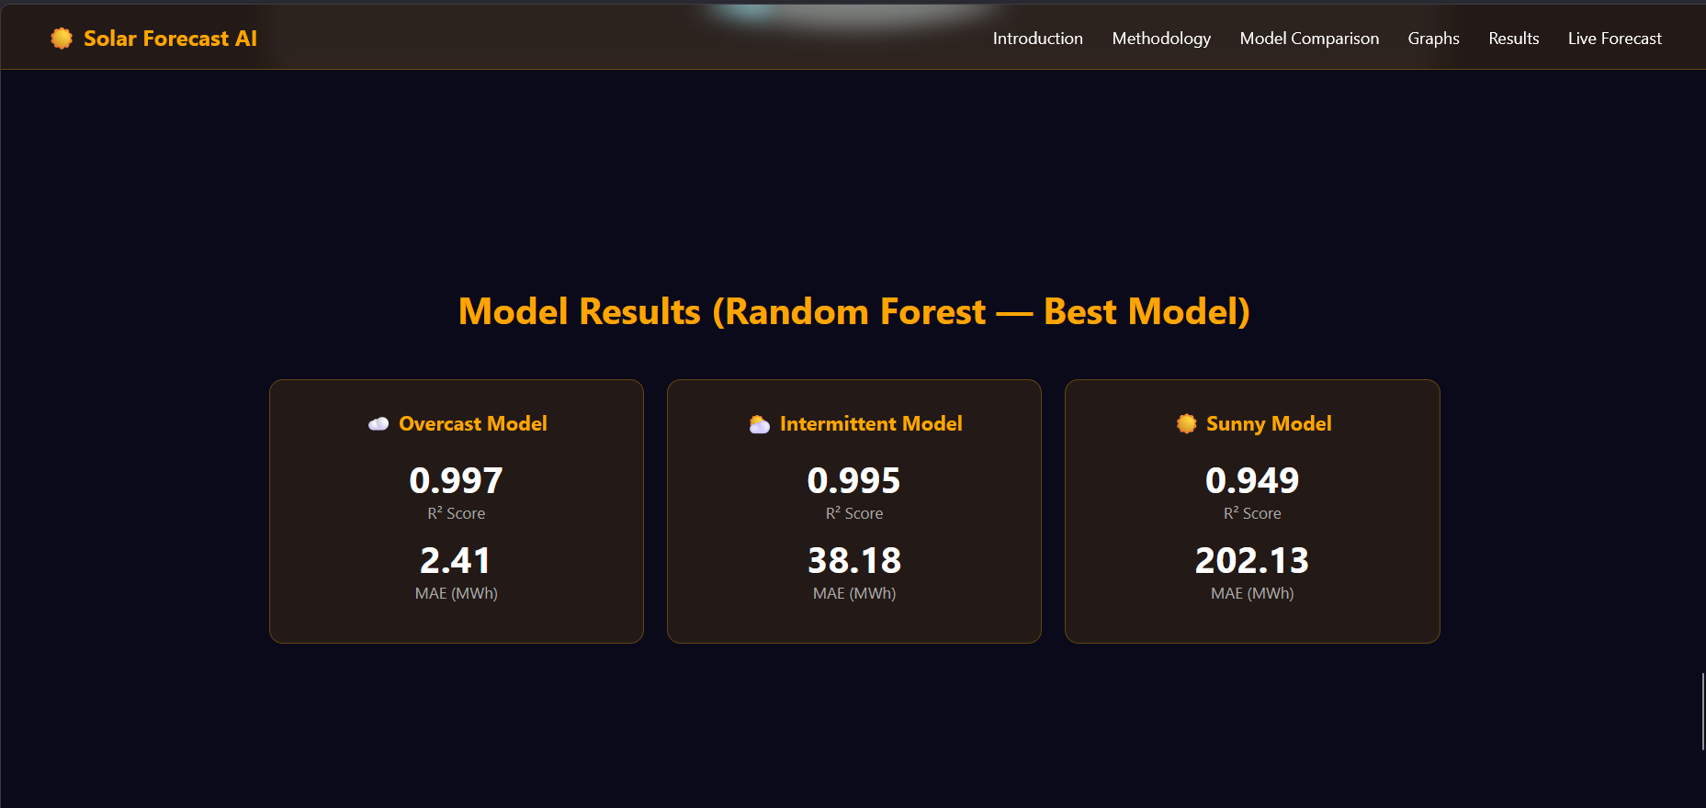
01
04
FIGURE 5 : MODEL RESULTS, USING RANDOM FOREST

Slide 18
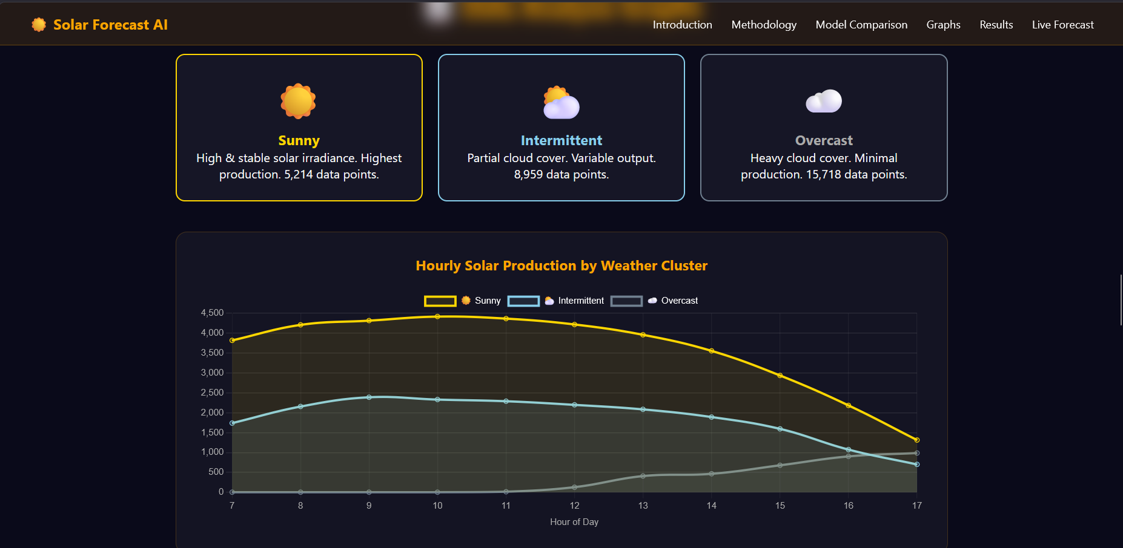
01
04
FIGURE 6 : CLUSTER SCREEN CLASSIFIES INTO THREE WEATHERS

Slide 19
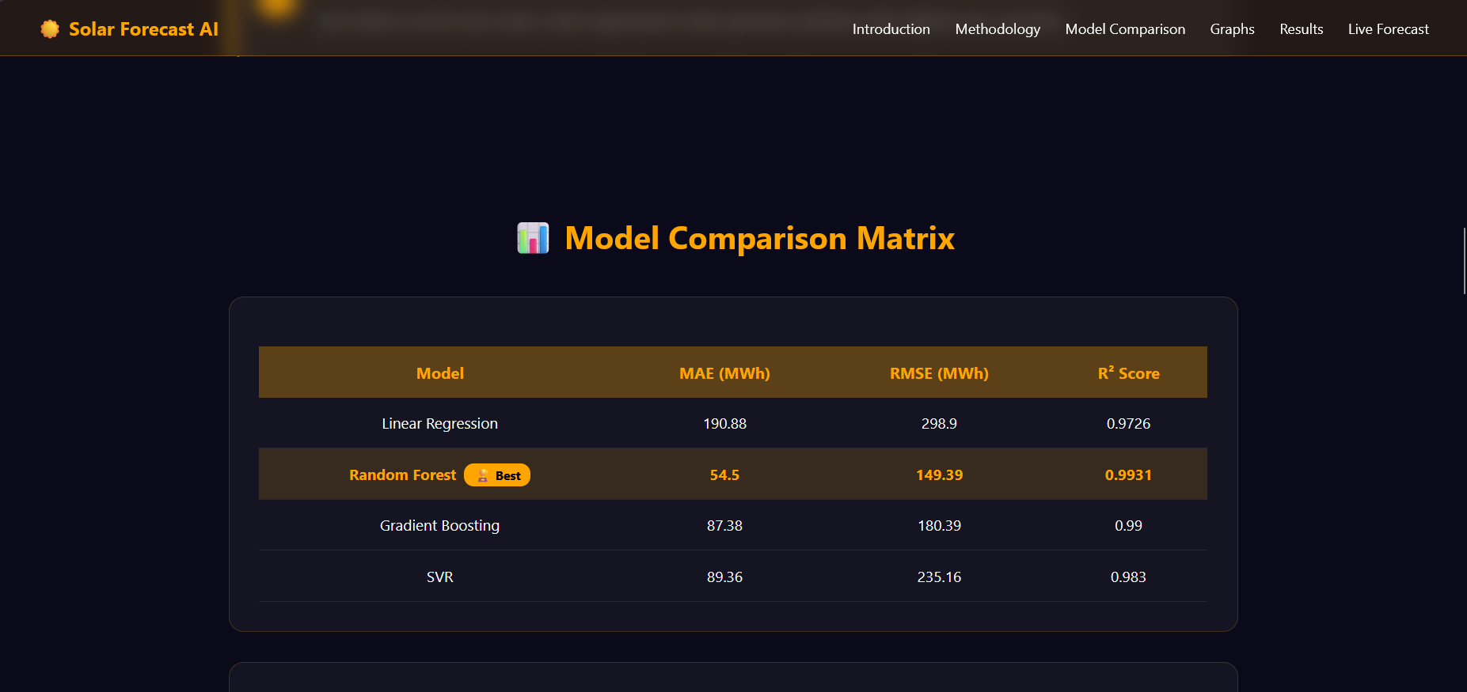
01
04
FIGURE 7 : MODEL COMPARISON , Models evaluated using MAE, RMSE, R²

Slide 20
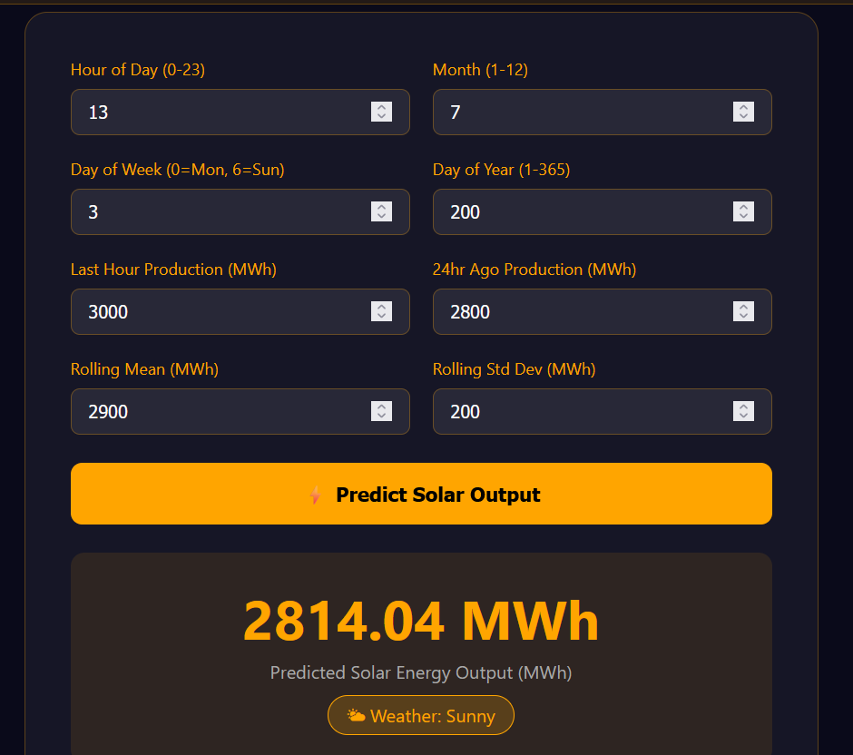
01
04
FIGURE 8 : LIVE FORECAST PREDICTS SOLAR OUTPUTS INSTANTLY

Slide 21
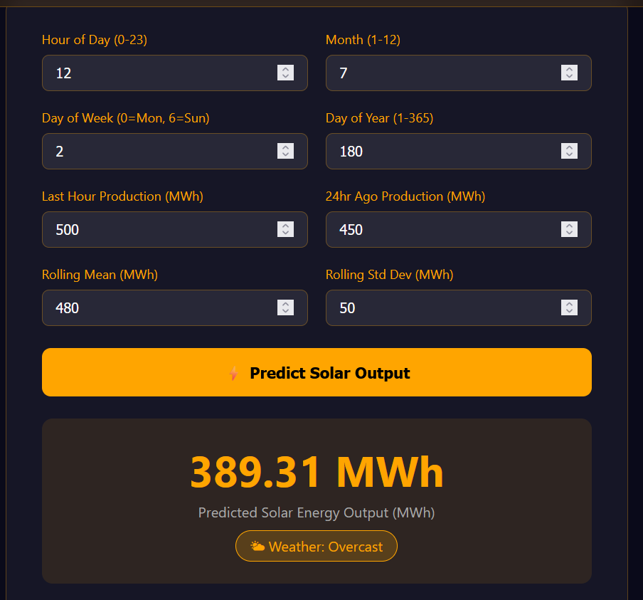
01
04

Slide 22
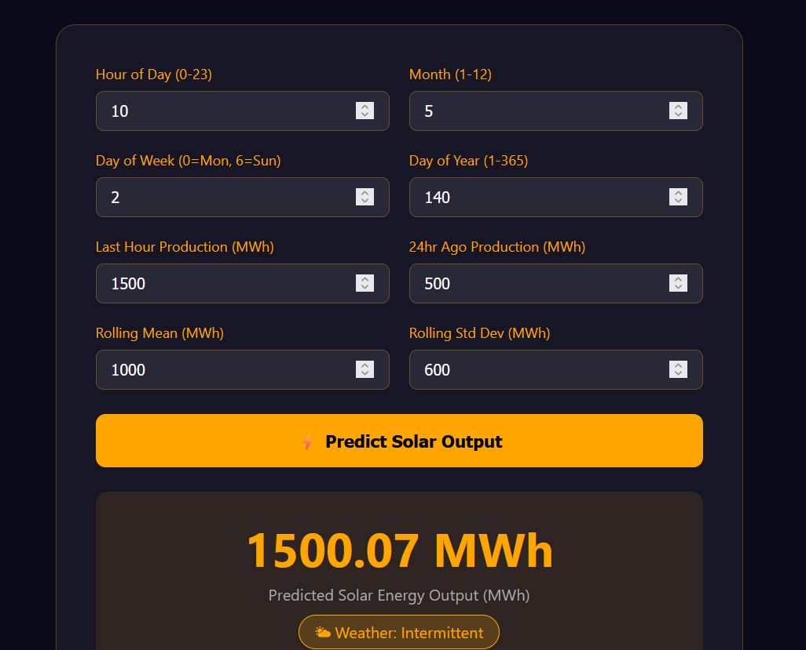
01
04

Slide 23
Comparative Analysis of Models
Model | MAE(MWh) | RMSE(MWh) | R² Score
Linear Regression | 190.88 | 298.90 | 0.9726
Random Forest | 54.50 | 149.39 | 0.9931
Gradient Boosting | 87.38 | 180.39 | 0.9900
SVR | 89.36 | 235.16 | 0.9830
01
Data split: 80% training, 20% testing
Random Forest achieved best performance (R² = 0.9931)
Lowest error observed in Random Forest (MAE = 54.50 MWh)
Linear Regression showed higher error due to inability to capture non-linearity
Gradient Boosting and SVR performed well but were less accurate than Random Fores
Random Forest was selected as the final model due to highest accuracy and lowest prediction error.

Slide 24
CONCLUSION
Developed a hybrid AI-based solar energy forecasting system
Integrated K-Means clustering with machine learning models
Achieved high prediction accuracy (R² up to 0.99)
Random Forest selected as best model based on evaluation metrics
Successfully implemented real-time forecasting using a web interface
01

Slide 25
REFERENCES
[1] Egbuna, I. K., Salihu, F. B., Okara, C. C., & Olayiwola, D. E. (2025). Advances in AI-powered energy management systems for renewable-integrated smart grids. World Journal of Advanced Engineering Technology and Sciences, 15(2), 2300-2325. https://doi.org/10.30574/wjaets.2025.15.2.0685
[2] Sharif, A. A. (2021). AI-Powered Renewable Energy Forecasting: A Hybrid Deep Learning and Physics-Based Model for Solar and Wind Energy Prediction in Smart Grid Applications. International Journal of Emerging Trends in Computer Science and Information Technology, 2(2), 1-7. https://doi.org/10.63282/3050-9246.IJETCSIT-V2I2P101
01
[3] Shan, S., Ding, Z., Zhang, K., Wei, H., Li, C., & Zhao, Q. (2023). ACGL-TR: A deep learning model for spatio-temporal short-term irradiance forecast. Energy Conversion and Management, 284, 116970. https://doi.org/10.1016/j.enconman.2023.116970
[4] Ukoba, K., Olatunji, K. O., Adeoye, E., Jen, T. C., & Madyira, D. M. (2024). Optimizing renewable energy systems through artificial intelligence: Review and future prospects. Energy & Environment, 35(7), 3833-3879. https://doi.org/10.1177/0958305X241256293
[5] Khan, N., Khan, S. U., Ullah, F. U. M., Lee, M. Y., & Baik, S. W. (2023). AI-assisted hybrid approach for energy management in IoT-based smart microgrid. IEEE Internet of Things Journal, 10(21), 18861-18875. https://doi.org/10.1109/JIOT.2023.3293800
[https://www.kaggle.com/datasets/henriupton/wind-solar-electricity-production (datasets)
FIGURE 1:PERCENT OF RENEWABLE ENERGY SOURCE IN TOTAL LITERATURE(https://www.mdpi.com/2076-3417/10/17/5975)
FIGURE2: Flowchart representation of Methodology
04
Figure 3: Detailed analysis of flowchart of Hybrid AI-Based Adaptive Weather-Cluster Solar Forecasting System.

Slide 26
[6] Ladjal, B., Nadour, M., Bechouat, M., Hadroug, N., Sedraoui, M., Rabehi, A., ... & Agajie, T. F. (2025). Hybrid deep learning CNN-LSTM model for forecasting direct normal irradiance: a study on solar potential in Ghardaia, Algeria. Scientific Reports, 15(1), 15404. https://doi.org/10.1038/s41598-025-94239-z
[7] Zhou, H., Liu, Q., Yan, K., & Du, Y. (2021). Deep learning enhanced solar energy forecasting with AI‐driven IoT. Wireless Communications and Mobile Computing, 2021(1), 9249387.https://doi.org/10.1155/2021/9249387
[8] Mariappan, Y., Ramasamy, K., & Velusamy, D. (2025). An optimized deep learning based hybrid model for prediction of daily average global solar irradiance using CNN SLSTM architecture. Scientific Reports, 15(1), 10761. https://doi.org/10.1038/s41598-025-95118-3
[9] Dissawa, L. H., Godaliyadda, R. I., Ekanayake, P. B., Agalgaonkar, A. P., Robinson, D., Ekanayake, J. B., & Perera, S. (2021). Sky Image‐Based Localized, Short‐Term Solar Irradiance Forecasting for Multiple PV Sites via Cloud Motion Tracking. International Journal of Photoenergy, 2021(1), 9973010. https://doi.org/10.1155/2021/9973010
FIGURE 4 : SYSTEM INTERFACE OVERVIEW : THE FRONT PAGE OF WEBSITE
FIGURE 5 : MODEL RESULTS, USING RANDOM FOREST
FIGURE 6 : CLUSTER SCREEN CLASSIFIES INTO THREE WEATHERS
04
FIGURE 7 : MODEL COMPARISON , Models evaluated using MAE, RMSE, R²
FIGURE 8 : LIVE FORECAST PREDICTS SOLAR OUTPUTS INSTANTLY

Slide 27

THANK YOU
Ananya Sharma
2427030109
ananya.2427030109@muj.manipal.edu

