Slide 1
Employee Dataset — Data Analysis
Creative, colorful presentation with real analysis and visuals

Slide 2
Objective & Outcomes
• Analyze employee data to extract salary, dept, experience, and performance insights.
• Outcomes: Visual insights, code snippets, recommendations for HR.

Slide 3
Dataset Overview
Rows: 1000
Columns: 19
Detected columns: Employee_ID, First_Name, Last_Name, Gender, Age, Department...
Preview (first 5 rows):
Employee_ID First_Name Last_Name Gender Age Department Job_Title Hire_Date Salary Experience_Years Performance_Score Bonus Promotion_Last_Year City State Country Education_Level Marital_Status Remote_Work _parsed_date _year
EMP1000 Wendy Wallace Male 37 Engineering Chartered public finance accountant 2017-12-02 78108 34 4 11786.82 No Lake Brandon Washington USA High School Single Yes 2017-12-02 2017
EMP1001 Jessica Lamb Female 29 HR Sports development officer 2024-09-08 101918 39 1 12006.97 No West David Missouri USA Master's Divorced No 2024-09-08 2024
EMP1002 Sara Cohen Male 53 Finance Nurse, adult 2016-02-20 69171 13 1 10302.86 No Stephenmouth Connecticut USA Bachelor's Single No 2016-02-20 2016
EMP1003 David Rangel Male 40 Sales Music therapist 2019-05-13 76779 34 2 13250.16 No North Megan Hawaii USA PhD Single Yes 2019-05-13 2019
EMP1004 Katherine Vargas Male 33 IT Pharmacist, hospital 2021-06-26 103828 19 2 5366.71 No East Kristi Pennsylvania USA High School Married Yes 2021-06-26 2021

Slide 4
Step 1: Upload & Read Data
Code:
import pandas as pd
df = pd.read_csv('employee_dataset.csv')
df.head()

Slide 5
Step 2: Mean & Mode
Code:
mean_salary = df['Salary'].mean()
print(mean_salary)
Average salary: 90150.80

Slide 6
Step 3: Min & Max
Code:
min_salary = df['Salary'].min()
max_salary = df['Salary'].max()
print(min_salary, max_salary)
Min: 35155
Max: 149914

Slide 7
Step 4: Filtering Data
Code:
experienced = df[df['Experience_Years'] > 5]
experienced.head()

Slide 8
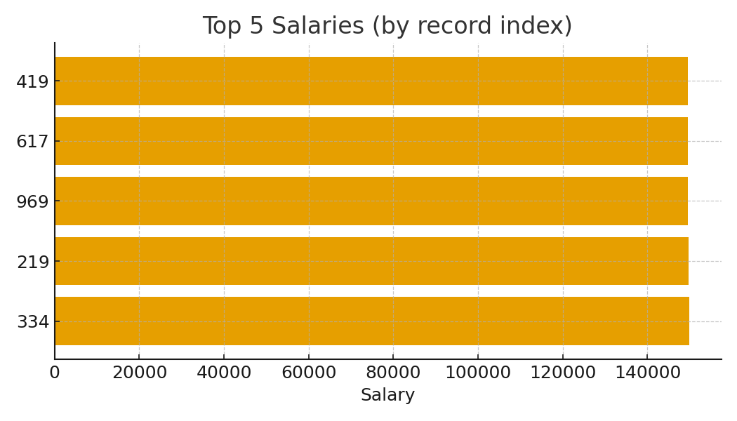
Step 5: Sort (Descending)
Code:
sorted_desc = df.sort_values(by='Salary', ascending=False)
sorted_desc.head()

Slide 9
Step 6: Sort (Ascending)
Code:
sorted_asc = df.sort_values(by='Salary', ascending=True)
sorted_asc.head()

Slide 10
Step 7: Grouping Data
Department or Salary column not detected.

Slide 11
Step 8: Visualizations
Generated charts: dept counts, avg salary by dept, experience vs salary scatter, salary histogram, top5 salaries, average salary by year (if date present).

Slide 12
Employee Count by Department
Dept counts chart not available.

Slide 13
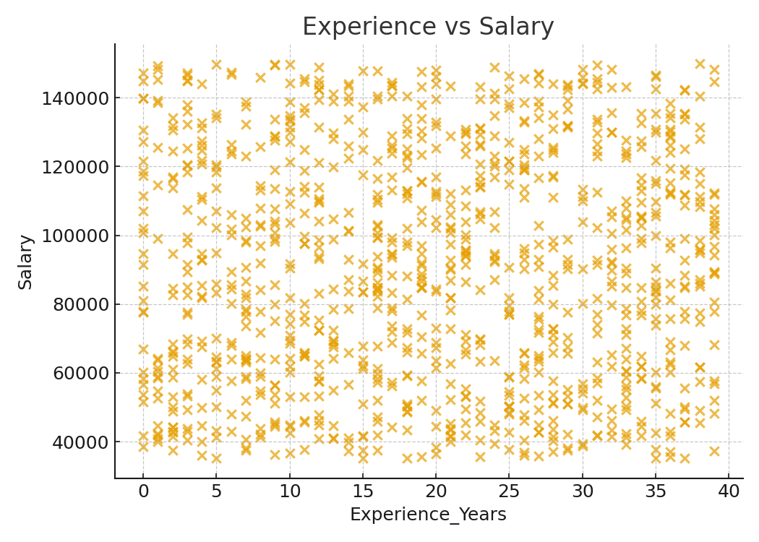
Experience vs Salary (Scatter)
Corr: 0.03

Slide 14
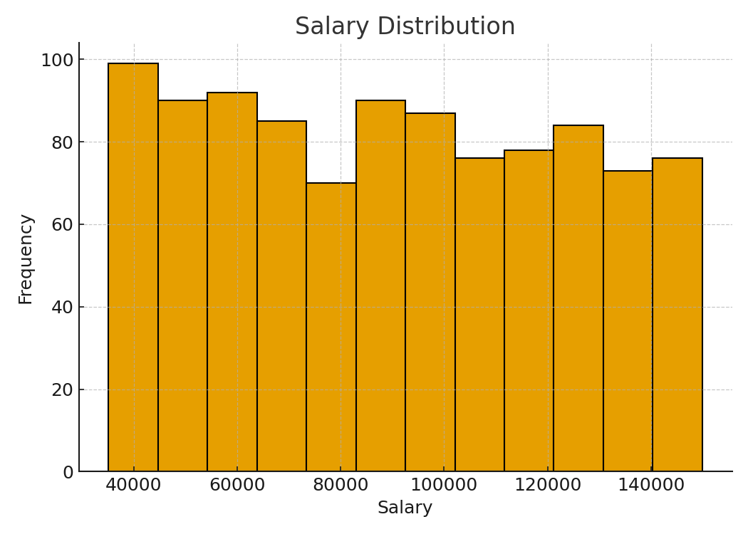
Salary Distribution

Slide 15
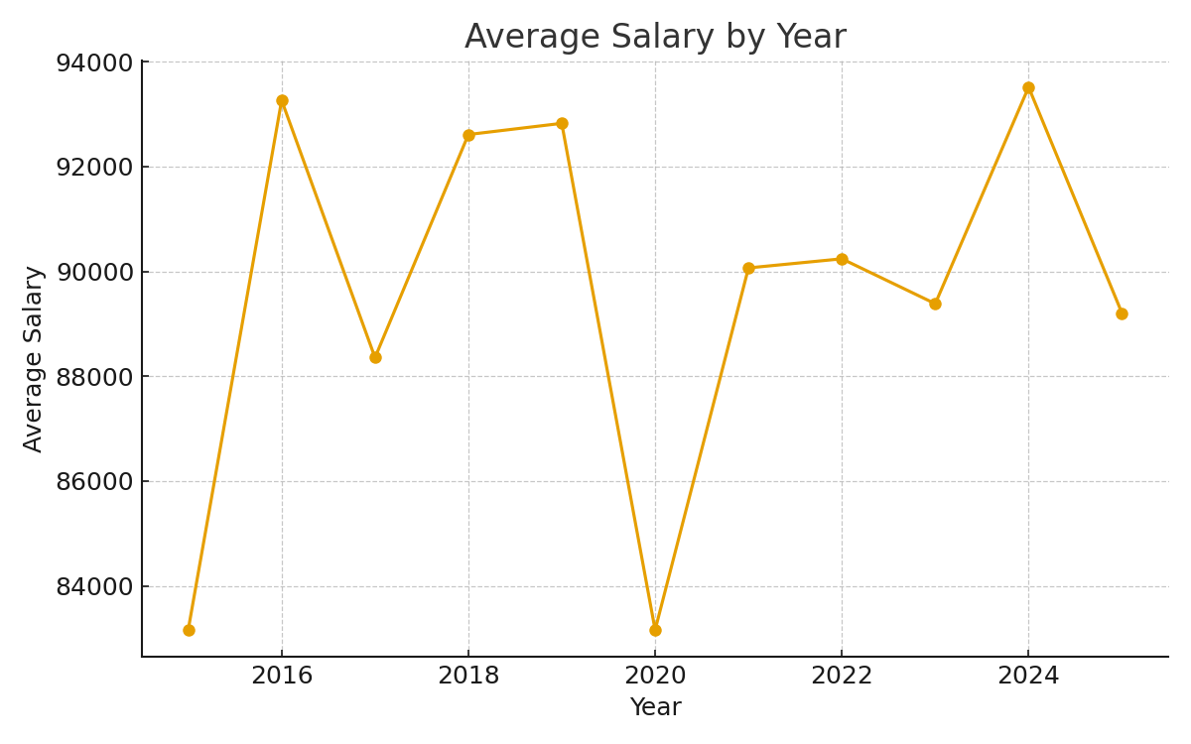
Average Salary by Year

Slide 16
Top 5 Salaries

