Slide 1
FINTECH · BFSI
Credit Card
Fraud Detection
4457 9090 0437 5050
Tableau Dashboard · Data Analytics & Visualization
CARDHOLDER
VALID THRU
TEAM E_G14
12/26
TEAM ID E_G14
Team: Ananya Soni · Shaurya Sharma · Parrv Luthra · Yug Johri · Ranajeet Roy
Mentor: Aayushi Vashishth
FRAUD ANALYTICS · 2026

Slide 2




PROBLEM STATEMENT
The $12.5M Question
Detecting Fraud Without Punishing Real Customers
1.71%
$12.5M
$730 vs $174
Fraud Rate
Total Fraud Loss
Fraud vs Legit Avg $
17,143 fraud cases on 1M transactions
Direct exposure ($12,516,734)
Fraud transactions are ~4.2× larger
OBJECTIVE Surface high-risk transactions early, recover preventable losses (~$249K identified), and reduce friction for the 98.3% of legitimate customers.
CREDIT CARD FRAUD DETECTION · TEAM E_G14
2 / 10

Slide 3





DATA & ARCHITECTURE
Data Foundation & Dashboard Design
DATA SOURCES
5-PAGE DASHBOARD ARCHITECTURE
Synthetic Transaction Dataset
01
Fraud Monitoring
Source: Kaggle · global, multi-currency
Headline KPIs · Time series · Hour & weekday trends
1M
17K
201
02
Transaction & Risk Analysis
Transactions
Fraud Cases
Rings Detected
Amount × fraud · IP risk · Device · 2FA · Foreign
KEY SIGNALS USED
03
Category, Geo & Account
ip_risk_score
Network-level risk indicator
Country map · Merchant categories · Account types
device_known
Returning vs unknown device
04
Fraud Pattern & Network
Pattern distribution · Avg by type · Linked accounts
is_foreign_txn
Cross-border activity flag
05
Detection & Actionable Insights
has_2fa
Two-factor auth presence
Risk score · Factor contribution · Preventable loss
CREDIT CARD FRAUD DETECTION · TEAM E_G14
3 / 10

Slide 4

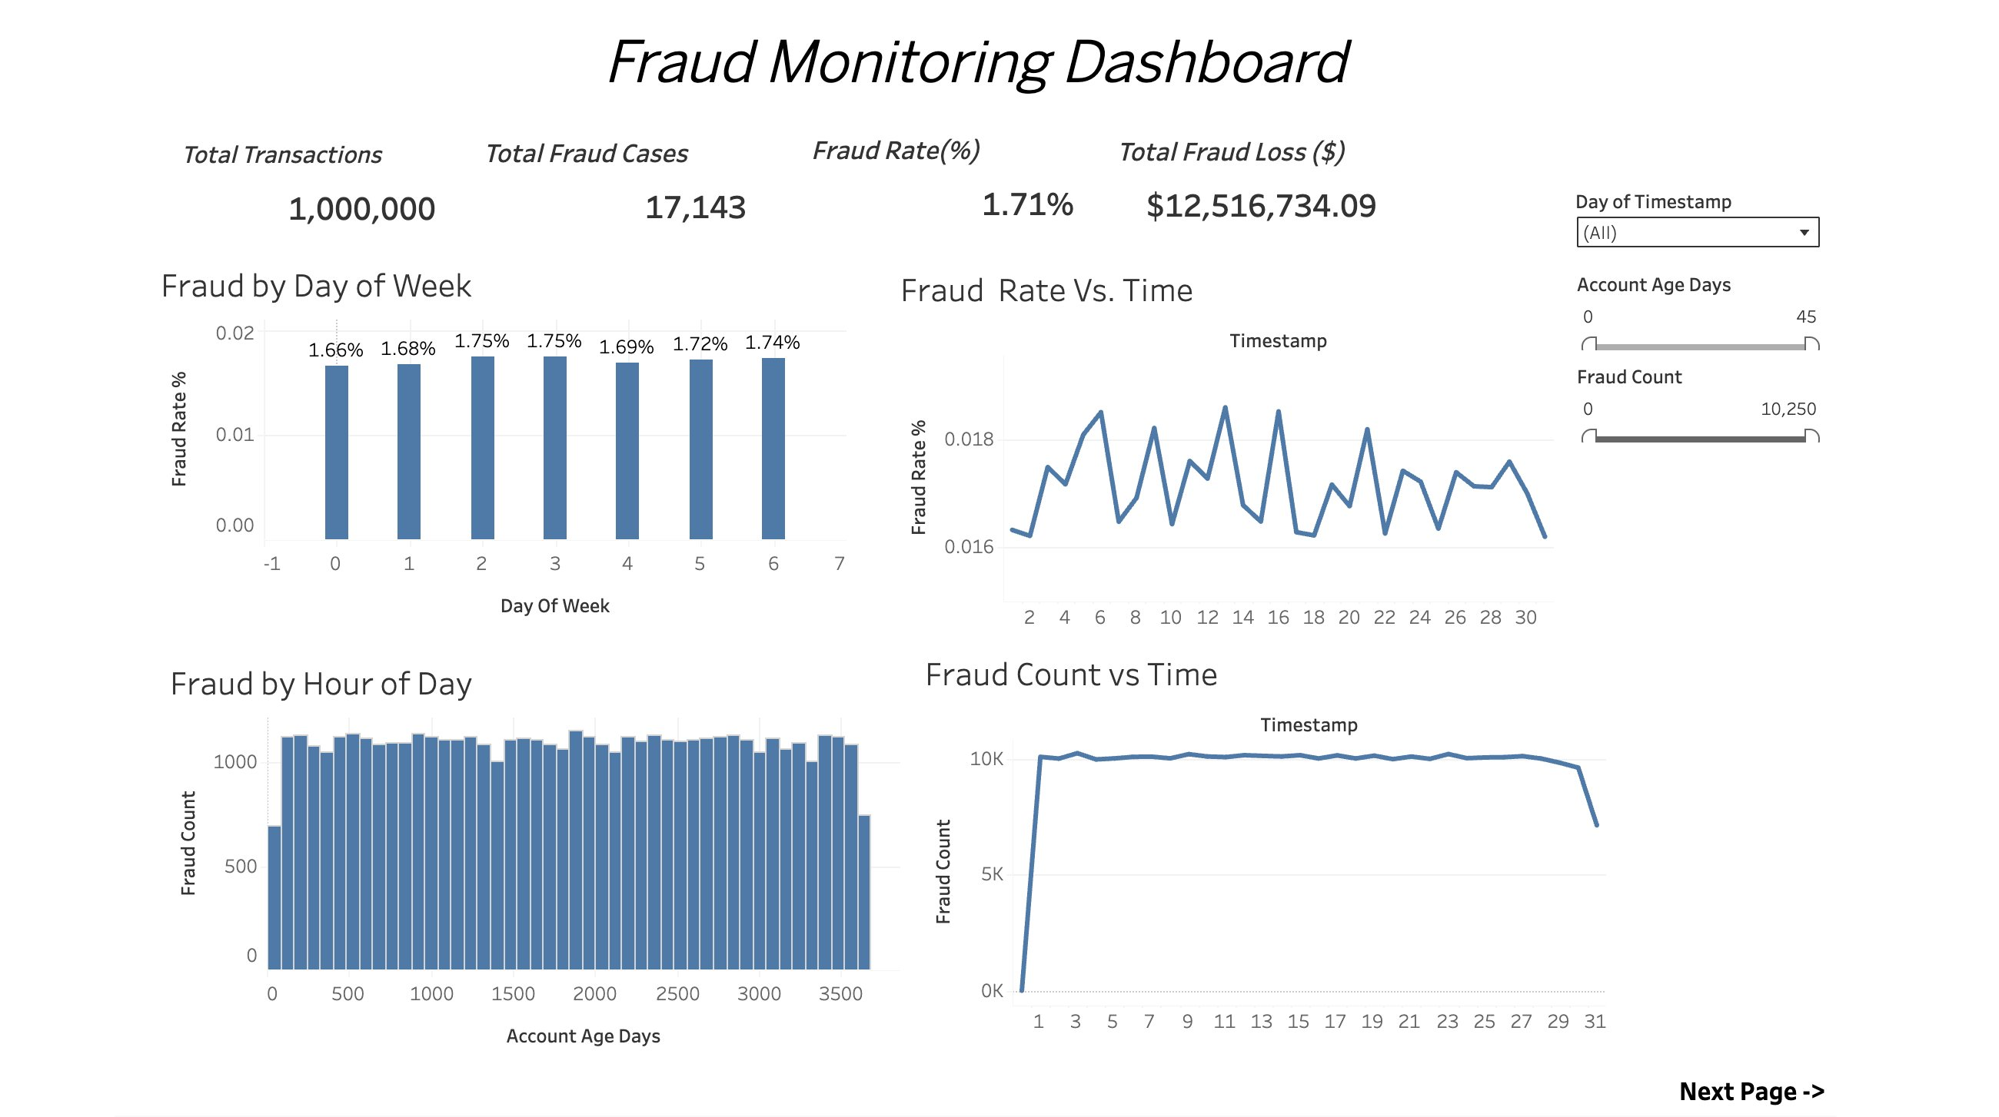
DASHBOARD · PAGE 1
Executive Overview — Fraud Monitoring
1,000,000
17,143
1.71%
$12.5M
Total Transactions
Total Fraud Cases
Fraud Rate
Total Fraud Loss
DASHBOARD READOUT
Steady fraud rate ~1.66–1.75%
Across all weekdays — no obvious calendar gap to exploit.
Hour distribution is flat
Volume per hour is uniform; detection cannot rely on time alone.
Stable fraud count ~10K/day
Sharp drop on the final day signals incomplete data window.
Account age does not correlate
Fraud appears across the full 0–3,500 day age range.
CREDIT CARD FRAUD DETECTION · TEAM E_G14
4 / 10

Slide 5
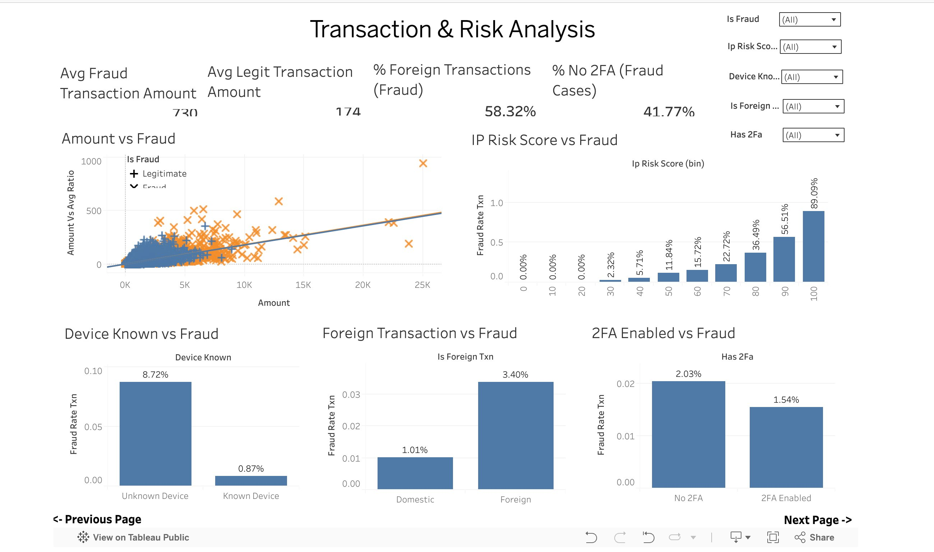
DASHBOARD · PAGE 2
Transaction & Risk Analysis
The Amount × Fraud scatter shows fraud transactions are larger and ride above the trend — risk concentrates as ticket size grows.
KEY METRICS
$730
Avg Fraud Amount
vs $174 legit · 4.2× higher
58.32%
Fraud is Foreign
Cross-border activity dominates
41.77%
Fraud has No 2FA
Missing auth is highly predictive
89.09%
IP Risk Score = 100
Top IP-risk band is essentially fraud
CREDIT CARD FRAUD DETECTION · TEAM E_G14
5 / 10

Slide 6
DASHBOARD · PAGE 2 CONT.
Risk Signal Breakdown — Real Numbers
Three independent fraud signals — each separates fraud from legitimate transactions by 1.3× to 10×.
DEVICE KNOWN
FOREIGN TRANSACTION
2FA ENABLED
Fraud rate by device recognition
Fraud rate domestic vs foreign
Fraud rate with vs without 2FA
Unknown device = 10× the fraud rate of a returning device.
Foreign transactions carry 3.4× the domestic fraud rate.
Missing 2FA correlates with higher fraud — and 41.77% of fraud cases skip it.
CREDIT CARD FRAUD DETECTION · TEAM E_G14
6 / 10

Slide 7
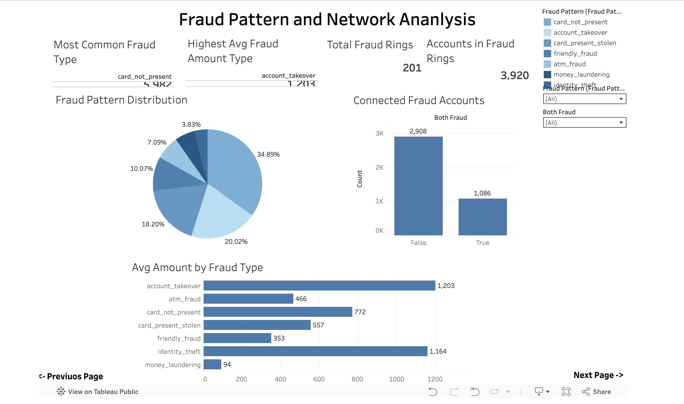
DASHBOARD · PAGE 4
Fraud Pattern Distribution & Avg Amount
Card-not-present is the dominant fraud type by count; account_takeover leads by average $ value at $1,203 per incident.
PATTERN BREAKDOWN
Share · Avg Amount
card_not_present
34.89%
$772
account_takeover
20.02%
$1,203
card_present_stolen
18.20%
$557
friendly_fraud
10.07%
$353
atm_fraud
7.09%
$466
identity_theft
—
$1,164
money_laundering
3.83%
$94
CREDIT CARD FRAUD DETECTION · TEAM E_G14
7 / 10

Slide 8



DASHBOARD · PAGES 3 & 4
Fraud Rings & Connected Accounts
201 fraud rings link 3,920 accounts — and 26.7% of fraud accounts are connected to at least one other.
201
CONNECTED FRAUD ACCOUNTS
Counts from Page 4: 'Both Fraud' analysis
Total Fraud Rings
Distinct connected clusters detected
3,920
Accounts in Rings
Linked through shared fraud signals
26.72%
Fraud Accounts Connected
TAKEAWAY Catching one ring node lets investigators surface the other 1,086 linked fraud accounts.
Tied to at least one other fraud account
CREDIT CARD FRAUD DETECTION · TEAM E_G14
8 / 10

Slide 9
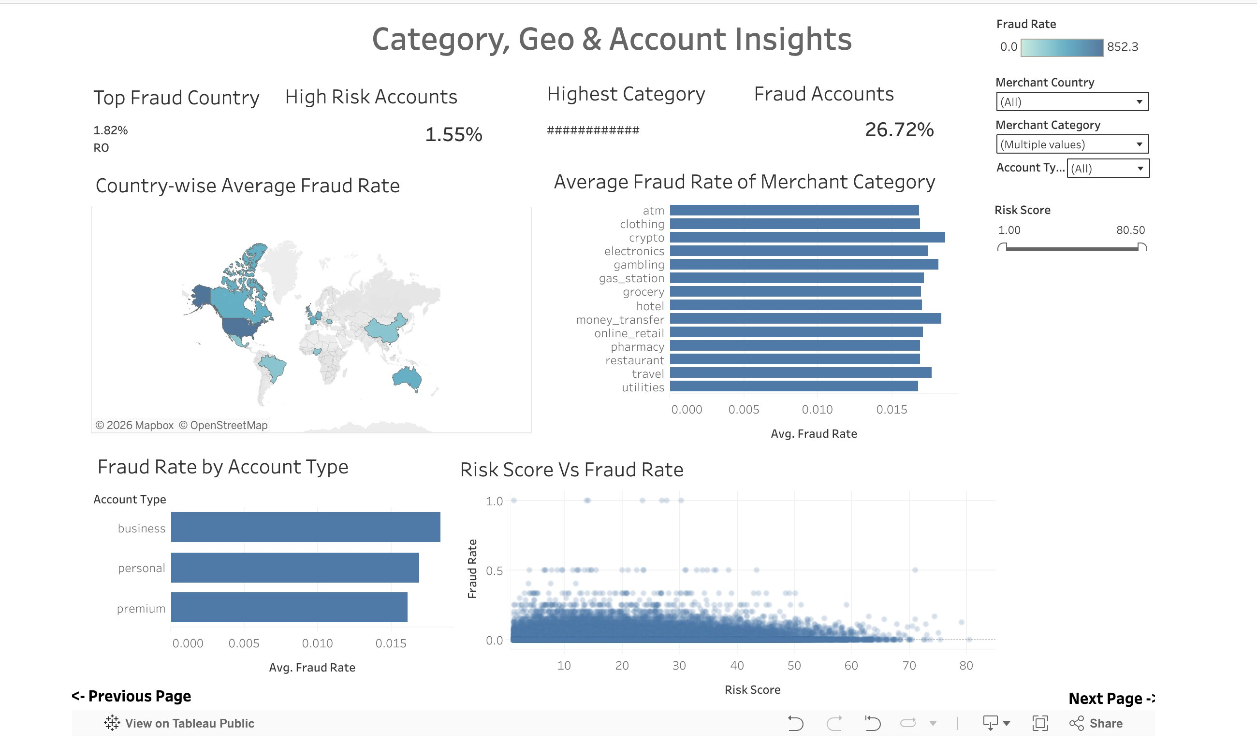
DASHBOARD · PAGE 3
Geographic Hotspots & Investigation Workflow
Top fraud country: Romania (RO) at 1.82%. Highest-risk merchant categories: crypto, gambling, money_transfer.
INVESTIGATION WORKFLOW
1
DETECT
Risk score crosses threshold; transaction flagged for review.
2
TRIAGE
Geo-routing assigns case to regional analyst pool by hotspot.
3
INVESTIGATE
Analyst reviews velocity, device, and ring linkage in case view.
4
RESOLVE
Block, clear, or escalate — outcome retrains the model.
CREDIT CARD FRAUD DETECTION · TEAM E_G14
9 / 10

Slide 10





FINDINGS & RECOMMENDATIONS
Key Findings → Five Rules → Real Impact
KEY FINDINGS
RECOMMENDED RULES
BUSINESS IMPACT
Unknown device = 10× risk
01
$249K
8.72% fraud rate vs 0.87% on known devices.
Step-up Auth on Unknown Device
02
Preventable Loss
Foreign-Txn Friction & Limits
Identified by risk-score model ($249,219.16)
Foreign txns dominate fraud
58.3% of fraud is cross-border; 3.4× domestic rate.
775
03
Block / Hold on IP Risk ≥ 90
IP risk is decisive
High-Risk Txns Flagged
Risk band 100 → 89.09% fraud rate.
04
Surfaced for immediate review
Enforce 2FA on Risky Sessions
Organized rings detected
1,086
05
201 rings linking 3,920 accounts.
Auto-Freeze Linked Ring Accounts
Linked Accounts to Freeze
Connected to confirmed fraud nodes
Fraud is predictable and preventable — this dashboard surfaces $249K of immediately actionable risk.
CREDIT CARD FRAUD DETECTION · TEAM E_G14
10 / 10

