Slide 1
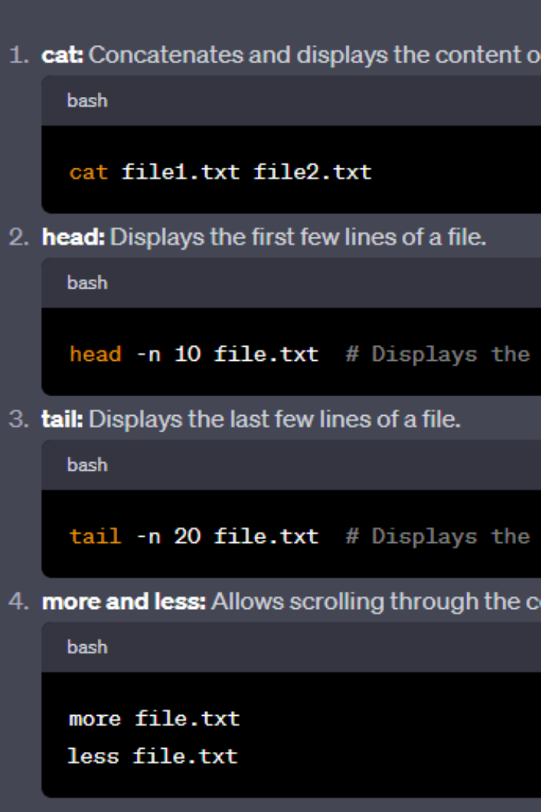


Linux File Processing Utilities and Commands
Linux file processing utilities and commands offer a world of convenient functions for developers, analysts, and system administrators, making everyday tasks much simpler. Below are some practical examples to give you a head start.
by bandham ananya

Slide 2
Displaying File Content
cat
head and tail
Concatenate and display entire file content.
Display first/last lines of a file, specify number of lines shown with -n flag.

Slide 3
Searching for Text Patterns in Files
1
grep
Searches for the pattern in a file or stream, can be used with regex format.
ack
2
A powerful tool designed for developers, looks for code patterns, and is customizable.
3
find
Searches for files and directories with specific name, size, or modified time.

Slide 4
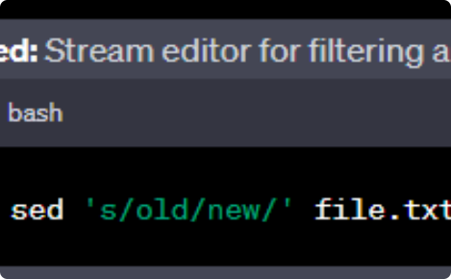
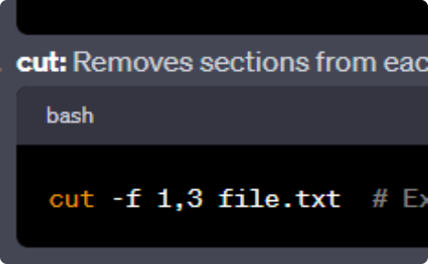
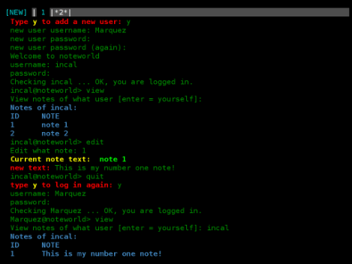
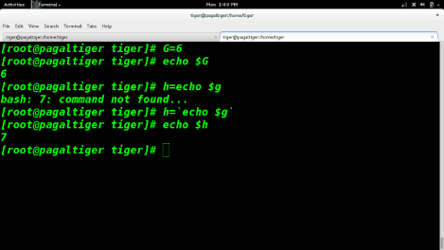
Text Manipulation and Structured Data Processing
sed
cut
A stream editor used to perform basic text manipulations on an input stream.
Cuts out sections from each line of a file and writes them to standard output.

Slide 5
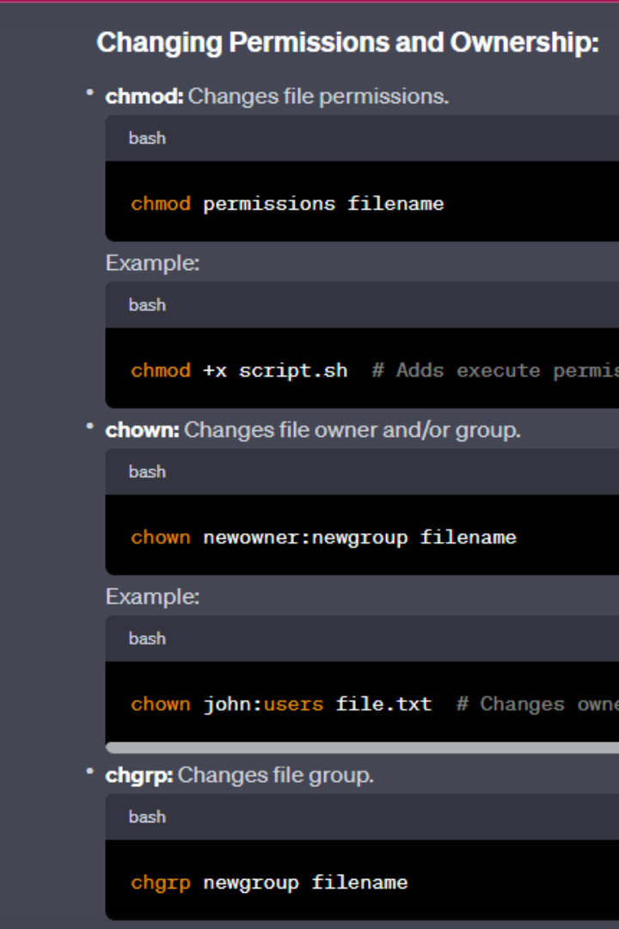
File Permissions and Ownership
1
chmod
2
chown
Changes the file mode (permissions) of the specified file.
Changes the user and/or group ownership of each given file.
3
umask
Sets the file mode creation mask for the process, which determines the permissions of newly created files.

Slide 6
Archiving and Compressing Files
tar
gzip
zip
Archive files and directories into a tarball file.
Compress files using the gzip algorithm to reduce file size.
Archive and compress files into a zip file.
Usage example:
Usage example:
Usage example:
tar -cvf archive.tar file1.txt file2.txt dir1 dir2
gzip file.txt
zip compressor.zip file1.txt file2.txt

Slide 7
Process Management and System Performance
ps
top
Lists the currently running processes, displays their IDs, statuses, and other information.
Displays the system resources being used by processes in real-time, sorted by CPU or memory usage.
nice
kill
Changes the priority of a process, which controls how much system resources the process can consume.
Sends a signal to processes, ending the process under certain defined circumstances.

Slide 8
Networking and Connectivity
1
ifconfig
Shows network interfaces and their configurations.
ping
2
Sends packets to another network device and measures the response time.
3
traceroute
Displays the route packets travel to reach a remote host.
curl
4
A command-line tool for transferring data from or to a server, supports many protocols.

