Slide 1

MACHINE LEARNING · PBL-II · PROJECT REVIEW 2
Jailbreaker-LLM
Finding LLM compliance states without labels: PCA, K-means, Gaussian mixtures with EM, and hierarchical clustering
Unit 3: mixture models, EM, latent dimensions and clustering
NumPy analysis plus standalone K-means with no imports
Ananya Kar
RA2411003010453 · 21CSC305P
Notes:
Review 2 adds PCA, K-means, Gaussian mixture EM and hierarchical clustering to the current GitHub codebase. Results are from a generated synthetic campaign.

Slide 2
INTERACTIVE CONTENTS
Choose a section
Each card jumps to its section. Each model is shown as its mathematical model, then its NumPy code, then the measured result.
01
Problem and Review 2 scope
02
Dataset and setup
OPEN SECTION · SLIDE 03
OPEN SECTION · SLIDE 05
03
PCA
04
K-means and GMM-EM
OPEN SECTION · SLIDE 07
OPEN SECTION · SLIDE 08
05
Hierarchical and results
06
Code, limits, references
OPEN SECTION · SLIDE 10
OPEN SECTION · SLIDE 12

Slide 3
What Review 2 adds to the project
REVIEW 2 SCOPE
The GitHub codebase adds unsupervised models and a no-import K-means script
REVIEW 2 BRIEF
HOW THE REVIEWS BUILD ON EACH OTHER
Draft the mathematical model for the problem and implement it as a Python script, avoiding Python libraries.
Review | Content | Status
1 | EDA, linear regression, logistic regression and SVM classification | Presented
2 | PCA, K-means, Gaussian mixture (EM), hierarchical clustering | This deck
3 | HMM, CART and ensembles, comparative analysis | Next
Component | Marks
Mathematical modelling of the algorithm | 2
Python script for the mathematical model | 3
NumPy models: src/analysis/unsupervised.py
No-import script: review2_kmeans_pure_python.py
Both fit synthetic judge scores without labels
Same question as Review 1, now without labels: can the hidden compliance state be recovered from judge scores alone?
The labels are used only afterwards, to score the clusters.
PROBLEM AND SCOPE
CONTENTS
PREVIOUS
NEXT
03 / 14
Notes:
Course plan section 9.0, Project Review 2: mathematical model (2 marks) plus a Python script for it (3 marks), avoiding Python libraries.

Slide 4
Where the unsupervised step sits in the red-team system
PROBLEM STATEMENT
Judges score every turn of a red-team conversation. Unsupervised models test whether those scores alone reveal the target's state
RED-TEAM PIPELINE (UNCHANGED)
Synthetic category seeds
(generated locally)
PPO attacker
Qwen2.5-0.5B + LoRA
Target LLM
(allowlisted)
Reward and Eval
judges (DistilBERT)
Transcript
+ report
same row schema
MAIN_ANALYSIS.PY · REVIEW 2 STEP
Synthetic campaign
978 turns, 220 conversations,
known hidden state
Standardize
3 live-judge probabilities
z = (x − μ) / σ
PCA
3-D → 2-D
(the scores sum to 1)
Cluster
K-means · GMM-EM ·
hierarchical
Evaluate
ARI, silhouette,
matched accuracy
QUESTION
WHY IT MATTERS
Without labels, do judge scores fall into three groups that match refusal, partial compliance and full violation?
Human labels are expensive. If score clusters track the true state, clusters can flag turns for review without a labelled set.
PROBLEM AND SCOPE
CONTENTS
PREVIOUS
NEXT
04 / 14
Notes:
Pipeline paths are documented in README.md. Review 2 runs as step 6 of main_analysis.py after synthetic campaign generation.

Slide 5
A simulated campaign whose hidden states are known
DATASET
The repository generates simulated conversations with known states so each cluster can be checked
SYNTHETIC MULTI-TURN CAMPAIGN
GENERATING MODEL
978
220
3
6
z₁ ~ Cat(0.75, 0.20, 0.05)
z_t | z_{t−1} ~ A_target[z_{t−1}, ·]
(p_ref, p_par, p_full) ~ Dirichlet(α_{z_t})
A conversation stops when the judge's P(full) ≥ 0.5, or after 6 turns
turns
conversations
target profiles
max turns
Hidden state z | Turns
Refusal | 523
Partial compliance | 311
Full violation | 144
DATA BOUNDARY
Rows use the real campaign transcript schema (data/generate_synthetic_campaign.py, seed 42), so the same code runs on a real campaign.
These results use the generated synthetic campaign. Review 1 examined a separate real-data baseline; do not compare the two as one dataset.
DATA
CONTENTS
PREVIOUS
NEXT
05 / 14
Notes:
Upward transitions are scaled by 0.6, 1.0 and 1.6 for the guarded, baseline and weak synthetic target profiles. The 978-turn dataset is generated locally with seed 42; it is separate from Review 1 real-data baselines.

Slide 6
Features, standardization and the simplex constraint
MATHEMATICAL SETUP
Turn-level models use the three judge probabilities; hierarchical clustering uses one row per conversation
TURN-LEVEL INPUT
CODE SNIPPET
src/analysis/unsupervised.py
01 df = load_transcript_rows().dropna(subset=['true_compliance_state'])
02 y = df['true_compliance_state'].map(COMPLIANCE_STATES.index).values
03 X = df[SCORE_COLUMNS].values
04 X = (X - X.mean(axis=0)) / X.std(axis=0)
05
06 mean, U, ratio = pca(X)
07 Z = (X - mean) @ U[:, :2] # 2-D principal subspace
08
09 km_labels = kmeans(Z, 3)[0]
10 gmm_labels = gmm_em(Z, 3)[0]
11 hc_labels = agglomerative(C, 3, 'complete')
xₙ = (P_refusal, P_partial, P_full) ∈ ℝ³
zₙ = (xₙ − μ) / σ (per column)
P_refusal + P_partial + P_full = 1
Because of this constraint the points lie on a plane, so one direction carries no variance. PCA should find it.
CONVERSATION-LEVEL INPUT (HIERARCHICAL)
Mean P_refusal, P_partial and P_full; peak P_full; number of turns; final P_full. That is 220 × 6, standardized.
y is never passed to a model. It is only compared with the clusters afterwards.
DATA
CONTENTS
PREVIOUS
NEXT
06 / 14

Slide 7
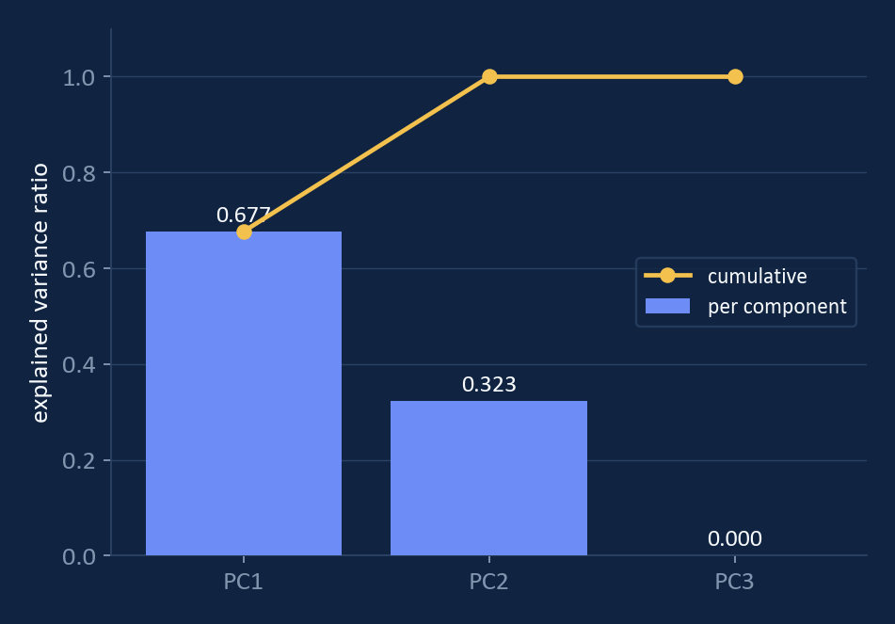
PCA shows three judge scores carry only two dimensions
UNIT 3 · PCA, CHOOSING LATENT DIMENSIONS
Eigen-decomposition of the covariance; the third eigenvalue is exactly zero because the probabilities sum to 1
67.7 %
MATHEMATICAL MODEL
S = (1/N) Σₙ (xₙ − x̄)(xₙ − x̄)ᵀ
S uᵢ = λᵢ uᵢ, λ₁ ≥ λ₂ ≥ λ₃
zₙ = U_Mᵀ (xₙ − x̄)
ratioᵢ = λᵢ / Σⱼ λⱼ
Keep M = 2. Keeping the zero-variance direction would make every Gaussian covariance in the GMM singular.
PC1: refusal versus the rest
32.3 %
PC2: partial versus full
0.000
PC3: the simplex constraint
Keep 2 PCs: 100 % of the variance
CODE
01 S = (X - mean).T @ (X - mean) / len(X)
02 eigvals, eigvecs = np.linalg.eigh(S)
03 order = np.argsort(eigvals)[::-1]
MODELS
CONTENTS
PREVIOUS
NEXT
07 / 14
Notes:
Murphy MLPP 12.2 (PCA) and 12.3 (choosing the number of latent dimensions).

Slide 8
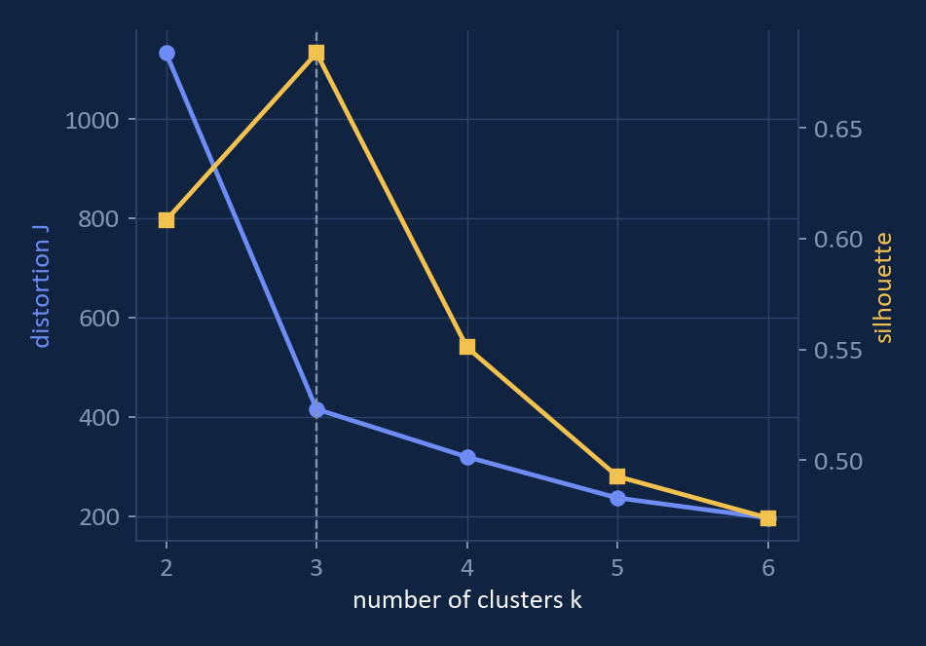
K-means alternates nearest-centre assignment and mean updates
UNIT 3 · K-MEANS CLUSTERING
k-means++ seeding with 10 restarts; k is chosen with the elbow in distortion and with the silhouette
MATHEMATICAL MODEL
J = Σₙ Σ_k r_nk ‖xₙ − μ_k‖²
E-step: r_nk = 1 if k = argminⱼ ‖xₙ − μⱼ‖²
M-step: μ_k = Σₙ r_nk xₙ / Σₙ r_nk
k-means++: P(next centre = xₙ) ∝ minⱼ ‖xₙ − μⱼ‖²
CODE SNIPPET
unsupervised.py::kmeans
01 # E-step: nearest centre
02 labels = sq_dists(X, mu).argmin(axis=1)
03 # M-step: mean of each cluster
04 new_mu = np.array([X[labels == j].mean(axis=0)
05 for j in range(k)])
k = 3
0.684
0.924
elbow + peak silhouette
silhouette at k = 3
ARI vs true state
MODELS
CONTENTS
PREVIOUS
NEXT
08 / 14
Notes:
Bishop PRML 9.1. Same ARI as scikit-learn KMeans (0.924) in strategy_clustering.py, which checks the from-scratch version.

Slide 9
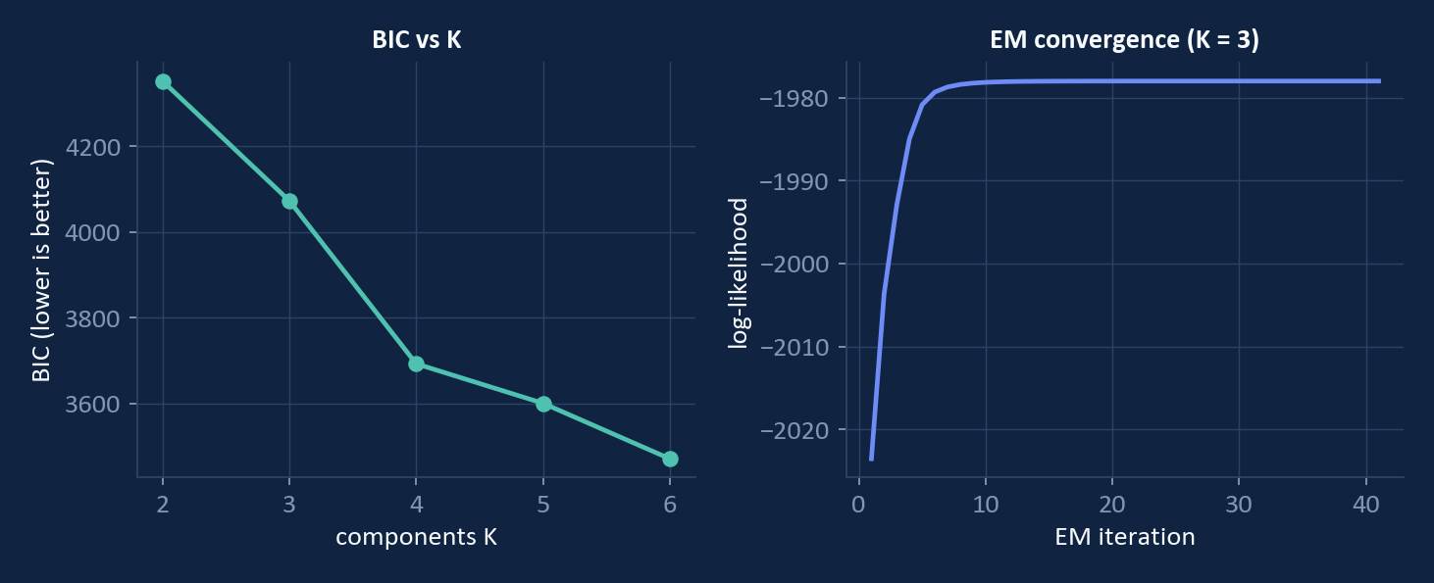
Gaussian mixture fitted with expectation–maximization
UNIT 3 · MIXTURES OF GAUSSIANS AND EM
Soft responsibilities instead of hard assignments; initialized from K-means, converged in 41 iterations
MATHEMATICAL MODEL
p(x) = Σ_k π_k N(x | μ_k, Σ_k)
E: γ_nk = π_k N(xₙ|μ_k,Σ_k) / Σⱼ πⱼ N(xₙ|μⱼ,Σⱼ)
M: N_k = Σₙ γ_nk, π_k = N_k / N, μ_k = Σₙ γ_nk xₙ / N_k
Σ_k = Σₙ γ_nk (xₙ − μ_k)(xₙ − μ_k)ᵀ / N_k
ln p(X) = Σₙ ln Σ_k π_k N(xₙ | μ_k, Σ_k) (never decreases)
BIC = −2 ln L + p ln N
E-STEP
unsupervised.py::gmm_em
01 lj = np.column_stack([
02 np.log(pi[j]) + log_gauss(X, mu[j], cov[j])
03 for j in range(k)])
04 m = lj.max(axis=1, keepdims=True) # log-sum-exp
05 log_norm = m[:, 0] + np.log(np.exp(lj - m).sum(axis=1))
06 R = np.exp(lj - log_norm[:, None]) # gamma_nk
0.865
0.951
41
ARI vs true state
accuracy after matching
EM iterations
BIC keeps falling as K grows: the Dirichlet-shaped clusters are skewed, so extra Gaussians help fit them. The silhouette still picks 3.
MODELS
CONTENTS
PREVIOUS
NEXT
09 / 14
Notes:
Bishop PRML 9.2 and 9.3. Densities use a Cholesky factor; the E-step uses log-sum-exp for numerical stability. A unit test checks the log-likelihood never decreases.

Slide 10
Agglomerative clustering of whole conversations
UNIT 3 · HIERARCHICAL CLUSTERING
220 conversations × 6 features; one merge loop covers all four linkages through the Lance–Williams update
LANCE–WILLIAMS UPDATES
ARI VS FINAL CONVERSATION STATE, BY LINKAGE
single d(AB, C) = min(d_AC, d_BC)
complete d(AB, C) = max(d_AC, d_BC)
average (n_A d_AC + n_B d_BC) / (n_A + n_B)
Ward d² = ((n_A+n_C)d²_AC + (n_B+n_C)d²_BC
− n_C d²_AB) / (n_A+n_B+n_C)
MEASURING DISSIMILARITY
silhouette s = (b − a) / max(a, b)
ARI = (Σ C(n_ij,2) − E) / (½(Σ C(aᵢ,2) + Σ C(bⱼ,2)) − E)
matched accuracy = max over label permutations
Single linkage chains every point into one cluster. Complete linkage separates the outcome groups best, so it is the reported model.
RESULTS
CONTENTS
PREVIOUS
NEXT
10 / 14
Notes:
Murphy MLPP 25.5 (hierarchical clustering) and 25.1.2 (evaluating clustering output).

Slide 11
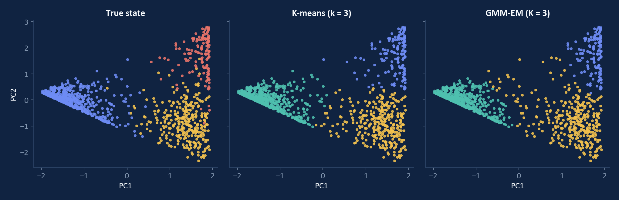
Without labels, K-means recovers 97 % of the hidden states
MEASURED RESULTS
Clusters in the 2-D principal subspace, compared with the true state afterwards
Model | Implementation | ARI | Matched acc. | Silhouette
K-means (k = 3) | NumPy (Review 2) | 0.924 | 0.969 | 0.684
GMM-EM (K = 3) | NumPy (Review 2) | 0.865 | 0.951 | 0.652
Hierarchical, complete (conversations) | NumPy (Review 2) | 0.692 | 0.805 | 0.423
K-means | scikit-learn baseline | 0.924 | – | 0.684
DBSCAN | scikit-learn baseline | 0.883 | – | 0.725
The NumPy K-means matches scikit-learn exactly (ARI 0.924).
Most errors fall on the partial / full boundary, where the judge scores overlap.
RESULTS
CONTENTS
PREVIOUS
NEXT
11 / 14

Slide 12
Review 2 code and commands
EXECUTION
Step 6 runs the models; a standalone K-means script uses no imports
Function in src/analysis/unsupervised.py | Model
pca(X) | Covariance eigen-decomposition, explained-variance ratio
kmeans(X, k) | k-means++ seeding, Lloyd iterations, best of 10
gmm_em(X, k) | EM with log-sum-exp, log-likelihood trace, BIC
agglomerative(X, k, linkage) | Lance–Williams: single / complete / average / Ward
silhouette, adjusted_rand, matched_accuracy | Cluster evaluation
main() | Runs everything, writes metrics.json and 2 plots
COMMANDS
01 python main_analysis.py
02 python review2_kmeans_pure_python.py
03 python -m pytest tests/test_unsupervised.py
VERIFICATION
3 / 3
Focused Review 2 tests pass
No-import K-means: 96.9% matched accuracy on synthetic rows
EM log-likelihood never decreases
PCA finds the zero-variance simplex direction
Model fitting uses no ready-made ML algorithm.
DELIVERY
CONTENTS
PREVIOUS
NEXT
12 / 14
Notes:
Review 2 assessment: mathematical model (2 marks) and Python script (3 marks). The NumPy implementations write the algorithms from their equations instead of calling ready-made model libraries. The separate K-means script has no imports. It uses synthetic judge scores for fitting and hidden-state labels only for evaluation.

Slide 13
What the results do not show yet, and the Review 3 plan
LIMITATIONS AND NEXT REVIEW
Review 3 compares these models with Unit 4 and 5 algorithms
LIMITATIONS
REVIEW 3 · UNITS 4 AND 5
The data is simulated. High scores show the method recovers a known structure, not real-world performance
Turn-level clustering ignores turn order, so each turn is treated as independent
The Gaussian assumption is wrong for Dirichlet-shaped scores, so BIC keeps preferring more components
Hierarchical clustering is O(N²) in memory, which is fine for 220 conversations but not for large campaigns
Model | Use on this data
HMM: forward–backward, Viterbi | Add turn order: decode the state from score sequences
Baum–Welch | Learn the transition matrix and compare it with the true A
CART | Interpretable rules over judge scores
Boosting, bagging | Compare ensembles with the clusters and the Review 1 classifiers
Preview: the existing hmmlearn HMM already reaches ARI 0.868 with matched accuracy 0.951. That is how much turn order adds.
DELIVERY
CONTENTS
PREVIOUS
NEXT
13 / 14

Slide 14
Textbooks, data and method sources
REFERENCES
Equations follow the course reference books; section numbers are given in the speaker notes
1. Bishop, Pattern Recognition and Machine Learning
Springer, 2006 · ch. 9 (K-means, mixtures, EM)
2. Murphy, Machine Learning: a Probabilistic Perspective
MIT Press, 2012 · ch. 12 (PCA), 25 (clustering)
3. Arthur and Vassilvitskii, k-means++
SODA 2007
4. Chao et al., JailbreakBench
NeurIPS Datasets and Benchmarks 2024 · arxiv.org/abs/2404.01318
5. Hubert and Arabie, Comparing Partitions (ARI)
Journal of Classification, 1985
6. Project repository
github.com/Ananyacodes/jailbreaker-llm
DELIVERY
CONTENTS
PREVIOUS
14 / 14
Notes:
Measured results: outputs/analysis/metrics.json (keys pca_numpy, kmeans_numpy, gmm_em_numpy, hierarchical_numpy), produced by main_analysis.py.

