Slide 1
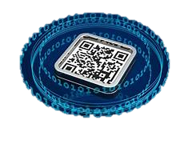
Problem statement:
Develop a QR code-based virtual assistant that enhances the navigation experience for customers in malls and universities, helping them locate specific products or navigate through complex campuses effortlessly.
The problem statement is to develop a QR code-based virtual assistant that can enhance the navigation experience for customers in malls and universities.
This assistant would help customers locate specific products or effortlessly navigate through complex campuses.
The goal is to create a virtual assistant that uses QR codes to improve navigation for customers in malls and universities.

Slide 2

High-level design:
User Interaction
QR Code Generation
Backend System
Navigation Assistance
Enhanced Features
Interactive Content
User Profiles and Preferences
Analytics and Improvements
Security and Privacy
Scalability
Admin Interface
Testing and Feedback

Slide 3

Technology architecture
Frontend:
Web Interface / Mobile App
Augmented Reality (AR) Integration
Voice Guidance
Backend:
Server Infrastructure
API Gateway
Navigation Services
Database Management
Content Delivery
QR Code Management:
QR Code Generation
QR Code Scanner
User Profiles and Preferences:
User Authentication
Preference Storage

Slide 4
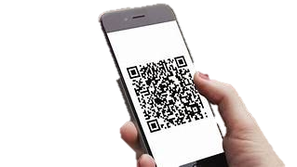
Low-level design
Frontend:
QR Code Scanner
AR Integration
User Interface
Voice Guidance
Backend:
API Endpoints
Route Calculation
Database Schema
Authentication
QR Code Management:
QR Code Generation
QR Code Validation

Slide 5
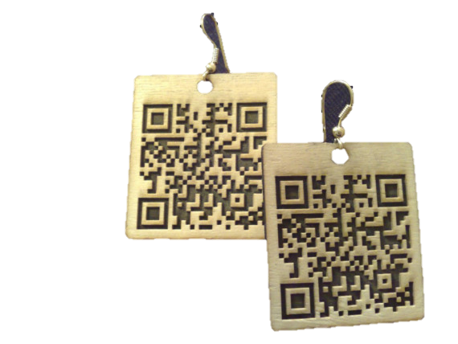
User Profiles and Preferences:
User Registration/Login
Preference Storage
Analytics and Insights:
Analytics Integration
Feedback Collection
Admin Interface:
Admin Dashboard
Security and Privacy:
Data Encryption
User Data Protection
Deployment and Scaling:
Server Deployment
Load Balancing
Caching

Slide 6
Source code: https://github.com/Ananyashreekg/QR-based-virtual-assisstance

