Slide 1
ANAPARTHI SUSHMA SRIVALLI GAYATHRI
Final Project

Slide 2
PROJECT TITLE
KEYLOGGER
AND
SECURITY

Slide 3


AGENDA
Problem Statement
Project Overview
End Users
Solutions and its Value Proposition
Wow in the Solutions
Modelling
Results
3/21/2024 Annual Review

Slide 4

PROBLEM STATEMENT
The objective of this project is to develop a basic keylogger application with a graphical user interface (GUI) to capture and log keystrokes on a computer. The keylogger should be able to record every key pressed, held, and released by the user and store these logs in both text and JSON formats. The application should provide a simple interface with start and stop functionalities, making it user-friendly and easy to operate.

Slide 5

PROJECT OVERVIEW
Objective:
Develop a user-friendly keylogger with a GUI to capture and log keystrokes in text and JSON formats.
Features:
GUI:
- Built with Tkinter.
Key Logging:
- Use `pynput` to capture pressed, held, and released keys.
Workflow:
-Start logging with Start button.
-Capture and log keystrokes.
-Stop logging with Stop button.
-Save logs in text and JSON formats.
Use Cases:
- Monitor keyboard activity.
- Learn keylogging and GUI development.
Conclusion:
-Demonstrates capturing and logging keyboard events with a simple, user-friendly interface.

Slide 6
WHO ARE THE END USERS?
The keylogger application is useful for a variety of users, from improving security to helping in education and research. It provides valuable insights and control over computer usage.
IT Security Professionals
- To monitor unauthorized keyboard activity which enhances security by identifying potential threats.
Parents
-To keep track of children's online activities which ensures children's safety and appropriate internet use.
Employers
- To monitor employee productivity that improves workplace efficiency and detects misuse of resources.
Researchers
-To study user behavior and interaction patterns which provides data for improving user interface design.
Educators
-To demonstrate keylogging concepts which helps teach cybersecurity and programming in a practical way.

Slide 7

SOLUTION AND ITS VALUE PROPOSITION
Solution Overview
- Keylogger Application: Simple GUI for logging keystrokes.
- Detailed Logging: Records key presses, holds, and releases.
- Storage Options: Saves logs in text and JSON formats.
- Efficient Performance: Runs with minimal system impact.
Value Proposition
- Enhanced Security: Identify and prevent unauthorized access.
- Parental Control: Monitor children's internet activities for safety.
- Behavioral Insights: Gather data for usability and research.
- Productivity Monitoring: Track and improve workplace efficiency.
- Educational Tool: Practical demonstration of cybersecurity concepts.

Slide 8

THE WOW IN SOLUTION
Key Benefits
Enhanced Security: Detect and prevent unauthorized access.
Behavioral Insights: Analyze patterns for improved user experience.
Productivity Monitoring: Track and improve efficiency.
This keylogger application serves diverse needs from security monitoring to educational demonstrations, providing valuable insights and enhanced control over computer usage.
3/21/2024 Annual Review
8

Slide 9
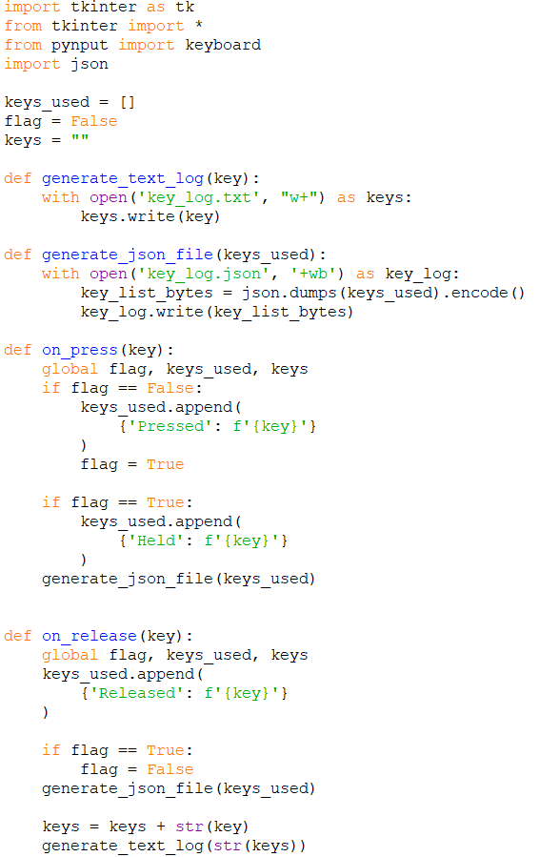
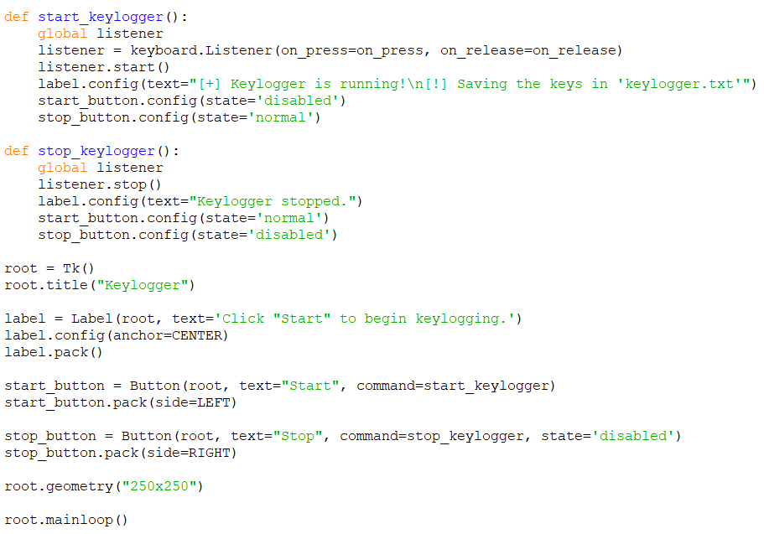
MODELLING
9

Slide 10
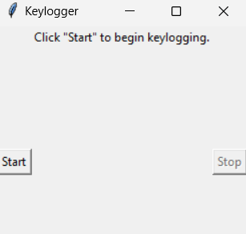
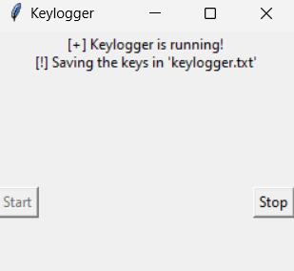
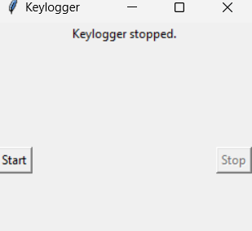
RESULTS
Github Project Link:
https://github.com/AnaparthiSushma/sushma_project_edunet.git
10

