Slide 1

SBB Case, START HACK St. Gallen
Four Musketeers

Slide 2
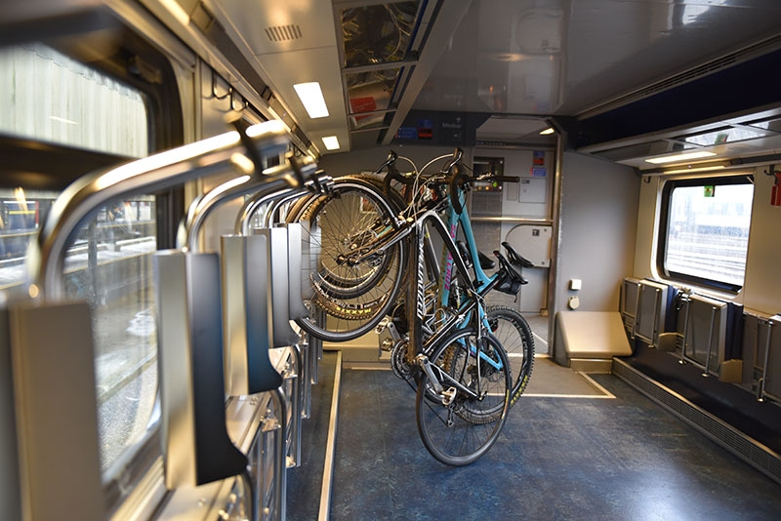
The Problem
Increased demand for bike spaces on Swiss trains between March and October at stations near popular bike trails.
Customers get no clear picture of the possible demand or capacity of bike spaces in the trains.
Customers book multiple bike places on different trains, hence many booked spaces end up unused and unavailable for other costumers.

Slide 3
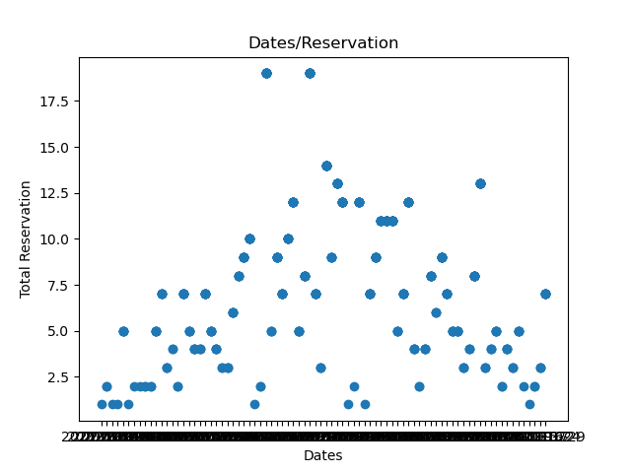
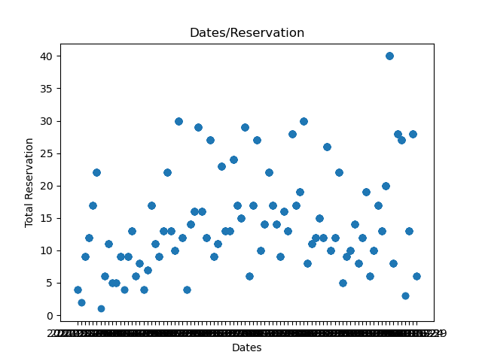
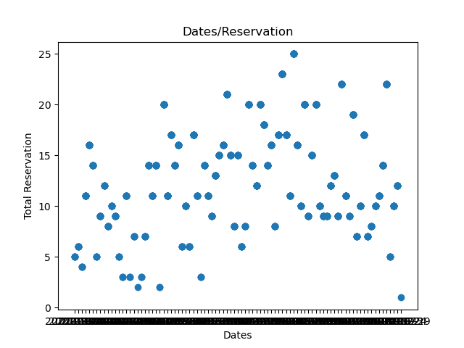
The Problem
IC 8
821
827
830

Slide 4
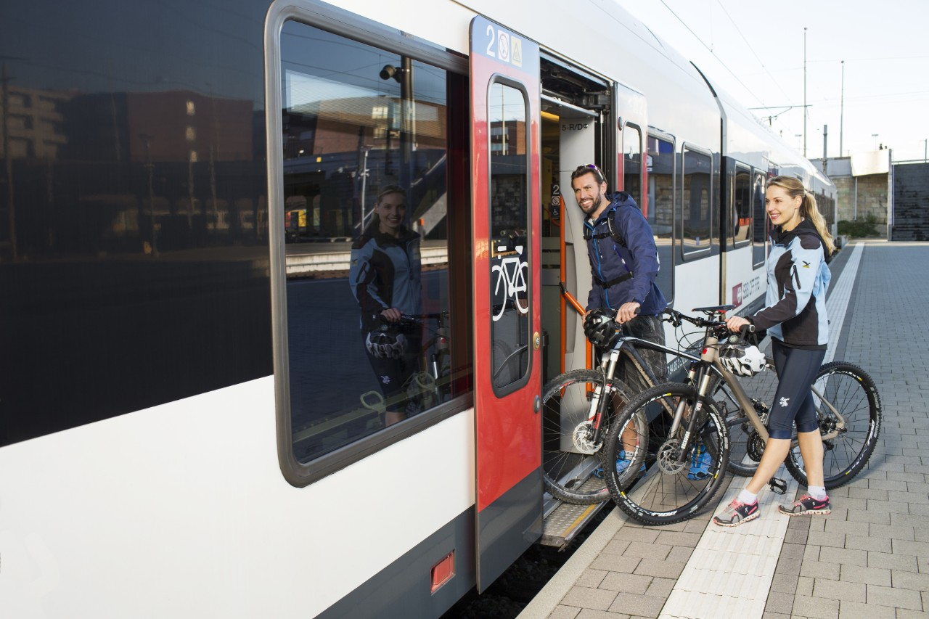
The Solution
Analytical real time data utilizing solution that provides the customer with a suggestion on when they should book a bike spot at the latest for routes in high demand.
Creates a sense of certainty so that unused “safety” bookings are avoided.
High congestion is reduced, as customers have a better picture of what to expect and how to plan.

Slide 5
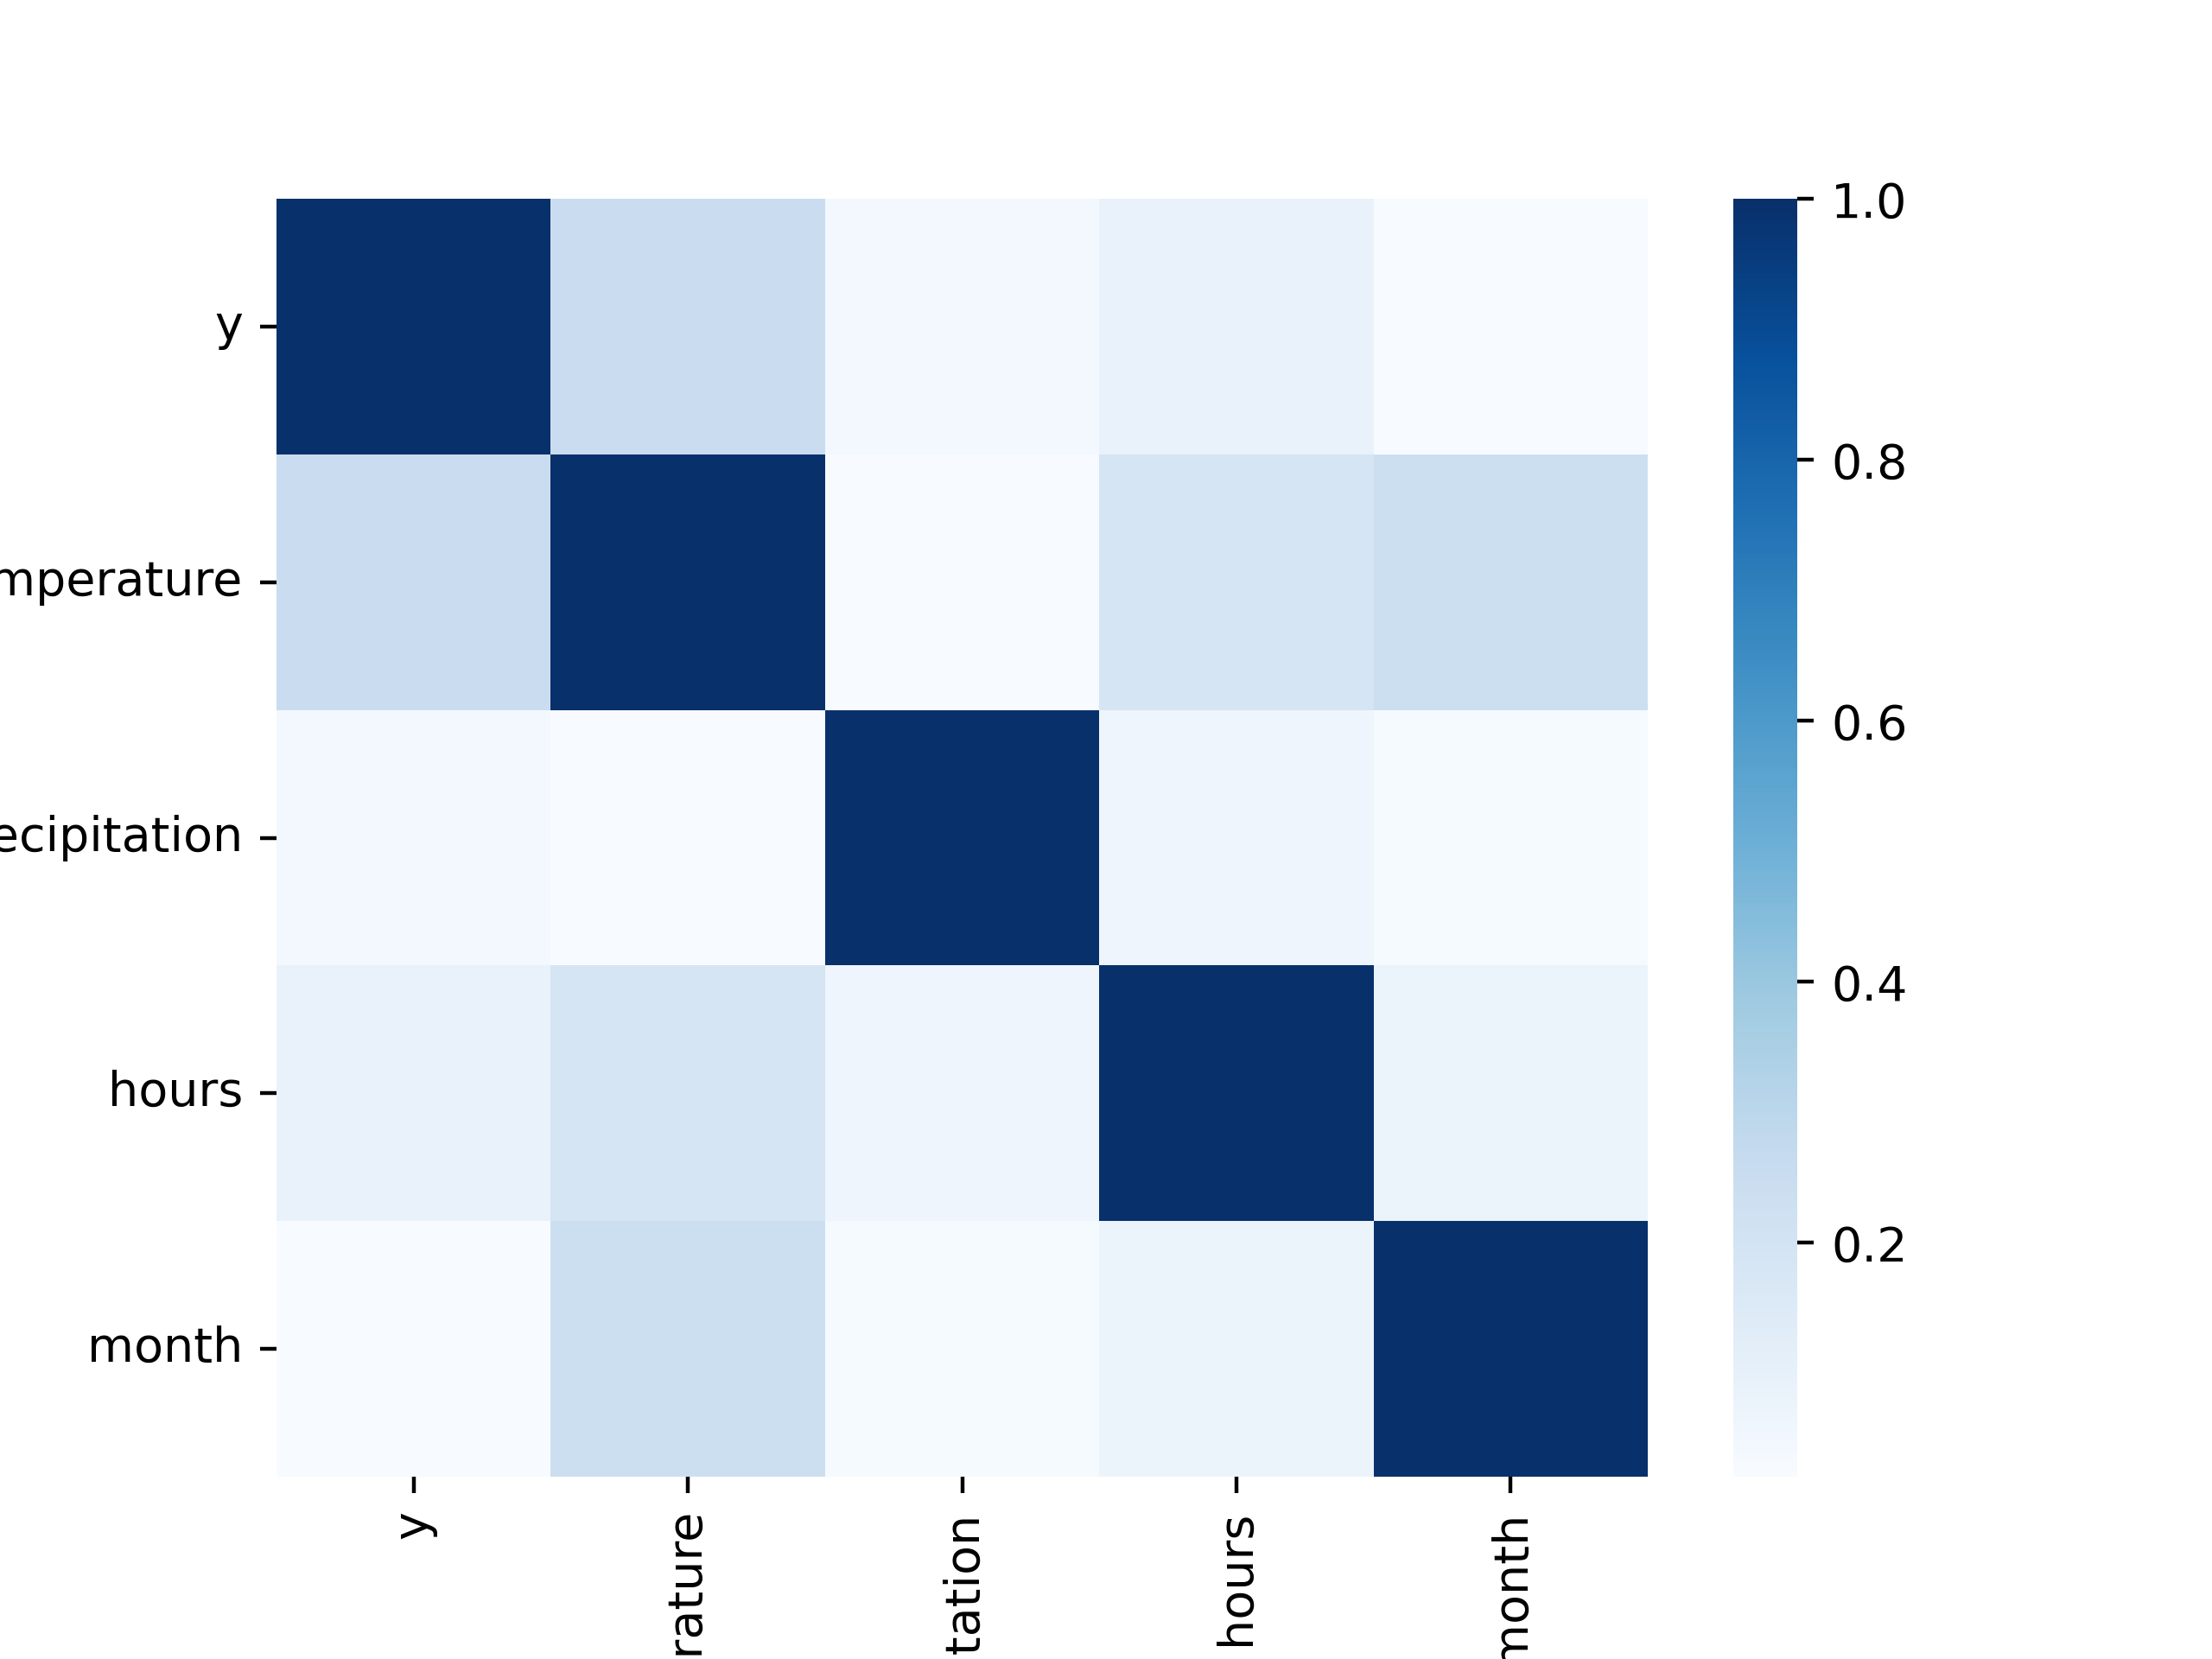
The Factors
Departure time
Forecasted Temperature
Holliday / Weekend

Slide 6
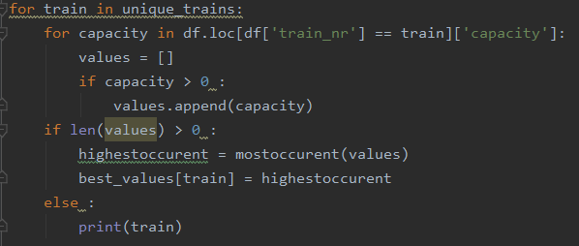
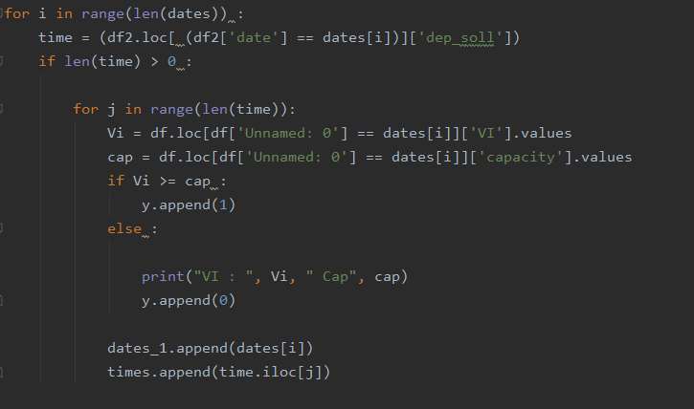
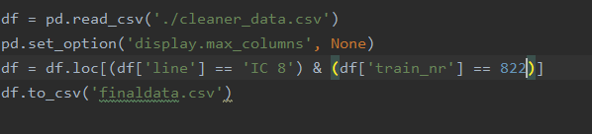
The implementation
Cleaning the data

Slide 7
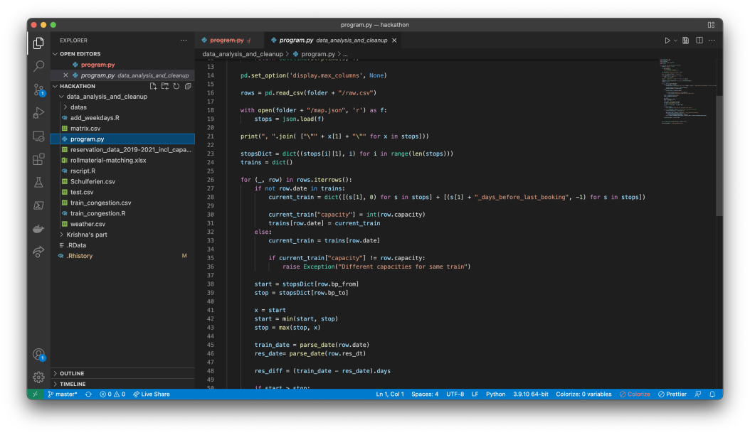
The implementation
Grouping reservation and extracting congestion between stations

Slide 8
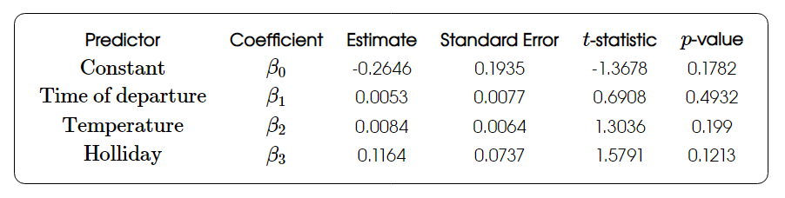
The Regression Model
3 variables prrooved relevant, hovewer for a more accurate representation a greater sample pool is needed as well as more date on other relevant variables such as regional population etc.

Slide 9
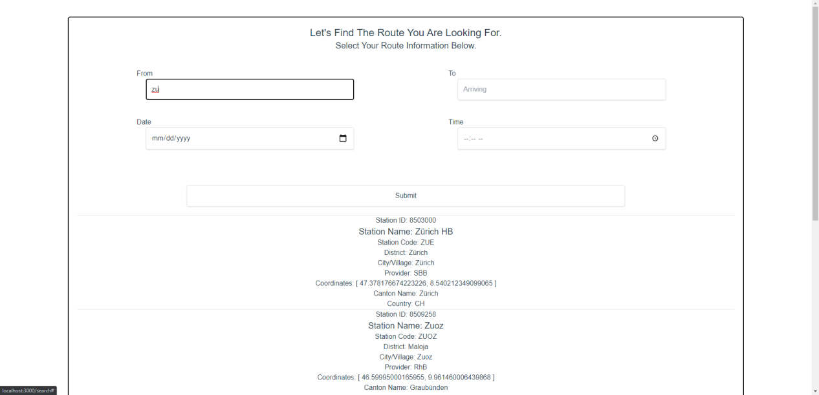
How it works – search for your route

Slide 10

How it works – picking your train
Using the SBB open data API users would get a list of trains on the rout they selected
They can then select which train they will be taking based on their search criteria
Based on our regression model, we would apply this information regarding the predicted demand and estimated time to book a bike spot before all the spots are taken

Slide 11
Q & A

Slide 12

Thank you for your attention

