Slide 1
Exploring Architectural Styles with Variations of GANs
CS464: Introduction to Machine Learning
Bilkent University
Fall 2019
Anar Huseynov, Bahadir Durmaz, Doren Calliku, Ismayil Mammadov, Ufuk Turker

Slide 2
Introduction
Problem : Create architectural pictures which are not perceptually skewed or troubling, based on dataset.
Method: Use GANs. Transform and preprocess pictures. Create Vanilla GAN - Ground Truth. Create CNN GAN. Tune parameters.
Results: Not that good for the purpose of Creating new worlds, and architectural restoration.

Slide 3
Problem Description
How to make a generator from random improve its looks just by changing pixels all the time?
Use GANs! Use CNN GANs for better ideas.

Slide 4
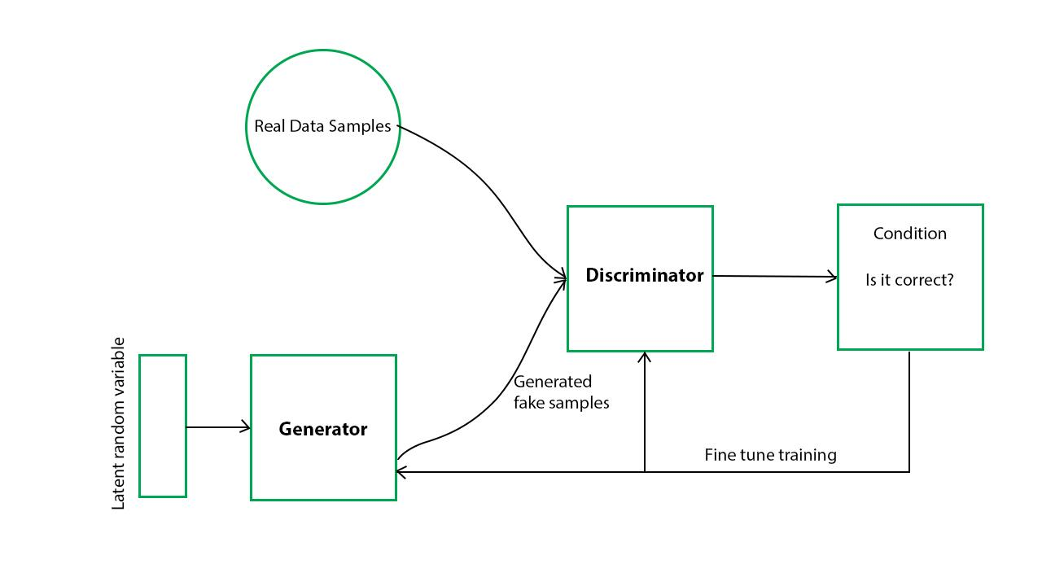
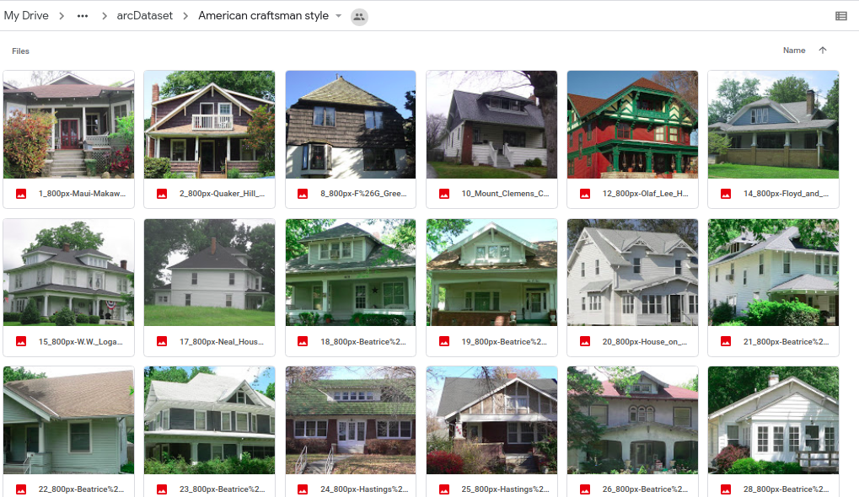
3. Methods
Model
Data
Preprocessing
Ground Truth (Vanilla GAN)
DCGAN

Slide 5
Model
Discriminator:
Conv2d, LeakyRELU
Conv2d, BatchNorm, LeakReLU
Conv2d, BatchNorm, LeakyReLU
Conv2d, BatchNorm, LeakyReLU
Conv2d, Sigmoid()
Generator:
ConvTranspose2d, BatchNorm2d, ReLU
ConvTranspose2d, BatchNorm2d, ReLU
ConvTranspose2d, BatchNorm2d, ReLU
ConvTranspose2d, BatchNorm2d, ReLU
ConvTranspose2d, Tanh()

Slide 6
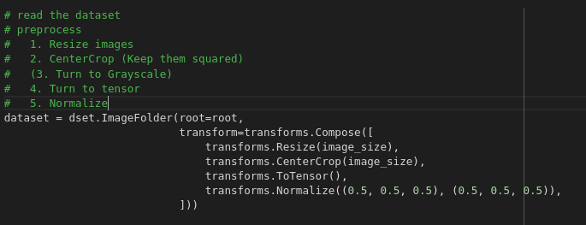
Preprocessing

Slide 7
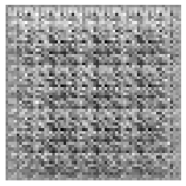
4. Results
Vanilla GAN

Slide 8
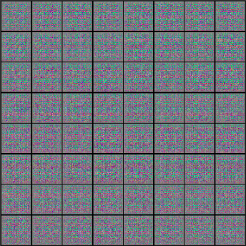
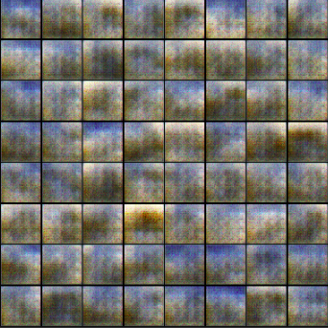

Slide 9
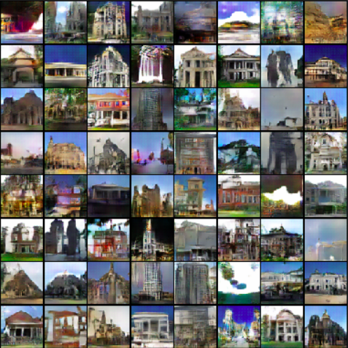
Colored Generated Images After trials

Slide 10
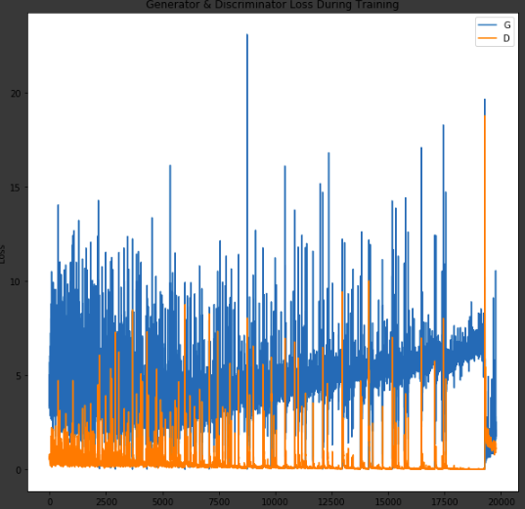
Loss

Slide 11
5. Discussion and Conclusion
How was our experience? There were many new terms we needed to work on, and some of them we did not understand until the last week of classes.
What happened to the Vanilla model? Why were the results not representative of what we expected? Adopting the tuning parameters for VanillaGAN did not work, also we had to interrupt the learning after a point because these models learn very slowly (because of all the layers and updates).
Were you able to build what you set out to do? To a certain extent. Building DCGAN was a tough task as it needed a lot of time to run. For a whole run we had to wait for at least 5-6 hours, which made the whole process slow and triggering. The results’, even though dependent on our model’s parameters, are only at a low resolution.
Future directions? For the models that have been working so far, we have understood that it is not possible for these results to be useful for the aims we wanted. Neural Style Transfer would be a better application for the use cases.

Slide 12
7. Appendix
Ground truth GAN
Implementing Vanilla GAN - BAHADIR, ANAR
Exploration for changes
DCGAN - ANAR, DOREN, ISMAYIL, BAHADIR

