Slide 1



A Design Proposal for Interactive Data analysis on the Grid
  Anar Manafov, GSI
  HEPCG Workshop, Jun 2007

Slide 2

“Road map”
Introduction
Design of “PROOF on gLite”
Development process and tools
Life demo
Summary
Future plans

Slide 3
Introduction
Tools for ROOT based data analysis
Self-made solutions for local cluster
Self-made solutions for Grid
PROOF:
  Preinstalled PROOF clusters (local/remote)‏
  Manually written PROOF job submission
Get an ALICE VO membership and use AliEn+PROOF

Slide 4
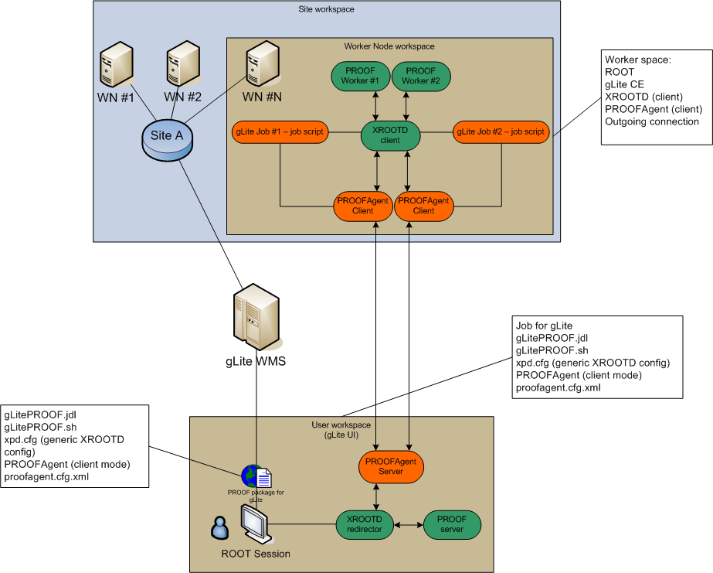

Slide 6
RGLite
// Initializing RGLite plug-in
TGrid::Connect("glite");
// Submitting a Job to gLite Grid
TGridJob *job = gGrid->Submit("JDLs/proofd.jdl");
// querying a Status of the Job
TGridJobStatus *status = job->GetJobStatus();
status->GetStatus();
// Getting a Job's output back to the user
TGLiteJob* job_glite(job);
job_glite->GetJobOutput("/home/anar/");
Job submission, Status querying, Output retrieving.
// Initializing RGLite plug-in
TGrid::Connect("glite");
// Changing current File Catalog directory to "dteam"
gGrid->Cd("dteam");
// Querying a list of files of the current FC directory
TGridResult* result = gGrid->Ls();
// Printing the list out, including full file information
result->Print("all");
List full file information of a catalog folder.

Slide 7
Demo

Slide 8
Development process and tools
Documentation: Wiki, doxygen, ROOT HTML.
Version control: SVN
Automatic Builds and tests (SLC3, FC6)‏
Nightly releases
Project metrics

Slide 9
Summary

Slide 10

Future plans

