Slide 1



RGLite plug-in and gLitePROOF package
  Anar Manafov, GSI,
  PROOF Workshop,
  30 Nov. 2007
Ver.0.8

Slide 2
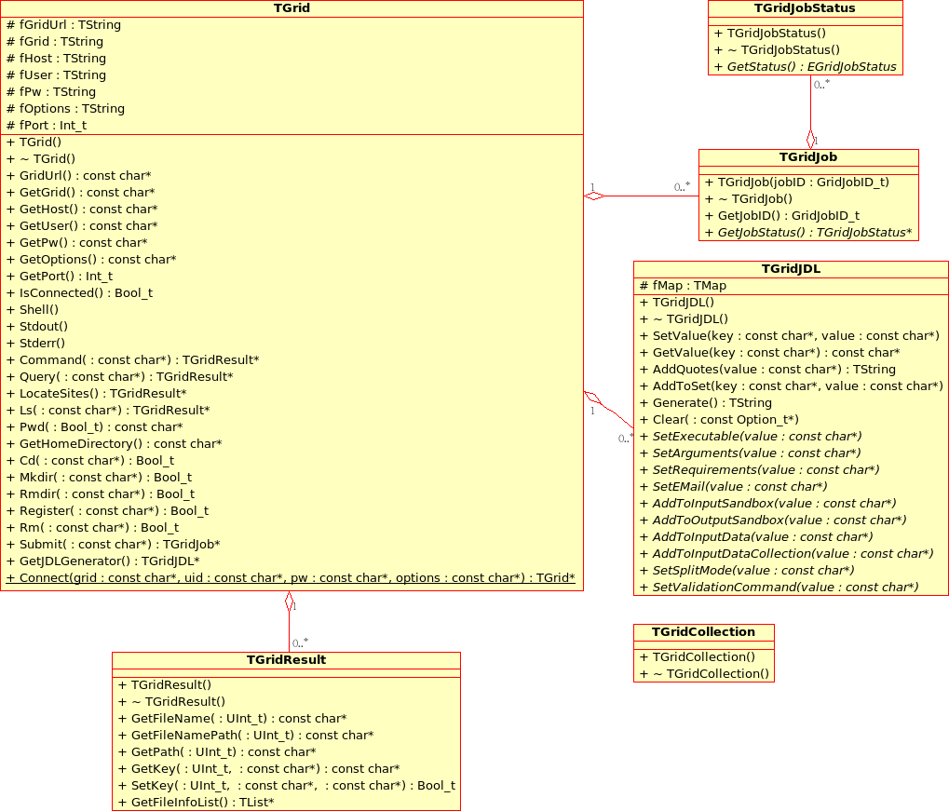

Slide 3

glite-api-wrapper
User Application
User Application
User Application
GAW Library
GAW Interface Manager
GAW Job Manager
GAW Catalog Manager
gLite Middleware
gLite API (WMProxy, LFC, LB)‏
gLite WMS (with WMProxy)‏
gLite LB
LCG LFC

Slide 4
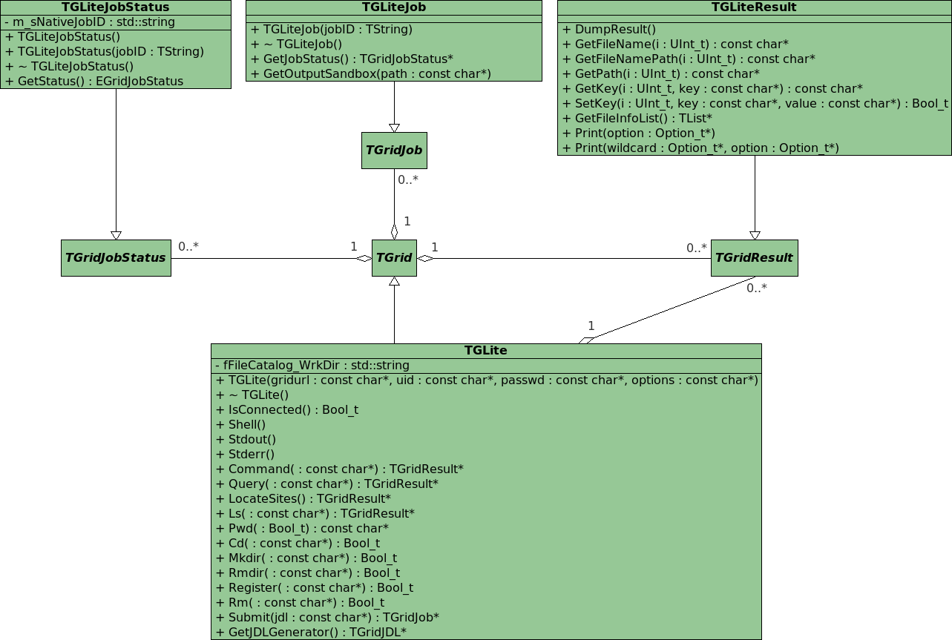

Slide 5
RGLite features
Workload Management System operations:
  job submission – normal, DAG and parametric jobs (gLite WMProxy API),
  smart look-up algorithm for WMP-Endpoints,
  job status querying (gLite LB API),
  job output retrieving (Globus GridFTP).
File Catalog operations (gLite/LCG LFC API):
  set/query the current working catalog directory,
  list files, directories and their stats,
  add/remove files in a catalog namespace,
  add/remove directories,
  add/remove replicas from a given file.
An executive logging.
Support of an external xml configuration file.

Slide 6
RGLite example
// Initializing RGLite plug-in
TGrid::Connect("glite");
// Submitting a Job to gLite Grid
TGridJob *job = gGrid->Submit("JDLs/proofd.jdl");
// querying a Status of the Job
TGridJobStatus *status = job->GetJobStatus();
status->GetStatus();
// Getting a Job's output back to the user
job->GetOutputSandbox("/home/anar/");
Job submission,
status querying,
output retrieving.
// Initializing RGLite plug-in
TGrid::Connect("glite");
// Changing current File Catalog directory to "dteam"
gGrid->Cd("dteam");
// Querying a list of files of the current FC directory
TGridResult* result = gGrid->Ls();
// Printing the list out
Int_t i=0;
while (result->GetFileName(i))\
> printf("File %s\n",result->GetFileName(i++));
Changing file catalog directory,
querying lists of files.

Slide 7
RGLite example
// Initializing RGLite plug-in
TGrid::Connect("glite");
// Changing current File Catalog directory to "dteam"
gGrid->Cd("dteam");
// Querying a list of files of the current FC directory
TGridResult* result = gGrid->Ls();
// Printing the list out, including full file information
result->Print("all");
List full file information of a given catalog folder.
// Initializing RGLite plug-in
TGrid::Connect("glite");
// Changing current File Catalog directory to "dteam"
gGrid->Cd("dteam");
// Printing a current working directory
cout << "Working Directory is" << gGrid->Pwd() << endl;
// Creating a new File Catalog Folder
Bool_t b = gGrid->Mkdir("root_test2");
Retrieving current catalog folder,
creating a new file catalog folder.

Slide 8
gLitePROOF
gLitePROOF – a gLite PROOF package.
It is a number of utilities and configuration files developed at GSI in terms of the D-Grid project and aims to implement a PROOF distributed data analysis on the gLite Grid.

Slide 9
gLitePROOF components
PROOFAgent – a lightweight, standalone C++ application. Acts as a multifunctional proxy client/server and helps to use proof/xrootd on the Grid worker nodes behind a firewall.
PAConsole – a standalone C++ application, provides a GUI and aims to simplify the usage of PROOFAgent and gLitePROOF configuration files. PAConsole uses GAW to perform gLite job submissions. Users can control jobs directly using ROOT and RGLite plug-in instead of using PAConsole.
xpd.cfg – a generic XROOTD configuration file (configures redirector and remote Grid workers).

Slide 10
gLitePROOF components
Server_gLitePROOF.sh – a server side script. Helps to start/stop services of gLitePROOF. Could be used via command line or PAConsole GUI.
gLitePROOF.jdl – a JDL file, describes a generic, parametric Grid job, which is submitted to gLite and aims to execute gLitePROOF workers on Grid worker nodes.
gLitePROOF.sh – a job script. Executed by LRMS on remote workers. Script makes environment recon, uploads necessary packages and starts gLitePROOF services.

Slide 11
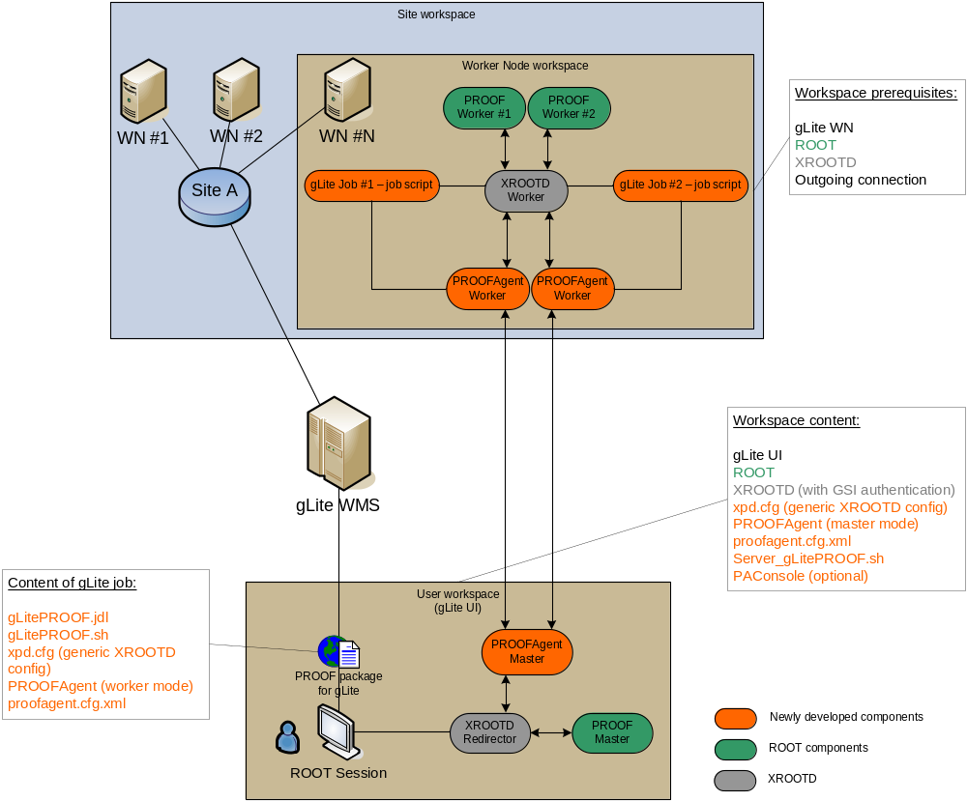

Slide 12
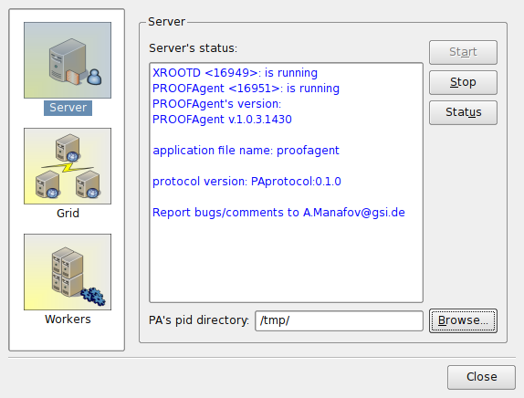
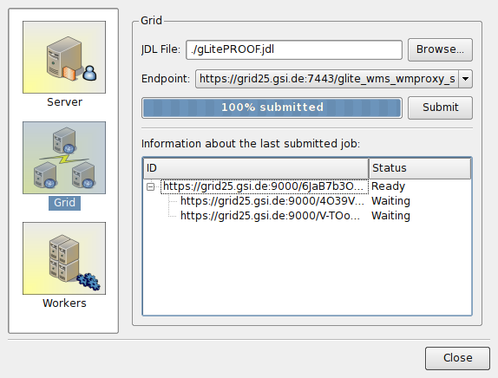
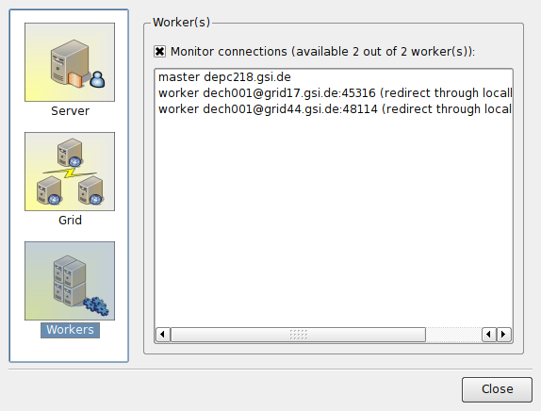

Slide 13

Summary
  RGLite is ready.
    TGridXXX interface are implemented in RGLite for gLite MW.
    ROOT team accepted our suggestions to TGridXXX interface.
  gLitePROOF package – alpha release (tested against FZK and GSI WMSs).
    It setups “on-the-fly” a PROOF cluster on gLite Grid.
    It works with mixed type of gLite worker nods (x86_64, i686...)
    It supports reconnection.
  Use of Agile methods of software development.
    Continues integration,
      automated build system (tests on SLC3, SL4, and F8),
      nightly builds.
    Unit tests.
    Projects metrics.
    Task tickets and sprints…
  For more info: http://wiki.gsi.de/cgi-bin/view/Grid/RGLiteAndGAW

