Slide 1
gLite: Short Summary
Anar Manafov, GSI
Material on EGEE 3rd Conference
April 18-22, 2005
Athens

Slide 2
From Development to Product
LCG-2 (=EGEE-0)
Fast prototyping approach allowing end users for rapid feedback
Provide individual components to SA1 for deployment on the pre-production service
These components need to go through integration and testing
  To ensure they are deployable and basically work
2004
prototyping
prototyping
product
2005
product

Slide 3

Main Differences to LCG-2
Workload Management System works in push and pull mode
Computing Element moving towards a VO based scheduler guarding the jobs of the VO (reduces load on GRAM)
Re-factored file & replica catalogs
Secure catalogs (based on user DN; VOMS certificates being integrated)
Scheduled data transfers
SRM based storage
Information Services:
R-GMA with improved API, Service
Discovery and registry replication
Move towards Web Services

Slide 4
gLite Services for Release 1
Software stack and origin (simplified)
Computing Element
  Gatekeeper, WSS (Globus)
  Condor-C (Condor)
  CE Monitor (EGEE)
  Local batch system (PBS, LSF, Condor)
Workload Management
  WMS (EDG)
  Logging and bookkeeping (EDG)
  Condor-C (Condor)
Storage Element
  File Transfer/Placement (EGEE)
  glite-I/O (AliEn)
  GridFTP (Globus)
  SRM: Castor (CERN), dCache (FNAL, DESY), other SRMs
Catalog
  File and Replica Catalog (EGEE)
  Metadata Catalog (EGEE)
Information and Monitoring
  R-GMA (EDG)
Security
  VOMS (DataTAG, EDG)
  GSI (Globus)
  Authentication and authorization for C and Java based (web) services (EDG)

Slide 5
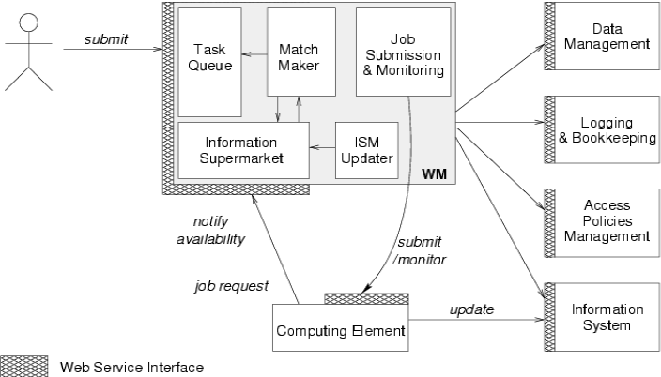
WMS Interaction Overview

Slide 6
CE Interaction Overview
Collaboration of JRA1 (INFN, Univ. of Chicago, Univ. of Wisconsin-Madison), and JRA3
Submit
job
Grid
Gatekeeper
CEMon
LCAS
LCMAPS
WSS
Notifications
Launch
Condor-C
Launch
Condor-C
Blahpd
Condor-C
CE
Should evolve into a VO scheduler
Local
batch
system
LSF
PBS/
Torque
Condor

Slide 7
DM Interaction Overview
Storage Element
WSDL
VOMS
Storage
API
Get
credential
File I/O
gLite I/O
SRM
gridFTP
File namespace
and Metadata mgmt
Fireman
File and
Replica Catalog
Store
credential
Database
File replication
File Transfer and
Placement Service
StorageIndex
FPS
Transfer Agent
MyProxy
Proxy renewal
Database
Replica
Location
WMS
FTS

Slide 8
Software Process
JRA1 Software Process is based on an iterative method
It comprises two main 12-month development cycles divided in shorter development-integration-test-release cycles lasting 1 to 4 weeks
The two main cycles start with full Architecture and Design phases, but the architecture and design are periodically reviewed and verified.
The process is documented in a number of standard documents:
  Software Configuration Management (SCM) Plan
  Test Plan
  Quality Assurance Plan
  Developer’s Guide

Slide 9
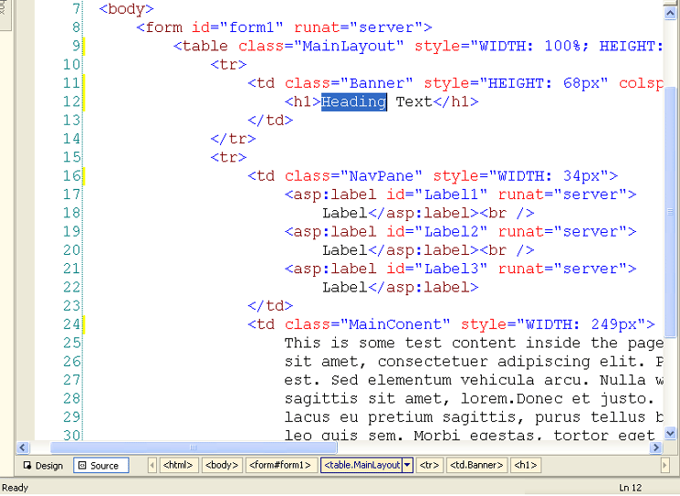




Release Process
Development
Integration
Testing
Software Code
Deployment Packages
Fail
Pass
Testbed Deployment
Integration Tests
Fix
Fail
Pass
Functional Tests
Installation Guide, Release Notes, etc

Slide 10
QA and SCM Metrics
Several QA and SCM Metrics are mandated by the SCM and QA Plans
Metrics are calculated periodically and published on the gLite web site:
  Total complete builds done: 208
  Number of subsystems: 12
  Number of CVS modules: 343
  (development, integration modules, test suites, documentation and tools)
  Total Physical Source Lines of Code (SLOC)
  SLOC = 632,478 (as of 5 April 2005)
    Total SLOC by language (dominant language first)
    C++ 193996 (30.67%)
    Java 183782 (29.06%)
    Ansi C 149411 (23.62%)
    Perl 62627 ( 9.90%)
    Python 24967 ( 3.95%)
    sh 12634 ( 2.00%)
    Yacc 3635 ( 0.57%)

Slide 11
WMS
Major problems
  Failure rate ~12% (retrycount = 0), otherwise 100% success
    Several reasons being investigated (e.g. race conditions)
    Shallow re-submission (i.e. retry of submission, not execution) might help
  Matchmaking is being blocked sometimes
    Fix provided for Release 1.1 (end of April)
  Condor as backend not yet working
  Not yet final architecture of CE:
    One Schedd per local user id
    Need setuid services and head node monitoring (Globus+JRA3)
  Not a lot of experience tuning the CE Monitor
    Need some examples

Slide 12
Applications deployed on EGEE
Three application groups
  High Energy Physics pilots
  Biomedical application pilots
  Generic applications (catch-all)
Multiple infrastructures, two middlewares
  EGEE LCG2 production infrastructure
  GILDA LCG2/gLite integration infrastructure
  gLite testbeds (development/testing/certification)
Many users
  broad range of needs
  different communities with different background and internal organization

Slide 13
Industry forum: VERY Short Summary
Anar Manafov, GSI
Material on EGEE 3rd Conference
April 18-22, 2005
Athens

Slide 14
Recommendations from Reviewers
Reviewers Recommendations:
1. Better capitalise on success stories from all activities through a constant
solicitation of the activity leaders. Special emphasis is to be given to innovation in
scientific areas triggered by the deployment onto EGEE of key applications.
2. Improve the appeal of flyers and publicity material to better target executive and
politician audiences.
3. Encourage more participation from the Industry Forum.
4. Continue to have strong participation in international meetings and increase
presence at key HPC international events (for example SC in the US or ISC in
Europe).
5. Publish press releases for each new production-quality service which goes live,
portraying its added value to EGEE user communities.
6. Put more effort into making information sheets available in most European
languages.

Slide 15
Session Agenda
Industry Forum Working Groups
  Yann Guérin, IBM EMEA Grid Design Center
  Kosmas Kitsos, Hewlett-Pakard
Industrial Grid Users' Point of View
  Pascal Dauboin, Total Research and Development
  Rolf Kubli, EDS

Slide 16
EGEE Industry Forum Objectives
EGEE Industry Forum aims at :
  Raising awareness of the project among the industry
  Promoting Grid technologies towards the industry
  Disseminating the results of the EGEE project

Slide 17
Market evidence points
“Expensive licenses tied (node-locked) to their biggest server - when a large simulation is running another has to wait whereas with a license migration service it could have used a less powerful server. We would like to migrate license (via grid) to available resources and improve license ROI.”
"My software costs 10 times more than what my servers. If you have an on-demand solution, I'd like to get my software licenses on-demand."
“We have invested in homegrown SW to be used as an alternative to the licensed code to avoid additional license costs.”
Requirement for licensing based on actual usage. Wish to run simulations over night on high-end Unix engineering workstations (4000 nodes) - but the cost of additional licenses negated business case. Lack of solution limits ROI on workstations and handicaps business case for additional purchases.
“ We would like to buy fully-integrated hardware, software (including grid middleware) and license management stack from IBM. Currently this is ‘built’ using various component technologies including Scheduling and License management software from different companies.”
Strong desire to see license as a flexible resource rather than a static asset. Recognizes the existing ability to schedule jobs across enterprise but lacks commensurate license capability. Lack of solution inhibits grid adoption, hw ROI and move towards on demand OE.

Slide 18
On Demand License Requirements
Primary customer requirement:
  Maximize license utilization and improve overall license ROI
Common high-level requirements:
  Provide flexible method for managing high-value software licenses across the enterprise (typically global companies). Ideally through a Grid model (to allow easy integration with other application services), where jobs can be run at various locations, with a mechanism for automatically moving, managing and auditing licenses.
  Preference to standards-based approach to avoid lock-in
  Technical solutions must be competitively priced (less than buying additional software licenses) otherwise the business justification is weak
Specific functional requirements:
  Manage lower level license managers e.g FlexLM, Tivoli License Manager (ITLM), etc.
  Coupling of license flexibility with load balancing/scheduling
  Priority management (ordering, pre-emption) (if a job is suspended, the license should be released)
  Monitoring for compliance to license agreement with thresholds, alerts, etc
  Security: Mutual authentication, authorized access (role/user/group based)
  Not require changes to existing applications
  Automatically discover new licenses
  Policy based intelligent scheduling and reservation (delegation, leasing, borrowing) of software licenses
  Must not impact performance

Slide 19
HP Summary
It’s all about economics
  Not all IT needs to be a fixed cost – it’s variable too!
“Utility” Licensing can get complex for both customers and vendors alike
  Consider flexible licensing that’s “good enough” and provides value
  It’s not for Grid only, but other computing styles as well.

Slide 20






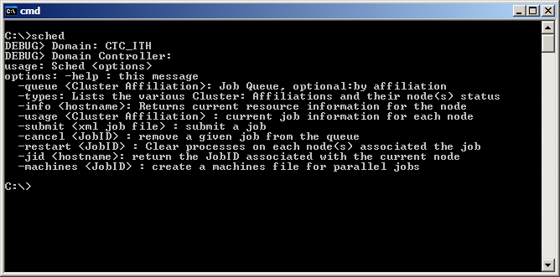




Windows HPC Environment
Active Directory
Head Node
Microsoft Operations Manager
User Mgmt
Cluster Mgmt
Job Mgmt
Resource Mgmt
Web service
Job
Policy, reports
User
Web page
Admin
Input
Management
Cmd line
Job
Sensors, Workflow,
Computation
Windows Server 2003, Compute Cluster Edition
Data
Data mining, Visualization,
Workflow Remote query
DB or FS
Cluster Node
High speed, low latency
interconnect (Ethernet over RDMA,
Infiniband)
Job Mgr
MPI
User App
Resource Mgr
Node Mgr

Slide 21
We agree on a lot … MS says
Grid moving to WS & SOA
Service Orientation – essentially abstraction
Web Services
Inherent heterogeneity - Interoperability
Scientist productivity
Integration with typical desktop productivity tools
Scientist in control – stop/start, reproducibility
Core standards areas
Addressing
Management
Security & Trust

Slide 22


The unified programming model for building service-oriented applications
Unifies today’s distributed technologies
Appropriate for use on-machine, cross machine, and cross Internet
Unification
WS-* interoperability with other platforms
Interoperable with today’s technologies
Interoperability
Service-Oriented
Programming
Service-oriented programming model
Maximized developer productivity

