Slide 1



Anar Manafov, GSI Darmstadt,
CHEP 2009
v. 0.13

Slide 2
Motivation
Design a toolset to setup a PROOF cluster on-the-fly.
The main goal is to make it transparent, also simple in use and extensible.
Use and combine Grid/Batch resources.

Slide 3
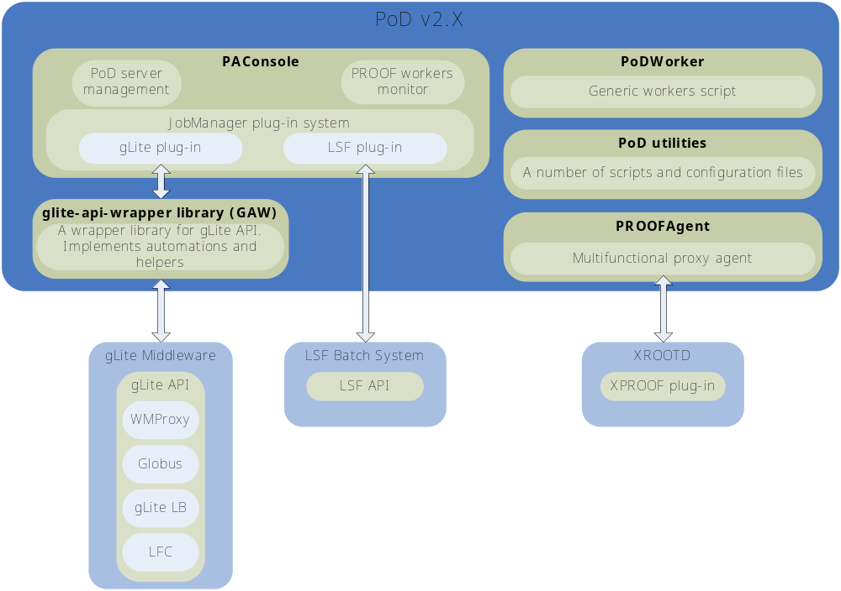

Slide 4
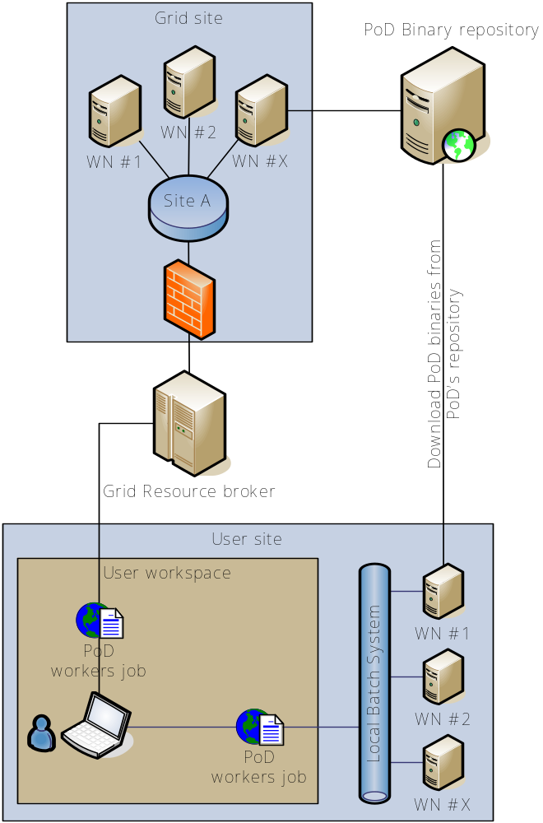
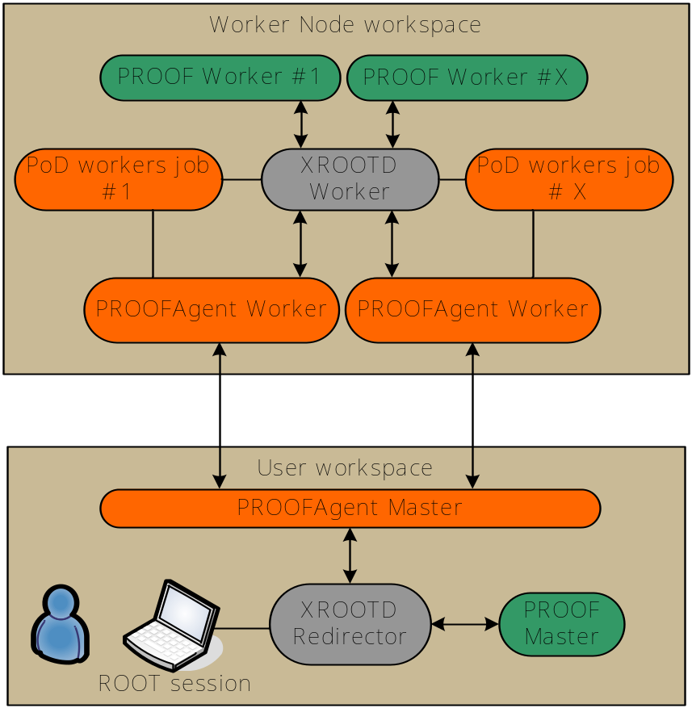


Slide 5
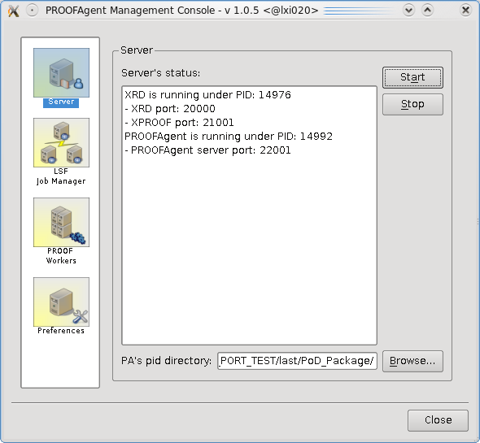
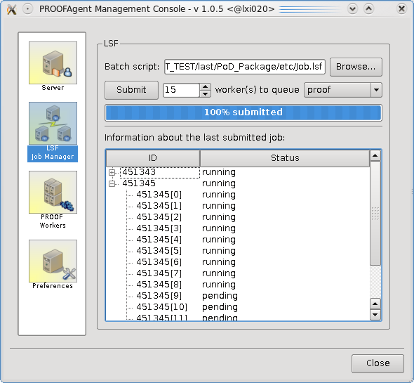
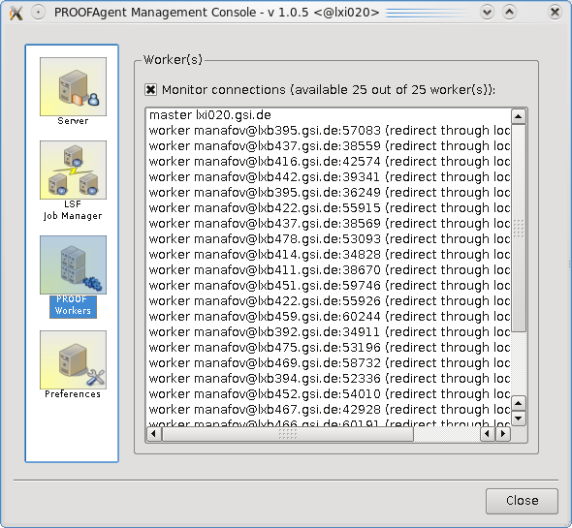
PAConsole - a GUI of PoD

Slide 6
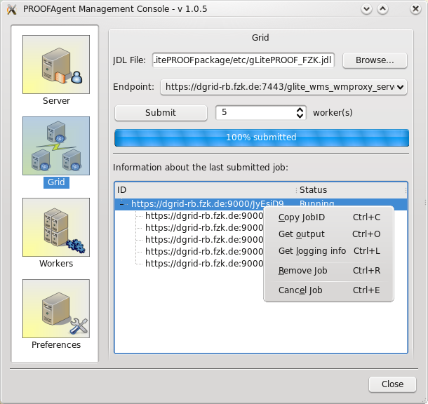
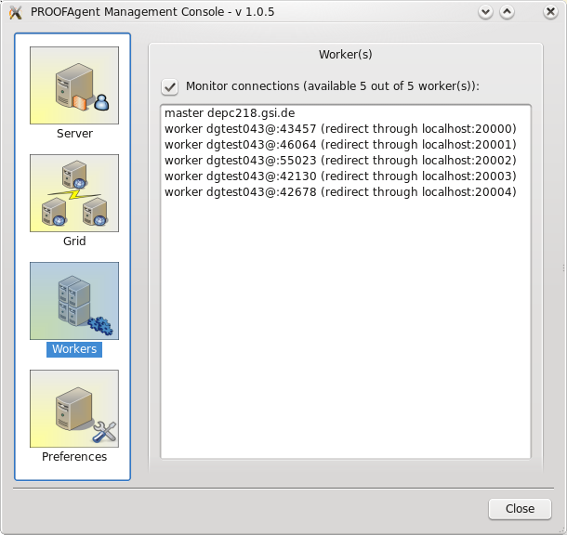
PAConsole - a GUI of PoD

Slide 7
TODO
Implement plug-ins for
  SGE, Condor, PBS, Globus...
Support Mac OS X UI and WNs
  implement PAConsole natively using Cocoa framework and Objective-C,
  port PROOFAgent to Mac OS X,
  advertise workers vie Bonjour.
Extend PAConsole functionality
Use PROOFAgent proxying dynamically
Extend code coverage

Slide 8
Software development
Agile methods are used
  continues integration (automated builds on SLC3, SL4, and F9, nightly builds),
  unit tests,
  projects metrics,
  task tickets and sprints…
Current build systems
  GNU Autotools,
  CMake.
Documentation systems
  DocBook (user manual and misc docs),
  Doxygen (source code documentation).
Continues integration
  Buildbot (automated distributed builds).

Slide 9

Summary
Easy in use
  user’s manual (http://www-linux.gsi.de/~manafov/D-Grid/docz/),
  one-click-installation,
  user friendly GUI – easy to configure and use,
  works out of the box,
  dynamic ports on UIs and WNs,
  supports reconnections,
  support different resources (with help of plug-in system).
Transparent
Resource sharing and monitoring for free
PoD: a PROOF cluster on-the-fly
Documentation/Download:
https://subversion.gsi.de/trac/dgrid

