Slide 1


RGLite plug-in and gLitePROOF package
Anar Manafov, GSI,
HEPCG Workshop, Jun 2008
v. 0.3

Slide 2
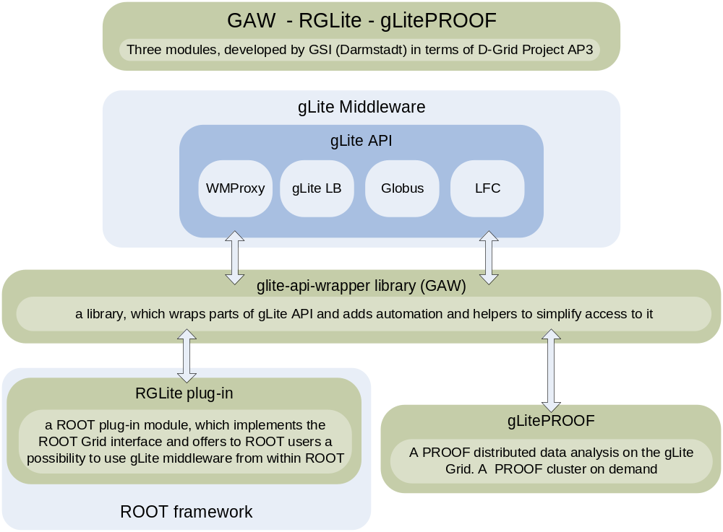

Slide 3
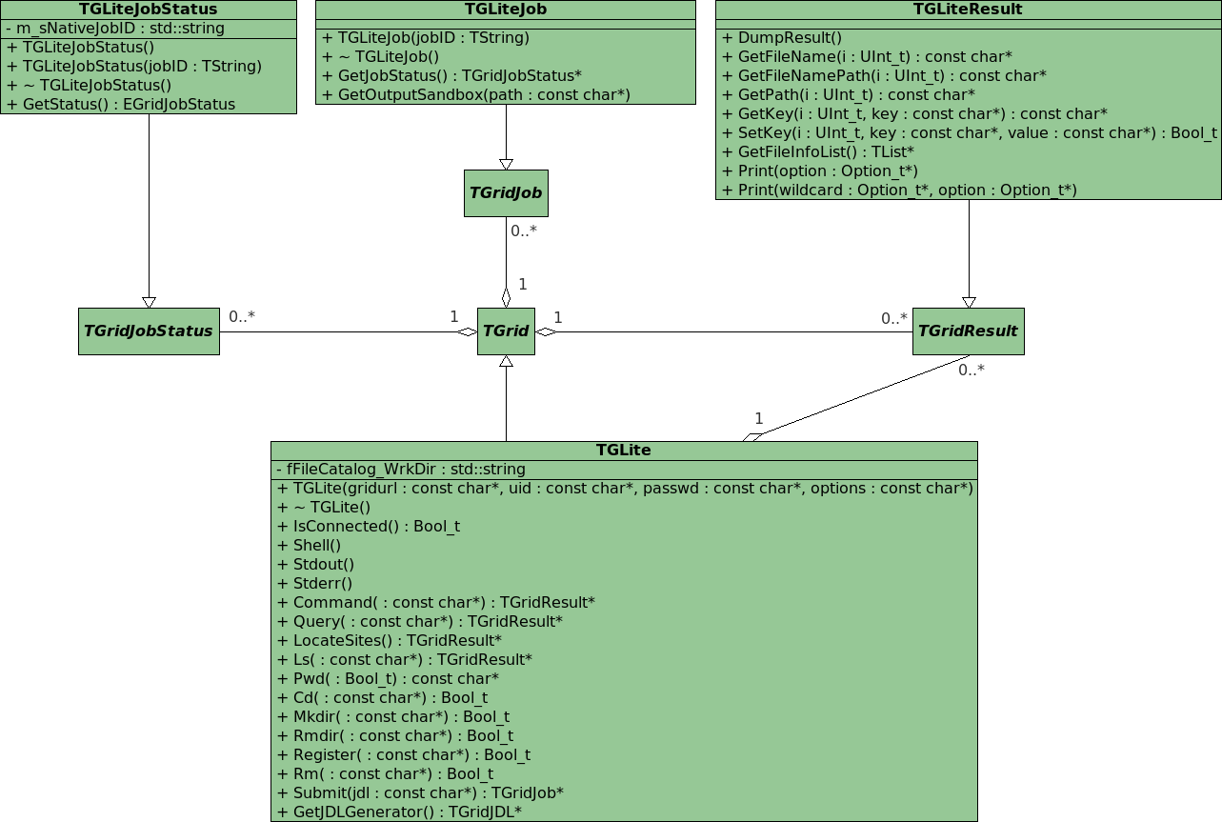

Slide 4
RGLite example
// Initializing RGLite plug-in
TGrid::Connect("glite");
// Submitting a Job to gLite Grid
TGridJob *job = gGrid->Submit("JDLs/proofd.jdl");
// querying a Status of the Job
TGridJobStatus *status = job->GetJobStatus();
status->GetStatus();
// Getting a Job's output back to the user
job->GetOutputSandbox("/home/anar/");
Job submission,
status querying,
output retrieving.
// Initializing RGLite plug-in
TGrid::Connect("glite");
// Changing current File Catalog directory to "dteam"
gGrid->Cd("dteam");
// Querying a list of files of the current FC directory
TGridResult* result = gGrid->Ls();
// Printing the list out
Int_t i=0;
while (result->GetFileName(i))\
> printf("File %s\n",result->GetFileName(i++));
Changing file catalog directory,
querying lists of files.

Slide 5

RGLite features
An official part of the ROOT distribution since ROOT v5.19.
Workload Management System operations:
  job submission – normal, DAG and parametric jobs (gLite WMProxy API),
  smart look-up algorithm for WMP-Endpoints,
  job status querying (gLite LB API),
  job output retrieving (Globus GridFTP).
File Catalog operations (gLite/LCG LFC API):
  smart session manager,
  set/query the current working catalog directory,
  list files, directories and their stats,
  add/remove files in a catalog namespace,
  add/remove directories,
  add/remove replicas from a given file.
An executive logging.
Support of an external xml configuration file.

Slide 6
gLitePROOF
gLitePROOF – a gLite PROOF package.
It is a number of utilities and configuration files, developed at GSI in terms of the D-Grid project and aims to implement a PROOF distributed data analysis on the gLite Grid.

Slide 7
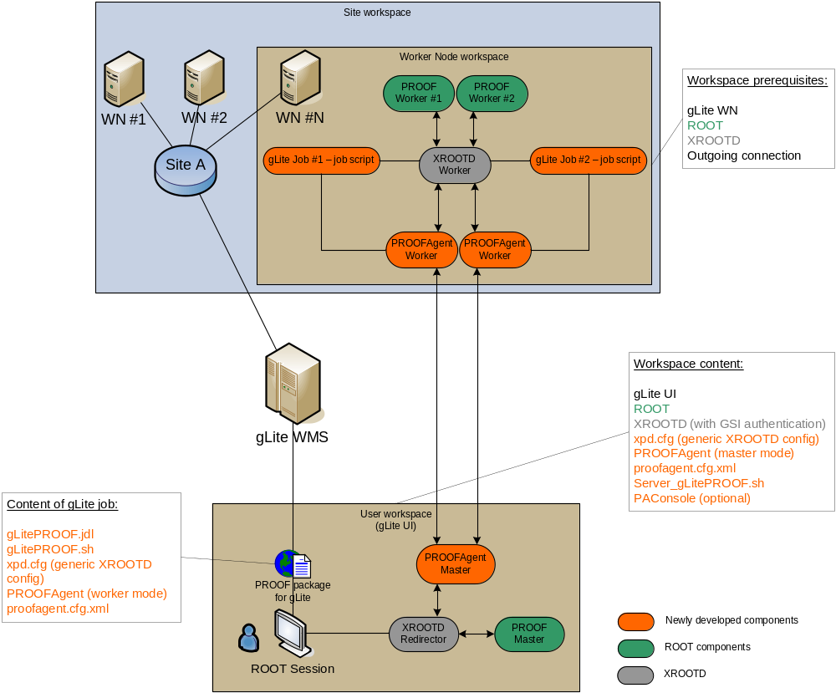

Slide 8
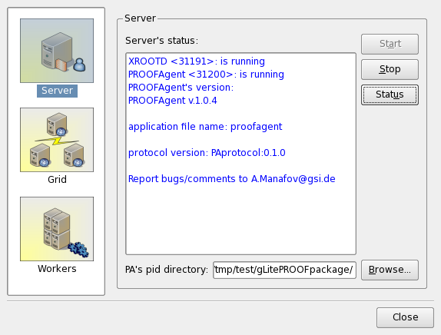
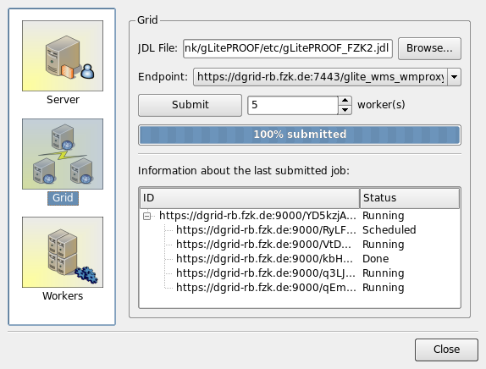
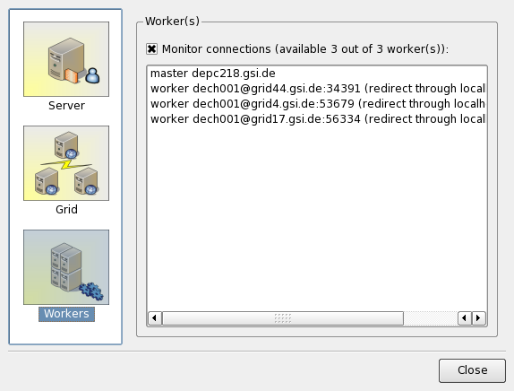
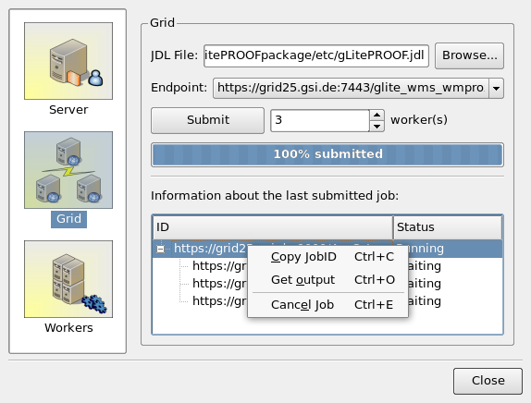
PAConsole - a GUI of gLitePROOF

Slide 9
gLitePROOF summary
Requirements
  Client-Side: gLite UI 3.1, ROOT 5.18+,
  Remote-Side: WMP Endpoint, open out. traffic (Globus ports on WNs).
Easy in use
  one-click-installation,
  user’s manual (http://www-linux.gsi.de/~manafov/D-Grid/docz/)
  user friendly GUI,
  works out of the box.
Easy to extend
Combines resources of the Grid and advantages of PROOF
  transparency (local ROOT analysis <-> PROOF <-> gLitePROOF),
  scalability (The basic architecture should not put any implicit limitations on the number of workers).
Works on heterogeneous machines (gLite WNs)
Uses xrootd and Grid methods to access data

Slide 10

Summary
  RGLite
    TGridXXX interface are implemented in RGLite for gLite MW.
    ROOT team accepted our suggestions to TGridXXX interface.
    uses WMP job submission.
    compatible with gLite UI 3.1.
    a part of the ROOT distributive (since ROOT v5.19).
  gLitePROOF package
    New stable release.
    Two officially registered users from ATLAS (CPPM and LAL, France).
    setups “on-the-fly” a PROOF cluster on gLite Grid.
    works with mixed type of gLite worker nods (x86_64, i686...).
    supports reconnections.
    provides GUI.
  Use of Agile methods of software development:
    Continues integration (automated builds on SLC3, SL4, and F8, nightly builds).
    Unit tests.
    Projects metrics.
    Task tickets and sprints…
Trac: https://subversion.gsi.de/trac/dgrid
Wiki: http://wiki.gsi.de/cgi-bin/view/Grid/RGLiteAndGAW

