Slide 1

WP 3: Distributed Data Analysis under usage of Grid Resources –
Gap Analysis
D-Grid Initiative
Author(s)XYZ, GSI
HEPCG Workshop, Nov 30 2006
last modified date : 03-11-2006; version: 0.4

Slide 2
Presentation “Road map”
An Interactive Parallel Data Analysis using Grid
The ALICE model of distributed and parallel data analysis
Gaps Analysis
The Model and its implementation
A design concept and development plan

Slide 3
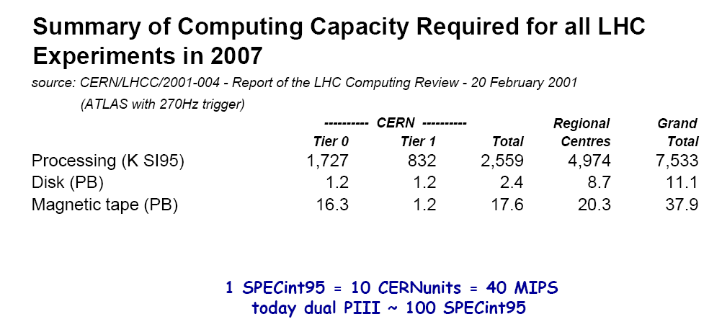
An Interactive Parallel Data Analysis using Grid
There is no any general and Grid enabled data analysis schema.
There is no standardized API of the Grid; (at least we are taking here about high level APIs, which could be in general used by an end-user to satisfy his needs in parallel data processing on the Grid in simplest possible way).
But it is require more and more resources to process data analysis or simulations!

Slide 4
The ALICE model of distributed and parallel analysis
ROOT is a de facto standard framework in HEP community.
Shortly saying it provides two key points:
  the possibility to do interactive analysis work in familiar C++ style syntax;
  data visualization, an object-oriented I/O system.
It is successfully used within frameworks of different experiments as an “all in one” solution.
PROOF extends a workstation based concept of ROOT to a parallel processing on a cluster, where:
  user procedures are kept identical during an analysis session,
  tasks are distributed automatically in the background.
PROOF says: “Bring the KB to the PB, not the PB to the KB!”
AliEn (ALICE production distributed environment) as a Grid analysis platform provides two key elements:
  a global file system, files are indexed and tagged in a virtual file catalogue and everywhere globally accessible;
  a global queue system, global job scheduling according to resource requirements.

Slide 5
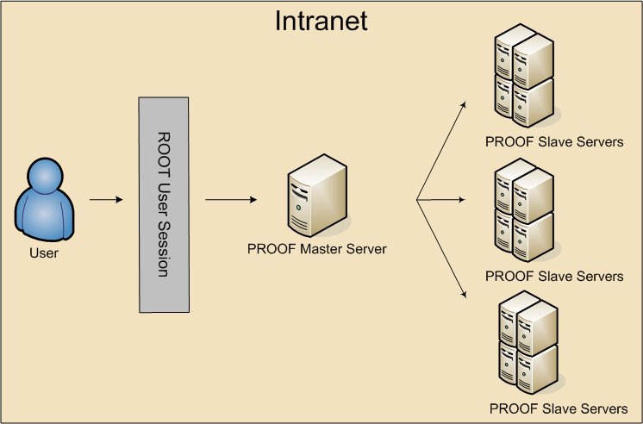

Slide 6
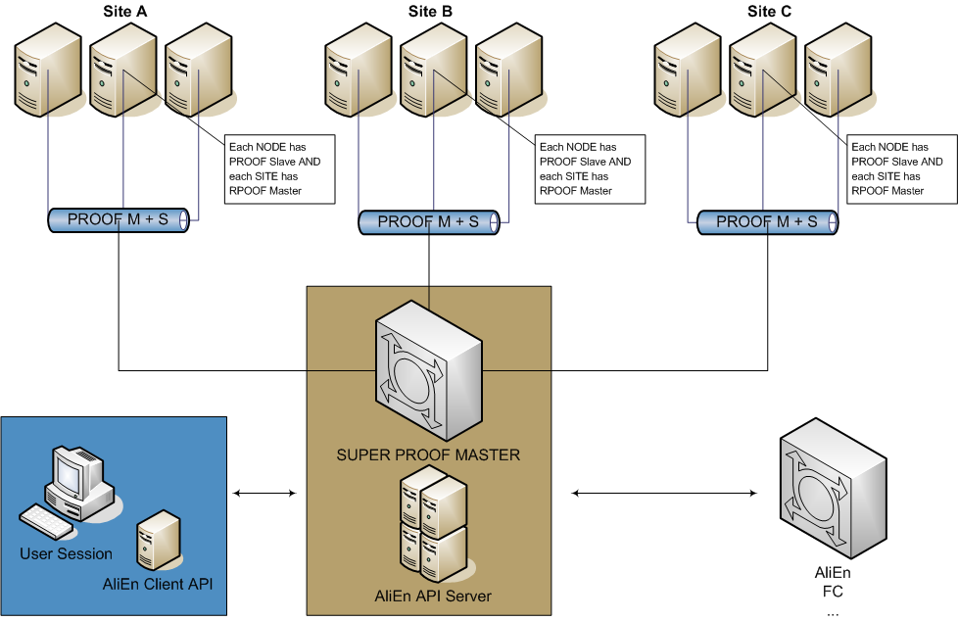

Slide 7
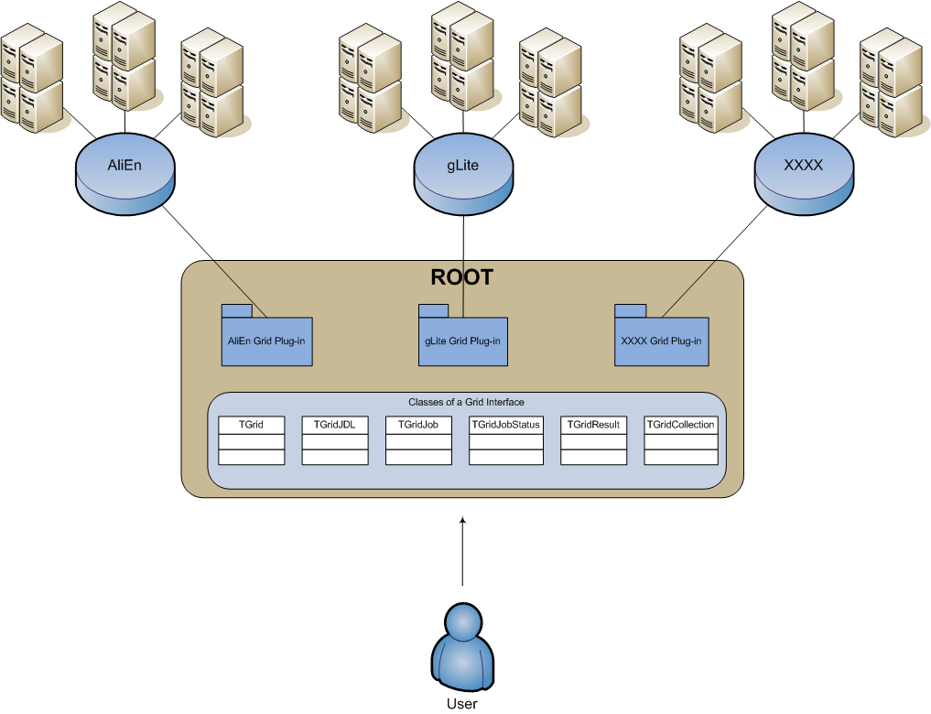

Slide 8
Gaps Analysis

Slide 9
The Model
gLite testbed (resent version of gLite)
glite-api-wrapper library (GAW)
A ROOT plug-in for RGLite

Slide 10
GAW

Slide 11
RGLite

Slide 12
RGLite Samples
RGLite Usage Code example – Job submission, Status querying, Output retrieving
// Initializing RGLite plug-in TGrid::Connect("glite"); // Submitting a Job to gLite Grid TGridJob *job = gGrid->Submit("JDLs/proofd.jdl"); // querying a Status of the Job TGridJobStatus *status = job->GetJobStatus(); status->GetStatus(); // Getting a Job's output back to the user TGLiteJob* job_glite(job); job_glite->GetJobOutput("/home/anar/");
RGLite Usage Code example – Changing File Catalog directory, querying lists of files
// Initializing RGLite plug-in TGrid::Connect("glite"); // Changing current File Catalog directory to "dteam" gGrid->Cd("dteam"); // Querying a list of files of the current FC directory TGridResult* result = gGrid->Ls(); // Printing the list out Int_t i=0; while (result->GetFileName(i))\ > printf("File %s\n",result->GetFileName(i++));

Slide 13
RGLite Samples
RGLite Usage Code example – List full file information of a File Catalog folder
// Initializing RGLite plug-in TGrid::Connect("glite"); // Changing current File Catalog directory to "dteam" gGrid->Cd("dteam"); // Querying a list of files of the current FC directory TGridResult* result = gGrid->Ls(); // Printing the list out, including full file information result->Print("all");
RGLite Usage Code example – retrieving a name of a current File Catalog folder
// Initializing RGLite plug-in TGrid::Connect("glite"); // Changing current File Catalog directory to "dteam" gGrid->Cd("dteam"); // Printing a current working directory std::cout << "Working Directory is" << gGrid->Pwd() << std::endl;
RGLite Usage Code example – creating a new File Catalog Folder
// Initializing RGLite plug-in TGrid::Connect("glite"); // Changing current File Catalog directory to "/grid/dech" gGrid->Cd("/grid/dech"); // Creating a new File Catalog Folder Bool_t b = gGrid->Mkdir("root_test2");

Slide 14
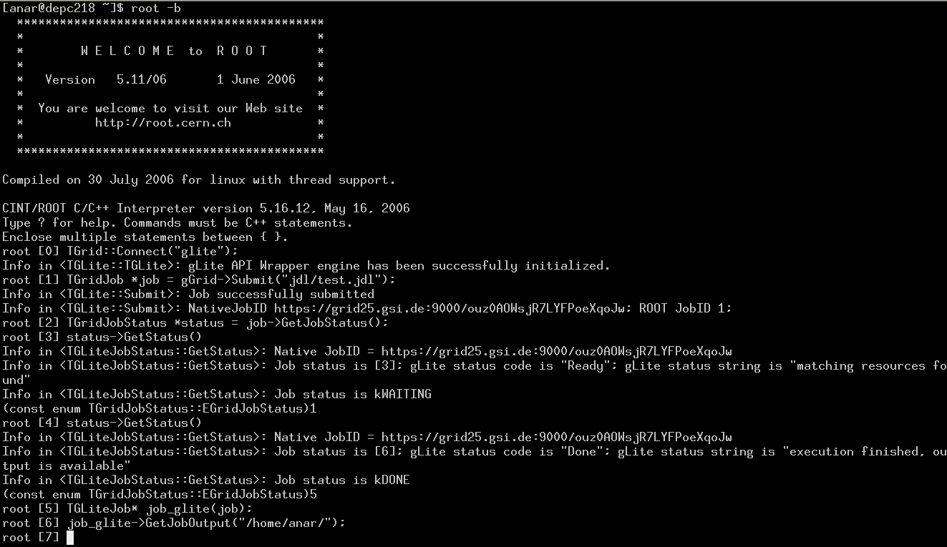
RGLite Samples

Slide 15
Design concept and development plan

