Slide 1
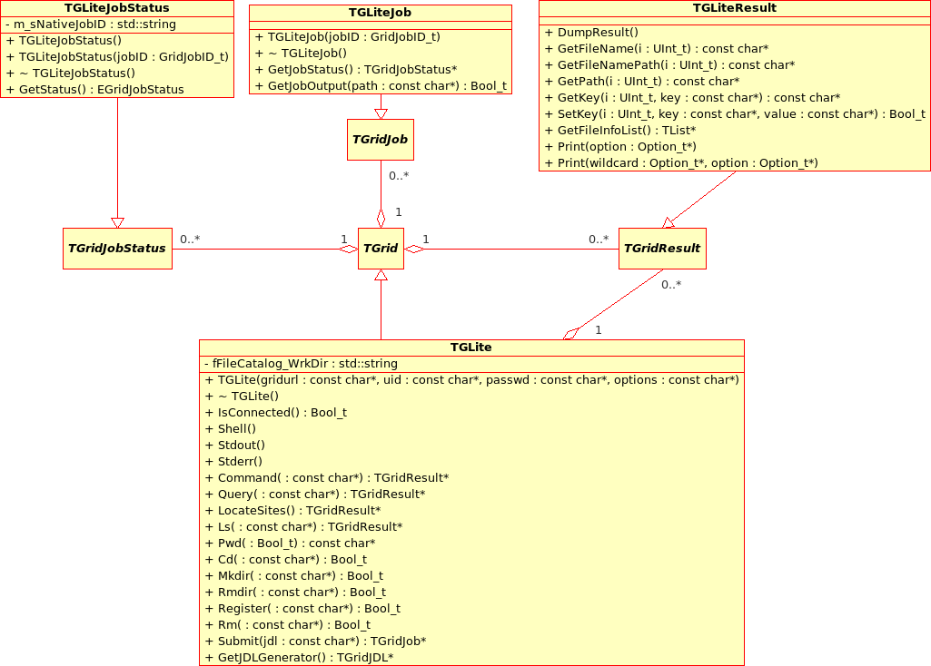
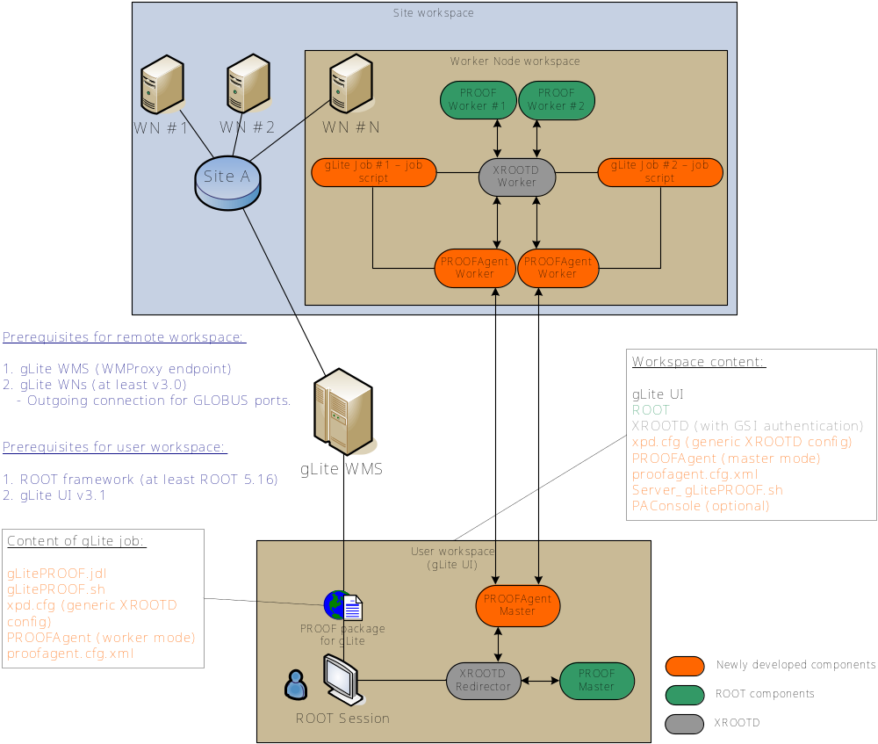





RGLite, an interface between ROOT and gLite
Anar Manafov, Kilian Schwarz (GSI, Germany)
After all LHC experiments managed to run globally distributed Monte Carlo productions on the Grid, now the development of tools for equally spread data analysis stands in the foreground. To grant Physicists access to this world suited interfaces must be provided. ROOT/PROOF framework is used as a starting point and base services of this project. Using abstract ROOT classes (TGrid, ...) interfaces can be implemented via which Grid access directly from ROOT can be accomplished. A concrete implementation exists already for the ALICE Grid environment AliEn. Within the D-Grid project now also an interface to the common Grid middleware of all LHC experiments, gLite, has been created. Herewith it is possible to query Grid File Catalogues directly from inside ROOT for the location of the data to be analysed, Grid jobs can be submitted into a gLite based Grid, the status of the jobs can be asked for, and the results can be obtained. It is also shown, that using gLitePROOF package it is possible to perform PROOF-based distributed data analysis on the gLite Grid.
glite-api-wrapper (GAW) is a C++ library, which wraps some part of gLite API and adds automation and helpers in order to simplify access to the needed functionality of gLite MW. Wasn’t designed as a general gLite API wrapper, but rather in terms and needs of the RGLite project.
glite-api-wrapper (GAW library)
GAW provides the following features
Workload Management System operations:
  job submission – normal, DAG and parametric jobs (WMProxy API),
  job status querying (LB API),
  job output retrieving (GRIDFTP).
File Catalog operations (LFC API):
  set/query the current working catalog directory,
  list files, directories and their stats,
  add/remove files in a catalog namespace,
  add/remove directories,
  add/remove replicas from a given file.
An executive logging.
Support of an external xml configuration file.
Serialization support.
A short demonstration of GAW usage
Please note, that to do the same operations using raw gLite API one should write about 500 LOC in some cases more.
…
// GAW Init
CGLiteAPIWrapper::Instance().Init()
// Job Submission
CJobManager &JobMng( CGLiteAPIWrapper::Instance().GetJobManager() );
JobMng.DelegationCredential();
const string jdl( “test.jdl” );
string JobID;
JobMng.JobSubmit( jdl, &JobID );
…
// Checking job's status
const glite::lb::JobStatus::Code status =
JobMng.JobStatus( JobID );
…
// Job’s Output
JobMng.JobOutput( JobID, output_dir, &joboutput_path );
User Application
User Application
User Application
GAW Library
GAW Interface Manager
GAW Job Manager
GAW Catalog Manager
gLite Middleware
gLite API (WMProxy, LFC, LB)
Src. Documentation (Doxygen): http://www-linux.gsi.de/~manafov/D-Grid/docz/glite-api-wrapper/html/index.html
Nightly releases: http://www-linux.gsi.de/~manafov/D-Grid/Release/
gLite WMS (with WMProxy)
gLite LB
LCG LFC
RGLite – a grid plug-in for the ROOT
RGLite – a ROOT plug-in module, which implements ROOT Grid interface and offers to ROOT users a possibility to use gLite from within their ROOT macros/programs.
The current implementation of RGLite is using GAW library to perform gLite grid operations.
RGLite currently provides the whole range of functionality, which is defined by ROOT Grid interface.
Since RGLite is implemented by using GAW calls, it supports WMProxy job submission and brings all advantages of this method to the ROOT users.
So-far RGLite isn’t a part of ROOT distributive, we therefore provide a ROOT patch which helps users to easily install RGLite with ROOT source.
RGLite has been successfully tested with the recent version of ROOT (5.17.01).
A usage examples
Job submission, Status querying, Output retrieving:
List full file information of a catalog folder:
UML Class Diagram of RLite
// Initializing RGLite plug-in
TGrid::Connect( "glite“ );
// Submitting a Job to gLite Grid
TGridJob *job = gGrid->Submit( “test.jdl“ );
// querying a Status of the Job
TGridJobStatus *status = job->GetJobStatus();
status->GetStatus();
// Getting a Job's output back to the user
TGLiteJob *job_glite( job );
job_glite->GetOutputSandbox( "/home/anar/“ );
// Initializing RGLite plug-in
TGrid::Connect( "glite“ );
// Changing current File Catalog directory to “dech"
gGrid->Cd( "dech“ );
// Querying a list of files of the current FC directory
TGridResult *result = gGrid->Ls();
// Printing the list out, including full file information
result->Print( "all“ );
Src. Documentation (ROOT HTML Doc.):
http://wiki.gsi.de/cgi-bin/view/Grid/RGLiteAndGAW#Code_documentation
Nightly releases: http://www-linux.gsi.de/~manafov/D-Grid/Release/
gLitePROOF – a gLite PROOF package. It consists of a number of utilities and configuration files developed at GSI in terms of the D-Grid project and aims to implement a PROOF distributed data analysis on the gLite Grid.
gLitePROOF – A gLite PROOF package
gLitePROOF components
PROOFAgent –a lightweight, standalone C++ application. Acts as a multifunctional proxy client/server and helps to use proof/xrootd on the Grid's worker nods which are behind a firewall. Also PROOFAgent has a number of additional useful functionalities which help to start, process and control PROOF interactive analysis on the remote Grid worker node. With the gLitePROOF package users get PROOFAgent‘s default configuration file.
PAConsole – a standalone C++ application, provides GUI and aims to simplify the usage of PROOFAgent application/daemon and gLitePROOF configuration files. PAConsole uses GAW to perform gLite jobs submission. When it’s required users can implement GUI and Job submission directly using ROOT and RGLite plug-in instead of using PAConsole.
xpd.cfg – a generic XROOTD configuration file (configures redirector and also remote grid workers to act as xrootd/proof workers).
Server_gLitePROOF.sh – a server side script. Helps to start/stop services of gLitePROOF package. Could be used in the command line when users can’t/don’t want to use PAConsole GUI.
gLitePROOF.jdl – a JDL file, describes a generic, parametric grid job, which is submitted to the gLite and aims to execute gLitePROOF workers on grid worker nodes.
One of gLitePROOF use case
User installs gLitePROOF package on his local PC.
Using PAConsole user configures and starts PROOFAgent (PA) server and XROOTD redirector.
Then PA connects to XROOTD's proof port and waits for PA clients.
Using PAConsole user submits gLitePROOF parametric job to the Grid.
When gLitePROOF job arrives to a remote worker node it configures environment and starts all needed services including XROOTD worker and PA client.
Then PA client communicates with PA server, exchanges environment data and initiates a network tunnel.
When PA server accepts connection from client, the client is ready to be a real PROOF worker node.
When PA server detects good connections with his clients, this information immediately reflected by PAConsole.
When all workers are connected or when user is satisfied with the number of connected workers, he can process normal PROOF analysis if it would be happening on a local batch farm.
PA can manage disconnects, user can restart his ROOT session without resubmitting gLitePROOF Grid jobs.
Src. Documentation (Doxygen):
http://wiki.gsi.de/cgi-bin/view/Grid/RGLiteAndGAW
Nightly releases: http://www-linux.gsi.de/~manafov/D-Grid/Release/
www.gsi.de
www.bmbf.de
www.d-grid.de
root.cern.ch
public.eu-egee.org
Contact: Anar Manafov, A.Manafov@gsi.de

