Slide 1
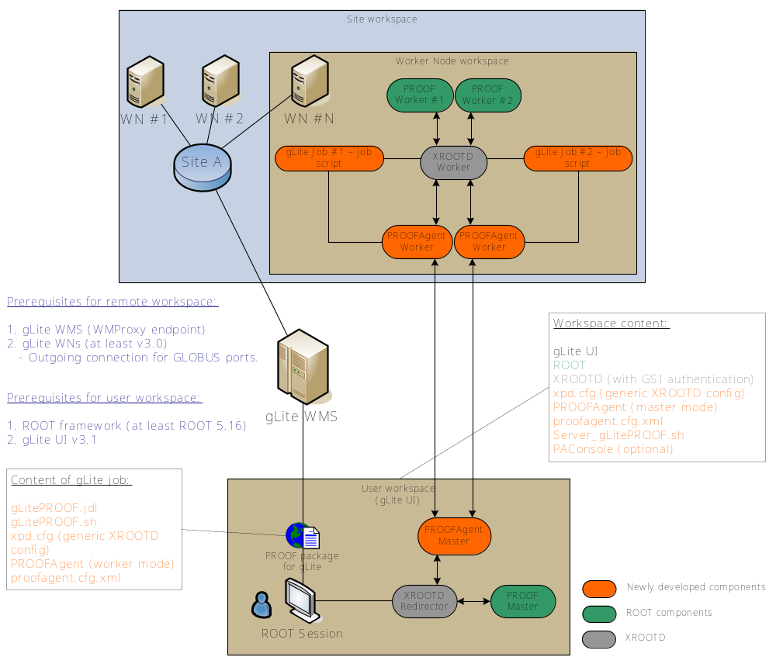
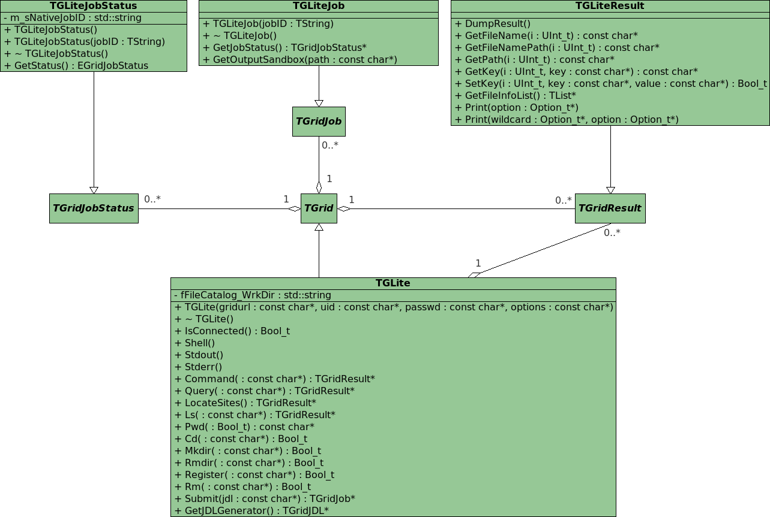





RGLite, an interface between ROOT and gLite
Peter Malzacher, Anar Manafov, Kilian Schwarz (GSI Darmstadt, Germany)
Using the gLitePROOF package it is possible to perform PROOF-based distributed data analysis on the gLite Grid. The LHC experiments managed to run globally distributed Monte Carlo productions on the Grid, now the development of tools for data analysis stands in the foreground. To grant access interfaces must be provided. The ROOT/PROOF framework is used as a starting point. Using abstract ROOT classes (TGrid, ...) interfaces can be implemented, via which Grid access from ROOT can be accomplished. A concrete implementation exists for the ALICE Grid environment AliEn. Within the D-Grid project an interface to the common Grid middleware of all LHC experiments, gLite, has been created. Herewith it is possible to query Grid File Catalogues from ROOT for the location of the data to be analysed. Grid jobs can be submitted into a gLite based Grid. The status of the jobs can be asked for. The results can be obtained.
glite-api-wrapper (GAW library)
GAW provides the following features
Workload Management System operations:
  job submission – normal, DAG and parametric jobs (WMProxy API),
  job status querying (LB API),
  job output retrieving (GridFTP).
File Catalog operations (LFC API):
  set/query the current working catalog directory,
  list files, directories and their stats,
  add/remove files in a catalog namespace,
  add/remove directories,
  add/remove replicas from a given file.
An executive logging.
Support of an external xml configuration file.
Serialization support.
glite-api-wrapper (GAW) – a C++ library, which wraps some parts of the gLite API, adds automation and helpers in order to simplify access to the needed functionality of gLite. Not a general gLite API wrapper; designed for the needs of the RGLite project.
A short demonstration of GAW usage
To do the same using the gLite API directly one has to write about 500 LOC.
…
// GAW Init
CGLiteAPIWrapper::Instance().Init();
// Job submission
CJobManager &mng( CGLiteAPIWrapper::Instance().GetJobManager() );
mng.DelegationCredential();
const string jdl(“test.jdl”);
string jobID;
mng.JobSubmit(jdl, &jobID);
…
// Checking job's status
const glite::lb::JobStatus::Code status =
mng.JobStatus(jobID);
…
// Job’s output
mng.JobOutput(jobID, output_dir, &joboutput_path);
User Application
User Application
User Application
GAW Library
GAW Interface Manager
GAW Job Manager
GAW Catalog Manager
gLite Middleware
gLite API (WMProxy, LFC, LB)
gLite WMS (with WMProxy)
gLite LB
LCG LFC
gLitePROOF – A gLite PROOF package
gLitePROOF components
PROOFAgent – a lightweight, standalone C++ application. Acts as a multifunctional proxy client/server and helps to use proof/xrootd on the Grid worker nodes behind a firewall. Also PROOFAgent has a number of additional useful functionalities which help to start, process, and control PROOF interactive analysis. The default configuration file is included.
PAConsole – a standalone C++ application, provides a GUI and aims to simplify the usage of PROOFAgent and gLitePROOF configuration files. PAConsole uses GAW to perform gLite job submissions. Users can control jobs directly using ROOT and RGLite plug-in instead of using PAConsole.
xpd.cfg – a generic XROOTD configuration file (configures redirector and remote Grid workers).
Server_gLitePROOF.sh – a server side script. Helps to start/stop services of gLitePROOF. Could be used via command line or PAConsole GUI.
gLitePROOF.jdl – a JDL file, describes a generic, parametric Grid job, which is submitted to gLite and aims to execute gLitePROOF workers on Grid worker nodes.
gLitePROOF – a gLite PROOF package. It is a number of utilities and configuration files developed at GSI in terms of the D-Grid project and aims to implement a PROOF distributed data analysis on the gLite Grid.
Main use case of gLitePROOF: “Set up PROOF on the Grid”
Using PAConsole a user configures and starts PROOFAgent (PA) server and XROOTD redirector.
  PA connects to XROOTD's proof port and waits for PA clients.
Using PAConsole the user submits gLitePROOF parametric job to the Grid.
  When the job arrives to a remote worker node it configures the environment and starts all needed services including XROOTD worker and PA client.
  Then PA client communicates with PA server, exchanges environment data and initiates a network tunnel.
  When PA server accepts a client connection, the client is ready to be a PROOF worker node.
  When PA server detects good connections with its clients, this information is immediately reflected by PAConsole.
When all workers are connected or when the user is satisfied with the number of connected workers, the PROOF analysis can be processed like on a local batch farm.
  PA can manage disconnects, the user can restart the ROOT session without resubmitting gLitePROOF Grid jobs.
PROOF on the Grid
RGLite – a Grid plug-in for ROOT
The current implementation of RGLite is using the GAW library to perform gLite Grid operations.
RGLite currently provides the whole range of functionality, which is defined by the ROOT Grid interface.
Since RGLite is implemented using GAW calls, it supports WMProxy job submission and brings all advantages of this method to the ROOT users.
So far RGLite isn’t a part of the ROOT distribution, we therefore provide a ROOT patch which helps users to easily install RGLite with ROOT source.
RGLite has been successfully tested with recent versions of ROOT.
RGLite – a ROOT plug-in, which implements the ROOT Grid interface and offers to ROOT users a possibility to use gLite from within their ROOT macros/programs.
Usage examples
Job submission, Status querying, Output retrieving:
List full file information of a catalog folder:
// Initializing RGLite plug-in
TGrid::Connect( "glite“ );
// Submitting a job to gLite Grid
TGridJob *job = gGrid->Submit( “test.jdl“ );
// querying a status of the job
TGridJobStatus *status = job->GetJobStatus();
status->GetStatus();
// Getting a job's output back to the user
job->GetOutputSandbox( "/home/anar/“ );
// Initializing RGLite plug-in
TGrid::Connect( "glite“ );
// Changing current File Catalog directory to “dech"
gGrid->Cd( "dech“ );
// Querying a list of files of the current FC directory
TGridResult *result = gGrid->Ls();
// Printing the list out, including full file information
result->Print( "all“ );
Work supported by BMBF,
FK 01AK802G
www.bmbf.de
www.gsi.de
www.d-grid.de
root.cern.ch
public.eu-egee.org
Src. Documentation: http://wiki.gsi.de/cgi-bin/view/Grid/RGLiteAndGAW#Code_documentation
Nightly releases: http://www-linux.gsi.de/~manafov/D-Grid/Release/
Contact: Anar Manafov, A.Manafov@gsi.de

