Slide 1



A Design Proposal for Interactive Data Analysis on the Grid
  Anar Manafov, GSI,
  GridKa School,
  13 Sep. 2007

Slide 2

“Road map”
Introduction
Design of “PROOF on gLite”
Live demo
Summary
Future plans

Slide 3
Introduction
Tools for ROOT based data analysis
Self-made solutions for local cluster
Self-made solutions for Grid
PROOF:
  Preinstalled PROOF clusters (local/remote)‏
  Self-made PROOF job submission
  Get an ALICE VO membership and use AliEn+PROOF

Slide 4
RGLite
// Initializing RGLite plug-in
TGrid::Connect("glite");
// Submitting a Job to gLite Grid
TGridJob *job = gGrid->Submit("JDLs/proofd.jdl");
// querying a Status of the Job
TGridJobStatus *status = job->GetJobStatus();
status->GetStatus();
// Getting a Job's output back to the user
TGLiteJob* job_glite(job);
job_glite->GetJobOutput("/home/anar/");
Job submission, Status querying, Output retrieving
// Initializing RGLite plug-in
TGrid::Connect("glite");
// Changing current File Catalog directory to "dteam"
gGrid->Cd("dteam");
// Querying a list of files of the current FC directory
TGridResult* result = gGrid->Ls();
// Printing the list out, including full file information
result->Print("all");
List full file information of a catalog folder

Slide 5
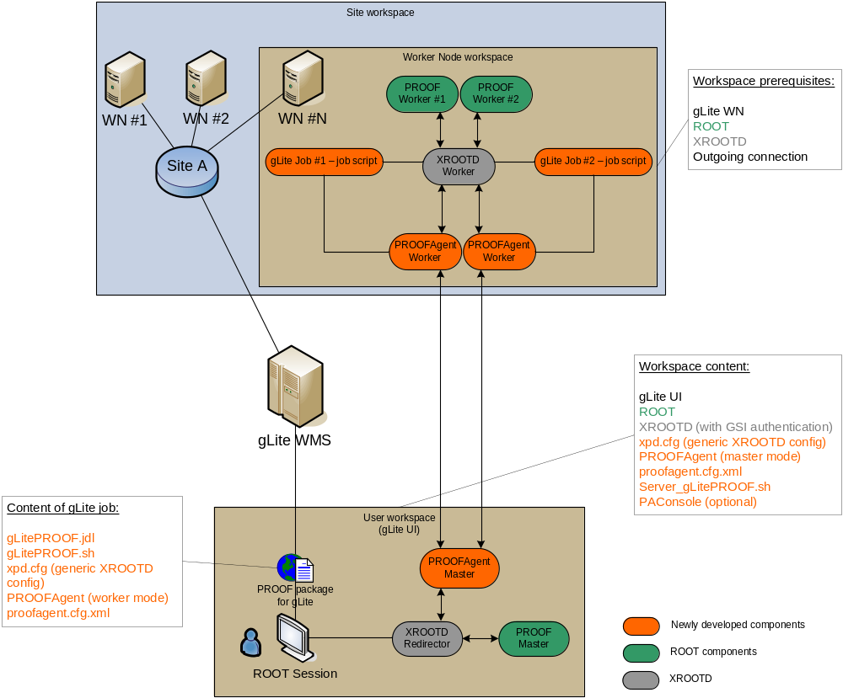

Slide 6
LIVE DEMO

Slide 7
Summary
RGLite is ready.
  ROOT team accepted our suggestions in order to improve TGridXXX.
A PROOF job submission on gLite MW is ready.
Using Agile methods of software development.
  Continues integration,
  automated build system (tests on SLC3 and FC6),
  nightly release,
  projects metrics,
  task tickets and sprints…
  see it all here: http://wiki.gsi.de/cgi-bin/view/Grid/RGLiteAndGAW

Slide 8

Future plans
Implement a schema with “sub-redirector”.

