Slide 1






RGLite
A gLite plug-in for ROOT
Anar Manafov, GSI
HEPCG Workshop, Apr 27 2006
www.gsi.de
www.bmbf.de
www.d-grid.de
aliceinfo.cern.ch
root.cern.ch
public.eu-egee.org

Slide 2
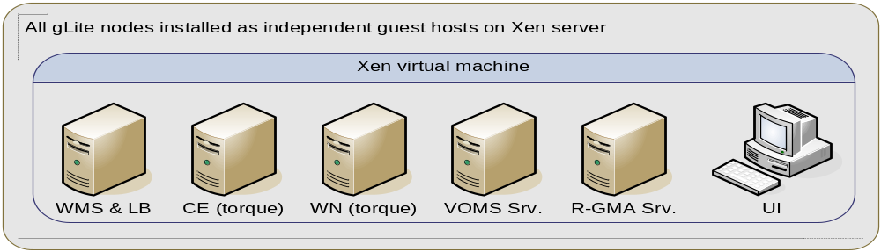
gLite R1.5
development and testing environment;
operational and providing essential resources needed for project development;
the installation and configuration process turned out to be a difficult task
  there is no support for this release and there are bugs in the MW,
  lots of time has been spent on it;
several tracked bugs were reported to “savannah” and fixed locally;
the process of installation and configuration was documented in GSI’s Wiki site (includes workarounds and tricks).

Slide 3
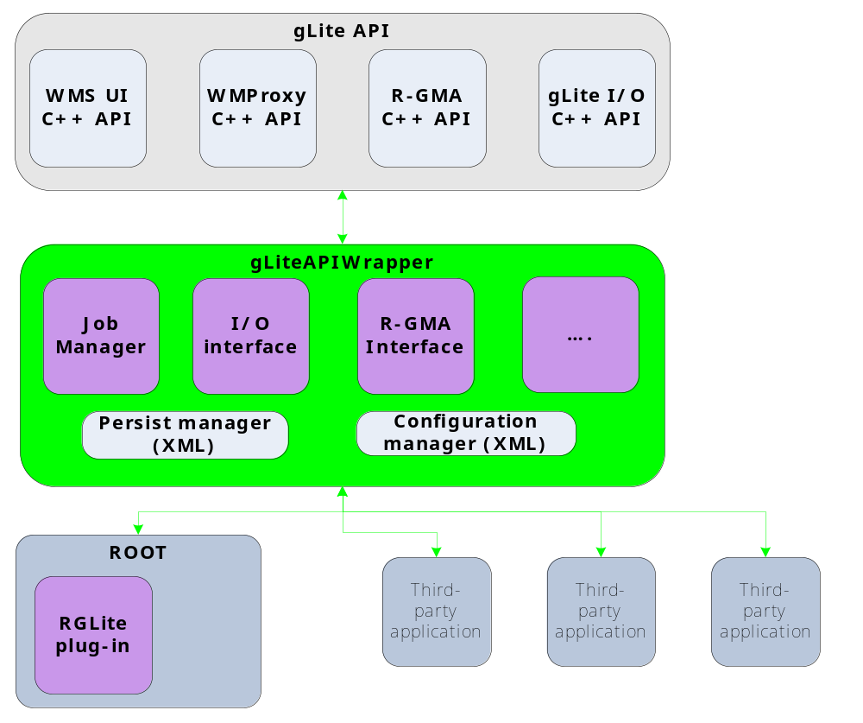
gLite API Wrapper library – UI provider

Slide 4
gLite API Wrapper
gLite API Wrapper:
encapsulates the gLite API,
offers (implements) simple gLite UI functionality,
implements an automation,
implements modularity of the system:
  simplifies the usage of gLite API,
  simplifies the development and testing,
by design it implements a number of managers:
  main manager is a singleton class,
supports the persistence and has internal log engine.
gLite API Wrapper development
C++ code.
So far home-made tests are used. It will be switched to the Boost Test Library.
The library building and installing is done using GNU’s autotools.
Version control system is GSI’s central SVN.
Code documentation is doxygen engine.
Project documentation: GSI’s Wiki site.
Bug tracking will be done using Bugzilla.

Slide 5
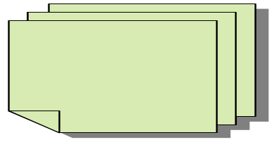
RGLite – ROOT plug-in
Set of ROOT Interfaces to the Grid
TGridJDL
Pure Abstract class. To generate JDL files for job submission to the Grid.
TGrid
Abstract base class defining interface to common Grid services.
TGridCollection
Class which manages collection files on the Grid.
TGridJobStatus
Pure Abstract class. Abstract base class containing the status of a Grid job.
TGridResult
Abstract base class defining interface to a Grid result. Objects of this class are created by TGrid methods.
TGridJob
Pure Abstract class. Abstract base class defining interface to a Grid job.
“realized”
TGLiteXXXX
TAlienXXXX

Slide 6
RGLite
Development and tests are done with ROOT 5.10.
Installation and registration of plug-in via a patch to ROOT src.
The following interfaces partially implemented up to now:
  TGrid -> TGLite,
  TGridJob -> TGLiteJob,
  TGridJobStatus -> TGLiteJobStatus.
RGLite implements:
  Job Submission (gLite WMSUI),
  Job Status Retrieving (gLite LB),
  Job Output Retrieving (gLite WMSUI).
Code documentation is the ROOT style auto HTML gen.
Project documentation: GSI’s Wiki site.

Slide 7
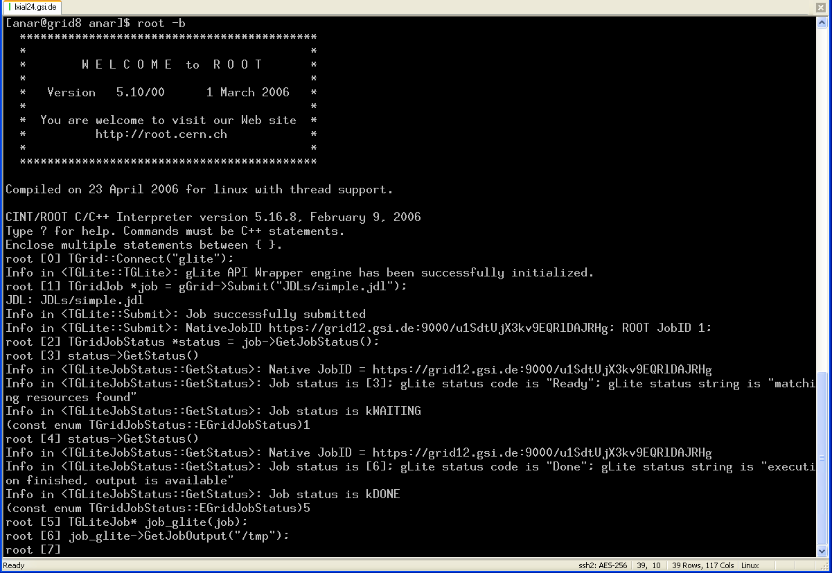
RGLite

Slide 8
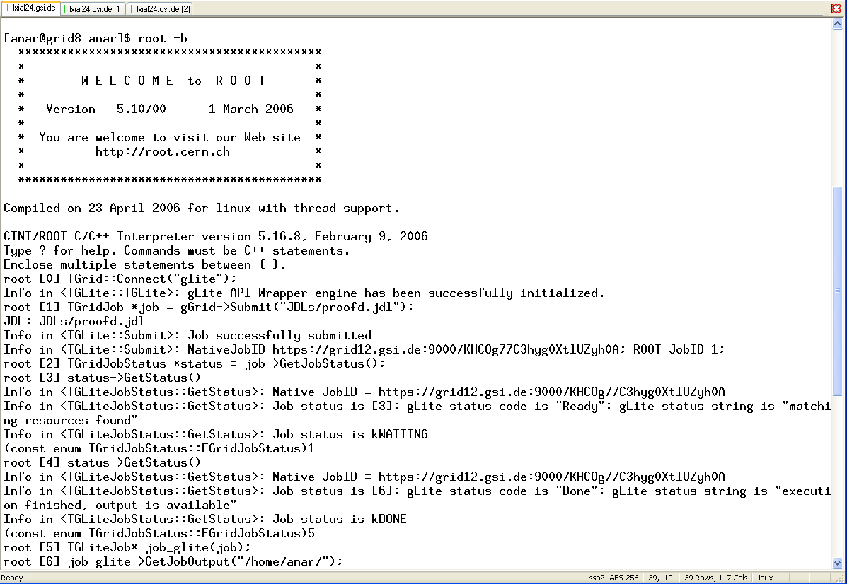
RGLite

Slide 9
TODO (till Aug 2006)
To complete job submission using WMProxy API.
To implement basic I/O operations using gLite I/O API.
To investigate an interface for interactive job submission:
  find out a way to communicate with interactive job.
To analyse current status and to define development plan for the next year.

