Slide 1



A Design Proposal for Interactive Data Analysis on the Grid
  Anar Manafov, GSI,
  GridKa School,
  13 Sep. 2007

Slide 2

Introduction
Tools for ROOT based data analysis
Self-made solutions for local cluster
Self-made solutions for Grid
PROOF:
  Pre-installed PROOF clusters (local/remote)‏
  Self-made PROOF job submission
  Get an ALICE VO membership and use AliEn+PROOF

Slide 3
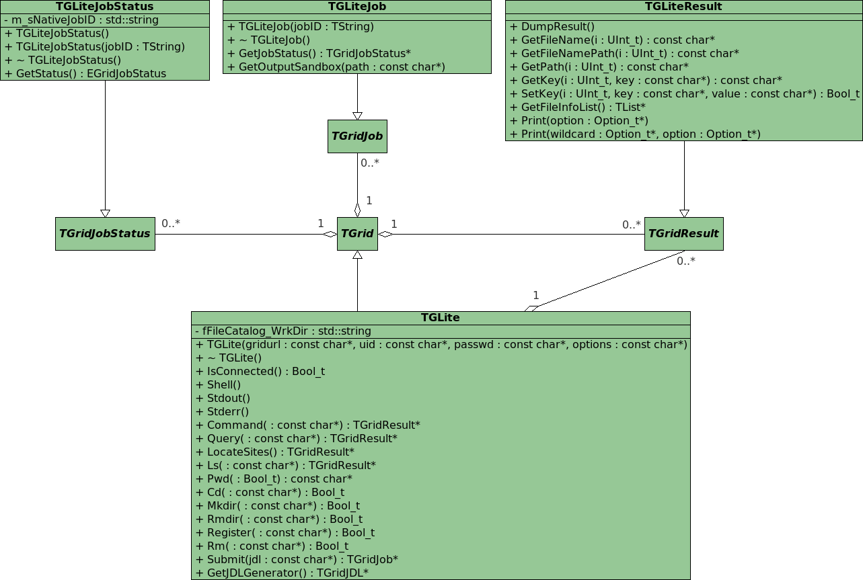

Slide 4
RGLite: LIVE DEMO

Slide 5
glite-api-wrapper
User Application
User Application
User Application
GAW Library
GAW Interface Manager
GAW Job Manager
GAW Catalog Manager
gLite Middleware
gLite API (WMProxy, LFC, LB)‏
gLite WMS (with WMProxy)‏
gLite LB
LCG LFC

Slide 6
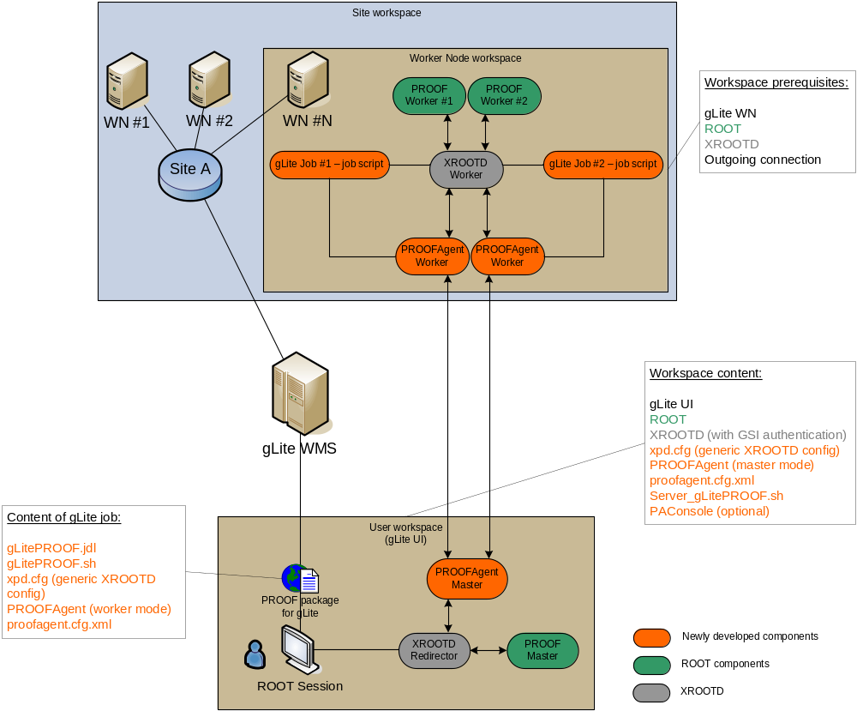

Slide 7
gLitePROOF: LIVE DEMO

Slide 8
Summary
RGLite is ready.
  ROOT team accepted our suggestions in order to improve TGridXXX.
gLitePROOF package – alpha release.
  A PROOF job submission on gLite MW is ready.
  gLitePROOF package supports reconnection.
Using Agile methods of software development.
  Continues integration,
    automated build system (tests on SLC3 and FC6),
    nightly release,
  projects metrics,
  task tickets and sprints…
  see it all here: http://wiki.gsi.de/cgi-bin/view/Grid/RGLiteAndGAW

Slide 9

Future plans
Implement a schema with “sub-redirector”.

