Slide 1
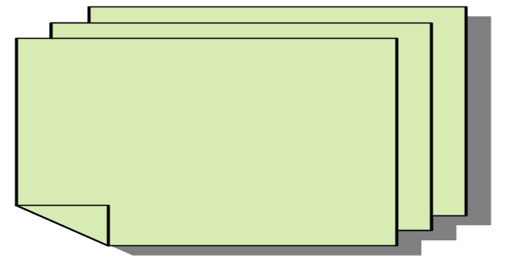
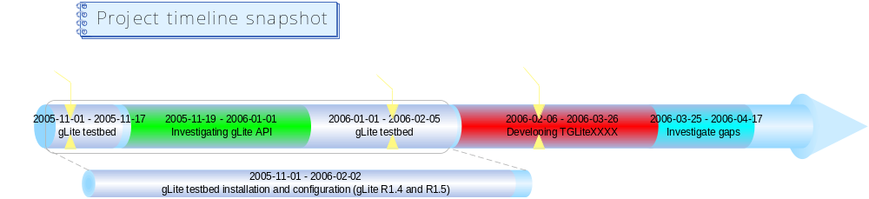






Developing a ROOT Interface for gLite
Anar Manafov, Kilian Schwarz (GSI, Germany)
Since September 2005, five Community projects and the D-Grid Integration project (DGI) started within the D-Grid Consortium to build a sustainable Grid infrastructure in Germany. This will help to establish methods of e-science in the German scientific community.
The main aim of this study is to investigate whether we can use “ALICE–like” interactive analysis in the Grid environment without requiring AliEn everywhere. As a good basis we took gLite middleware, since it is going to be general middleware for LHC experiments in near future (in terms of EGEE project). In the same time we try to proof that the same can be done with other types of Grid middleware like Globus4, for instance.
To achieve our aim we need to
get access to a gLite testbed or install it ourselves;
investigate available gLite API and tools;
implement TGridXXXX ROOT interfaces for gLite;
try to reproduce “ALICE-like” analysis using our new basis;
learn and understand the tools;
investigate possible gaps in TGrid and in gLite.
ALICE Analysis Basic Concepts
Analysis Models
  Prompt analysis at T0 using PROOF (+file catalogue) infrastructure;
  batch Analysis using Grid infrastructure;
  interactive Analysis using PROOF (+Grid) infrastructure.
User Interface
  ALICE users access any Grid Infrastructure via AliEn or ROOT/PROOF UI.
AliEn
  Native and “Grid on a Grid” (LCG/EGEE, ARC, OSG);
  integrate as much as possible common components
    LFC, FTS, WMS, MonALISA ...
PROOF/ROOT
  Single-/Multi- tier static and dynamic PROOF cluster;
  Grid API class TGrid (virtual) ---> TAliEn (implementation).
PROOF Session Diagram
Client
Master
Grid
Most of the PROOF components are MW independent.
To use PROOF on Grid we have to take care of the part which is MW dependent.
For a user MW dependent components are hidden behind TGridXXXX interfaces.
Our goal is to implement TGridXXXX for gLite and for other MW.
Combined with Grid middleware PROOF becomes a powerful environment for “interactive” parallel analysis of globally distributed data.
Phase I:
Grid MW
dependent
Client Grid query
PROOF steering populates Grid or batch queue with new slaves or discovers static slaves
Grid UI
Client sends analysis request to PROOF Steering
PROOF steering reserves PROOF slaves with Grid query dataset
Client Grid query
Client connects to private PROOF master
Private PROOF master connects to remote slaves via 'localhost' proxies
Phase II:
Grid MW
independent
Client runs analysis on Grid query dataset
Private PROOF master sends session timeout to client
Client terminates
Remote Slaves
*) Based on presentation of Fons Rademakers, “PROOF with AliEn and GLite”, GridKA School 2004.
TGLiteXXXX Schema
gLite WMProxy C++ API
Parametric Jobs
Bulk submission/Job Collections
Shared sandbox
Shared requirements
“non-local” Input Sandboxes
Automatic upload of Output Sandboxes
FQAN based authZ/mapping
JDL extensions
Partitioning on data
TGrid example with AliEn/gLite
// Connect
TGrid grid = TGrid::Connect(“alien://”); // Connect(“glite…”
// Query
TGridResult *res = grid.Query(“/home/test_user/analysis/”, ”*.root“);
// List of files
TList *listf = res->GetFileInfoList();
// Create chain
TChain chain(“Events", “session");
Chain.AddFileInfoList(listf);
// Start PROOF
TProof proof(“remote”);
// Process your query
Chain.Process(“selector.C”);
ROOT Facility
gLite User Interface
gLite WMS & LB
TGLiteXXXX
gLite API
WMProxy C++ API
RGMA C++ API
As a WM API we find the gLite WMProxy C++ API best choice, because it has several advantages in comparing to the old WM UI API
Grid Access using ROOT facility
Set of ROOT Interfaces to the Grid
UI to Grid
Service + Files
Abstract Base Classes
Grid Plug-in Classes
TGridJDL
Pure Abstract class. To generate JDL files for job submission to the Grid.
TGrid
Abstract base class defining interface to common Grid services.
TGridCollection
Class which manages collection files on the Grid.
TGrid::Connect(“alien://...)
TGrid
TAlien
Alien API Service
TGrid::Connect(“glite://...)
TGrid
TGLite
gLite C++ API
TGridJobStatus
Pure Abstract class. Abstract base class containing the status of a Grid job.
TGridResult
Abstract base class defining interface to a Grid result. Objects of this class are created by TGrid methods.
TGridJob
Pure Abstract class. Abstract base class defining interface to a Grid job.
TGrid::Connect(“globus4...)
TGrid
TGlobus4
Globus4 API
Could be implement in the future?
“realized”
TAlien – Based on AliEn middleware; initially developed and used by the ALICE collaboration.
TGlite – Based on gLite middleware. In terms of the EGEE project it can be used by HEP (4 LHC experiments) + Biomedical + other VOs.
TGLiteXXXX
TAlienXXXX
Comments on the project timeline
Significant time of the project was spent on installation and configuration of gLite (R1.4 and R1.5) testbed.
gLite API has very good documentation and tests, which are very handy for our development.
It is very helpful for our project to have TAlienXXXX implementation. It is the very first implementation of TGridXXXX interfaces.
A first alpha release of TGliteXXXX implementation is expected in the end of February 2006.
www.gsi.de
www.bmbf.de
www.d-grid.de
aliceinfo.cern.ch
root.cern.ch
public.eu-egee.org
Contact: A.Manafov@gsi.de (Anar Manafov)

