Slide 1



RGLite plug-in and gLitePROOF package
  Anar Manafov, GSI,
  PROOF Workshop,
  30 Nov. 2007

Slide 2

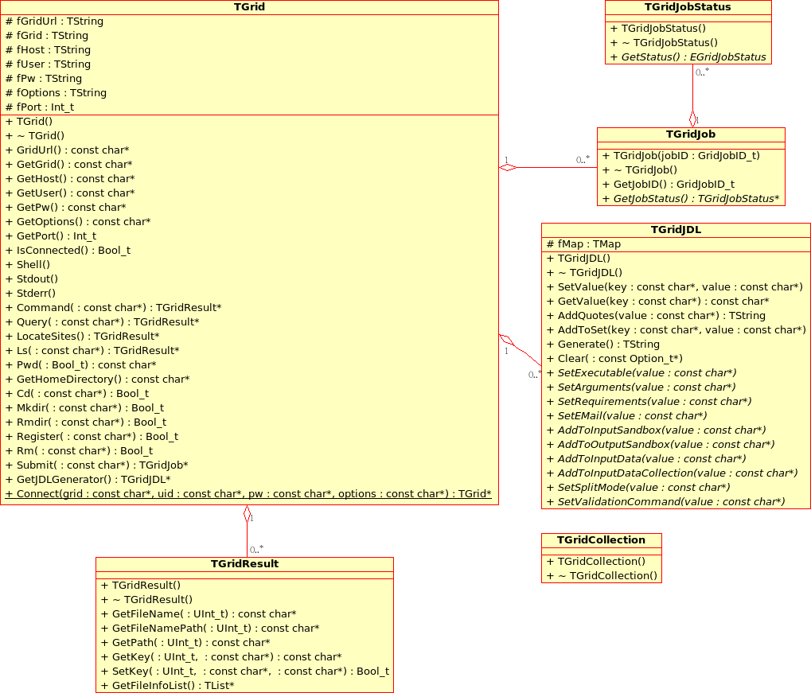
ROOT Grid Interface

Slide 3
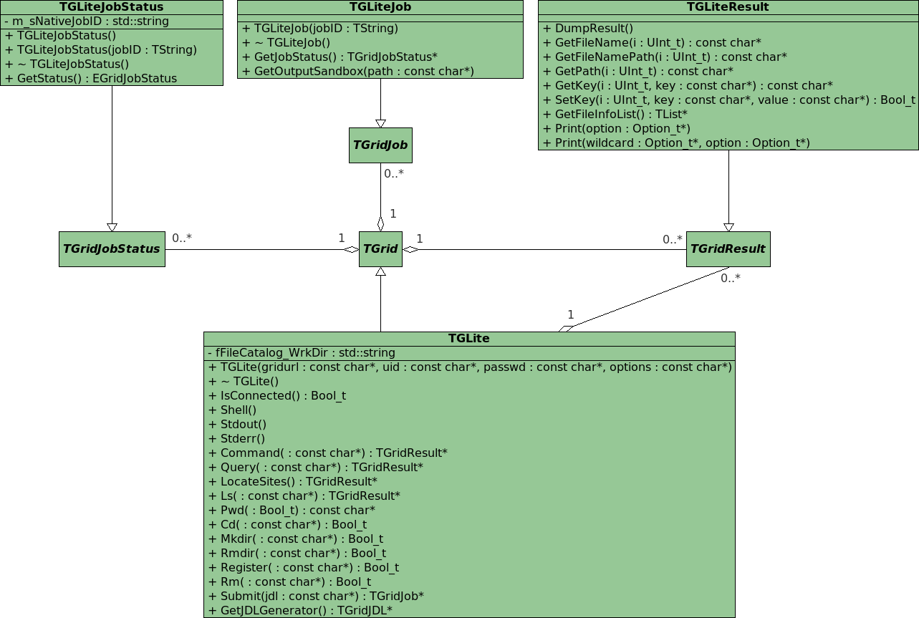

Slide 4
glite-api-wrapper
User Application
User Application
User Application
GAW Library
GAW Interface Manager
GAW Job Manager
GAW Catalog Manager
gLite Middleware
gLite API (WMProxy, LFC, LB)‏
gLite WMS (with WMProxy)‏
gLite LB
LCG LFC

Slide 5
RGLite featurs
RGLite provides:
Workload Management System operations:
  job submission – normal, DAG and parametric jobs (gLite WMProxy API),
  smart look-up algorithm for WMPendpoint,
  job status querying (gLite LB API),
  job output retrieving (Globus GridFTP).
File Catalog operations (gLite/LCG LFC API):
  set/query the current working catalog directory,
  list files, directories and their stats,
  add/remove files in a catalog namespace,
  add/remove directories,
  add/remove replicas from a given file.
An executive logging.
Support of an external xml configuration file.

Slide 6
// Initializing RGLite plug-in
TGrid::Connect("glite");
// Submitting a Job to gLite Grid
TGridJob *job = gGrid->Submit("JDLs/proofd.jdl");
// querying a Status of the Job
TGridJobStatus *status = job->GetJobStatus();
status->GetStatus();
// Getting a Job's output back to the user
TGLiteJob* job_glite(job);
job_glite->GetJobOutput("/home/anar/");
// Initializing RGLite plug-in
TGrid::Connect("glite");
// Changing current File Catalog directory to "dteam"
gGrid->Cd("dteam");
// Querying a list of files of the current FC directory
TGridResult* result = gGrid->Ls();
// Printing the list out
Int_t i=0;
while (result->GetFileName(i))\
> printf("File %s\n",result->GetFileName(i++));
Changing file catalog directory, querying lists of files.

Slide 7
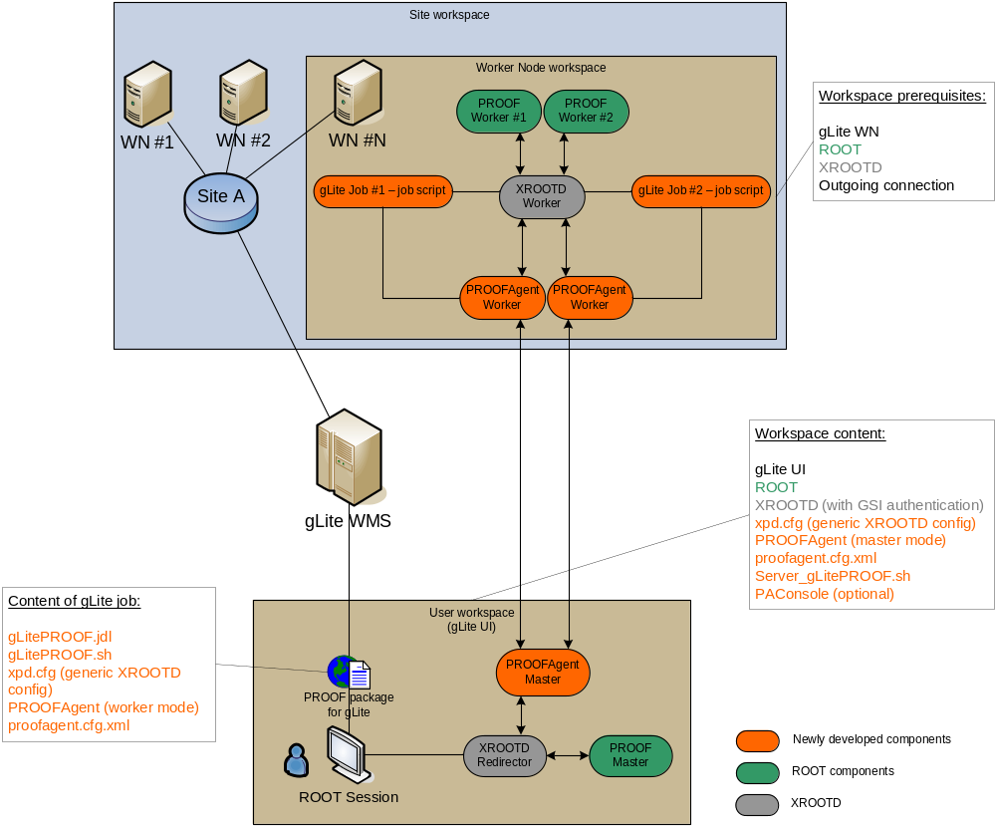

Slide 8
gLitePROOF package

Slide 9
Summary
RGLite is ready.
  ROOT team accepted our suggestions in order to improve TGridXXX.
gLitePROOF package – alpha release.
  A PROOF job submission on gLite MW is ready.
  gLitePROOF package supports reconnection.
Using Agile methods of software development.
  Continues integration,
    automated build system (tests on SLC3 and FC6),
    nightly release,
  projects metrics,
  task tickets and sprints…
  see it all here: http://wiki.gsi.de/cgi-bin/view/Grid/RGLiteAndGAW

Slide 10

Future plans
Implement a schema with “sub-redirector”.

