Slide 1




Anar Manafov, GSI,
DPG 2009
v. 0.8

Slide 2
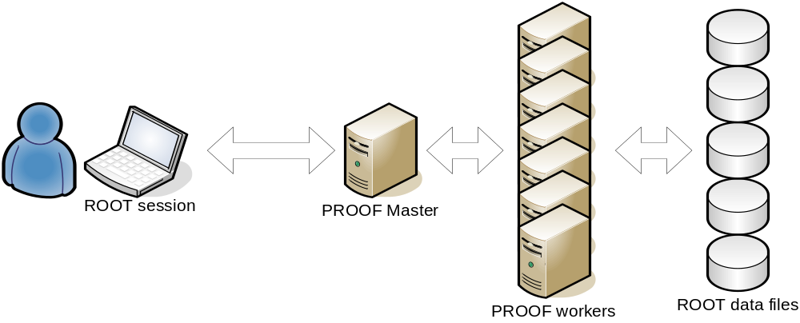
PROOF: Bring the KB to the PB not the PB to the KB
stdout/obj
ana.C
$ root
root [0] tree->Process(“ana.C”)
root [1] gROOT->Proof(“remote”)
root [2] chain->Process(“ana.C”)
Interactive parallel analysis on local cluster

Slide 3
Dynamic PROOF cluster
Why to have it dynamic???
User has a full control of it
  Don’t need to wait until admins install PROOF.
  No unpleasant discussions with admins anymore ;).
Setup on demand
  Use resources only when you need them.
Resources by needs
  Reserve only needed amount of workers.
Perfect playground and test platform

Slide 4
Motivation
Design a toolset to setup a PROOF cluster on-the-fly.
The main goal is to make it transparent, simple in use and extensible.
Use and combine Grid/Batch resources.

Slide 5
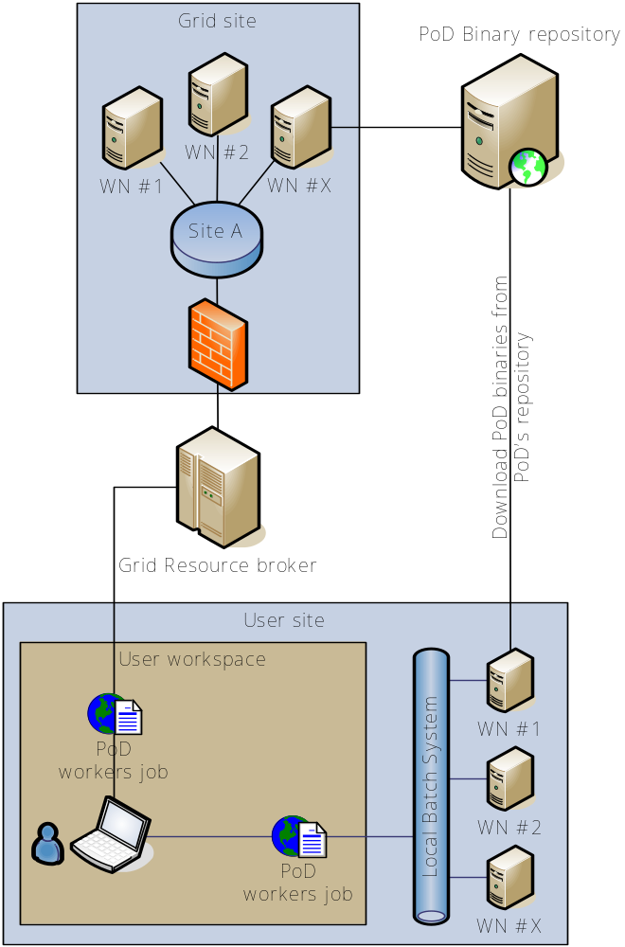
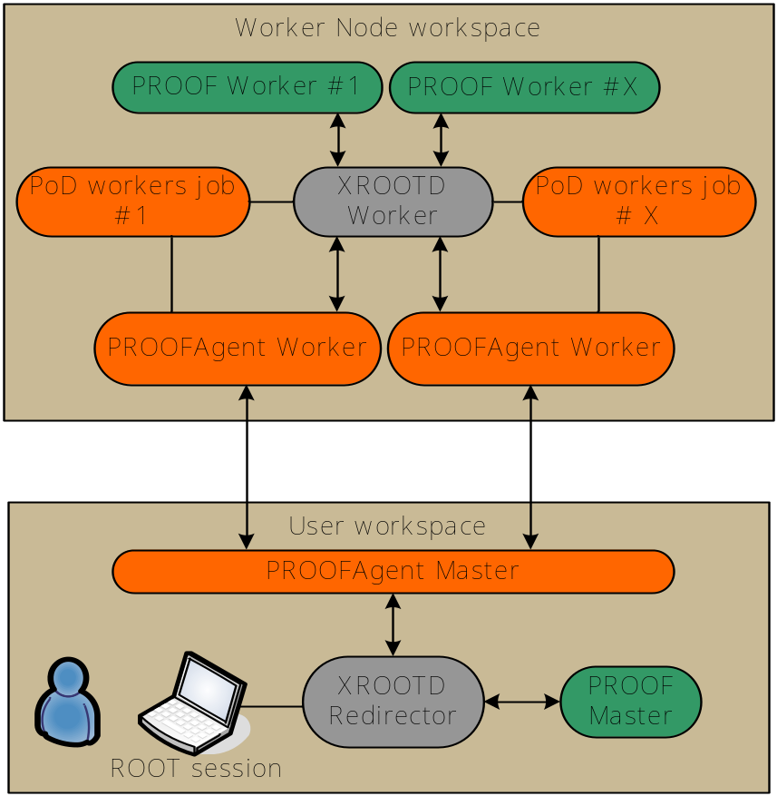


Slide 6
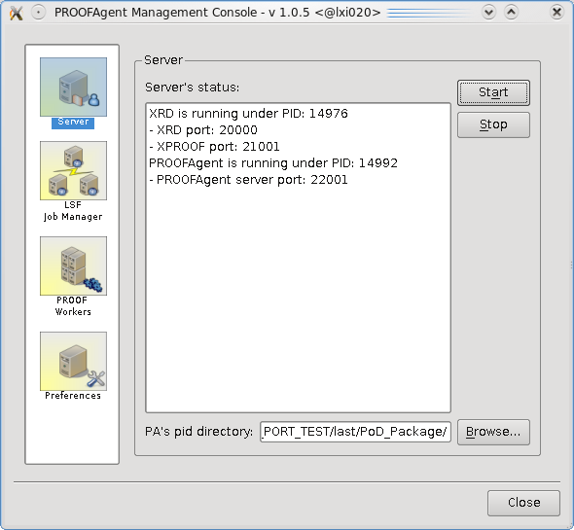
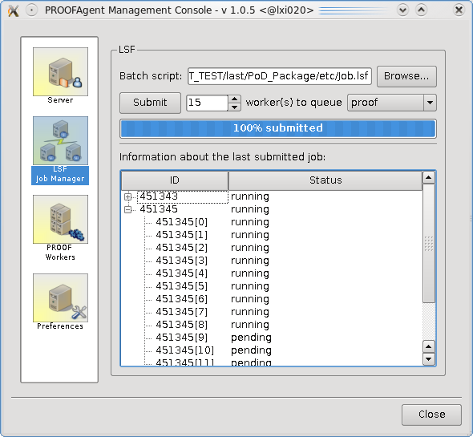
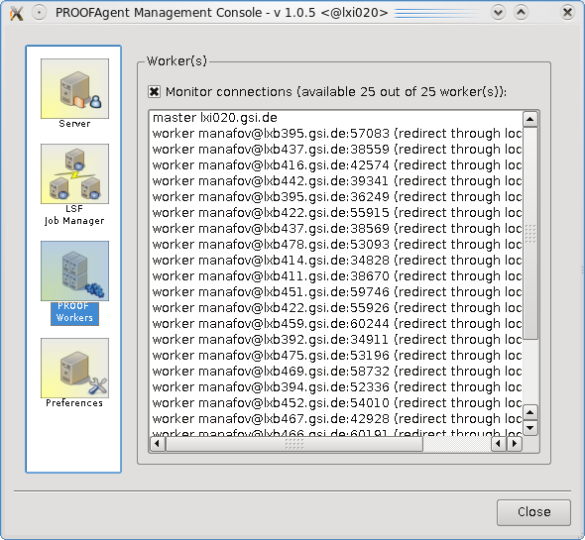
PAConsole - a GUI of PoD

Slide 7
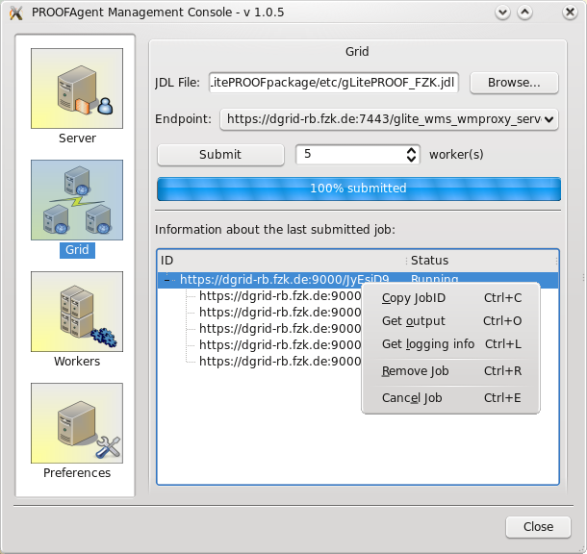
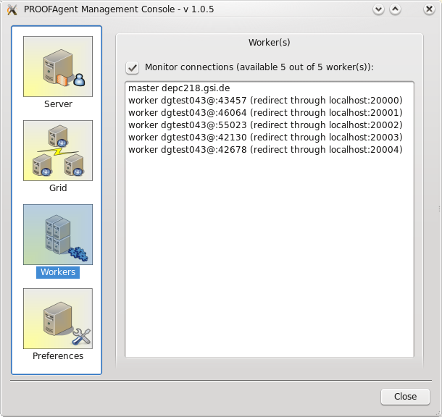
PAConsole - a GUI of PoD

Slide 8
TODO
User support
  Feedback is very import, it helps to improve and populate the product.
Support more Grid/Batch systems
  Condor, PBS, Globus.
Support UI on Mac OS X
  Implement PAConsole natively using Cocoa framework and Objective-C and Port PROOFAgent to Mac OS X.
Extend PAConsole functionality

Slide 9

Summary
Easy in use
  one-click-installation,
  user’s manual (http://www-linux.gsi.de/~manafov/D-Grid/docz/),
  user friendly GUI – easy to configure,
  works out of the box,
  dynamic ports on UIs and WNs,
  supports reconnections.
Transparent
Resource sharing and monitoring for free
PoD: a PROOF cluster on-the-fly
Documentation/Download:
https://subversion.gsi.de/trac/dgrid

Slide 10
