Slide 1


A Design Proposal for Interactive Data Analysis on the Grid
D-Grid Initiative
Anar Manafov, GSI
HEPCG Workshop, Nov 30 2006
last modified date : 28-11-2006; version: 1.03

Slide 2
Presentation “Road map”
The ALICE model of distributed data analysis
Gap Analysis
The model and its implementation
The design concept and development plan

Slide 3
The ALICE model of distributed data analysis
ROOT is a de facto standard framework in HEP community and provides three key points:
  the possibility to do interactive analysis work in familiar C++ style syntax;
  data visualization;
  an object-oriented I/O system.
It is successfully used within frameworks of different experiments as an “all in one” solution.
PROOF extends a workstation based concept of ROOT to a parallel processing on a cluster, where:
  user procedures are kept identical during an analysis session;
  tasks are distributed automatically in the background.
The motto of PROOF is: “Bring the KB to the PB, not the PB to the KB!”
AliEn (ALICE production distributed environment) as a Grid analysis platform provides two key elements:
  a global file system, files are indexed and tagged in a virtual file catalogue and everywhere globally accessible;
  a global queue system, global job scheduling according to resource requirements.

Slide 4
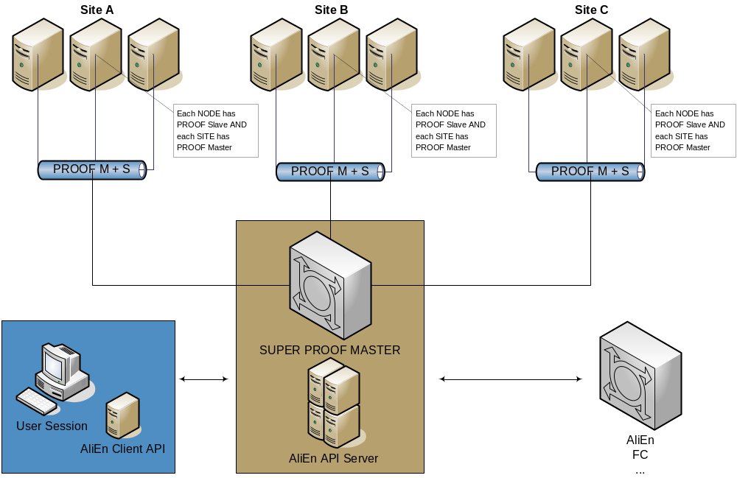
The ALICE model of distributed data analysis

Slide 5
Gap Analysis
High level gaps
  There is no general and Grid enabled data analysis schema;
  There is no standardized API of the Grid;
  So far it is not possible to use gLite to distribute PROOF servers without ALICE/AliEn.
Low level gaps
Mainly there is missing or erroneous functionality of the ROOT Grid interface. It has only been tested using AliEn, our task is to improve it using other MWs (gLite, GLOBUS4, UNICORE ).
Third-party gaps
As a third-party gap we would like to call the one that was discovered and analyzed by our effort, but unfortunately can’t be fixed or redesigned by ourselves (gLite MW issues for example).
For detailed information we would like to refer to:
GSI’s “Stage One Report on WP 3: Distributed Data Analysis under usage of Grid Resources –Gap Analysis“,
http://wiki.gsi.de/cgi-bin/view/Grid/D-GridProjectReport

Slide 6
The model and its implementation
Components of our Model are:
gLite testbed (gLite R1.4, R1.5 and R3.0 were used),
SRM compatible storage (currently dCache),
ROOT frame work,
glite-api-wrapper library (GAW),
RGLite - a ROOT plug-in for gLite.

Slide 7
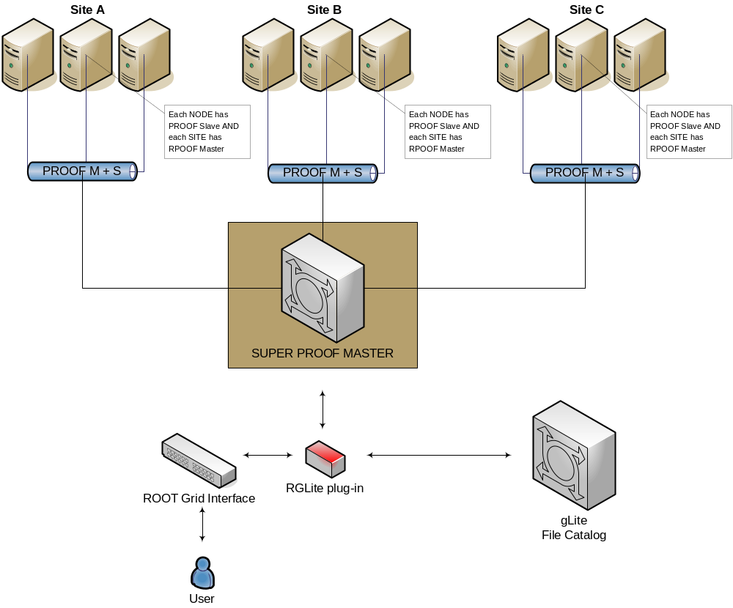
The model and its implementation

Slide 8
gLite MW
We base our project on gLite Grid Middleware, since it is widely used and one of the biggest operational Grids today. gLite is a strategic Grid middleware for HEP.
The current implementation of our project is based on:
gLite WMSUI – for job submission, status querying and output retrieving;
LFC (Local LCG File Catalog) API – for file catalog operations;
GFAL (Grid File Access Library) API – for file operations on the gLite Grid.
But we also used the following components of gLite:
WMProxy – for job submission;
FiReMan – for file catalog operations;
gLite I/O server — for file operations on the gLite Grid.

Slide 9
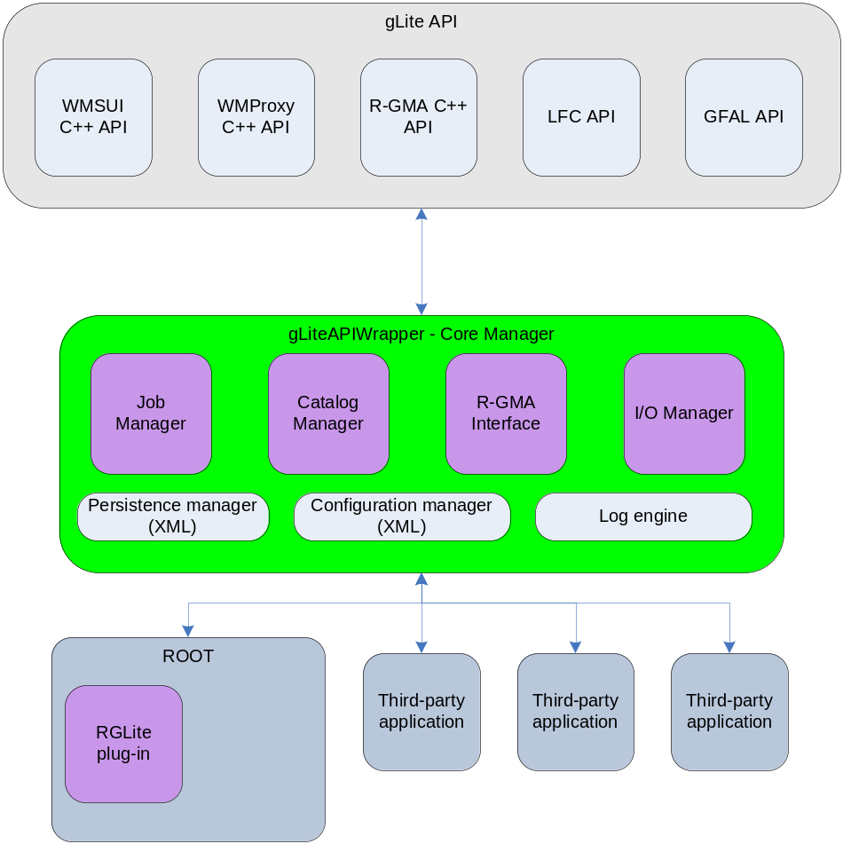
GAW – glite-api-wrapper library
GAW Core Manager,
GAW Job Manager,
GAW Catalog Manager,
GAW Persistence Manager,
GAW Configuration Manager,
GAW Log Engine.

Slide 10
RGLite
Workload Management System (WMS) operations:
  job submission,
  job status querying,
  job output retrieving.
File Catalog operations:
  to set and query current working catalog directory,
  to list the content of the selected catalog directory (list files, directories and their stats),
  to create a file in a catalog namespace,
  to add replica(s) to a given file in the catalog namespace,
  to remove replica(s) from a given file in the catalog namespace,
  to remove a file or directory from a given file in the catalog namespace.
An executive logging.
Support of an external configuration.
File I/O operations could be performed with the help of TGFALFile - a ROOT class wrapper of GFAL.

Slide 11
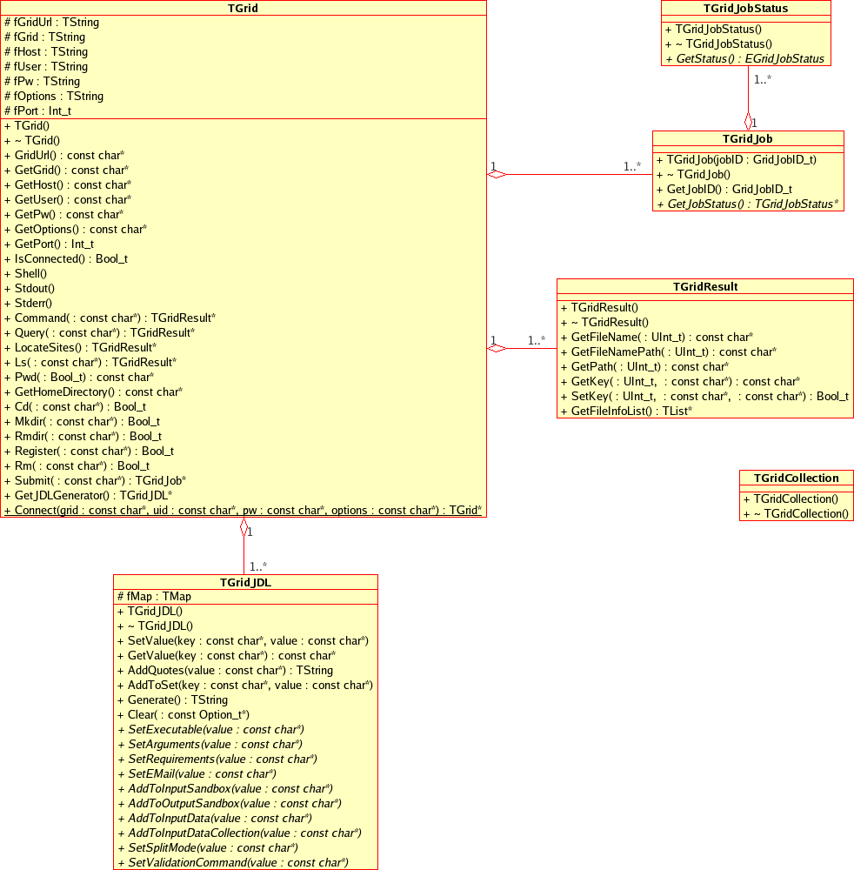
ROOT
ROOT
UML class diagram of the ROOT Grid Interface

Slide 12
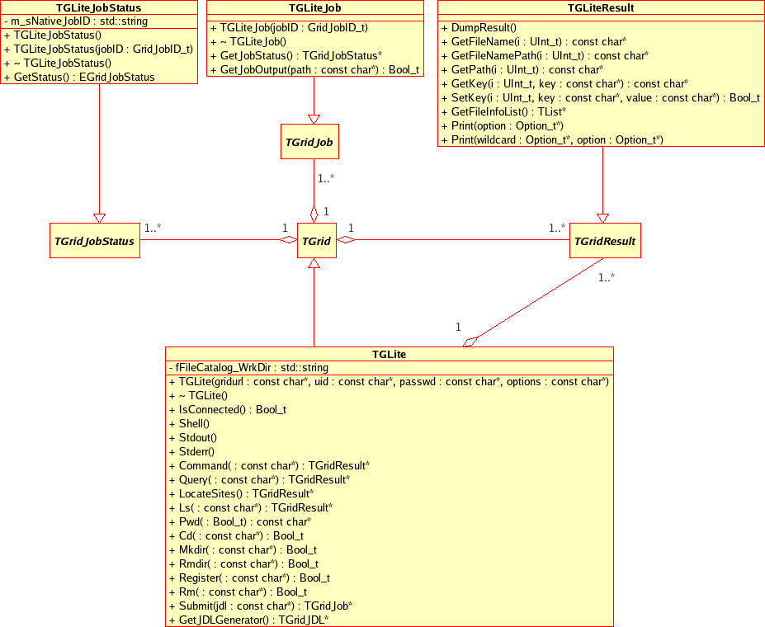

Slide 13
RGLite Samples
// Initializing RGLite plug-in TGrid::Connect("glite"); // Submitting a Job to gLite Grid TGridJob *job = gGrid->Submit("JDLs/proofd.jdl"); // querying a Status of the Job TGridJobStatus *status = job->GetJobStatus(); status->GetStatus(); // Getting a Job's output back to the user TGLiteJob* job_glite(job); job_glite->GetJobOutput("/home/anar/");
Job submission, Status querying, Output retrieving.
// Initializing RGLite plug-in TGrid::Connect("glite"); // Changing current File Catalog directory to "dteam" gGrid->Cd("dteam"); // Querying a list of files of the current FC directory TGridResult* result = gGrid->Ls(); // Printing the list out Int_t i=0; while (result->GetFileName(i))\ > printf("File %s\n",result->GetFileName(i++));
Changing file catalog directory, querying lists of files.

Slide 14
RGLite Samples
// Initializing RGLite plug-in TGrid::Connect("glite"); // Changing current File Catalog directory to "dteam" gGrid->Cd("dteam"); // Querying a list of files of the current FC directory TGridResult* result = gGrid->Ls(); // Printing the list out, including full file information result->Print("all");
List full file information of a catalog folder.
using namespace std; // Initializing RGLite plug-in TGrid::Connect("glite"); // Changing current File Catalog directory to "dteam" gGrid->Cd("dteam"); // Printing a current working directory cout << "Working Directory is" << gGrid->Pwd() << endl; // Creating a new File Catalog Folder Bool_t b = gGrid->Mkdir("root_test2");
Retrieving a name of a current file catalog folder,
Creating a new file catalog folder.

Slide 15
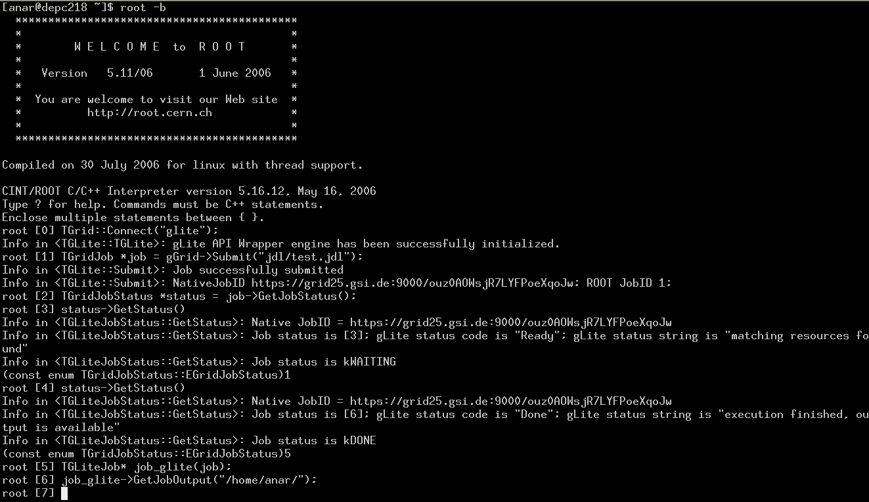
RGLite Samples

Slide 16

Design concept and development plan
Local PROOF cluster
“Marriage” of PROOF and gLite
Complete GAW and RGlite plug-in implementation
Deployment
Testing by user
Implementation for other Grid MW
Investigate other Grid APIs
  GAT
  SAGA

