Slide 1
Time series modelling of COVID cases and hospitalisations

Slide 2
Long short term memory (LSTM) Networks
Information is added or removed through gates
Gates optionally let information through for example via a sigmoid neural net layer and pointwise multiplication.

Slide 3













Long short term memory (LSTM) Networks
1- Forget 2- Store 3- Update 4-Output
$$y_{t}$$
Cell state
$$c_{t−1}$$
$$×$$
$$+$$
$$c_{t}$$
tanh
$$f_{t}$$
$$×$$
$$×$$
$$σ$$
$$σ$$
tanh
$$σ$$
state
$$h_{t−1}$$
$$h_{t}$$
input
$$x_{t}$$

Slide 4

Long short term memory (LSTM) Networks
1- Forget 2- Store 3- Update 4-Output
$$y_{t}$$
$$×$$
$$c_{t−1}$$
$$×$$
$$+$$
$$c_{t}$$
tanh
$$f_{t}$$
$$f_{t}$$
$$×$$
$$×$$
$$σ$$
tanh
$$σ$$
$$σ$$
$$σ$$
$$h_{t−1}$$
$$h_{t}$$
$$h_{t−1}$$
$$x_{t}$$
$$x_{t}$$

Slide 5






Long short term memory (LSTM) Networks
1- Forget 2- Store 3- Update 4-Output
$$y_{t}$$
$$×$$
$$+$$
$$c_{t−1}$$
$$+$$
$$c_{t}$$
tanh
$$f_{t}$$
$$i_{t}$$
$$×$$
$$×$$
$$×$$
tanh
$$σ$$
$$σ$$
tanh
$$σ$$
$$σ$$
$$h_{t−1}$$
$$h_{t}$$
$$h_{t−1}$$
$$x_{t}$$
$$x_{t}$$

Slide 6
Long short term memory (LSTM) Networks
1- Forget 2- Store 3- Update 4-Output
$$y_{t}$$
$$×$$
$$×$$
$$+$$
$$c_{t−1}$$
$$+$$
$$c_{t}$$
$$c_{t−1}$$
$$c_{t}$$
tanh
$$f_{t}$$
$$×$$
$$×$$
$$σ$$
$$σ$$
tanh
$$σ$$
$$h_{t−1}$$
$$h_{t}$$
$$x_{t}$$

Slide 7
Long short term memory (LSTM) Networks
1- Forget 2- Store 3- Update 4-Output
$$y_{t}$$
$$×$$
$$×$$
$$+$$
$$c_{t−1}$$
$$+$$
$$c_{t}$$
$$c_{t−1}$$
$$c_{t}$$
tanh
$$f_{t}$$
$$×$$
$$×$$
$$σ$$
$$σ$$
tanh
$$σ$$
$$h_{t−1}$$
$$h_{t}$$
$$x_{t}$$

Slide 8






Long short term memory (LSTM) Networks
1- Forget 2- Store 3- Update 4-Output
$$y_{t}$$
$$y_{t}$$
$$c_{t−1}$$
$$×$$
$$+$$
$$c_{t}$$
tanh
$$f_{t}$$
$$×$$
$$×$$
$$×$$
$$σ$$
$$σ$$
tanh
$$σ$$
$$σ$$
$$h_{t}$$
$$h_{t−1}$$
$$h_{t}$$
$$h_{t−1}$$
$$x_{t}$$
$$x_{t}$$

Slide 9
Long short term memory (LSTM) Networks
Key concepts
1- Maintain a separate cell state from what is outputted
2- Use gates to contro linformation flow.
- forget gatees get rid of irrelevant information
- store information from current input
- selectively update cell state
Ouput gate returns a filtered version of the cell state.
3- There is backpropagation through time with uninterrupted gradient flow

Slide 10
LSTM data
Total transaction counts in Oxford street (time series)
Total international arrivals in the UK (from UK nationals and non-UK nationals)
Total number of new Covid-19 positive tests (per date of test) in greater London
Day of the week
Total Number of new Covid-19 hospitalisations in greater London per date
From 19/03/2020
To 31/01/2021
n= 289

Slide 11
LSTM preprocessing
Min-max scaling between 0 and 1
Transformation of time series to supervised data (generating a shift of one day before as the predictors).
Prediction lag = 1 day (it would be interesting to see if we can use several days prediction lag).

Slide 12
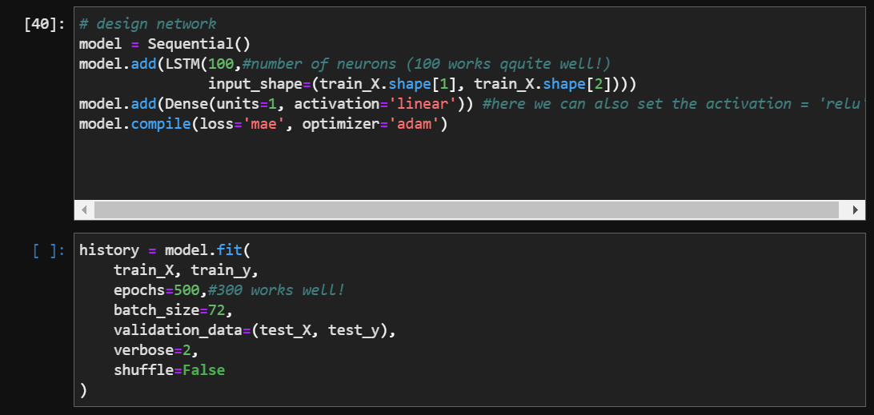
LSTM MODEL 1: Cases
Dense layer:
Activation function
(Z = XW +b) = y
y is the output
W is the weight matrix
X the input matrix

Slide 13
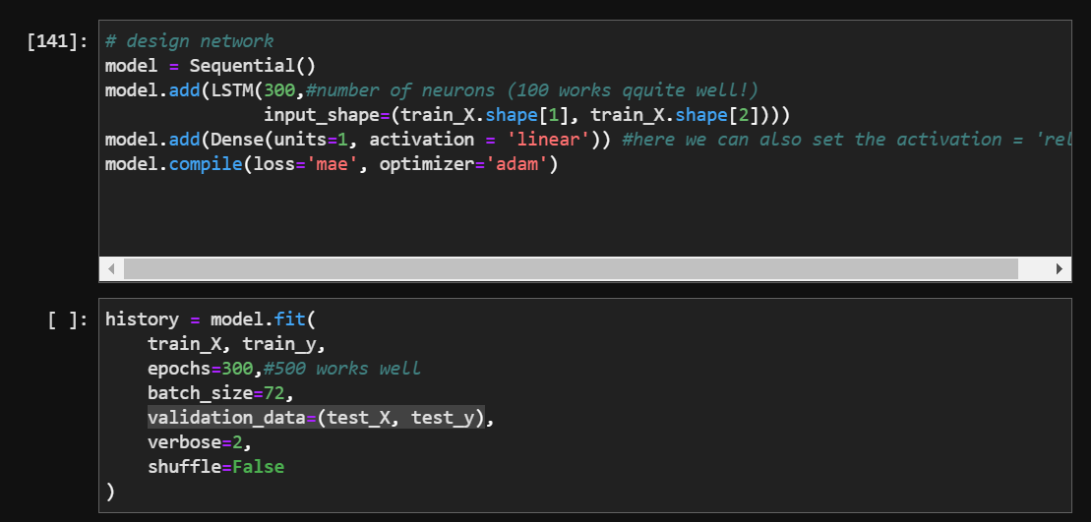
LSTM MODEL 1I: hospitalisations

Slide 14
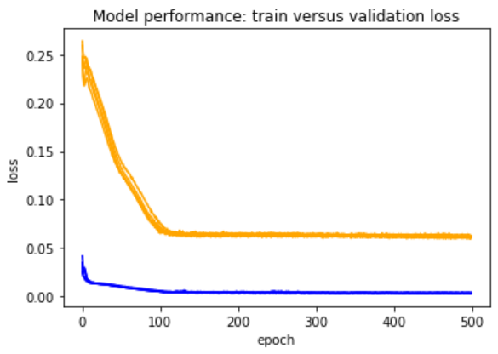
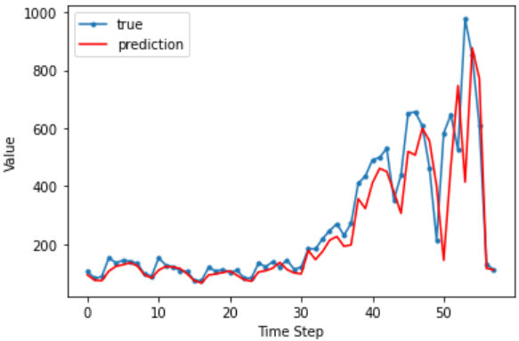
LSTM Results: cases model

Slide 15
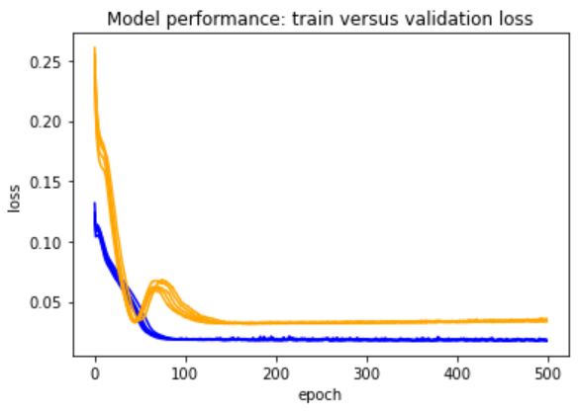
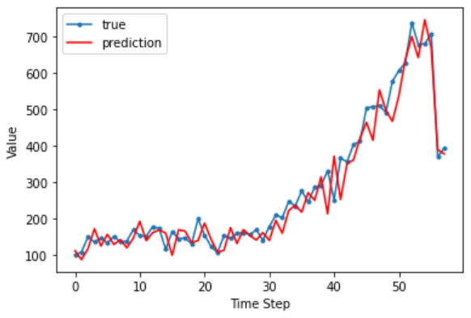
LSTM Results: hospitalisations model

Slide 16
Next steps lstm models
VERY EMPIRICAL !
Try a longer lag, not one day but 5 or 7 or maybe even 14.
Include the number of vaccinations as predictors
Include the lockdown status in the predictors
Include holiday status in the predictor….
Include weather conditions as predictors => yes! Use openWeather… average temp, cloudedness, rainfall.
Try making the predictor time-series stationary
Try predicting several days in the future.
Try doing feature importance, maybe even SHAP!
Try doing feature extraction! (look it up!)
Try hugging face (transformer)
Try temporal cNNs
Try KATS from facebook? Read about them!

Slide 17
Next steps Overall
Try recurrent Neural Networks (also convolutional?)
Try transformer models
Try ‘simple’ linear timeseries models !
Use the Clairvoyance pipeline : https://www.vanderschaar-lab.com/clairvoyance-alpha-the-first-unified-end-to-end-automl-pipeline-for-time-series-data/
Try clairvoyance, counterfactual recurrent network (CRN)
https://iclr.cc/virtual_2020/poster_BJg866NFvB.html
Try the clairvoyance INVASE for interpretability:
https://www.vanderschaar-lab.com/from-black-boxes-to-white-boxes/
Search what counterfactual actually means.
Download the software from here: https://bitbucket.org/mvdschaar/mlforhealthlabpub/src/02edab3b2b6d635470fa80184bbfd03b8bf8082d/app/clairvoyance, here is an eplanation on how to use it:
https://bitbucket.org/mvdschaar/mlforhealthlabpub/raw/02edab3b2b6d63547 0fa80184bbfd03b8bf8082d/app/clairvoyance/paper/alpha_final.pdf
Try contacting Mihaela van der Schaar?

Slide 18
Advice from Marc & Gianluca
Run models on influenza data (for 2019) and on a non-communicable disease like a typ of cancer.
Try Prophet (from Facebook)
Try a MARCOV SEIR model on Pystan (need to read more about that!)
Try and understand LSTM model you have !!!! Translate it to the diagram!
Look at the three waves separately !
Run the same LSTM model by removing the transactions and only with transactions
Try SVR!

Slide 19
Vector autoregression with moving average : VARIMA
Aim : use two time series to predict one of them.
Granger causality test: test if a time series is can be predicted with itself and another time series.

Slide 20
VARIMA Data
Daily transaction counts in Oxford Street
Daily new COVID-19 cases in Greater London or
Daily new COVID-19 hospitalisations in Greater London
Train – test split : 80%-20%
From 12/02/2020
To 26/02/2021
n= 354

Slide 21
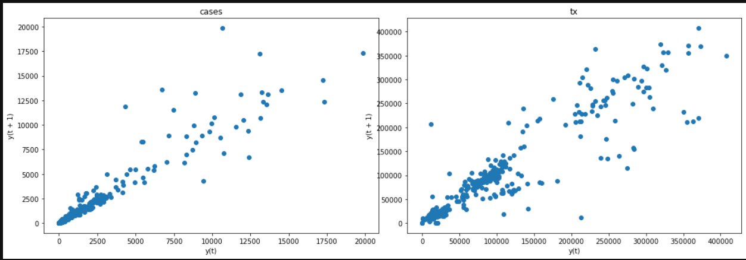
VARIMA model 1: for cases Preprocessing
Differencing (with lag of 1 day) to make transaction time-series stationary
Log transformation and differencing (with lag of 1 day) to make the case time series stationary.

Slide 22
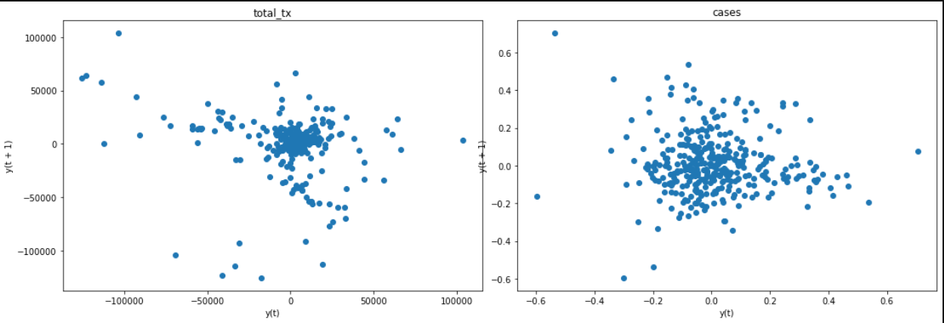
VARIMA model 1: for cases Preprocessing
Differencing (with lag of 1 day) to make transaction time-series stationary
Log transformation and differencing (with lag of 1 day) to make the case time series stationary.
AD Fuller test: we can reject H0 of time series being non-stationary.
KPSS test: we cannot reject the null hypothesis that the series is stationary.

Slide 23
VARIMA model 1: for cases
We chose a lag of 11 days, since that presented the lowest AIC for a VAR model on the raw data.
We tested for serial correlation of the residuals with the Durbin-Watson test and found no significant serial correlation.
We tested for cointegration of the time series with the augmented Engle-Granger two-step cointegration test and found that the transactions and case time-series were cointegrated.
We tested for Granger causality, H0 = x does not ‘cause’ y in both directions and we found that in both cases we could reject the null hypothesis. So we found Granger causality of transactions on cases and of cases on transactions.

Slide 24
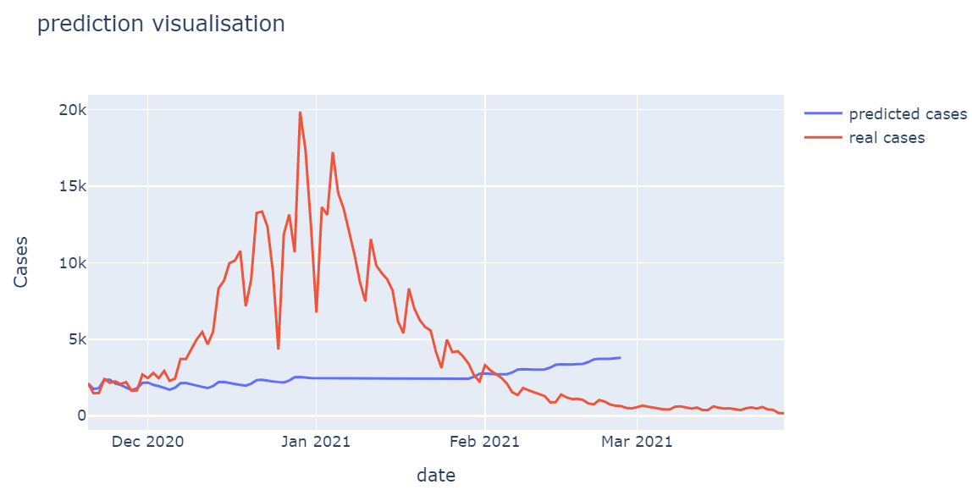
VARIMA model 1: Results
Predicts case number accurately ~10 days in the future

Slide 25
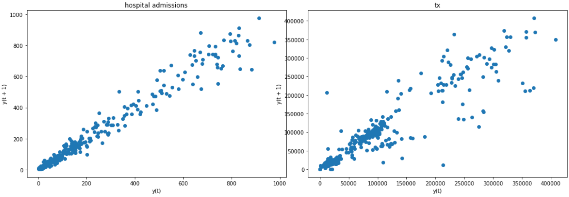
VARIMA model 2: for hospitalisations Preprocessing
Differencing (with lag of 1 day) to make transaction time-series stationary
Log transformation and differencing (with lag of 1 day) to make the hospitalisation time series stationary.

Slide 26
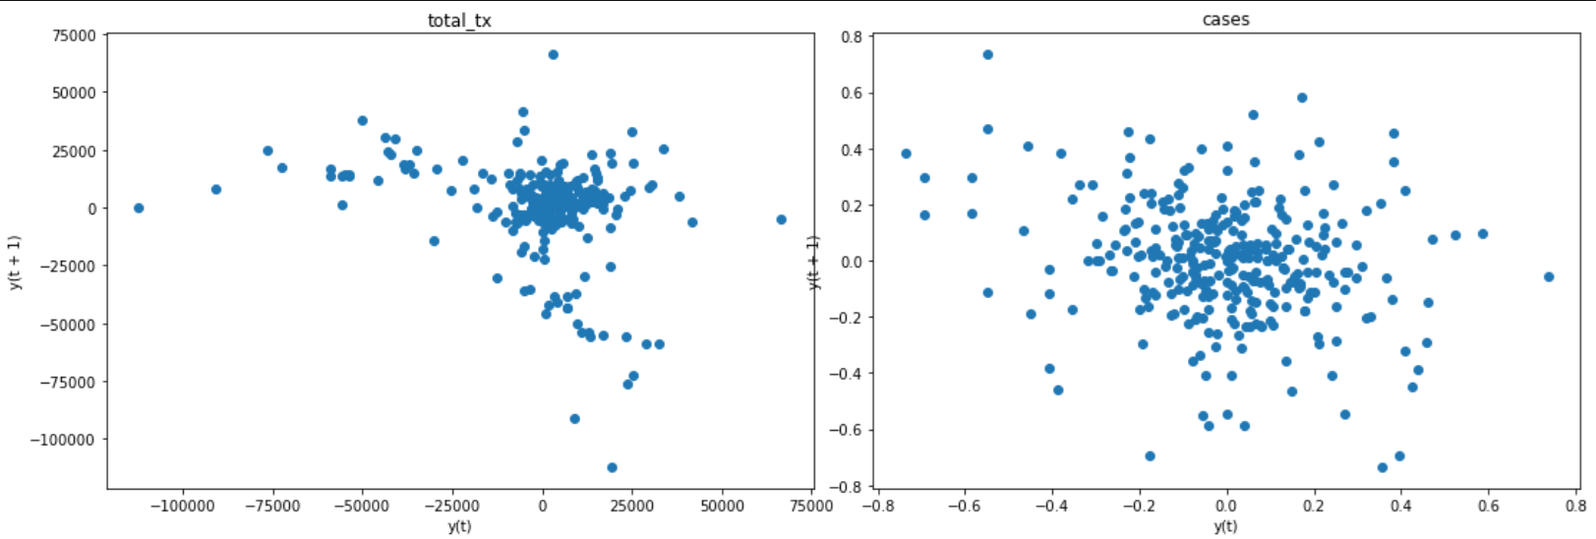
VARIMA model 1: for for hospitalisations Preprocessing
Differencing (with lag of 1 day) to make transaction time-series stationary
Log transformation and differencing (with lag of 1 day) to make the hospitalisation time series stationary.
AD Fuller test: we can reject H0 of time series being non-stationary.
KPSS test: we cannot reject the null hypothesis that the series is stationary.

Slide 27
VARIMA model 2: for hospitalisations
We chose a lag of 11 days, since that presented the lowest AIC for a VAR model on the raw data.
We tested for serial correlation of the residuals with the Durbin-Watson test and found no significant serial correlation.
We tested for cointegration of the time series with the augmented Engle-Granger two-step cointegration test and found that the transactions and hospital admission time-series were cointegrated.
We tested for Granger causality, H0 = x does not ‘cause’ y in both directions and we found that in both cases we could reject the null hypothesis. So we found Granger causality of transactions on hospital admissions and of hospital admissions on transactions.

Slide 28
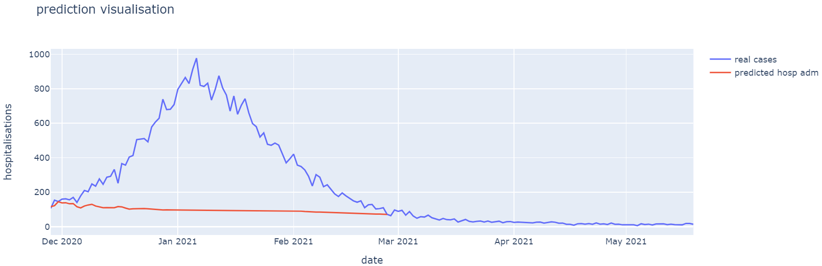
VARIMA model 2: hospitalisations Results
Predicts hospital admissions more or less accurately ~5 days in the future

