Slide 1
Time series modelling of COVID cases and hospitalisations

Slide 2
Long short term memory (LSTM) Networks
Information is added or removed through gates
Gates optionally let information through for example via a sigmoid neural net layer and pointwise multiplication.

Slide 3













Long short term memory (LSTM) Networks
1- Forget 2- Store 3- Update 4-Output
$$y_{t}$$
Cell state
$$c_{t−1}$$
$$×$$
$$+$$
$$c_{t}$$
tanh
$$f_{t}$$
$$×$$
$$×$$
$$σ$$
$$σ$$
tanh
$$σ$$
state
$$h_{t−1}$$
$$h_{t}$$
input
$$x_{t}$$
Adapted from MIT 6.S191 Intro to Deep Learning course

Slide 4

Long short term memory (LSTM) Networks
1- Forget 2- Store 3- Update 4-Output
$$y_{t}$$
$$×$$
$$c_{t−1}$$
$$×$$
$$+$$
$$c_{t}$$
tanh
$$f_{t}$$
$$f_{t}$$
$$×$$
$$×$$
$$σ$$
tanh
$$σ$$
$$σ$$
$$σ$$
$$h_{t−1}$$
$$h_{t}$$
$$h_{t−1}$$
$$x_{t}$$
$$x_{t}$$
Adapted from MIT 6.S191 Intro to Deep Learning course

Slide 5






Long short term memory (LSTM) Networks
1- Forget 2- Store 3- Update 4-Output
$$y_{t}$$
$$×$$
$$+$$
$$c_{t−1}$$
$$+$$
$$c_{t}$$
tanh
$$f_{t}$$
$$i_{t}$$
$$×$$
$$×$$
$$×$$
tanh
$$σ$$
$$σ$$
tanh
$$σ$$
$$σ$$
$$h_{t−1}$$
$$h_{t}$$
$$h_{t−1}$$
$$x_{t}$$
$$x_{t}$$
Adapted from MIT 6.S191 Intro to Deep Learning course

Slide 6
Long short term memory (LSTM) Networks
1- Forget 2- Store 3- Update 4-Output
$$y_{t}$$
$$×$$
$$×$$
$$+$$
$$c_{t−1}$$
$$+$$
$$c_{t}$$
$$c_{t−1}$$
$$c_{t}$$
tanh
$$f_{t}$$
$$×$$
$$×$$
$$σ$$
$$σ$$
tanh
$$σ$$
$$h_{t−1}$$
$$h_{t}$$
$$x_{t}$$
Adapted from MIT 6.S191 Intro to Deep Learning course

Slide 7
Long short term memory (LSTM) Networks
1- Forget 2- Store 3- Update 4-Output
$$y_{t}$$
$$×$$
$$×$$
$$+$$
$$c_{t−1}$$
$$+$$
$$c_{t}$$
$$c_{t−1}$$
$$c_{t}$$
tanh
$$f_{t}$$
$$×$$
$$×$$
$$σ$$
$$σ$$
tanh
$$σ$$
$$h_{t−1}$$
$$h_{t}$$
$$x_{t}$$
Adapted from MIT 6.S191 Intro to Deep Learning course

Slide 8






Long short term memory (LSTM) Networks
1- Forget 2- Store 3- Update 4-Output
$$y_{t}$$
$$y_{t}$$
$$c_{t−1}$$
$$×$$
$$+$$
$$c_{t}$$
tanh
$$f_{t}$$
$$×$$
$$×$$
$$×$$
$$σ$$
$$σ$$
tanh
$$σ$$
$$σ$$
$$h_{t}$$
$$h_{t−1}$$
$$h_{t}$$
$$h_{t−1}$$
$$x_{t}$$
$$x_{t}$$
Adapted from MIT 6.S191 Intro to Deep Learning course

Slide 9
Long short term memory (LSTM) Networks
Key concepts
1- Maintain a separate cell state from what is outputted
2- Use gates to control information flow.
- forget gates get rid of irrelevant information
- store information from current input
- selectively update cell state
Output gate returns a filtered version of the cell state.
3- There is backpropagation through time with uninterrupted gradient flow
Adapted from MIT 6.S191 Intro to Deep Learning course

Slide 10
LSTM data
Total transaction counts in Oxford street
Total international arrivals in the UK
Day of the week
Outcomes:
Total number of new Covid-19 positive tests (per date of test) in greater London
OR
Total Number of new Covid-19 hospitalisations in greater London per date
From 19/03/2020
To 31/01/2021
n= 289

Slide 11
LSTM preprocessing
Min-max scaling between 0 and 1
Transformation of time series to supervised data (generating a shift of one day before as the predictors).
Prediction lag = 1 day (it would be interesting to see if we can use several days prediction lag).

Slide 12
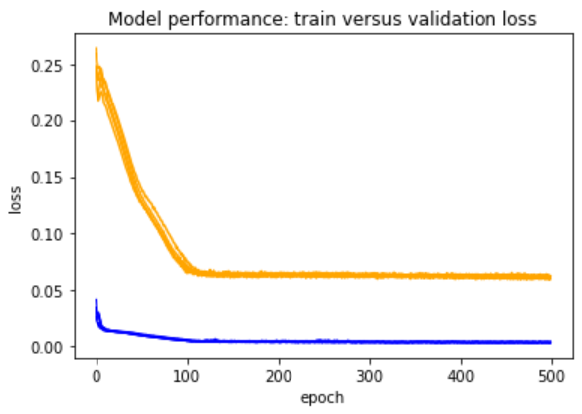
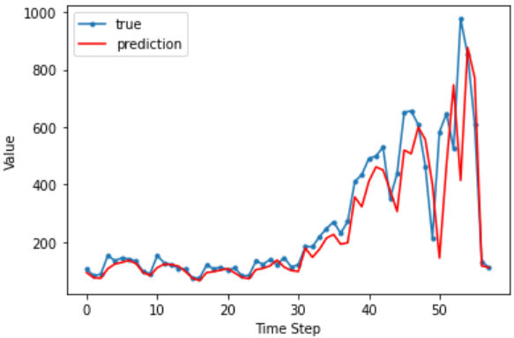
LSTM Results: cases model
Test loss
Train loss

Slide 13
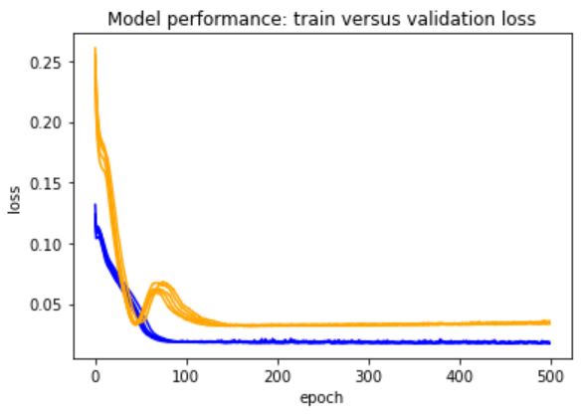
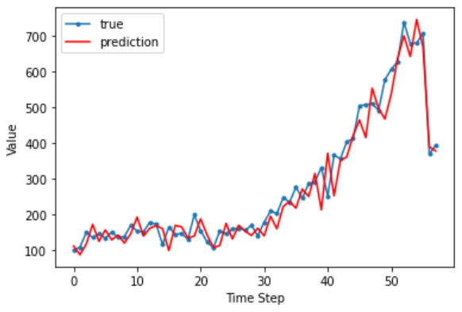
LSTM Results: hospitalisations model
Test loss
Train loss

