Slide 1
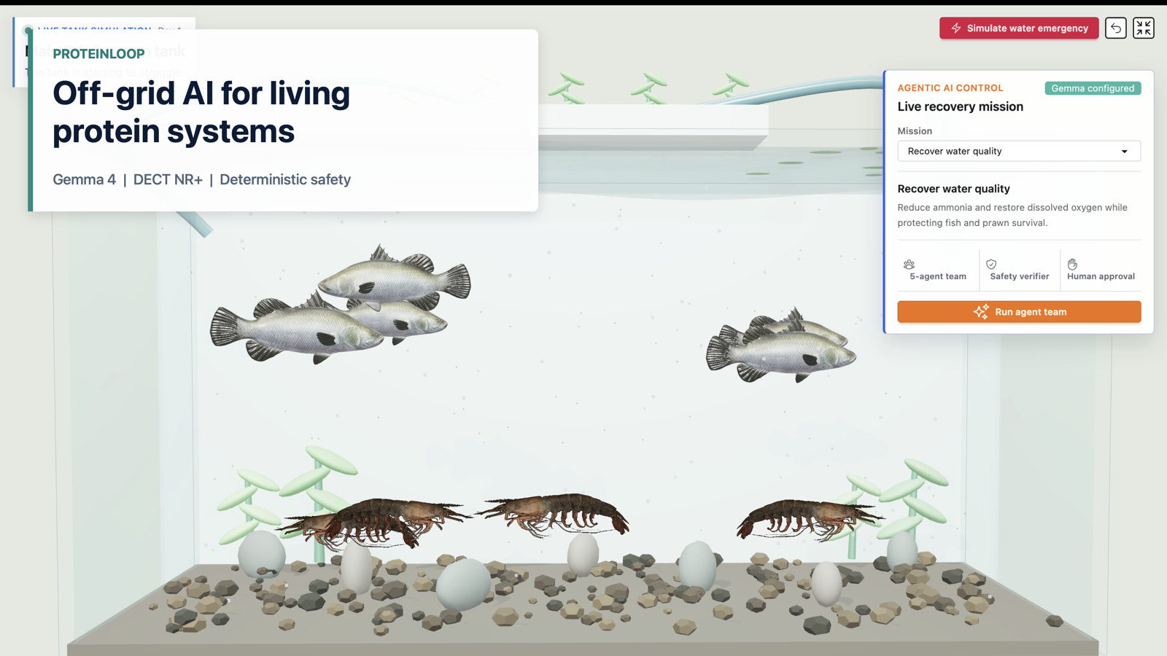

Slide 2
PROTEINLOOP
PROBLEM
ONE LOOP, SHARED RISK
A chemistry failure does not stop at the vegetables.
14.5 kg
fish + prawn stock
Fish and prawns breathe the water. Plants clean it. Duckweed stores feed. Eggs depend on what survives upstream.
5.0 kg
plants cleaning water
One ammonia spike
eggs
can threaten every protein output in the loop.
downstream protein
ProteinLoop measures the animal-protein outcome instead of treating it as a hidden side effect.

Slide 3
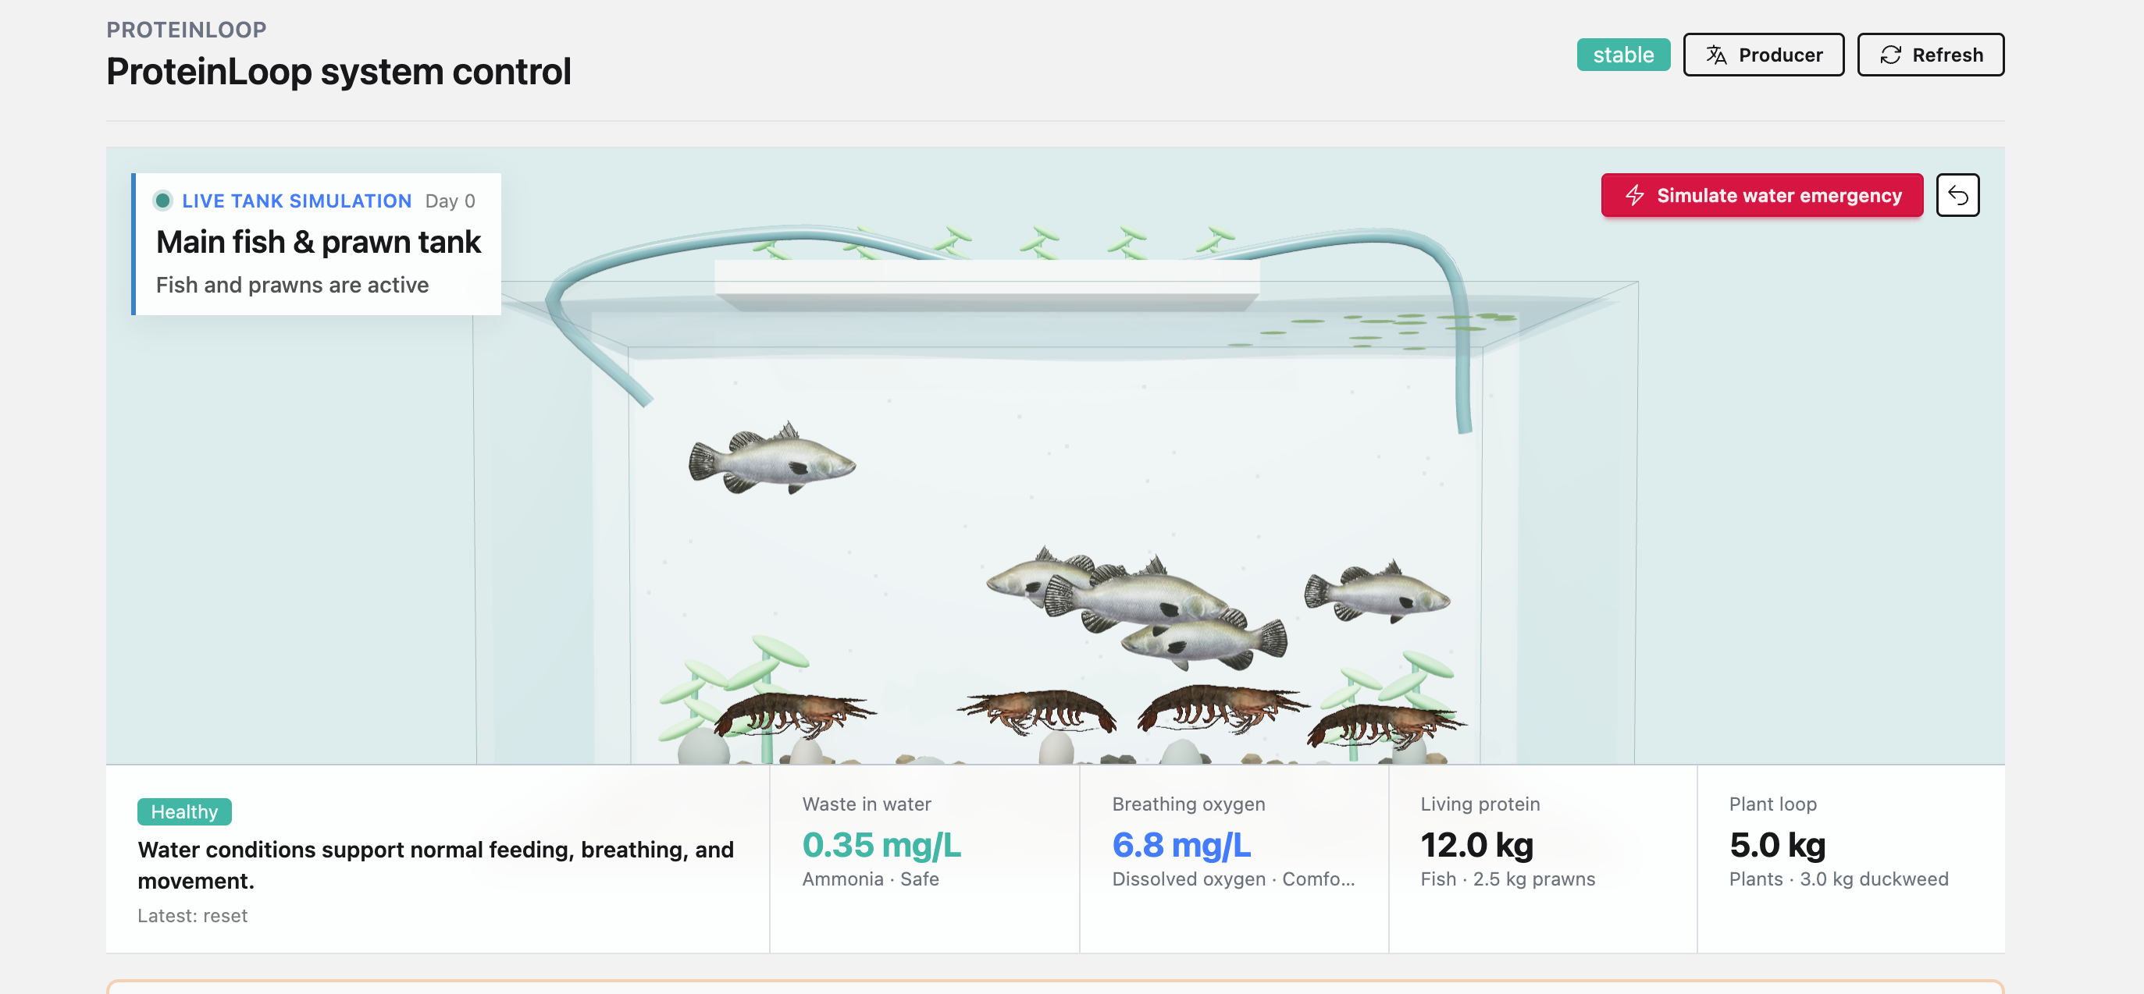
PROTEINLOOP
PRODUCT PROOF
A living system people can understand in seconds.
The deployed operator view connects animal behavior, plain-language chemistry, biomass, and action in one scene.
SEE THE ANIMALS
UNDERSTAND THE WATER
ACT WITH EVIDENCE
Real deployed UI at proteinloop.dev-vb.lat; the tank is rendered live, not a looping video.

Slide 4
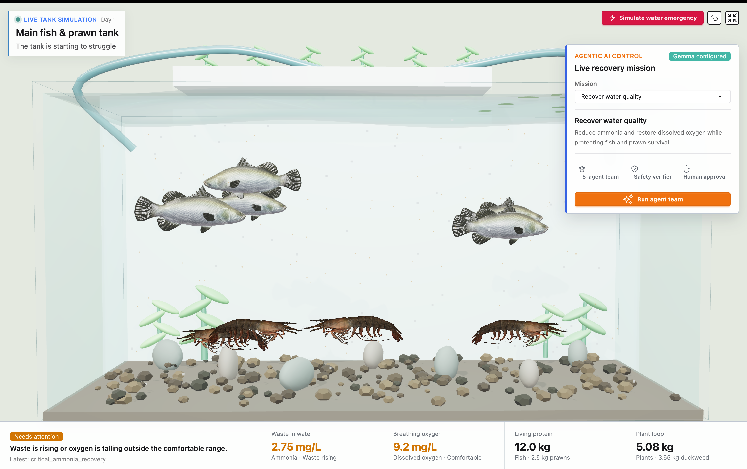
The recovery is visible while it happens.
1
Observe
2
4 specialists
3
Supervisor
4
Verify
5
Measure
Structured events and tool outcomes are visible; private model chain-of-thought is not presented as evidence.

Slide 5
PROTEINLOOP
SAFETY BOUNDARY
The model can recommend. It cannot mutate.
Authority moves left to right. Every connector ends at an explicit decision boundary.
1
Gemma specialists
2
Supervisor
3
Deterministic verifier
4
Simulator mutation
Fish, prawns, plants, and feed-loop briefs.
>
Combines briefs into one bounded proposal.
>
Checks chemistry, feed, water exchange, reserve, and collapse rules.
>
Only admitted actions can change ecosystem state.
v
BLOCKED
Rejected before state change, logged to the RLVR trace, and returned as verifier feedback.
verify_ecosystem_safety is the only authority allowed to admit simulator mutation.

Slide 6
PROTEINLOOP
EXECUTABLE EVIDENCE
Safety is demonstrated, not narrated.
The simulator is simultaneously the product demo, the policy evaluator, and the RLVR source of truth.
220
141
+463
100%
Python tests
Phoenix tests
reward delta
collapse avoidance
simulator, verifier, API, evidence
Sagents, LiveView, producer control
verified policy versus naive average
fixed baseline scenarios recovered
ONE-CLICK JUDGE PROOF
Inject emergency -> block unsafe proposal -> admit safe recovery -> inspect measured chemistry
Verified July 12, 2026: 220 Python and 141 Phoenix tests, zero failures.

Slide 7
PROTEINLOOP
OFF-GRID ARCHITECTURE
An on-site AMD GPU can keep the decision loop local.
After the application and Gemma weights are provisioned, farm decisions do not require an internet API.
ON-SITE AMD GPU · DEPLOYMENT OPTION
FIELD LINK · PHYSICALLY PROVEN
Gemma stays at the farm
LOCAL LAN
nRF9151 PT
DECT NR+
nRF9151 FT
Cached model
Gemma 4 E2B weights
>
>
>
>
Producer control
tank radio
private hop
gateway
ROCm + vLLM
local OpenAI-compatible endpoint
Python verifier
blocks unsafe actions
Approve risky actions and inspect receipts.
Two physical boards exchanged the same bidirectional sequence 100.
Simulator + UI
state, receipts, and producer control
No remote API in the action path
OPTIONAL CLOUD
Sync evidence and model updates when connectivity returns; never required to verify or execute.
POWER BOUNDARY
AMD compute still needs electricity; solar + battery autonomy is the next measured field proof.
AMD inference is proven on the assigned notebook; a farm-installed AMD GPU remains the next hardware deployment step.

Slide 8
PROTEINLOOP
PRODUCER CONTROL
Risky actions stop for a human decision.
APPROVE
Execute the verified proposal exactly once.
The producer sees the proposed change, safety result, and current chemistry before choosing what happens next.
APPLY HALF
Reduce the action, then verify the edited amount again.
No irreversible action
runs silently.
REJECT
Resume the workflow with zero simulator mutation.
Producer decisions are replaced in place by a receipt containing mutation status, chemistry, and verifier reward.

Slide 9
PROTEINLOOP
AMD GEMMA PROOF
Verifier feedback turns 10% first-pass safety into 100%.
Exact verifier failures return as bounded feedback; every revision is parsed and verified again.
CAPTURED AMD RUNTIME
20-EMERGENCY REPAIR
MEASURED EXECUTION
Gemma 4 E2B
18 repairs · zero fallback
139 requests
PyTorch 2.10 · ROCm 7.2
2/20 first answers safe
60,385 observed tokens
vLLM 0.20.2 · gfx1100
17 repaired once · 1 twice
99.793 completion tokens/s
47.98 GiB AMD GPU memory
20/20 model-safe · no weight update
p50 latency · 655.522 ms
420.648 kg aggregate scenario biomass · +221.7244 mean reward vs naive
Captured inference-time repair experiment; the public URL remains on its private 8 GB host and CPU fallback.

Slide 10
PROTEINLOOP
Protect protein production where connectivity cannot be assumed.
A verifier-gated, producer-controlled platform for rural farms, cooperatives, and food-security programs.
PRIVATE FIELD LINK
Two physical nRF9151 radios
LOCAL INTELLIGENCE
Self-hosted Gemma 4
EXECUTABLE SAFETY
Deterministic verifier + RLVR
proteinloop.dev-vb.lat | Best Unicorn
github.com/Anarpego/ProteinLoop
ASK: BEST UNICORN

