Slide 1
Soft Thinking at Small Scale
Diagnosing and repairing its limitations
Group Number: 33
Names: Anarva Kamdar
Roll Numbers: 25AI60R24
Notes:
(~20 s) Our project studies Soft Thinking, a NeurIPS 2025 method that lets a reasoning model think with mixtures of words instead of single words. We test it on a small 1.7B model, measure its main weakness, and try four ways to repair it.

Slide 2
Problem Statement
What Soft Thinking does (Zhang et al., NeurIPS 2025)
Standard chain-of-thought
Concept token
next-token
distribution p_{t}
pick ONE
token x
embedding
e(x)
ẽ_{t} = Σ_{k} c_{t}[k] · e(k) = c_{t}⊤E
If c_{t} is one-hot, this is ordinary chain-of-thought. Only the thinking is soft; the answer is normal text.
Everything except the chosen word is thrown away
Soft Thinking
Cold Stop
next-token
distribution p_{t}
concept token c_{t}
(top-k, top-p)
mixture
ẽ_{t} = Σ c_{t}[k]·e(k)
Stop thinking when the entropy H(c_{t}) stays below τ for k steps in a row.
Paper: +2.48 pts accuracy, −22.4% tokens on 32B–70B models.
Keeps the uncertainty: several possible words travel together
Notes:
(~1 min) A reasoning model writes a long chain of thought. At every step it has a full probability distribution over words, but normal decoding keeps only one word and throws the rest away. Soft Thinking keeps that information: it feeds back the probability-weighted average of the embeddings of the likely words, called a concept token. It needs no training. To stop long soft chains from going wrong, it ends thinking early when the model stays confident for many steps; this is Cold Stop. The paper reports better accuracy and fewer tokens on 32B to 70B models.

Slide 3
Problem Statement
The limitations we study, and our questions
L1
L2
L3
Concept tokens are out of distribution
Cold Stop is tuned for large models
Efficiency is untested at small scale
The model never saw a mixed embedding in training. The paper describes this, but never measures it, and asks for training-based fixes.
Its thresholds were chosen for 32B and 70B models. Does it work for a 1.7B model?
The paper reports up to 22.4% fewer tokens. How much of a small model's thinking is actually needed?
Our questions
Our setting
Does Soft Thinking still work on a small model?
Can we measure L1 instead of only describing it?
Can we repair L1–L3, and does the repair help?
Qwen3-1.7B, thinking mode, frozen (fp16)
GSM8K: 250 test + 400 training questions
One free Kaggle T4 GPU, five notebooks
Notes:
(~1 min) The authors say themselves that concept tokens are out of distribution: the model never saw a mixed embedding in training. They describe this but never measure it, and ask for training-based fixes as future work. Cold Stop was tuned for 32B and 70B models, and the efficiency claim was never tested on a small model. So we ask three questions: does Soft Thinking still work on a small model, can we measure the problem, and can we repair it. Everything runs on Qwen3-1.7B, on GSM8K, on one free Kaggle T4.

Slide 4
Architecture
The Soft Thinking loop, and where our four contributions act
next thinking step
hidden state h_{t}
next-token
distribution p_{t}
concept token c_{t}
(top-k, top-p)
mixture
ẽ_{t} = c_{t}⊤E
frozen
Qwen3-1.7B
Measurement (ours): the superposition gap
How far is the model's response to ẽ_{t} from the mix of its responses to each word?
stop thinking?
concept adapter
(ours, 0.26M params)
adapted input e'_{t}
calibrated Cold Stop
(ours, entropy-based)
answer-convergence exit
(ours, answer-aware)
write the final
answer (normal tokens)
Grey: Soft Thinking as published · Blue: our contributions
Notes:
(~1 min) The grey boxes are Soft Thinking as published. The thinking loop goes from the hidden state to the distribution, to the concept token, to the mixture, and back into the frozen model. Our contributions are in blue. The concept adapter sits between the mixture and the model and recalibrates the input. Two stopping rules decide when thinking ends: a re-tuned Cold Stop, and an answer-aware early exit. Before all of this, we built a measurement, the superposition gap, which tells us how badly the model misreads a mixture.

Slide 5
Architecture
Measuring the gap, and the concept adapter that closes it
Superposition gap at layer ℓ
1
Starts as the paper
‖ h_{ℓ}(ẽ_{t}) − Σ_{k} c_{t}[k] h_{ℓ}(e(k)) ‖ / ‖ Σ_{k} c_{t}[k] h_{ℓ}(e(k)) ‖
W_{up} = 0 at init, so untrained it is exactly Soft Thinking.
What the model does with the mixture vs. the superposition Soft Thinking intends. Computed exactly with parallel probe tokens (one extra forward pass per trace).
2
Norm cap
Input can never be larger than a real token at that step.
Concept adapter
3
Loss at every layer
Each input writes keys and values that all later tokens read.
e'_{t} = cap( ẽ_{t} + s·W_{up} GELU(W_{down} ẽ_{t}/s) )
Rank 64, 0.26M parameters, applied only to genuinely mixed steps. The 1.7B model stays frozen.
No labels
4
Targets come from the frozen model's own response to each candidate.
Notes:
(~1.5 min) The superposition gap compares two things at every layer: what the model actually does with the mixture, and the weighted mix of what it does for each candidate word, with the same prefix. We compute this exactly with probe tokens: one pass over the trace, then all candidate words appended in parallel, each with an attention mask that only shows it the tokens before its step. The concept adapter is a small residual network with 0.26M parameters. It starts at zero, so before training it is exactly Soft Thinking. A norm cap stops it from making inputs larger than a real token. It is trained to close the gap at every layer, because every input also writes keys and values that later tokens read. The targets come from the frozen model itself, so no labels are needed.

Slide 6
Contribution Code
Concept adapter and its layer-wise loss (Notebook 2)
class ConceptAdapter(nn.Module):
def __init__(self, d, rank=64):
super().__init__()
self.down = nn.Linear(d, rank)
self.up = nn.Linear(rank, d)
nn.init.zeros_(self.up.weight) # identity at start
nn.init.zeros_(self.up.bias)
def forward(self, e, p, ids):
x = e.float()
s = x.pow(2).mean(-1, keepdim=True).sqrt()
y = x + s * self.up(F.gelu(self.down(x / s)))
cap = candidate_norm(p, ids)[:, None]
return y * torch.clamp(cap / y.norm(dim=-1, keepdim=True), max=1.0)
# loss: hidden state at EVERY layer vs. the superposition target
targets = superpose(probe.hidden_states, w, owner, M) # sum_k c_k h_l(e(k))
out = model.model(inputs_embeds=adapter(se, P, C)[None],
attention_mask=probe_mask(L, pos), position_ids=pos[None],
past_key_values=cache, output_hidden_states=True)
loss = mean_l( ||h_l - target_l||^2 / ||target_l||^2 )
Scale-aware residual
Divide by RMS(ẽ), correct, multiply back.
Zero init
W_{up} = 0, so before training this is the paper's method.
Norm cap
Never larger than Σ c_{k}‖e(k)‖, the size of a real token.
Probe mask
Each query sees only the prefix of its own step, so one pass trains on 64 steps.
Notes:
(~1.5 min) This is the core of our adapter. The forward function divides by the input's RMS size, applies a small two-layer network, adds the result back, and then caps the norm at the size a real token would have. The up-projection starts at zero, so the adapter starts as the identity. In the loss, we first build the targets with no gradient: the weighted mix of the model's hidden states for each candidate, at every layer. Then we feed the adapted inputs at the same positions with the same probe mask, and penalise the relative squared error at every layer. Only the adapter gets gradients.

Slide 7
Contribution Code
Answer-convergence early exit (Notebook 5)
PROBE = FORCE_IDS + tok("The final answer is \\boxed{").input_ids
def exit_point(probes, every=128, k=3):
"""Stop when k consecutive probes give the same answer."""
seq = [p for p in probes if p["c"] % every == 0]
for i in range(k - 1, len(seq)):
window = [seq[i - j]["pred"] for j in range(k)]
if window[0] is not None and len(set(window)) == 1:
return seq[i]["c"] # stop thinking here
return None # never converged: keep trace
1
Probe
Every 128 thinking steps, ask for the current answer (about 13 tokens).
2
Discard
Probe tokens never enter the real trace.
3
Stop
Idea from: answer convergence for chain-of-thought (Liu & Wang, EMNLP 2025).
Our part: applying it to Soft Thinking's concept-token traces, with exact replay and honest probe-cost accounting.
When 3 probes in a row agree, end thinking and write the answer.
4
Replay exactly
Deterministic decoding lets us replay saved traces; final answers are really generated.
Notes:
(~1 min) The early exit asks the model for its current answer every 128 thinking steps. It appends '</think> The final answer is \boxed{' and reads a few tokens, then throws these probe tokens away. When the last three probes agree, thinking stops and the model writes its final answer as usual. Because decoding is deterministic, we replay the saved traces exactly instead of re-running everything, and all probes of a trace run in parallel using the same masking trick. Every reported accuracy comes from an answer the model really generated at the exit point.

Slide 8
Benchmark Methods and Evaluation
What we compare, and how we measure it
System | Notebook | Training | Changes
Soft Thinking (paper, baseline) | 1 | none | —
+ concept adapter | 2 | 0.26M, no labels | input
+ calibrated Cold Stop | 3 | none (calibrated) | stopping
+ calibrated adapter | 4 | 0.26M, on-policy | input + stopping
+ answer-convergence exit | 5 | none | stopping
Accuracy
Exact match of the number in \boxed{}
Thinking tokens
Concept tokens fed before thinking ends
Superposition gap
All layers, final layer, output KL, top-1 wins
Data: GSM8K test (first 250 questions); 400 training questions used only for traces and calibration.
Settings: identical for every system: temperature 0.6, top-k 15, top-p 0.95, 2048 thinking + 512 answer tokens.
Paired statistics
McNemar (accuracy), Wilcoxon (tokens, gap), p < 0.05
Notes:
(~1 min) Our baseline is Soft Thinking exactly as published, re-implemented and run on the same 250 GSM8K test questions. Every other system changes one thing on top of it. We measure accuracy and thinking tokens, and for the adapter, the superposition gap during real generation. Because every system answers the same questions, all tests are paired: McNemar for accuracy, Wilcoxon for tokens and the gap. We call a result significant when p is below 0.05.

Slide 9
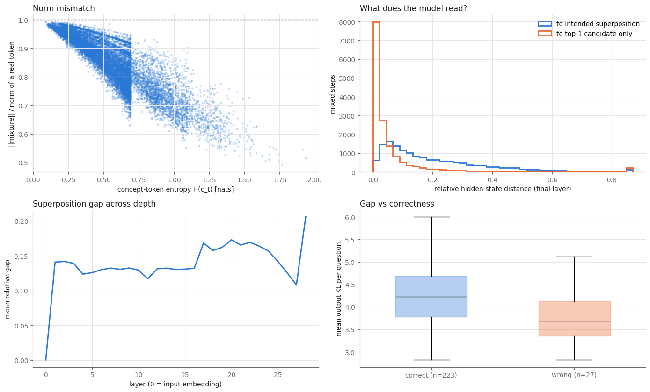
Results and Discussion
1 · Soft Thinking works at 1.7B, but the gap is real
89.2%
accuracy
250 GSM8K test questions
21%
real mixtures
the other steps act like normal tokens
90%
read as the top-1 word
distance 0.079 vs 0.206 to the mix
0.85×
mixture size
vs. a real token; ~0.5× when uncertain
Notes:
(~1.5 min) First, Soft Thinking works on the small model: 89.2 percent on 250 questions. But only 21 percent of thinking steps are real mixtures. Mixtures are only 0.85 times the size of a real token. And at 90 percent of mixed steps, the model's state is closer to its reaction to the top word than to the intended mix. So the small model is single-threaded: it mostly ignores the soft part. The bottom right plot shows that a bigger gap does not mean a wrong answer.

Slide 10
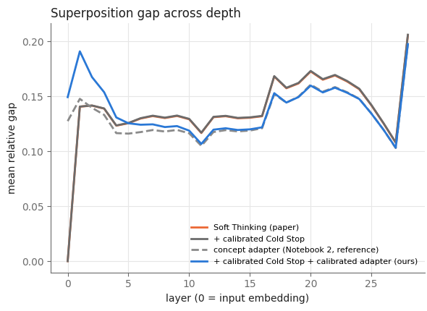
Results and Discussion
2 · The concept adapter closes the gap; accuracy stays the same
 | Paper | Adapter | Calibrated
Accuracy | 89.2% | 87.6% | 90.4%
p vs. paper | — | 0.48 | 0.66
Gap, all layers | 0.1425 | 0.1328 | 0.1380
Gap, final layer | 0.2055 | 0.1978 | 0.1975
Output KL | 4.20 | 4.01 | 3.99
Top-1 wins | 90.1% | 89.5% | 87.1%
Gap −6.8% across layers (p < 10⁻¹⁶, lower on 74% of questions)
Accuracy unchanged: no difference is significant
Final-layer floor ≈ 0.197: on-policy training did not move it
Notes:
(~1.5 min) The adapter reduces the gap significantly during real generation: 6.8 percent across layers, with a p-value below ten to the minus sixteen, and lower on 74 percent of questions. The plot shows that most of the gain is in the middle layers, and much of it fades at the final layer. Accuracy does not change significantly: 87.6 and 90.4 percent against 89.2. The calibrated version, trained on its own outputs, does not do better at the final layer, which suggests a floor an input-side adapter cannot reach.

Slide 11
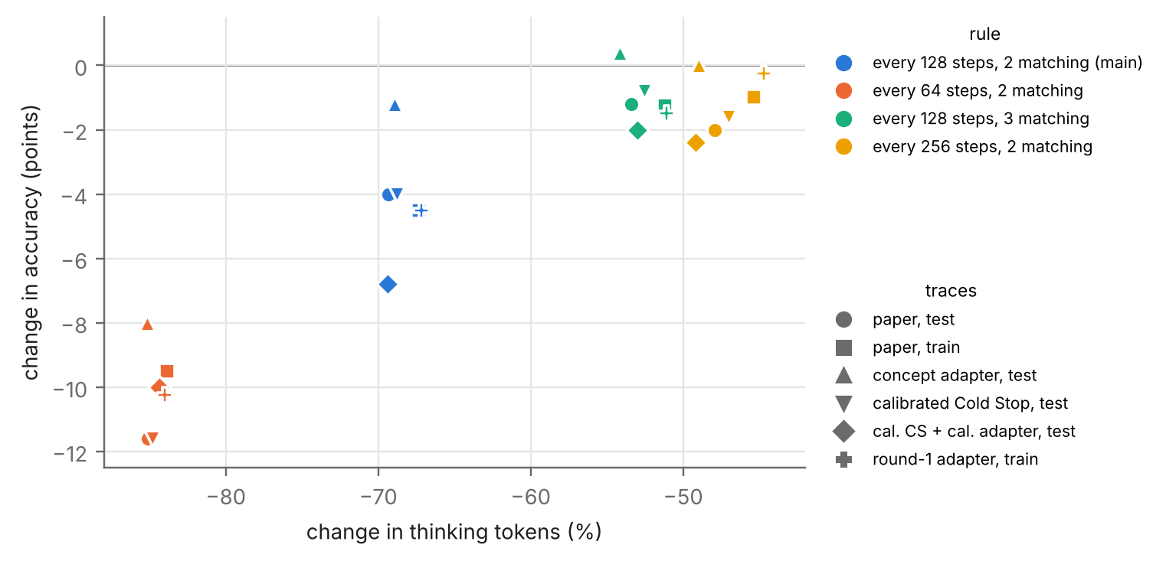
Results and Discussion
3 · Stopping at the right time halves the thinking
62%
of thinking comes after the answer
correct training traces (mean per trace)
−1.8%
tokens with calibrated Cold Stop
entropy cannot tell when the answer is ready
−53%
Each point: one exit rule (colour) on one set of saved traces (shape). Green: every 128 steps, 3 matching answers, chosen on the training questions; no significant accuracy loss on any of the 6 sets.
The rule fixed in advance (2 matching) removed 69% but lost 4 points (p = 0.031).
tokens with the answer-aware exit
88.0% vs 89.2% accuracy, p = 0.45
Notes:
(~1.5 min) The model overthinks: 62 percent of its thinking comes after the answer is already written. Re-tuning Cold Stop does not help, because savings and harm grow together: within 2 percent harm it saves only 1.8 percent of tokens, because the model is confident in many places, not just at the end. The answer-aware exit works. Our first rule, two matching answers, was too eager and lost 4 points. Choosing on the training questions alone, three matching answers removes 53 percent of thinking with no significant accuracy change, and this holds on all six sets of traces.

Slide 12
Results and Discussion
Takeaways, limitations and conclusion
What worked
What did not
Limitations
Superposition gap: the out-of-distribution worry made measurable
Concept adapter: significantly closes the gap with 0.26M parameters and no labels
Answer-aware exit: about half the thinking, same accuracy
Accuracy did not rise when the gap closed
Final-layer gap stayed near 0.197
Cold Stop cannot be fixed by tuning: entropy measures confidence, not completion
One model, one dataset, one run per system
250 test questions: only ~5-point accuracy changes are detectable
Answer probe is designed for numeric answers
At 1.7B, the model mostly ignores the “soft” part of Soft Thinking. A tiny adapter can fix how it reads mixtures, but stopping at the right time is what makes small-scale Soft Thinking about twice as efficient.
Code and outputs: github.com/AnarvaKamdar1/FLLM_Project
Notes:
(~1.5 min) What worked: the gap measurement, the adapter, which closes part of the gap at almost no cost, and the answer-aware exit, which halves the thinking. What did not: closing the gap did not raise accuracy, the final-layer gap barely moved, and Cold Stop cannot be fixed by tuning. Limitations: one model, one dataset, one run per system, and 250 test questions. In one sentence: at small scale, the model mostly ignores the soft part of Soft Thinking, and stopping at the right time matters more than reading the mixture better.

Slide 13
References
Zhang et al. Soft Thinking: Unlocking the Reasoning Potential of LLMs in Continuous Concept Space. NeurIPS 2025.
Wu et al. LLMs are Single-threaded Reasoners: Demystifying the Working Mechanism of Soft Thinking. ICLR 2026.
Shi et al. SwiReasoning: Switch-Thinking in Latent and Explicit for Pareto-Superior Reasoning LLMs. ICLR 2026.
Liu & Wang. Answer Convergence as a Signal for Early Stopping in Reasoning. EMNLP 2025.
Yang et al. Dynamic Early Exit in Reasoning Models. ICLR 2026.
Hao et al. Training Large Language Models to Reason in a Continuous Latent Space. arXiv 2024.
Cobbe et al. Training Verifiers to Solve Math Word Problems (GSM8K). arXiv 2021.
Qwen Team. Qwen3 Technical Report. arXiv 2025.
Notes:
(~10 s) These are the main works we built on and compared with.

