Slide 1
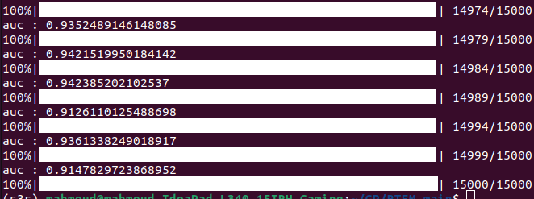
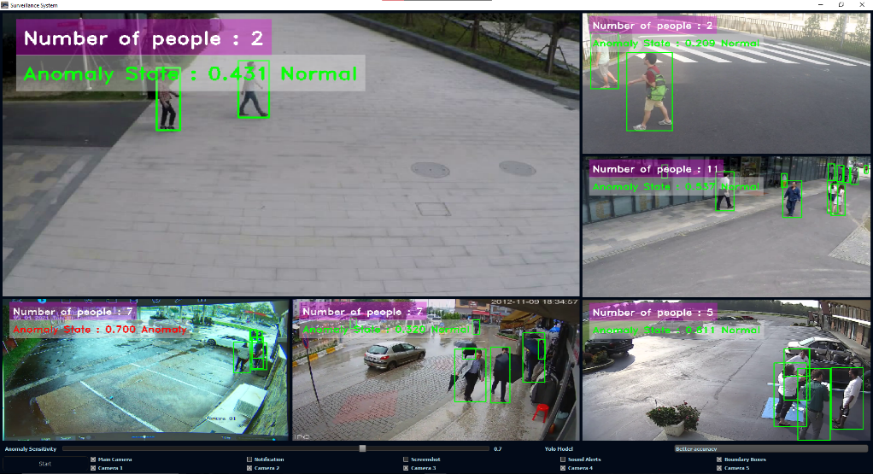
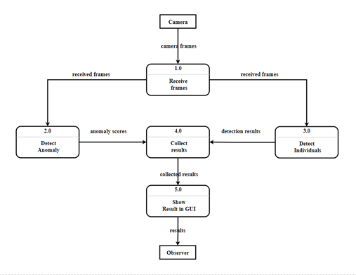
Passenger Flow Tracking
Anomaly Detection / Smart Surveillance system
Dr. Dina El Sayad and TA. Marwa Shams
Scientific Computing Department, Faculty of Computer and Information Sciences, Ain Shams University.
Abstract
This thesis presents the development and implementation of a real-time smart surveillance system.
Results
Training Results
System Running
Introduction
The system leverages advanced techniques from computer vision, machine learning, and artificial intelligence to enable proactive monitoring and detection of anomalies in various environments. Through the utilization of state-of-the-art models and algorithms, the system provides real-time analysis of multiple camera feeds, automatically detects anomalies, and triggers appropriate actions for timely response. The system offers a user-friendly interface, customizable settings, and integration with email notifications for efficient anomaly management.
Extensive experiments and evaluations demonstrate the effectiveness and practicality of the system in enhancing situational awareness and improving overall security.
Methods
Feature extraction :Inflated 3D ConvNet (I3D)
Anomaly Detection ;Robust Temporal Feature Magnitude Learning (RTFM)
Object Detection : YOLOv8
Desktop Application: Pyqt5
System Data Flow Diagram
Conclusion
The thesis presents a real-time anomaly surveillance system that uses cutting-edge technologies like deep learning, unsupervised learning, and multiple-instance learning for proactive monitoring and detecting anomalies in various environments. The system's architecture, employing the RTFM method and I3D model, demonstrates its ability to handle large-scale video data and effectively detect different anomalies. It includes user-friendly features like a customizable toolbar, adjustable anomaly sensitivity, and email notifications, making it adaptable and practical for real-world surveillance applications. The system has the potential to enhance situational awareness, improve security measures, and respond timely to anomalous events. Future research can focus on expanding its capabilities, integrating more anomaly detection algorithms, supporting additional camera sources, and optimizing performance for real-time processing of high-resolution video feeds.

