Slide 1
Face recognition

Slide 2
The project is targeting to recognize Human Faces in both Video and pictures files
The project is focusing in detecting multilabel faces in group pictures
The project also can be used throw social media apps for recognize faces

Slide 3
The process was done by using HAAR CASCADE
The process required positive pictures which contain cropped faces only and negative pictures which contain pictures without faces
The pictures were collected from the internet

Slide 4



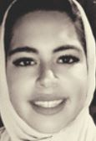
Sample of Positive Pictures

Slide 5
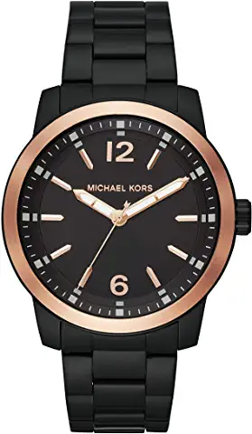
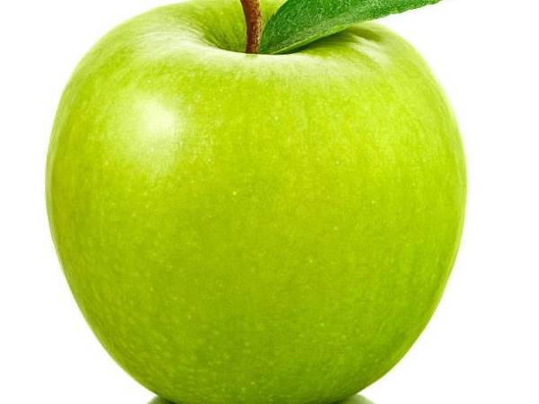
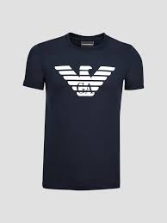
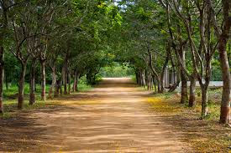
Sample of Negative Pictures

Slide 6
Put cropped pictures for the item want to be detected in positive images folder
Put the background pictures or similar pictures for the item of being detect in negative folder
Create the cascade filter and test it
If it detect an item that is not correct put more pics of that item in the negative folder

Slide 7
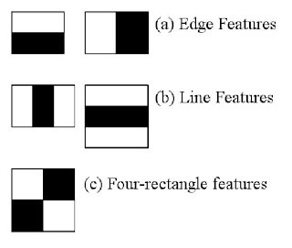
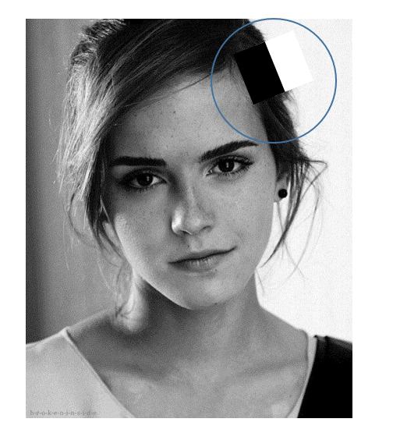
HAAR CASCADE
It is a machine learning based approach where a cascade function is trained from a lot of positive and negative images
The idea of Haar cascade is extracting features from images using a filter similar to the concept of the convolutional kernel

Slide 8
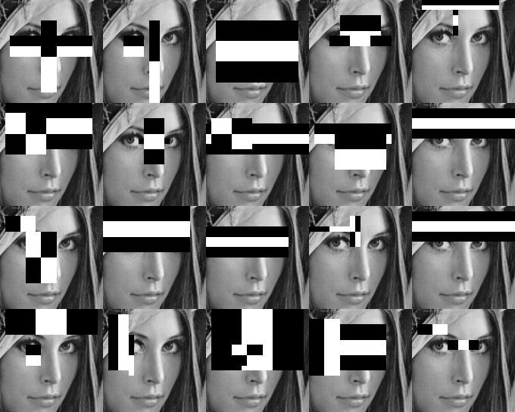
HAAR CASCADE

Slide 9
Improving methods
integral image: it reduces the calculations for a given pixel to an operation involving just four pixels by finding the sum of the pixels under white and black rectangles.
Adaboost: it is a process were each feature is applied to all training pictures to select the best and strongest features
Cascading: a process to enter the pictures into different stages to save time

Slide 10
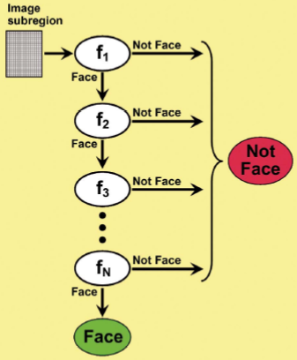
Cascading method

Slide 11
Training method
Resize the images before training
Set the number of patches
Convert to gray scale
Apply the method

Slide 12
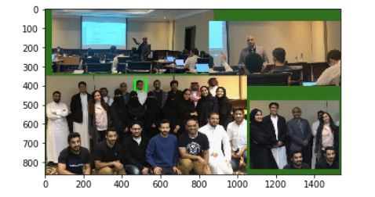
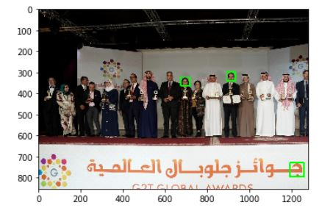
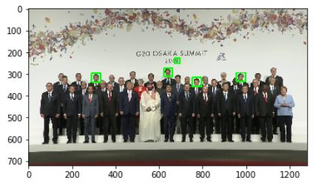
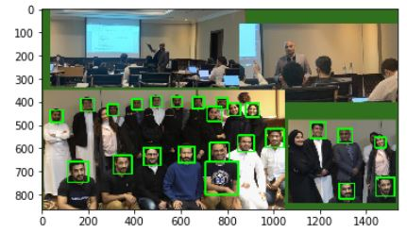
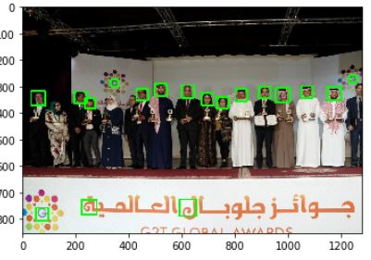
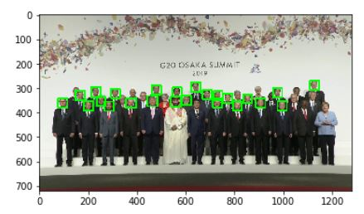
Progress

Slide 13
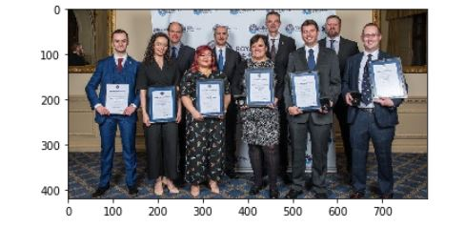
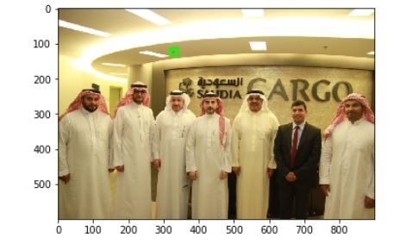
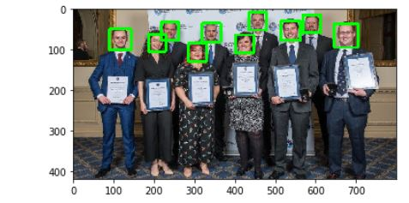
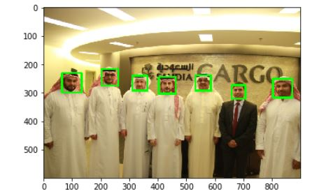
Progress

Slide 14
Challenges
Collecting data from the internet for the training
Code is not available for windows but it is for Mac and Linux so a filter creating tool was used
It is a power and time consuming process

Slide 15
The next step
To keep improving the model by adding new data based on test observation and make profile for each person to be identifier
To apply it throw monitoring systems to save memory space by saving pictures instead of video and compare the result or to it could be used to monitor area and keep a record as pictures that contain only the faces of people enter that area and a time sheet of their excess
To recreate the model with different filters and compare the result

