Slide 1



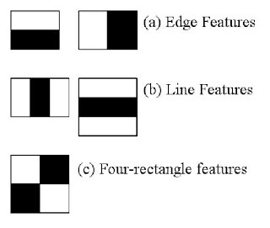
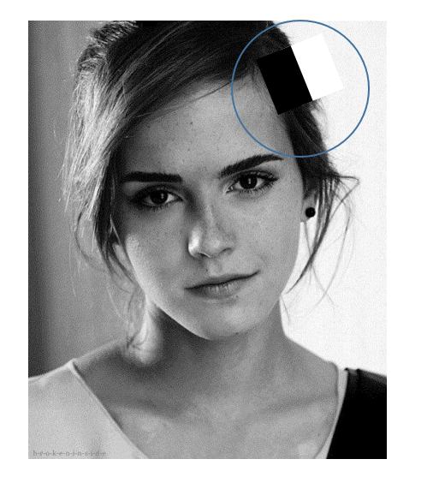
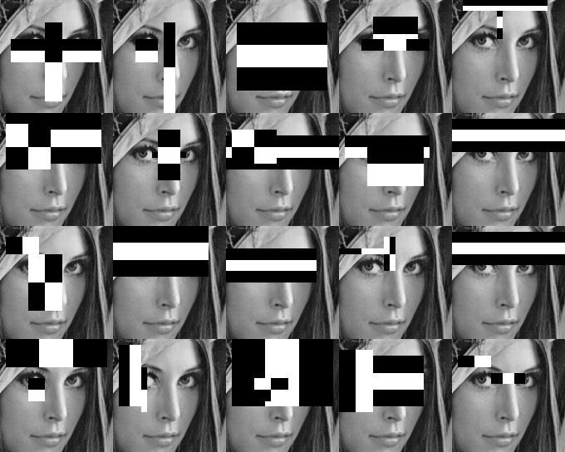
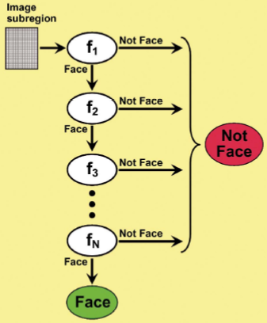
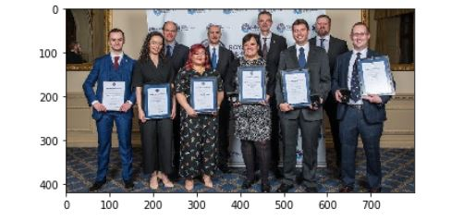
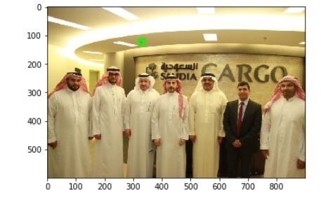
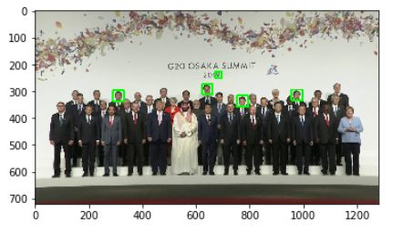
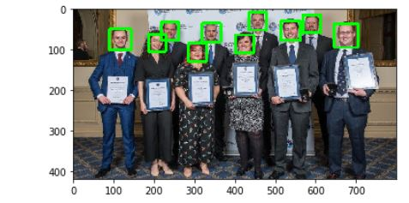
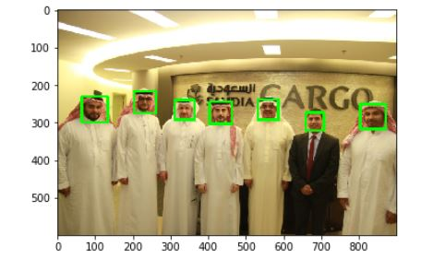
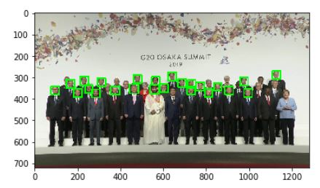
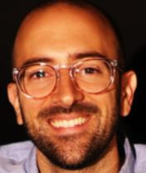
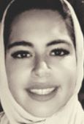
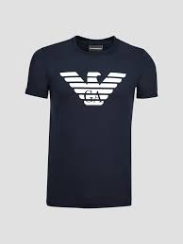
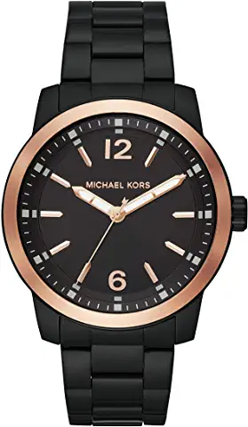
Face Recognition
Anas Omar Alamri
Goals
The project is focusing in detecting multilabel faces in group pictures
The project also can be used throw social media apps for recognize faces
detect faces in both live videos and pictures and find the number of faces exist and keep record of it as cropped faces record in a way it is easy to link to the original picture.
HAAR CASCADE
Improving methods
integral image
.
Adaboost
Cascading
Preprocessing
Cropped faces for faces pictures is collected in a file named the positive data
Pictures of background or any item is getting identify as a face by mistake during test stage (no faces in it)
Resize the images before training
Regenerate the pictures to overcome unbalanced data
First Model created
Future Work
Keep improving the model by adding new data pictures based on the test results.
Recreating the model with different filters
Applying neural network to the result of the model for face identification
Sample of Positive and Negative Data
Last Model created
Ask me about the Live Demo!
Positive
Negative

