Slide 1
OLA project : pricing

Slide 2
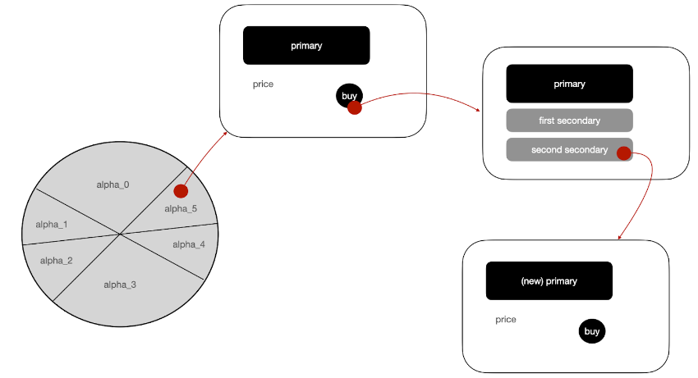
Common part
E-commerce website selling 5 products
Behavior:
she/he buys a number of units of the primary product if the price of a single unit is under the user’ reservation price (single unit price)
once the primary product has been bought, the user clicks on a secondary product with a probability p (to be defined later)

Slide 3
For simplicity, we make the following assumptions:
the clicks on the secondary products are independent of each other and the user can click on multiple secondary products, so as to activate multiple parallel paths over the graph depicted above;
the number of items a user will buy is a random variable independent of any other variable; that is, the user decides first whether to buy or not the products and, subsequently, in the case of a purchase, the number of units to buy;
the actions performed by the users are perfectly observable by the ecommerce website.

Slide 4
Every day, there is a random number of potential new customers (returning customers are not considered here). In particular, every single customer can land on the webpage in which one of the 5 products is primary or on the webpage of a product sold by a (non-strategic) competitor. Call 𝛼_i the ratio of customers landing on the webpage in which product Pi is primary, and call 𝛼_0 the ratio of customers landing on the webpage of a competitor. In practice, you can only consider the 𝛼 ratios and disregard the total number of users. However, the 𝛼 ratios will be subject to noise. That is, every day, the value of the 𝛼 ratios will be realizations of independent Dirichlet random variables.
The following picture summarizes the overall scenario.

Slide 5
In the following project proposals, we ask you to develop two different settings differing for the graph weights. First, assume that the graph is fully connected and therefore all the edges have strictly positive probabilities (in practice the secondary products displayed are just two and thus many of the edges are useless). In the second, assume that the graph is not fully connected and therefore some edges have zero probability.
The behavior of the user in the graph is similar to that of the social influence. Thus, in the following project proposals, you need to resort to social influence techniques to evaluate the probabilities with which the user reaches the webpage with some specific primary product.

Slide 6
Consider the scenario in which:
for every primary product, the pair and the order of the secondary products to display is fixed by the business unit and cannot be controlled,
the price of every primary product is a variable to optimize,
the expected values of the 𝛼 ratios are known.
For simplicity, assume that there are four values of price for every product and that the price can be changed once a day. For every product, order the prices in increasing levels. Every price is associated with a known margin. On the other hand, for every product, the conversion probability associated with each price value is a random variable whose mean is unknown.

Slide 7
Step 1: Environment. Develop the simulator by Python. In doing that, imagine a motivating application and specify an opportune choice of the probability distributions associated with every random variable. Moreover, assume that there are 2 binary features that define 3 different user classes. The users’ classes potentially differ for the demand curves of the 5 products, number of daily users, 𝛼 ratios, number of products sold, and graph probabilities. That is, for every random variable, you need to provide three different distributions, each one corresponding to a different users’ class.

Slide 8
Step 1 : Environment

Slide 9
A motivating application
5 different products
Sold on a website

Slide 10
Probability distributions

Slide 11
Customer classes

Slide 12
Step 2 : Optimization algorithm (greedy learner)

