Slide 1
ELEE 2790U Tutorial 2 Solutions
September 18, 2022

Slide 2
TA
Matthew Oinonen
matthew.oinonen@ontariotechu.net Office hours are Mondays and Thursdays, 12:40-2:00, ERC 4100, Desk 8

Slide 3
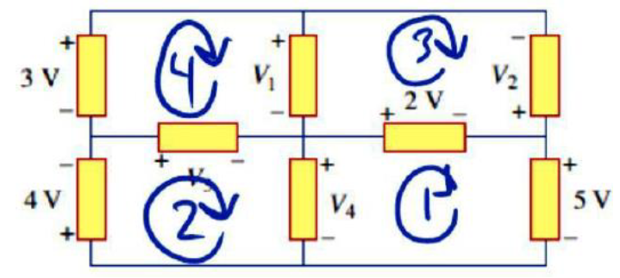








Problem 12
Use KVL to find the unknown voltages
$$\left(1\right) 0=−V_{4}+2+5$$
$$V_{4}=7 V$$
$$\left(2\right) 0=4+V_{3}+V_{4}$$
$$V_{3}=−11 V$$
$$\left(3\right) 0=−V_{1}−V_{2}−2$$
$$V_{2}=6 V$$
$$\left(4\right) 0=−V_{3}−3+V_{1}$$
$$V_{1}=−8 V$$

Slide 4
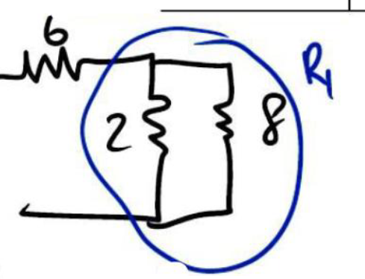
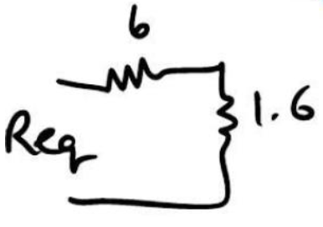


Problem 13
$$6+2=8 Ω$$
Find R_{eq}
$$R_{1}=2||8=\frac{2\left(8\right)}{2+8}=1.6 Ω$$
$$R_{eq}=6+1.6=7.6 Ω$$

Slide 5
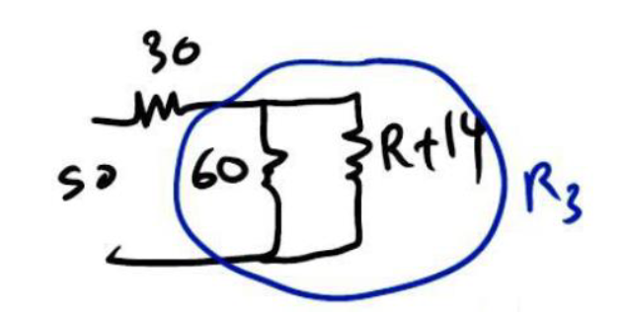
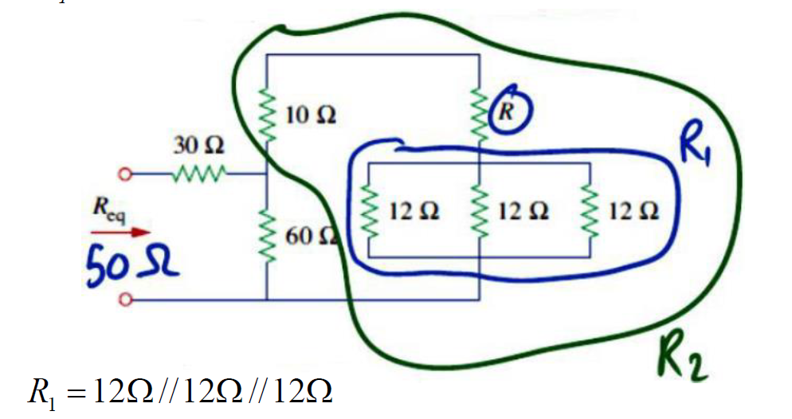

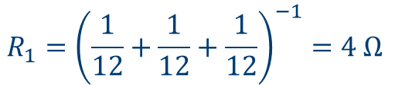


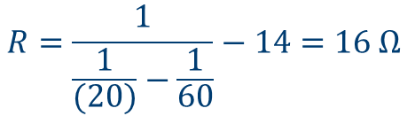
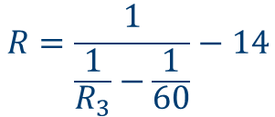
Problem 14
$$R_{1}={\left(\frac{1}{12}+\frac{1}{12}+\frac{1}{12}\right)}^{−1}=4 Ω$$
$$R_{2}=10+R+R_{1}=10+R+4=R+14$$
Find R when R_{eq} = 50Ω
$$\frac{1}{R_{3}}=\frac{1}{60}+\frac{1}{R+14}$$
$$R=\frac{1}{\frac{1}{R_{3}}−\frac{1}{60}}−14$$
$$R_{eq}=30+R_{3}$$
$$R_{3}=R_{eq}−30=50−30=20 Ω$$
$$R=\frac{1}{\frac{1}{(20)}−\frac{1}{60}}−14=16 Ω$$

Slide 6
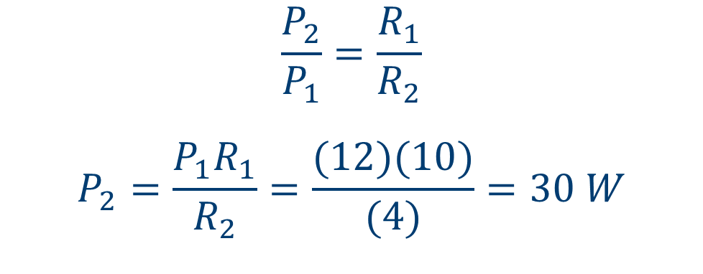
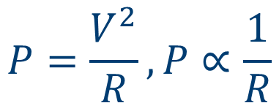
Problem 15
If a loudspeaker draws the maximum power of 12 W from an amplifier, determine the maximum power a 4 Ω loudspeaker will draw.
$$P=\frac{V^{2}}{R}, P∝\frac{1}{R}$$
$$\frac{P_{2}}{P_{1}}=\frac{R_{1}}{R_{2}}$$
$$P_{2}=\frac{{P_{1}R}_{1}}{R_{2}}=\frac{(12)(10)}{(4)}=30 W$$
V
+ -
10 Ω

Slide 7
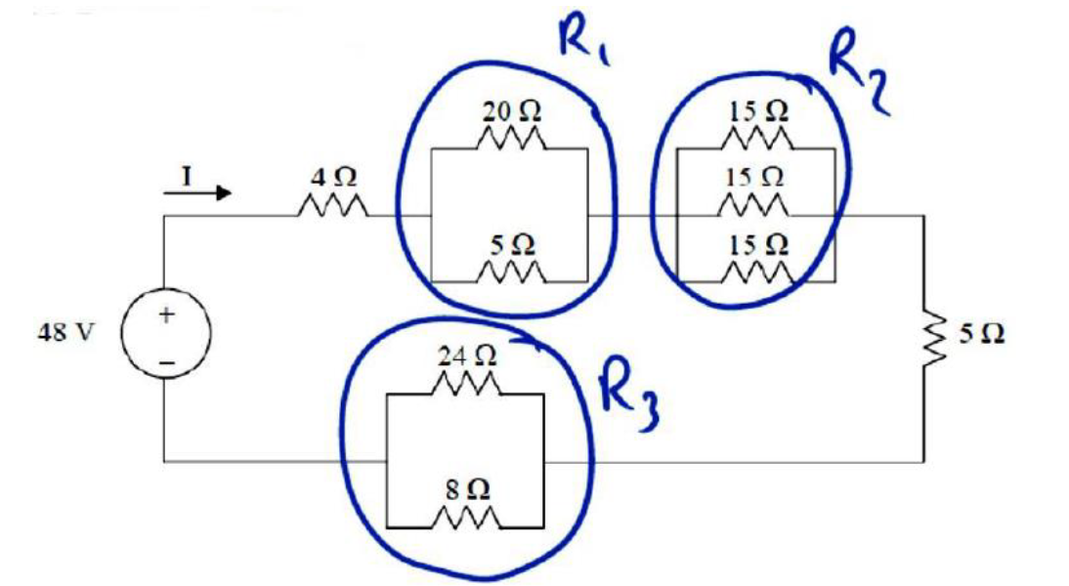


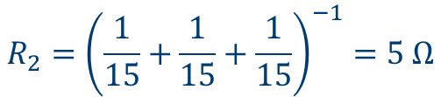

Problem 16
Find the current I in the following circuit:
Find R_{eq}
$$R_{1}=20||5=\frac{20\left(5\right)}{20+5}=4 Ω$$
$$R_{2}={\left(\frac{1}{15}+\frac{1}{15}+\frac{1}{15}\right)}^{−1}=5 Ω$$
$$R_{3}=24||8=\frac{24\left(8\right)}{24+8}=6 Ω$$
$R_{eq}=4+R_{1}+R_{2}$ $+{5+R}_{3}=4+4+5+5+6=24 Ω$
$$I=\frac{V}{R_{eq}}=\frac{48}{24}=2 A$$

