Slide 1
JSON&&AJAX

Slide 2
What is JSON?
Stands for (JavaScript Object Notation).
It is a lightweight data-interchange format.
It is not a markup language, not scripting or programming language.
JSON uses JavaScript syntax, but the JSON format is text only, just like XML.Text can be read and used as a data format by any programming language.
Text-based.
It can be used instead of XML.
It is a special object notational construct, that is a subset of JavaScript.
It is a text format that is completely language independent but uses conventions that are familiar to programmers of the C-family of languages.

Slide 3
JSON Features
lightweight data-interchange format.
Easy for humans to read and write.
JSON is "self-describing" and easy to understand.
Easy for machines to parse and generate.
JSON Supports a lot of programming languages such as: ActionScript, C, C#, ColdFusion, E, Java, JavaScript, ML, Objective CAML, Perl, PHP, Python, Rebol, Ruby, and Lua.
It has support for Unicode, allowing almost any information in any human language to be communicated.

Slide 4
JSON Structure
JSON is built on two structures:
  A collection of name:value pairs, separated by (:). Name is
string, value is one of JSON values. (Ex.: “Name” : “Ahmed”).
  An ordered list of values. In most languages, this is realized as an array, vector, list, or sequence.

Slide 5
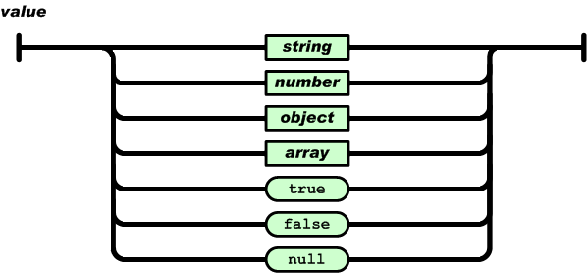
JSON Values Formats
JSON supports these basic data types:
  Strings (in double quotes)
  Numbers (integer or floating point)
  Booleans (true, false).
  Objects (in curly braces)
  Arrays (in square brackets)
o null

Slide 6



JSON Syntax
JSON Data representation:
<SCRIPT LANGUAGE="JavaScript">
var webclass =
{wclass: [
{student:
{
id:1,
name:"Linda Jones", legacySkill:["Access”, “VB 5.0“]
}
},
{student:
{
id:2,
name:"Adam Davidson", legacySkill:["Cobol”, “MainFrame“]
}
}
]
};
alert(webclass.wclass[1].student.legacySkill[0]);
// Cobol
</SCRIPT>

Slide 7






Parsing JSON string
You can write JSON objects and arrays directly as objects and arrays Directly in JavaScript:
<script>
var obj= {ID:10,name:“Ali",City:“Assiut“, Job: null, Married: true}; document.write(obj.ID);
document.write(obj.name);
</script>
You need to parse it to JSON when you read it from text file:
<script>
var jsonStr= ‘{“ID”:10,"name":“Ali",“City":“Assiut“, “Job”: null, “Married”: true}’;
var obj=JSON.parse(jsonStr); document.write(obj.ID); document.write(obj.name);
</script>

Slide 8



Parsing JSON string (Cont.)
For old browsers that don’t support the JavaScript function JSON.parse() can use the eval() function:
<script>
var jsonStr= ‘{“ID”:10,"name":“Ali",“City":“Assiut“, “Job”: null,
“Married”: true}’;
var obj=eval ("(" + text + ")"); document.write(obj.ID); document.write(obj.name);
</script>

Slide 9
How to read JSON files from the server?
The file type for JSON files is ".json" (or even .txt files), it’s just text files.
JSON Http Request: A common use of JSON is to read data from a web server, and display the data in a web page is using Http Request (XMLHttpRequest Object).
Http Request is also a technique used in Ajax.

Slide 10
What is AJAX?
AJAX stands for Asynchronous JavaScript And XML.
AJAX is a technique for creating “better, faster, more responsive web applications”.
AJAX allows web pages to be updated asynchronously by exchanging small amounts of data with the server behind the scenes. This means that it is possible to update parts of a web page, without reloading the whole page.
Classic web pages, (which do not use AJAX) must reload the entire page if the content should change.
Examples of applications using AJAX: Google Maps, Gmail, Youtube, and Facebook tabs.

Slide 11
How AJAX Works?
AJAX is based on internet standards, and uses a combination of:
  XMLHttpRequest object (to exchange data asynchronously with a server)
  JavaScript/DOM (to display/interact with the information)
  CSS (to style the data)
  XML / JSON (often used as the format for transferring data)

Slide 12
The XMlHTTPRequest object
The XMLHttpRequest object is used to exchange data with a server.
It is an object (a constructor function) that allows you to send
HTTP requests from JavaScript.
supported by virtually all modern browsers, including IE 5+ , Firefox and Opera, and it is supported on a wide range of platforms, including Microsoft Windows, UNIX/Linux, and Mac OS X.
Used in Ajax, and to get files and data from the server.

Slide 13
The XMlHTTPRequest object
HTTP error types (Status):
  1xx Informational
  2xx Success
  3xx Redirection
  4xx Client Error
  5xx Server Error
Status & Status Text:
404: Not found
The server found nothing matching the URI given.
  200: OK
The server successfully returned the page
  400: Bad Request
Server didn’t understand the request due to malformed syntax.
  401: Unauthorized
The request requires user authentication.
  500: Internal Server Error
The server encountered an unexpected error and couldn’t fulfill the request.
  503: Service Unavailable
The server is currently unable to handle the request due to temporary overloading or
maintenance.

Slide 14
The XMlHTTPRequest object
Some of the object's properties and methods:
oProperties:
Property | Description
readyState | Integer reporting the status of the request
onreadystatechange | Determines which event handler will be called when the object's readyState property changes
responseXML | Data returned by the server expressed as a document object
responseText | Data returned by the server in text string form
status | Returns the status as a number (e.g. 404 for "Not Found" or 200 for "OK")

Slide 15
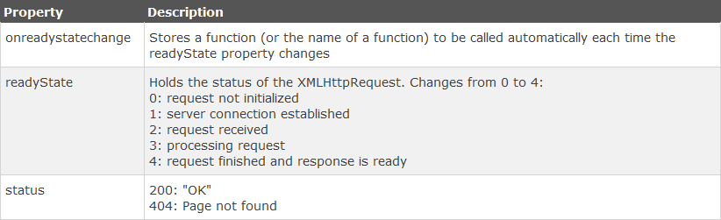
The XMlHTTPRequest object
Ready State Values:

Slide 16
The XMlHTTPRequest object(Cont.)
oMethods:
Method | Description
abort() | Stops the current request.
open('method','URL','a') | Specifies the type of request, the URL, and if the request should be handled asynchronously or not. method: the type of request: GET or POST url: the location of the file on the server async: true (asynchronous) or false (synchronous)
send() | Sends the request, optionally take post data as a parameter.

Slide 17
The XMlHTTPRequest object(Cont.)
Steps for communication with the server using XMLHTTPRequest:
  Creating XMLHTTPRequest (XHR) object.
  Initialize the object (using open() method).
  Send the request (Using send() method).
  Monitoring the state of the request.
  Dealing with the server response.

Slide 18





Putting it all together
Complete code:
var xmlhttp;
xmlhttp=new XMLHttpRequest(); xmlhttp.onreadystatechange=function()
{
if (xmlhttp.readyState==4 && xmlhttp.status==200)
{
var str=xmlhttp.responseText;
}
}
xmlhttp.open("GET",“json_info.txt",true);
xmlhttp.send();

Slide 19


















Cookies
What’re cookies?
  Cookies are small text strings that you can store on the computers of people that visit your Web site.
  Cookies were originally invented by Netscape to give ‘memory‘ to web servers and browsers.
  Normally, cookies are simple variables set by the server in the browser and returned to the server every time the browser accesses a page on the same server.
  Cookie is a method of storing information locally in the browser and sending it to the server whenever the appropriate pages are requested by the user.
  A cookie is not a script, it is a mechanism of the HTTP server accessible by both the client and the server.
  A cookie may be written and accessed by a script but the cookies themselves are simply passive text strings.

Slide 20
Benefits of Cookies
Benefits of Cookies:
  Shopping carts
→ By storing data as you move from one page (or frame) to another.
  Authentication
→ No longer need to enter password
→ Greeting people by name.
  Maintaining state
→ Adventure games that use cookies to keep track of pertinent character data and the current state of the game.
  Saving time for returning visitors
→ The user does not have to re-enter information
  Notifying visitor
→ What has changed since their last visit.

Slide 21





Creating a Cookie
Creating a Cookie:
  The simplest way to create a cookie is to assign a string value to the document.cookie.
  Syntax:
document.cookie = "key1=value1;expires=date";
<script language=”JavaScript”> var myDate = new Date();
Var d= myDate.getDate() +10; myDate .setDate(d);
document.cookie = “myCookie=” + escape(“This is my Cookie”) + “;expires=” + myDate.toGMTString();
</script>

Slide 22



Reading a Cookie
Reading a Cookie:
  The document.cookie will keep a list of name=value pairs separated by semicolons, where name is the name of a cookie and value is its string value.
  We use strings' split() function to break the string into key and values.
<script>
var newCookie = document.cookie;
var cookieParts = newCookie.split(“=”); var cookieName = cookieParts[0];
var cookieValue = unescape(cookieParts[1]);
alert(cookieName);
alert(cookieValue);
</script>

Slide 23



Deleting a Cookie
Deleting a Cookie:
  If the user logs out or explicitly asks not to save his or her username in a cookie, hence, you need to delete a cookie to remove a username cookie.
  Simply reassign the cookie, but set the expiration date to a time has already passed
<script language=”JavaScript”>
var newDate = new Date(); newDate.setTime(newDate.getDate() - 1); document.cookie = “myCookie=;expires=“+ newDate.toGMTString();
</script>

Slide 24
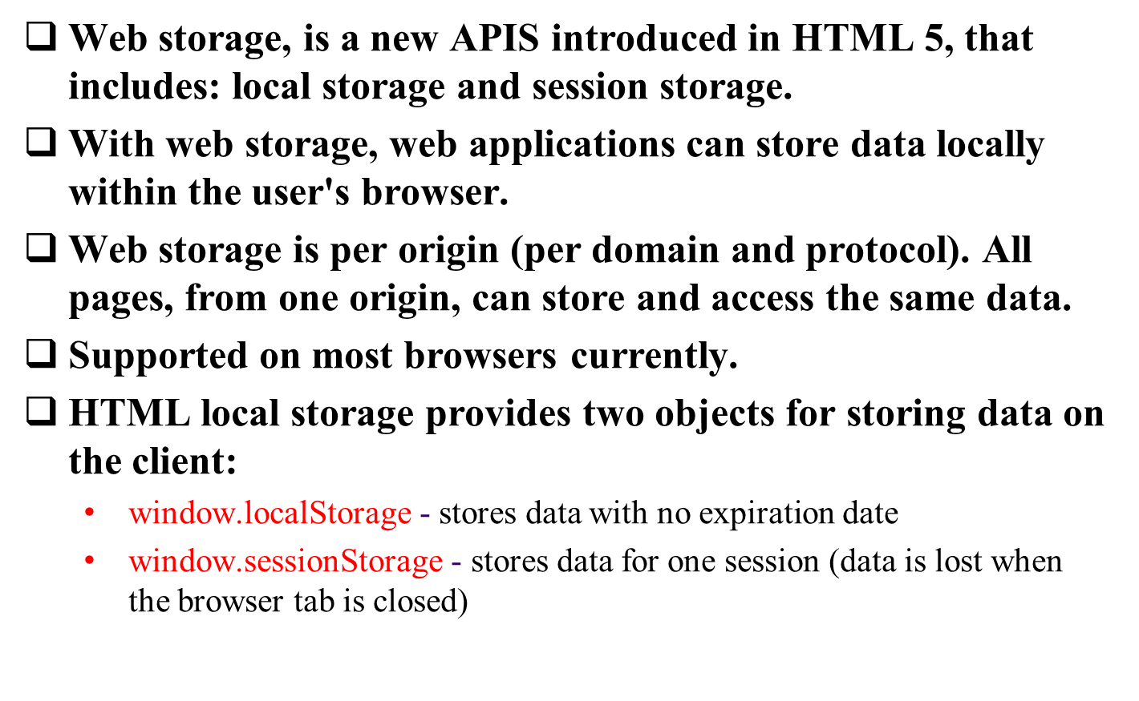
What is Web storage?

Slide 25
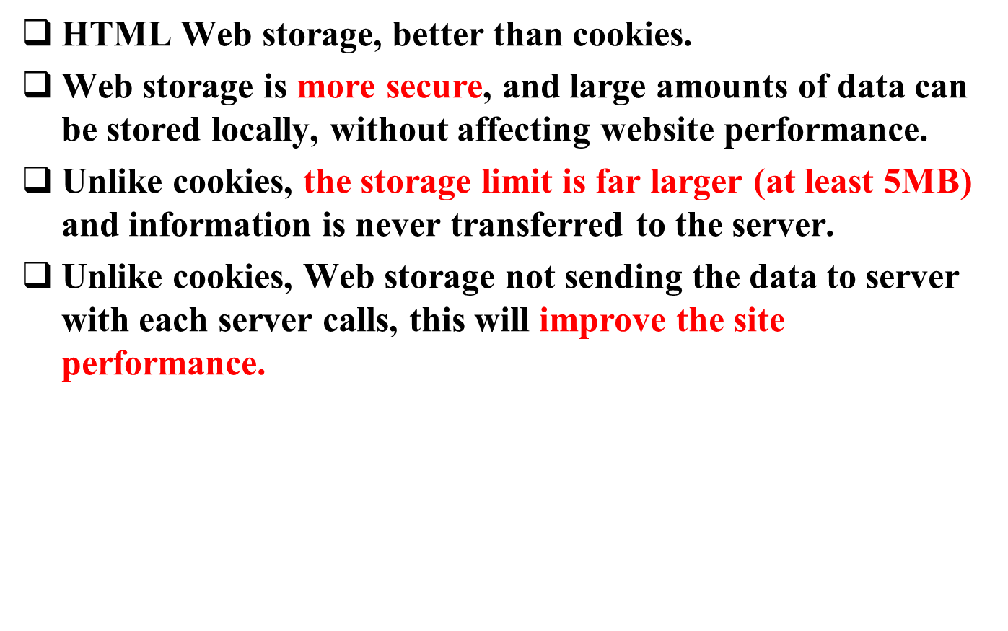
Why Web Storage is better than Cookies?

Slide 26
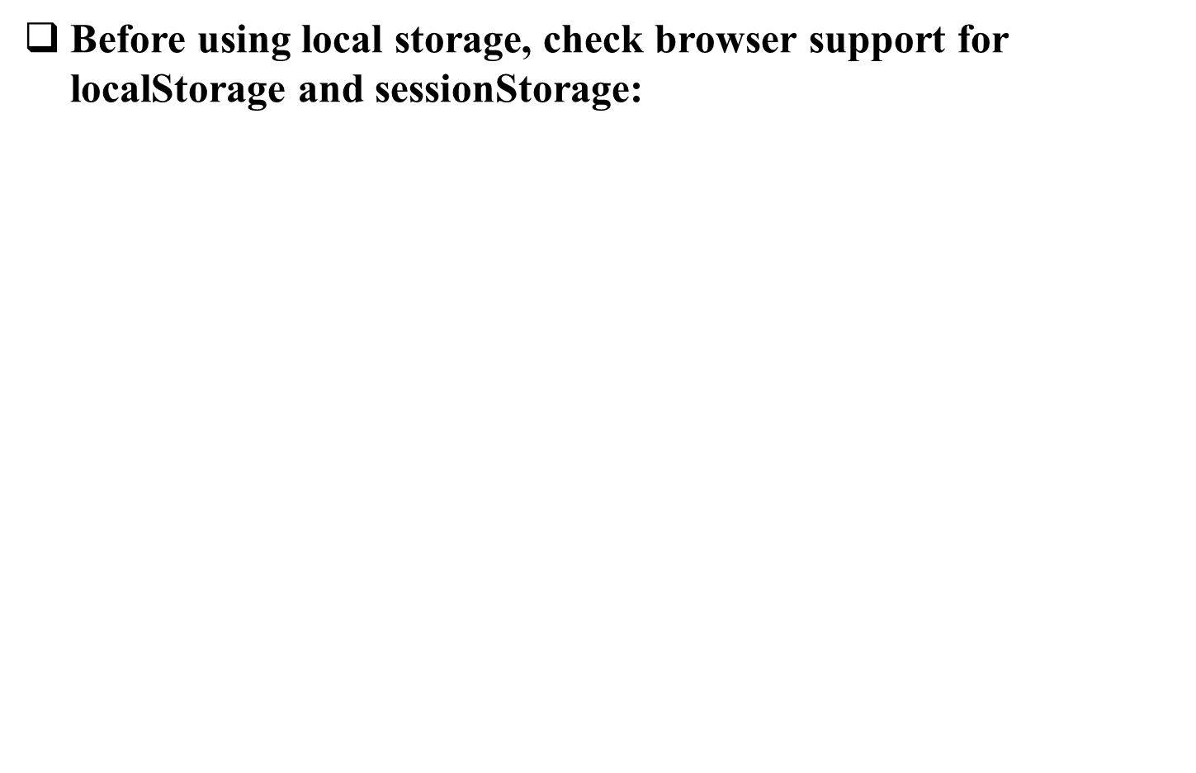

Start using Web storage
if(typeof(Storage) !== "undefined")
{
// Code for localStorage/sessionStorage.
}
else
{
// Sorry! No Web Storage support..
}
Notes:
By default, elements flow one after another in the same order as they appear in the HTML source, with each element having a size and position that depends on the type of element, the contents of the element, and the display context for the element as it will render on the page.
This default flow model for HTML layout doesn't allow a high level of control over the placement of elements on the page.
By applying a small set of CSS attributes to the elements that are defined for the page, CSS can control the precise position of elements by giving exact coordinates.
It is also possible to specify placement relative to the position of other objects on the page.

Slide 27
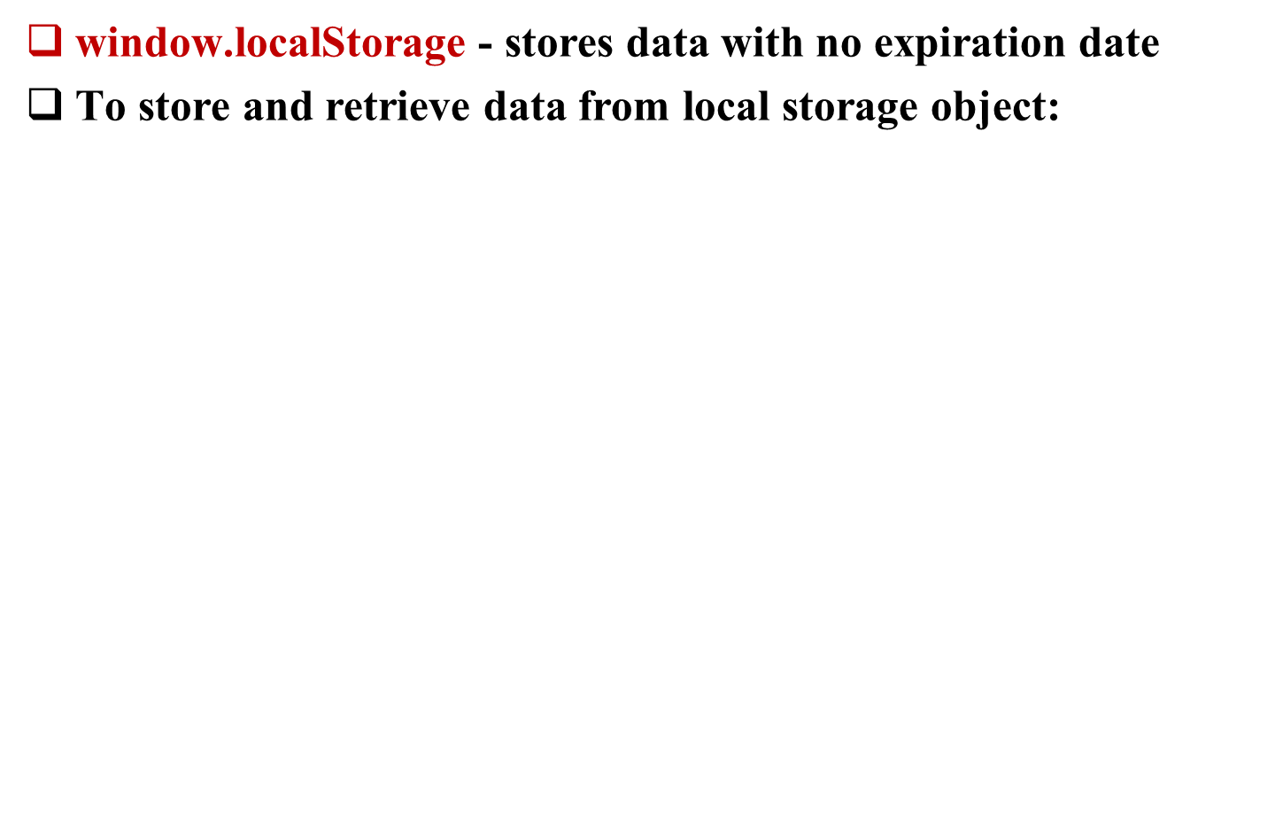
Local storage Object
//Store
localStorage.setItem("userName", "Ahmed");
//or
localStorage.userName = "Ahmed";
//or
localStorage[userName] = "Ahmed";
//Retrieve
var result= localStorage.getItem("userName");
//or
var result= localStorage.userName;
//or
var result= localStorage[userName];
//Remove
localStorage.removeItem("userName");
Notes:
By default, elements flow one after another in the same order as they appear in the HTML source, with each element having a size and position that depends on the type of element, the contents of the element, and the display context for the element as it will render on the page.
This default flow model for HTML layout doesn't allow a high level of control over the placement of elements on the page.
By applying a small set of CSS attributes to the elements that are defined for the page, CSS can control the precise position of elements by giving exact coordinates.
It is also possible to specify placement relative to the position of other objects on the page.

Slide 28
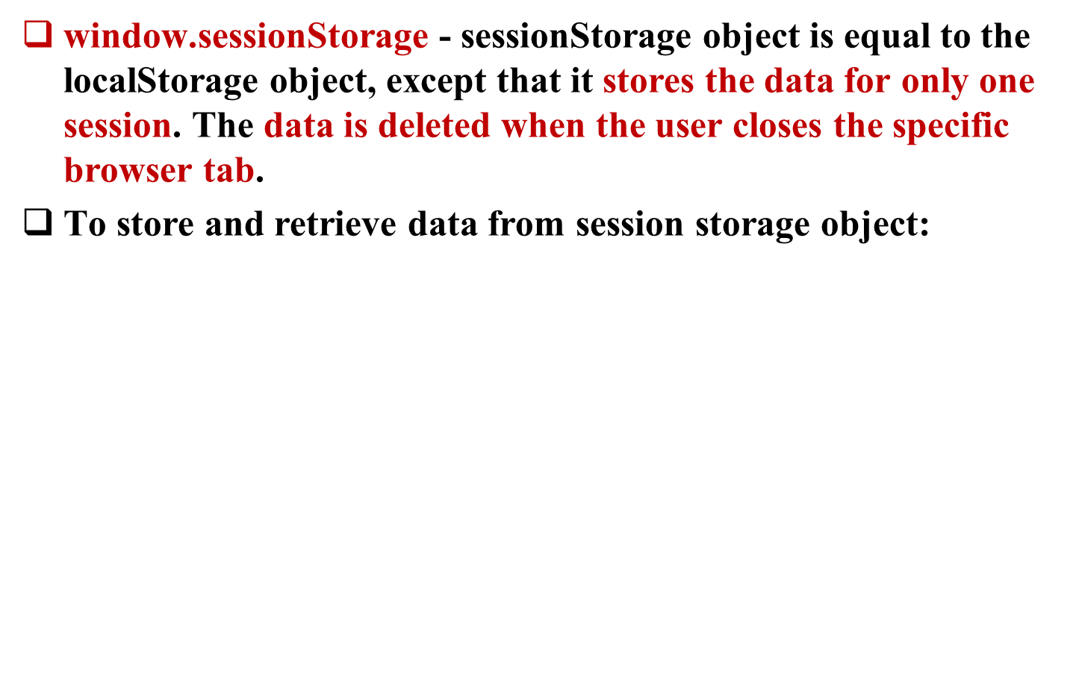
Session storage Object
//Store
sessionStorage.setItem("userName", "Ahmed");
//or
sessionStorage.lastname = "Ahmed";
//Retrieve
var result= sessionStorage.getItem("userName");
//or
var result= sessionStorage.userName;
//Remove
sessionStorage.removeItem("userName");
Notes:
By default, elements flow one after another in the same order as they appear in the HTML source, with each element having a size and position that depends on the type of element, the contents of the element, and the display context for the element as it will render on the page.
This default flow model for HTML layout doesn't allow a high level of control over the placement of elements on the page.
By applying a small set of CSS attributes to the elements that are defined for the page, CSS can control the precise position of elements by giving exact coordinates.
It is also possible to specify placement relative to the position of other objects on the page.

