Slide 1
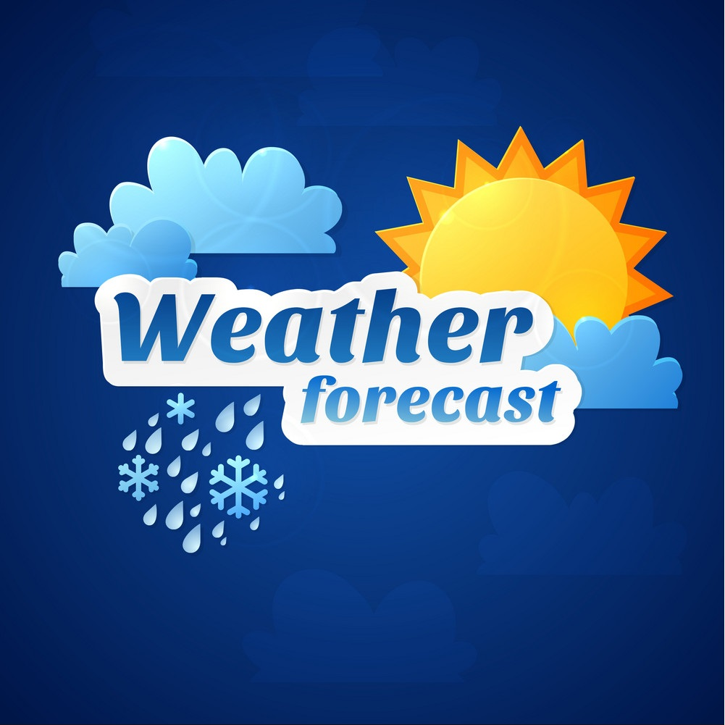
Project Report On “Weather App ”
Submitted By:
Name- ANAS KHAN
Guided By:
Roll No.- 1966001008
MR. BHARAT SINGH
IIMT UNIVERSITY MEERUT

Slide 2
Table of Contents
INTRO 3
CERTIFICATE 4
ACKNOWLEDGEMENT 5
PROJECT OVERVIEW 6
SYNOPSIS 7
FEATURES 10
SCREENSHORTS 11
CODE 15
CONCLUSION 31
10. BIBLIOGRAPHY 32

Slide 3

Bachelor Of Computer Applications
School of Computer Science and Application
IIMT University, Meerut Utter Pradesh
MINI PROJECT – BCA 355

Slide 4
CERTIFICATE
This is to certify that mini Project report entitled Weather Forecast is a bonafide record of the project that original work done by ANAS KHAN during the academic year of 2021-2022 bearing ROLL NO. 1966001008 towards the partial fulfillment of the requirement of the award of BCA and a student of Bachelor of computer applications in Vth Semester of the IIMT University, Meerut.
DEAN (Computer Science Department)
IIMT UNIVERSITY , MEERUT UTTER PRADESH

Slide 5
ACKNOWLEDGEMENT
The satisfaction that accompanies that the successful completion of any task would be incomplete without the mention of people whose ceaseless cooperation made it possible, whose constant guidance and encouragement crown all efforts with success.
We are grateful to our project guide Mr. Bharat Sir for the guidance, inspiration and constructive suggestions that helpful us in the preparation of this project.
Anas Khan
IIMT UNIVERSITY

Slide 6
OVEVIEW
Project Overview
Primary skill: | Web Development/Programming
Secondary skills: | HTML,CSS AND JAVASCRIPT, Open Weather API, Vscode
Type of website: | Weather Forecasting application

Slide 7
SYNOPSIS
A ‘Weather Forecasting Web Application” allows user to check the current weather conditions immediately it provides accurate information
Weather is the mix of events that happen each day in our atmosphere and is different in different parts of the world and changes over minutes, hours, days, and weeks. Rain and dull clouds, windy blue skies, cold snow, and sticky heat are very different conditions, yet they are all-weather. According to the Wikipedia definition:
Weather is the state of the atmosphere.
The Project Can be access in mobile as well through:-
https://weatherappimt.netlify.app/

Slide 8
An input for users to type the city name
And a Locate button to fetch the data i.e. latitude and longitude from the user machine to deliver the current
Weather location
It uses the Open Weather API,
OpenWeather is a team of IT experts and data scientists that has been practising deep weather data science since 2014. For each point on the globe, OpenWeather provides historical, current and forecasted weather data via light-speed APIs. Headquarters in London, UK. Provides The temperature in °C and also Provide Humidity With the Icon showing Current Weather conditions .

Slide 9
WEATHER FORECASTING
PURPOSE:
To Check the Current Weather Status
SCOPE :
It allows us to check the weather condition using your geographical location or by entering your city name.

Slide 10
FEATURES:
Use Latitude and Longitude of users to fetch data from the API’s
Can check the weather of almost every city in the world.
Storage can be saved
provide accurate data information about weather.
Instantly Delivers the Result.

Slide 11
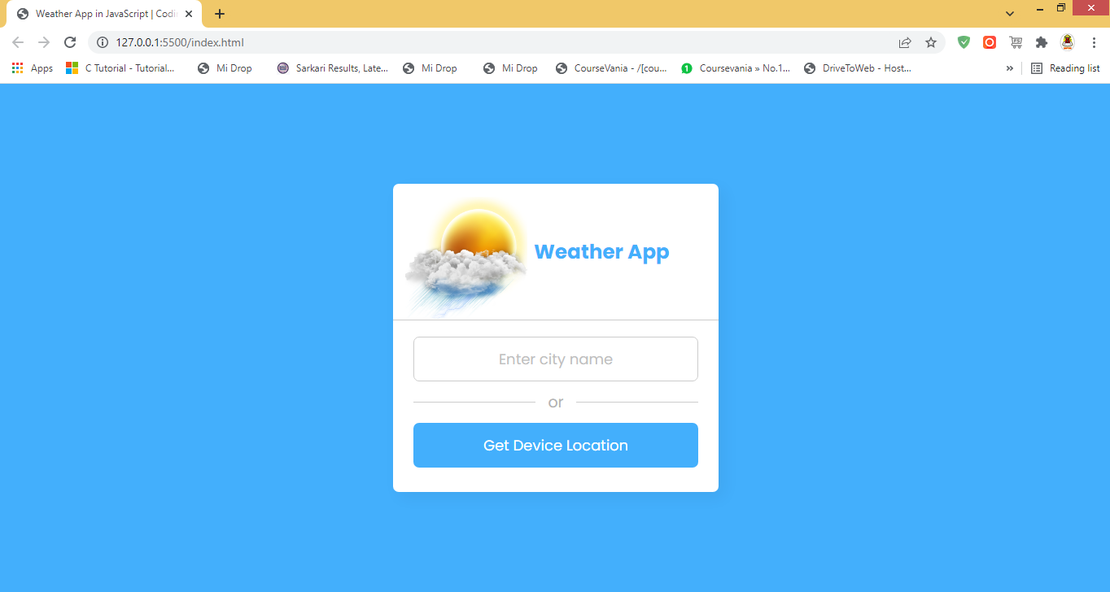
SCREEN SHOTS
All page’s screen shot with description

Slide 12
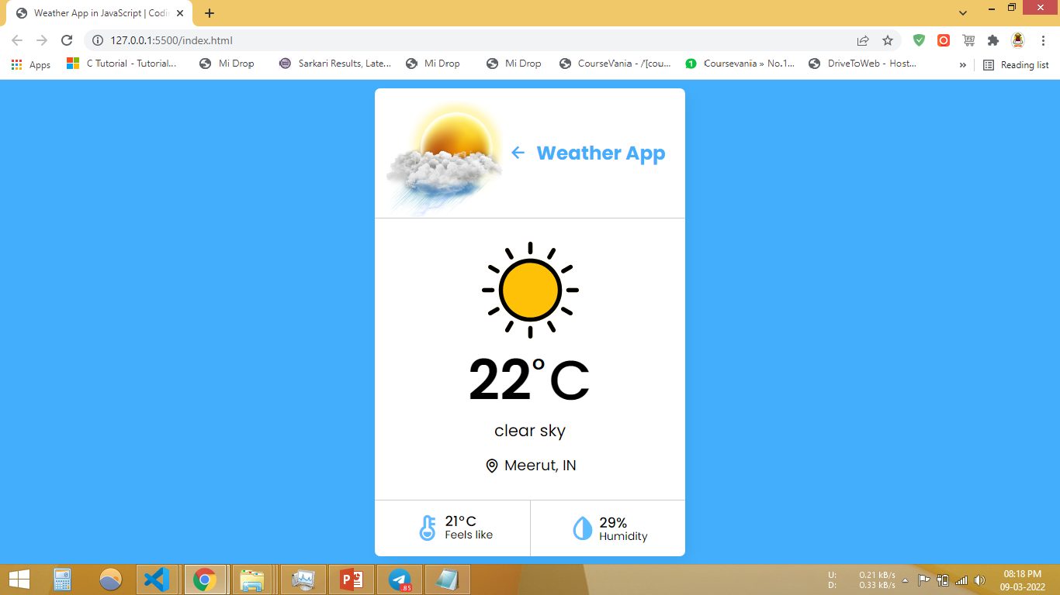

Slide 13
CONCLUSION
This project was successfully completed, within the time span allotted. The Project is tested and it’s successfully working, we have also deploy this project to Netlify and it is accessible through Mobile as well.
To conclude this,
we thank all the people who help us to complete this project.

Slide 14
Bibliography
Websites-
Javatpoint.com
openweathermap.org
MSDN
Youtube.com
develope.io
pngegg.com

Slide 15
Thanking You ANAS KHAN

